Slide 1
Preparation
Declaration
Invitation
Devotion

Slide 2
The Wise Men: Voice of Adoration (Worship) Matthew 2:1-12

Slide 3
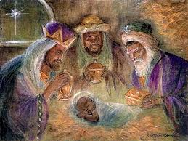
The Fallacies:
Much of what we believe about almost anything is based on a mixture of Misinformation; Imaginations; Assumptions and Traditions.
We “assume” there were 3 Kings probably based John Hopkins 1857 Carol “We three kings.”
Most believe they arrived at the manger scene based on Christmas Movies, nativities and cards.
That’s why it’s important to base our faith on the facts God reveals in His word.

Slide 4
The Facts:
Mt. 2 describes them as “wise men from the East”
Mag’os-oriental scientists.
From rab-mawg’: Babylonian official.
From Rab, meaning abundant in rank and quality.
They were Wise Men (Scientists) and Babylonian Officials (Politicians) seeking truth!!!
They intuitively knew that In Jesus:
”are hid all the treasures of wisdom and knowledge”
(Col. 2:3).

Slide 5
1. The Light they received!
Light “received” brings more light!
Light “ignored” brings darkness!
A. Possible “sources” of their “light.”
1) Ancient Babylonian records.
2) Ancient “prophecies”. (Balaam spoke of this)
Nu. 24:17,19 "there shall come a Star out of Jacob,
and a Sceptre shall rise out of Israel... out of Jacob
shall come he that shall have dominion.”

Slide 6
3) The supernatural “star”.
Ps. 19:1 “The heavens declare the glory of God.
The firmament showeth His handiwork”
a) They noticed because they were seeking!
4) Eventually Direct Revelation From God!
Mt. 2:12 "being warned of God"

Slide 7
1. The Light they received.
They certainly had less “light” than the priests in Jerusalem who “knew” about the birthplace of Messiah, (Mt. 2:5)
but they chose to act on the light they had…
So God was able to guide them to the Christ.
What are we doing with the
Light we’ve received?

Slide 8
The Light led them to Choices
2. The choices they made.
Life Is Full Of Decisions, each which may alter our journey and even our destination.
A. Follow The Light. (Wherever it led!)
1) They recognized the light they received
as God’s personal invitation!

Slide 9
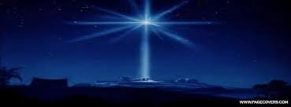
2. The choices they made.
B. Find The Christ.
1) In spite of delays and deceit!
a) Though they got “sidetracked” in Jerusalem,
they kept going until God gave more light!
Mt 2:9,10 “When they had heard the king, they
departed; and, lo, the star, which they saw in the
east, went before them, till it came and stood
over where the young child was.
When they saw the star, they
rejoiced with exceeding great joy.

Slide 10
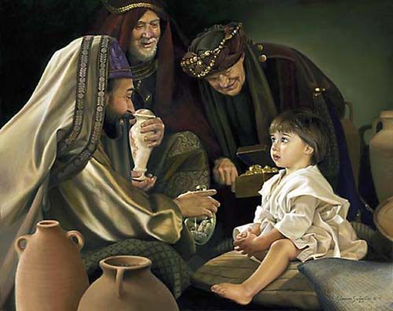
2. The choices they made.
Follow…Find…
C. Focus on the Christ. (Worship) Mt 2:11
“when they were come into the house, they saw the young child with Mary his mother, and fell down, and worshipped him: and when they had opened their treasures, they presented unto him gifts;
gold, and frankincense,
and myrrh.”

Slide 11
2. The choices they made.
Follow…Find…
C. Focus on the Christ. (Worship) Mt 2:11
Their gifts were:
1) Practical.
God knew Mary and Joseph would need them in Egypt!
2) Prophetic.
Gold for Jesus’ Royalty.
Frankincense for Jesus’ Deity.
Myrrh for Jesus sacrificial Death.

Slide 12
2. The choices they made.
Follow…Find…Focus
were only possible because they chose to:
D. Flex their lives around God’s plan. Ps 37:4
“Delight (anag: be pliable) thyself in the LORD;
and he shall give thee the desires of thine heart.”
Vs 5: “Commit thy way
unto the LORD;
Trust also in him;
and he shall bring it to pass.”
1) Delighting (Loving) leads to Committing! 1 Jn 5:3

Slide 13
Conclusion
The Wise Men represent the voice of “Adoration”.
What do you think they “expected” to find at the end that would make their journey “worth while?”
How do you think they felt when God guided them to a poor man’s humble home and a young child?
What did they do IN SPITE of their possible “disappointment”?
a) They still Worshipped!
b) They still “Gave” their best!

Slide 14
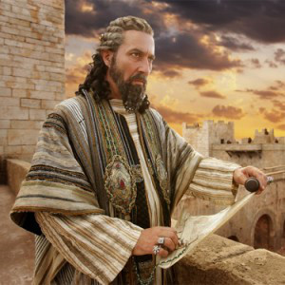
Application:
The “Wise men” found two Kings and had no trouble recognizing the true King:
Herod “the great” had all the trappings and appearance of power, but was a ruthless imposter.
He was preoccupied with his own plans for power,
possessions, and prestige.
This drove him to protect and preserve His kingdom at all costs, leading to an insane paranoia!

Slide 15
Application:
The “Wise men” found two Kings and had no trouble recognizing the true King:
2) The other had none of the adornments or signs
of Royalty, yet they intuitively knew that he was
the King of Kings!
This awareness motivated them to put their own personal “Kingdoms” at the disposal of this Christ Child
and to pay tribute and homage to Him.

Slide 16
Application:
The “Wise men” found two Kings and had no trouble recognizing the true King:
Many people worship and serve the wrong King,
(and “invest” their lives in the wrong Kingdom!)
They foolishly and often ignorantly pledge their service to the “god of this world”, coveting the temporary pleasure and power he offers to “faithful servants.”
(1 Jn 2:15-17)

Slide 17
Application:
Jesus said that “Wise Men” of every age will Recognize the lie of the “False King” and the Truth of who He is and build their accordingly!
“Many will say to me in that day, Lord, Lord, …
then will I profess unto them, I never knew you: depart from me, ye that work iniquity.
Therefore whosoever heareth these sayings of mine, and doeth them, I will liken him unto a wise man,
which built his house upon a rock:…”
Mt 7:22-27

Slide 18
What are you building your life on?
Wise men and women still seek and serve Him!

Slide 19
But the truly “Wise Men” Recognize and Respond to the King of Kings!

Slide 20
What have you come for?

