Slide 1
What can you give the God
who has everything?

Slide 2
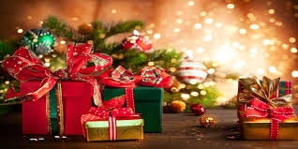
It’s God’s nature to give! (Jn 3:16; 1 Jn 4:8)
Since we’re made in His image,
part of that drive is in each of us.
This is a season when God’s “Christmas” gift to us motivates/inspires us to be more giving.

Slide 3
How strange it is that we
“Celebrate the birthday of Jesus”
By giving gifts to everyone but Him!
What can we give the God who has everything?
Let’s go back to that first Christmas “Party” and take a closer look at those who Gave to God.

Slide 4
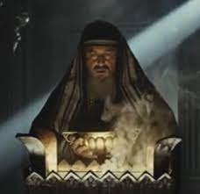
1. Zacharias & Elisabeth Luke 1:5-25
God gave them the gift of John. 13 “ Fear not, Zacharias:
thy prayer is heard; and thy wife Elisabeth shall bear thee a son,
and thou shalt call his name John.
“John” (yehôḥānān’: Jehovah Bestows)
14 And thou shalt have joy and gladness;
and many shall rejoice at his birth.
15 For he shall be great in the sight of the Lord, …and he shall be filled with the Holy Ghost,
even from his mother's womb.”
1) Every Child is a gift from God.
Ps. 127:3

Slide 5
1. Zacharias Luke 1:5-25
B. God had plans for John 16 “And many of the children of
Israel shall he turn to the Lord their God.
17 And he shall go before him in the spirit and power of Elias;
to turn the hearts of the fathers to the children, and the disobedient to the wisdom of the just;
to make ready a people prepared for the Lord.” (See Mal. 4:5,6)
1) God has plans for every Child!
Jer. 29:11

Slide 6
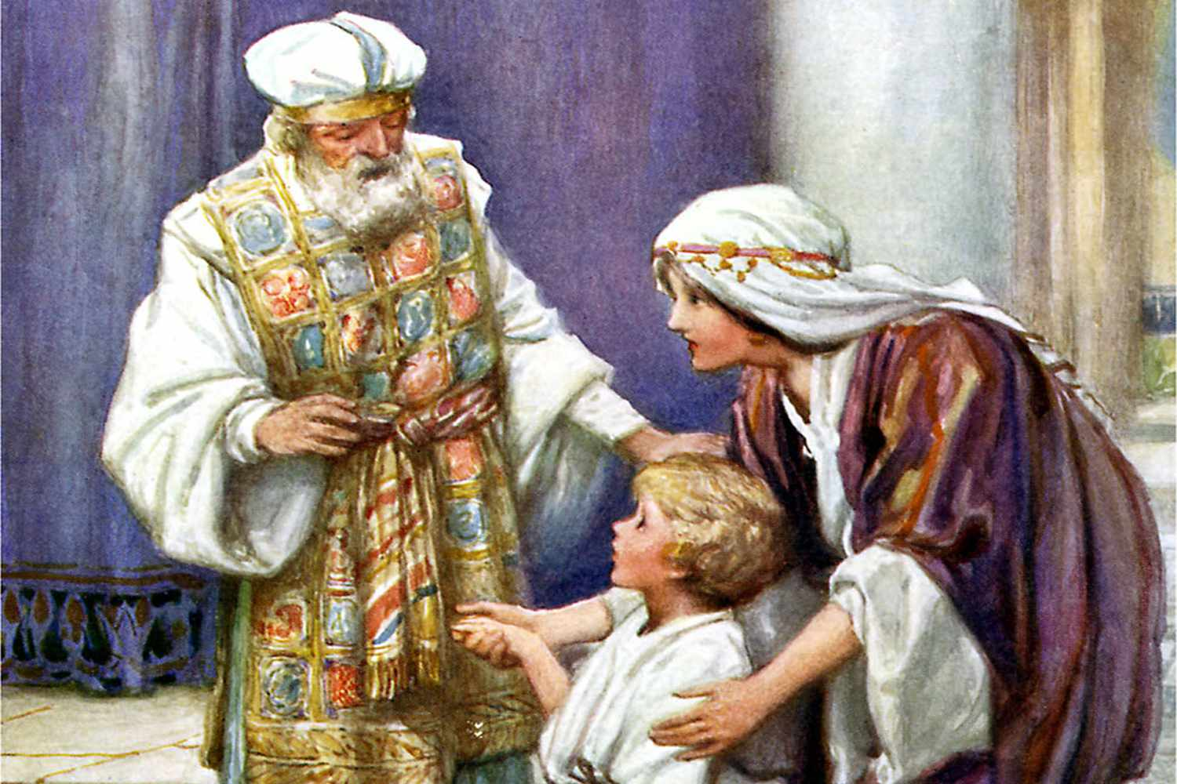
1. Zacharias Luke 1
C. Zacharias and Elizabeth raised John to know/love/serve God.
(Much like Hannah did to Samuel)
1 Sam. 1:27-28 “For this child I prayed;
and the LORD hath given me my petition
which I asked of him:
Therefore I have lent him to the LORD;
as long as he liveth
he shall be lent to the LORD.“
1) This is every parent’s commission.
Pr. 22:6; Eph. 6:1-4

Slide 7
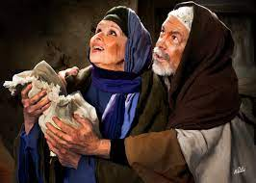
1. Zacharias/Elisabeth’s gift to God:
Zacharias and Elizabeth raised John to know/love/serve God.
65 “And fear came on all that dwelt round about them: and all these sayings were noised abroad throughout all …Judaea.
66 And all they that heard them laid them up in their hearts, saying,
What manner of child shall this be!
And the hand of the Lord was with him.”
Their gift to God was to return God’s gift to Him!

Slide 8
2. The Magi brought some of the first Christmas Gifts to Jesus. Matthew 2
Their story is unique in many ways:
They weren’t Jewish.
They didn’t have an “angelic” visit.
They traveled thousands of miles to give.
What motivated such sacrifice?

Slide 9
2. The Wise men. Matthew 2
A. While others saw a star,
They saw a Savior!
1) This Star was actually the gift of prophetic “light.”
Numbers 24:17,19 “there shall come a Star out of Jacob, and a Sceptre shall rise out of Israel…Out of Jacob shall come he that shall have dominion”
a) They had been “looking” for this light!

Slide 10
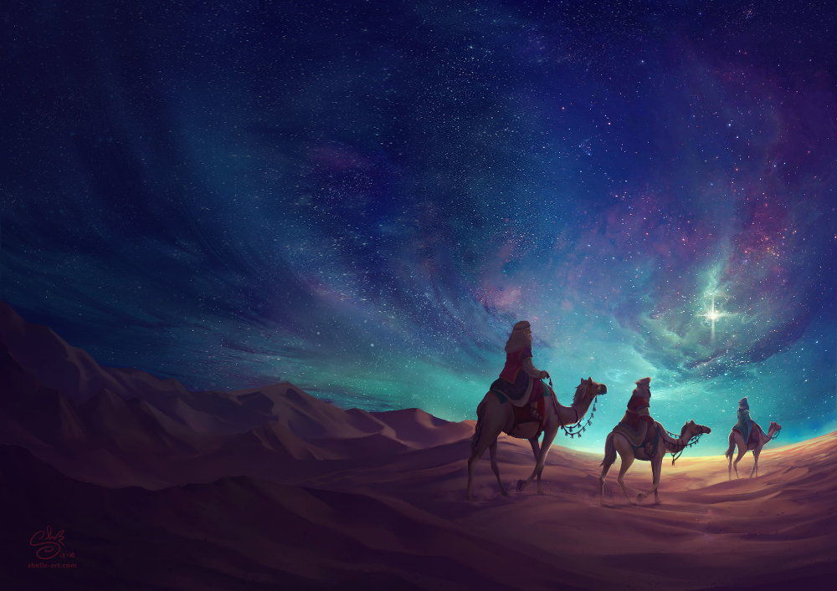
2) Since they responded to the light (truth) they had:
God gave them more “Light”. Vs 4-6
B. While some saw an obstacle, (vs 3)
they saw an opportunity! (Vs 2)
They journeyed in search
of the true “light”. John 1:4
“In him was life, and the life
was the light of men.
9 That was the true Light, which lighteth every man…”

Slide 11
2) Vs 2 “We have come to worship Him.”
Their Worship (gifts) involved:
a) A Trip: Going beyond familiar comfort zones.
b) A Testimony: Others knew of their journey
and were affected by it. (Vs 3)
Who’s affected by your testimony?
b) A Treasure: Giving something of value…
To someone of value!
Gen. 22:5 “I and the lad will go yonder and worship”
Should our Worship involve anything less?

Slide 12
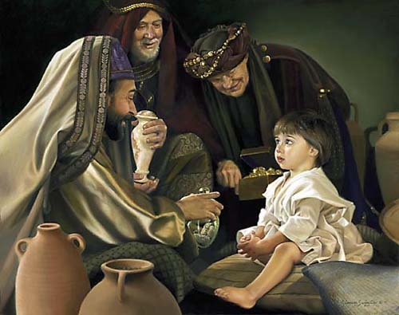
Mt 2:11 “they saw the young child with Mary …,
and fell down, and worshipped him:
when they had opened their treasures, they presented unto him gifts; gold, and frankincense, and myrrh.
C. Notice their “gifts” came after they
“opened their treasures”.
1) Their “treasures” were opened
because their “eyes” were opened!
Their gift to God involved acting on his gift of “Sight”.

Slide 13
What do you “See”?
Eph 1:17-19 “That the …Father of glory, may give unto you the spirit of wisdom and revelation in the knowledge of him:
The eyes of your understanding being enlightened;
that ye may know what is the hope of his calling,
and what the riches of the glory of his inheritance.
And what is the exceeding greatness
of his power to us-ward who believe,
according to the working
of his mighty power,
Which He wrought in Christ…”

Slide 14
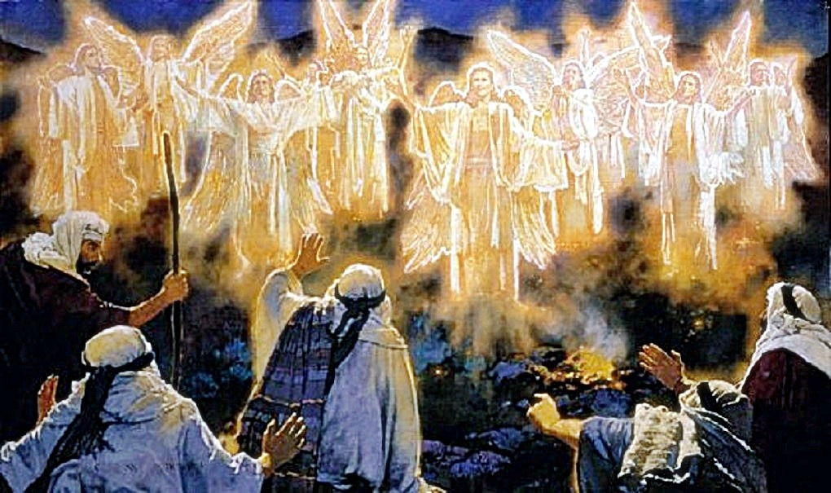
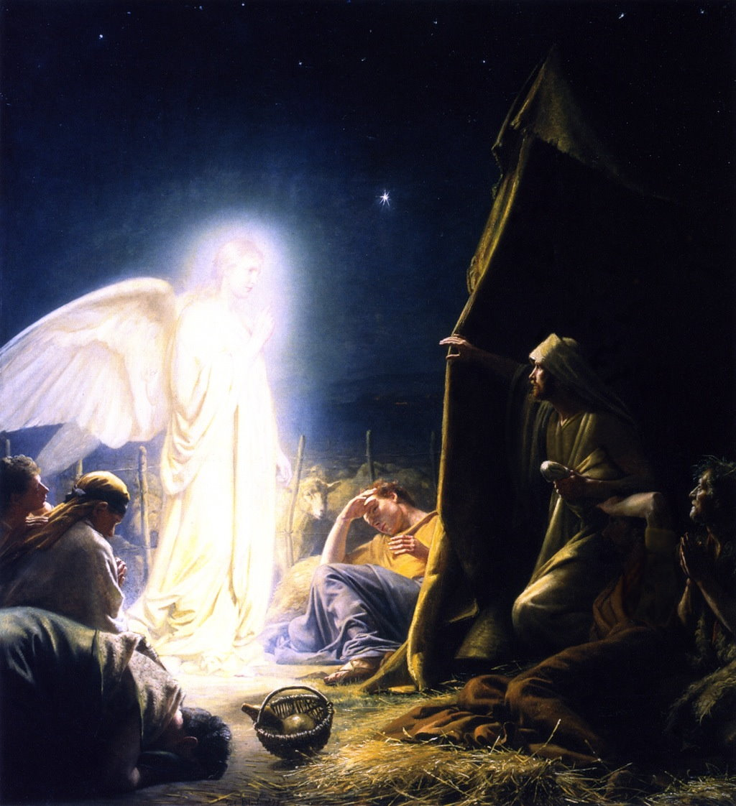
3. The Gift of the Shepherds. (Lk 2:8-20)
A. God sent His angels to share the news with them. 9-14
9 “The angel of the Lord came upon them and the glory of the Lord shone round about them: and they were afraid…
10 Fear not…I bring you good tidings of great joy...all people.
11 For unto you is born …this day a Savior…Christ the Lord..
¹³ And suddenly there was with the angel a multitude of the heavenly host
praising God, and saying, ¹⁴ Glory to God in the highest, and on earth
peace, (Eirene: to join: partnership!)
good will (eudokia: satisfying purpose)
toward men.”

Slide 15
3. The Gift of the Shepherds. (Lk 2:8-20)
B. They Responded Personally To The Angel’s Message.
1) They sought carefully.
Lk 2:15 “as the angels were gone away …into heaven,
the shepherds said one to another,
Let us now go even unto Bethlehem, and see this thing
which is come to pass,
which the Lord hath made known unto us.”

Slide 16
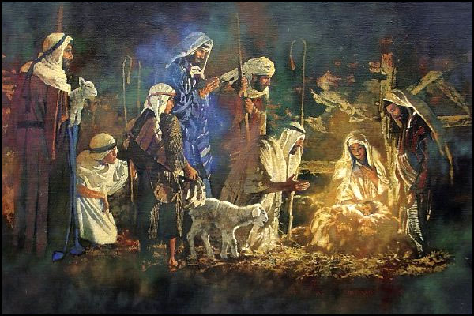
B. They Responded Personally To The Angel’s Message.
1) They sought carefully. Vs 15
2) They saw personally. Vs 16 “let us go and see”
3) They shared unselfishly. Vs 17 “made known abroad
the saying which was told them concerning this child”
And all they that heard it wondered at those things which were told them by the shepherds.
4) They Returned Differently!
20 “glorifying and Praising God”

Slide 17
What to give the God who has everything?
Like Zacharias and Elisabeth, we can:
recognize God’s gift in our children,
and raise them for,
and return them to, Him.
Pr 22:6 “Train up (ḥānak: dedicate/discipline)
a child in the way he should go:
and when he is old, he will not depart from it.”
Eph 6:4 “bring them up in the nurture
and admonition of the Lord.”

Slide 18
2) Like the Magi, we can give God the gift of our “sight”. (Focus)
What do you “see” in Christmas?
Do you see the promise fulfilled
when others see the “pretty” lights?
(The Preoccupied will always miss the Prince of Peace!)
Do you see a faith journey to take when others see a
“jammed” schedule and are too preoccupied to
investigate the claims of God?
(The Crowd will always miss the Christ)

Slide 19
What do you “see” in Christmas?
Do you see the value of Giving to (Worshipping) God
when others see an opportunity to get from God and others?
(The Selfish will never see the Savior!)
Are you “serving” based on your sight?
If so, then you are among the Wise Men
who still See, Seek, and Serve Him!

Slide 20
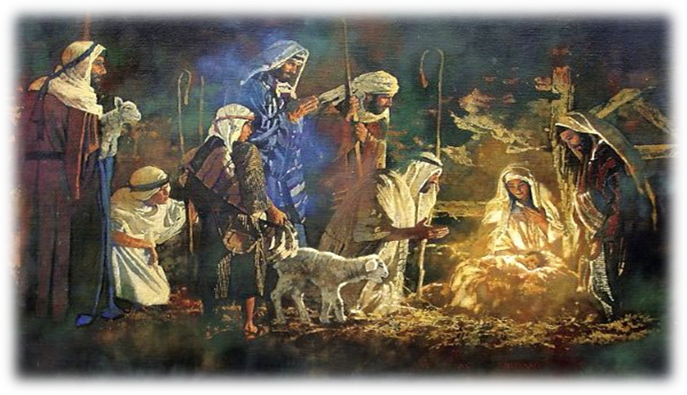
Like the shepherds, we can Give God the gift of sharing with others what He’s shared with us.
What has God “Shared” (revealed) with you?
Have you honestly/personally “investigated” it?
Are you sharing it with others?
Has it affected (changed) you?

Slide 21
What can we give Christ for Christmas?
Pr. 23:26 “My son, give me thine heart,
and let thine eyes observe my ways.”
from rāṣâ: to accept / be pleased with.
And nāṣar: to protect, guard
and maintain.

