Slide 1
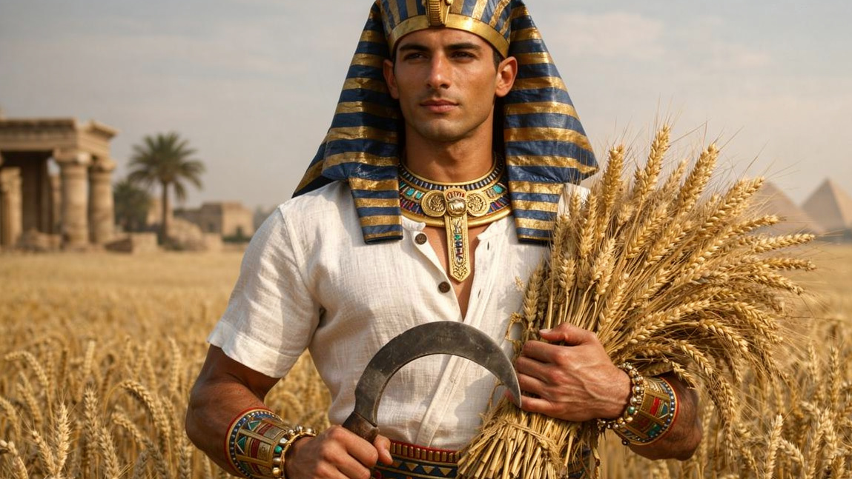
What God Meant for Good
By Joseph Peters

Slide 2

Objective
God’s People can forgive those who have caused them hard times
For these three reasons

Slide 3
During those hard times:
God is Still With Us
God is Still in Control
God is Still Accomplishing His Plan

Slide 4
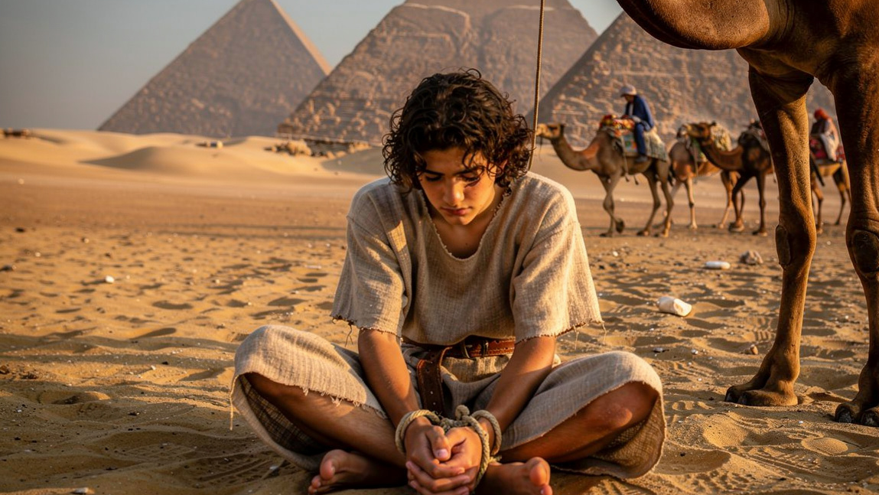
God is Still With Us

Slide 5
A Gift from God
And God remembered Rachel, and God hearkened to her, and opened her womb. And she conceived, and bare a son; and said, God hath taken away my reproach: And she called his name Joseph… (Gen 30:22–24a).

Slide 6
Comparison with Jesus
And the angel said unto her, Fear not, Mary: for thou hast found favour with God. And, behold, thou shalt conceive in thy womb, and bring forth a son, and shalt call his name JESUS (Luke 1:30–31).

Slide 7
Love and Hatred
Now Israel loved Joseph more than all his children, because he was the son of his old age: and he made him a coat of many colours. And when his brethren saw that their father loved him more than all his brethren, they hated him, and could not speak peaceably unto him (Gen 37:3–4).

Slide 8
Comparison with Jesus
He came unto his own, and his own received him not (John 1:11).
Then the Jews took up stones again to stone him. Jesus answered them, Many good works have I shewed you from my Father; for which of those works do ye stone me? The Jews answered him, saying, For a good work we stone thee not; but for blasphemy; and because that thou, being a man, makest thyself God (John 10:31–33).

Slide 9
Betrayal for the Price of a Slave
And Judah said unto his brethren, What profit is it if we slay our brother, and conceal his blood? Come, and let us sell him to the Ishmeelites…
Then there passed by Midianites merchantmen; and they drew and lifted up Joseph out of the pit, and sold Joseph to the Ishmeelites for twenty pieces of silver: and they brought Joseph into Egypt (Gen 37:26-27a, 28).

Slide 10
Comparison with Jesus
Then one of the twelve, called Judas Iscariot, went unto the chief priests, And said unto them, What will ye give me, and I will deliver him unto you? And they covenanted with him for thirty pieces of silver. And from that time he sought opportunity to betray him (Matt 26:14–16).

Slide 11
Prosperity in Servitude
And the LORD was with Joseph, and he was a prosperous man; and he was in the house of his master the Egyptian. And his master saw that the LORD was with him, and that the LORD made all that he did to prosper in his hand. And Joseph found grace in his sight, and he served him: and he made him overseer over his house, and all that he had he put into his hand. And it came to pass from the time that he had made him overseer in his house, and over all that he had, that the LORD blessed the Egyptian’s house for Joseph’s sake; and the blessing of the LORD was upon all that he had in the house, and in the field (Gen 39:2–5).

Slide 12
Comparison with Jesus
Even as the Son of man came not to be ministered unto, but to minister, and to give his life a ransom for many (Matt 20:28).
Whom God hath raised up, having loosed the pains of death: because it was not possible that he should be holden of it (Acts 2:24).

Slide 13
Falsely Accused
And Joseph’s master took him, and put him into the prison, a place where the king’s prisoners were bound: and he was there in the prison. But the LORD was with Joseph, and shewed him mercy, and gave him favour in the sight of the keeper of the prison. And the keeper of the prison committed to Joseph’s hand all the prisoners that were in the prison; and whatsoever they did there, he was the doer of it (Gen 39:20–22).

Slide 14
Comparison to Jesus
For many bare false witness against him, but their witness agreed not together (Mark 14:56).
Then said Jesus unto Peter, Put up thy sword into the sheath: the cup which my Father hath given me, shall I not drink it (John 18:11)?

Slide 15
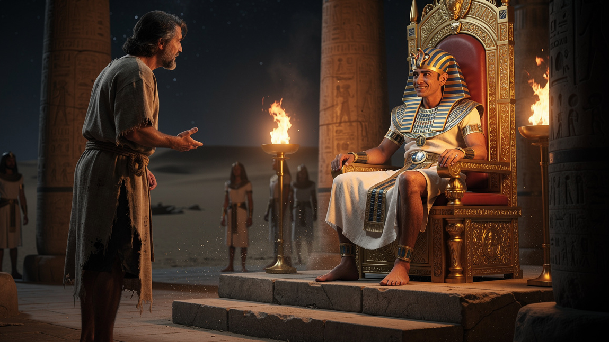
God is Still in Control

Slide 16
Joseph Remembered
And it came to pass in the morning that his spirit was troubled; and he sent and called for all the magicians of Egypt, and all the wise men thereof: and Pharaoh told them his dream; but there was none that could interpret them unto Pharaoh. Then spake the chief butler unto Pharaoh, saying… And there was there with us a young man, an Hebrew, servant to the captain of the guard; and we told him, and he interpreted to us our dreams; to each man according to his dream he did interpret (Gen 41:8–9, 12).

Slide 17
Comparison to Jesus
He is not here, but is risen: remember how he spake unto you when he was yet in Galilee, Saying, The Son of man must be delivered into the hands of sinful men, and be crucified, and the third day rise again. And they remembered his words (Luke 24:6–8).

Slide 18
Joseph Promoted
And Pharaoh said unto his servants, Can we find such a one as this is, a man in whom the Spirit of God is? And Pharaoh said unto Joseph, Forasmuch as God hath shewed thee all this, there is none so discreet and wise as thou art: Thou shalt be over my house, and according unto thy word shall all my people be ruled: only in the throne will I be greater than thou (Gen 41:38–40).

Slide 19
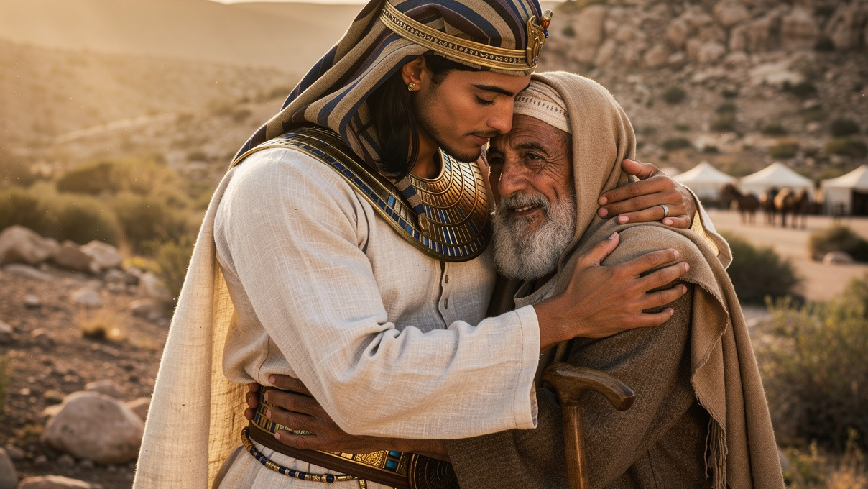
God is Still Accomplishing His Plan

Slide 20
Joseph Reunited with His Brothers
Then Joseph could not refrain himself before all them that stood by him; and he cried, Cause every man to go out from me. And there stood no man with him, while Joseph made himself known unto his brethren. And he wept aloud… And Joseph said unto his brethren, I am Joseph; doth my father yet live…? And Joseph said unto his brethren, Come near to me, I pray you. And they came near. And he said, I am Joseph your brother, whom ye sold into Egypt. Now therefore be not grieved, nor angry with yourselves, that ye sold me hither: for God did send me before you to preserve life (Gen 45:1–2a,3a, 4-5).

Slide 21
Comparison with Jesus
And in thy seed shall all the nations of the earth be blessed; because thou hast obeyed my voice (Gen 22:18).
For God so loved the world, that he gave his only begotten Son, that whosoever believeth in him should not perish, but have everlasting life (John 3:16).

Slide 22
Joseph Forgives
And when Joseph’s brethren saw that their father was dead, they said, Joseph will peradventure hate us, and will certainly requite us all the evil which we did unto him…
And Joseph said unto them, Fear not: for am I in the place of God? But as for you, ye thought evil against me; but God meant it unto good, to bring to pass, as it is this day, to save much people alive (Gen 50:15, 19–20).

Slide 23
Comparison to Jesus
For God sent not his Son into the world to condemn the world; but that the world through him might be saved (John 3:17).
Then said Jesus, Father, forgive them; for they know not what they do (Luke 23:34).

Slide 24
Conclusion
God’s People can forgive those who have caused them hard times
For these three reasons

Slide 25
During hard times:
God is Still With Us
God is Still in Control
God is Still Accomplishing His Plan

