Slide 1
Pictures of the People of God
Seeing ourselves through God’s Eyes.

Slide 2
We’ve been discussing some of the ways God “pictures” or describes His people.
Precious pictures
(Treasure/Pearl)
Progressive Pictures
(Sheep, Vessel’s, Masterpieces)
Personal Pictures
(Family, Bride)

Slide 3
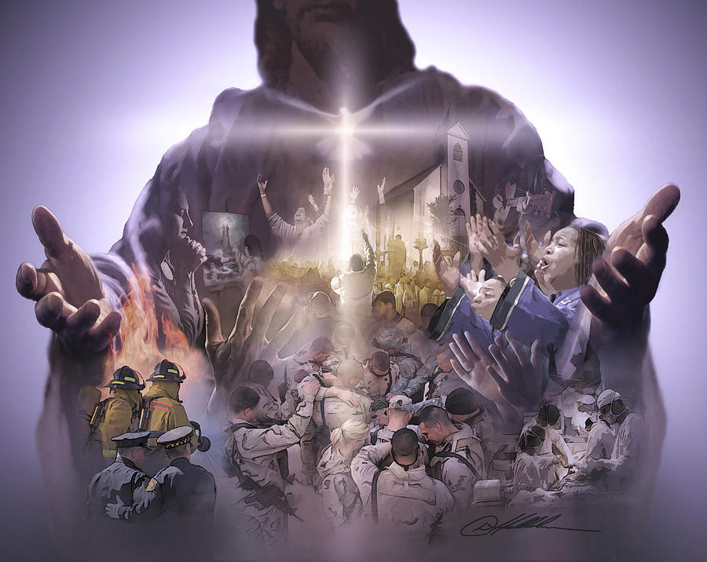
Practical Pictures
“Ye are the body of Christ,
and members in particular”
1 Cor 12:27

Slide 4
Being part of the “Body” of Christ involves:
 | Design: | Distinction: | Development:
1 Corinthians | 12:1-13 | 12:14-31 | 13:1-13
Romans | 12:1-5 | 12:6-8 | 12:9-21
Ephesians | 4:1-6 | 4:7-12 | 4:13-16
Unity
Diversity
Maturity
Maturity should produce Ability (Ministry 4:12)
and Stability! (Commitment 4:14)

Slide 5
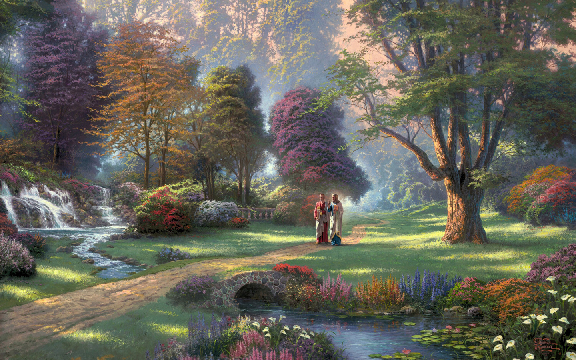
Another picture God often uses illustrates the Precious, Progressive, Personal, and Practical nature of our relationship with Him:
That of a Garden!

Slide 6
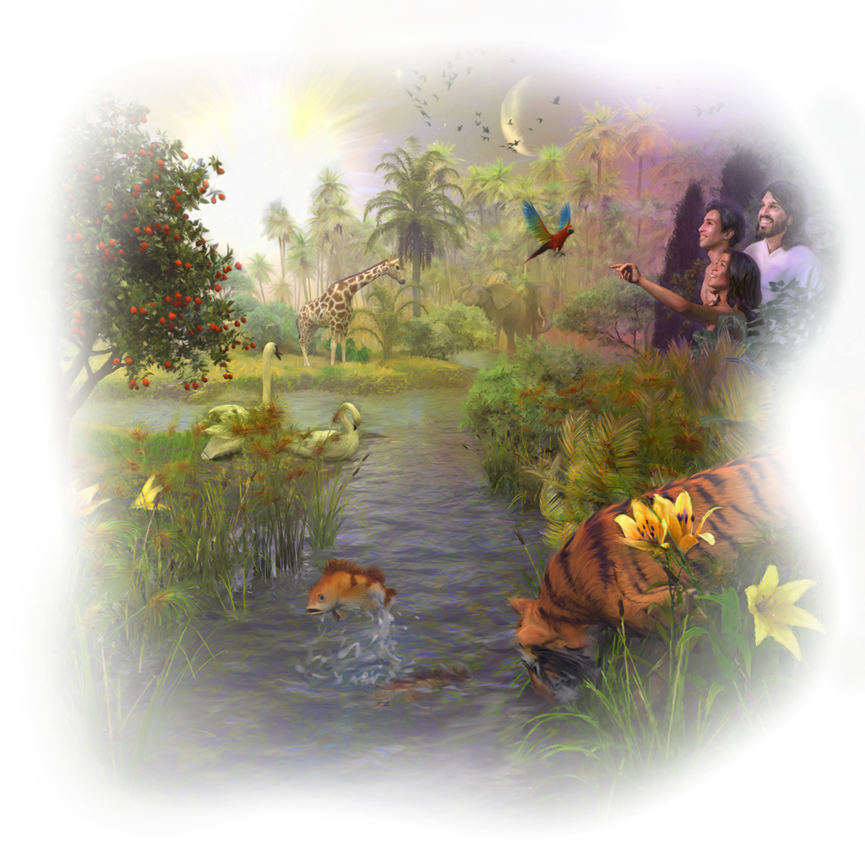
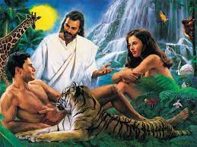
God loves Gardens!
Man’s Journey begins in a garden!
Gen 2:8 “God planted a garden eastward in Eden;
and there he put the man whom he had formed.”

Slide 7
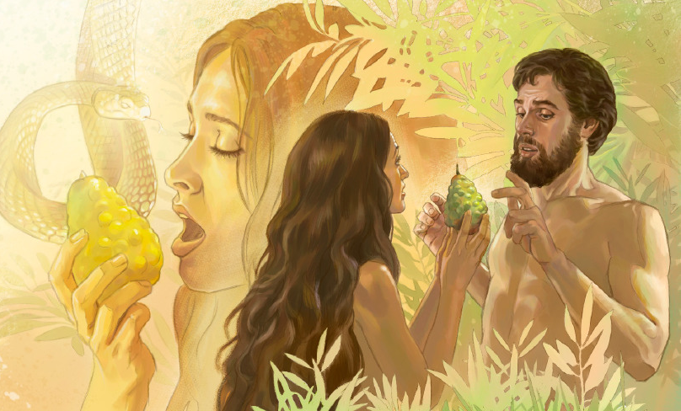
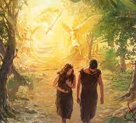
Satan and Sin led to us being expelled!
Genesis 3

Slide 8
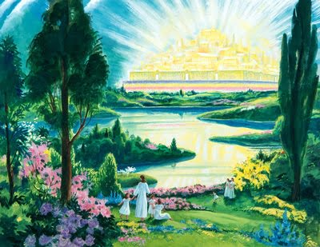
God has promised to Restore Eden!
Revelation 22:1-5

Slide 9
This theme was among Jesus’ favorites.
Sower and Seed (Mt 13:1-23)
Wheat and Tares (Mt 13:24-30)
Vineyard (Mt 21:33-41)
Fruitless Fig tree (Lk 13:6-9)
Vine and Branches (John 15:1-16)
Mt 7:20 “By their fruits Ye shall know them”

Slide 10
This theme transcends both Testaments. Hosea 10:12 “Sow to yourselves in righteousness, reap in mercy;
break up your fallow ground:
for it is time to seek the LORD,
till he come and rain righteousness upon you.”

Slide 11
This theme transcends both Testaments. Jer. 4:3 “Break up your fallow ground,
and sow not among thorns.”
1 Cor 3:9 “We are laborers together with God.
Ye are God’s husbandry!”
geōr’gion: farm,
From ge: ground and ergon: work

Slide 12
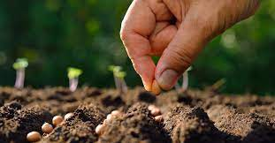
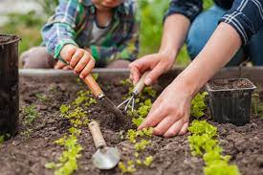
Why did God so often use this picture when describing
His Plan for His People?

Slide 13
Consider your life and key relationships in the context of a back yard garden.
If you knew that your daily diet would basically come out of your garden:
What priority would you place on it?
What would you plant?
What steps would you take to ensure a good harvest?

Slide 14
Gal 6:7-8 “Be not deceived;
God is not mocked:
for whatsoever a man soweth,
that shall he also reap.
For he that soweth to his flesh shall of the flesh reap corruption;
but he that soweth to the Spirit shall of the Spirit reap life everlasting.”

Slide 15
Since so much depends on what we sow into the soil of our souls, I’d like to examine this biblical analogy of a garden
and consider why God repeatedly uses it to describe the process, problems and progress of our relationships.

Slide 16
Many of the principles
(and processes) of cultivating a successful (fruitful) garden
apply to growing healthy relationships with God
and each other.

Slide 17
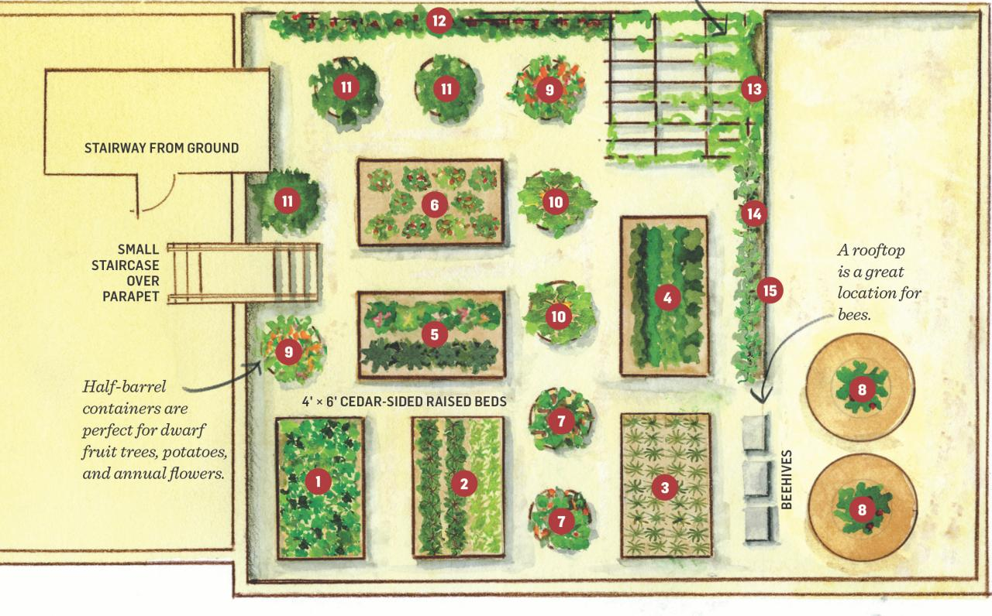
Cultivating Healthy “Gardens” require:
Planning Pr. 29:18 “Where there is
no vision, (ḥāzôn: perception, contemplation)
the people perish”
(para’: go back,
set at nought)
Failing to plan
is planning to fail!

Slide 18
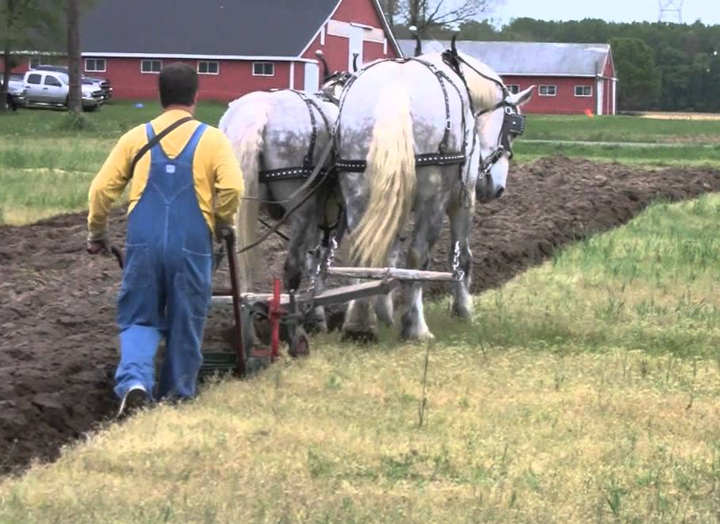
Cultivating Healthy “Gardens” require:
2. Preparing Hosea 10:12
“Break up your fallow ground,
for it is time to seek the Lord…”
Consider the Parable of the sower (Mt 13)
What made the “good
ground” Good?
What was the result?

Slide 19
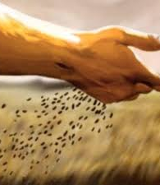
Cultivating Healthy “Gardens” require:
3. Planting Mt 13:3
“a sower went forth to sow.”
Gal. 6:9 “be not deceived…
whatsoever a man sows,
that shall he
also reap.”

Slide 20
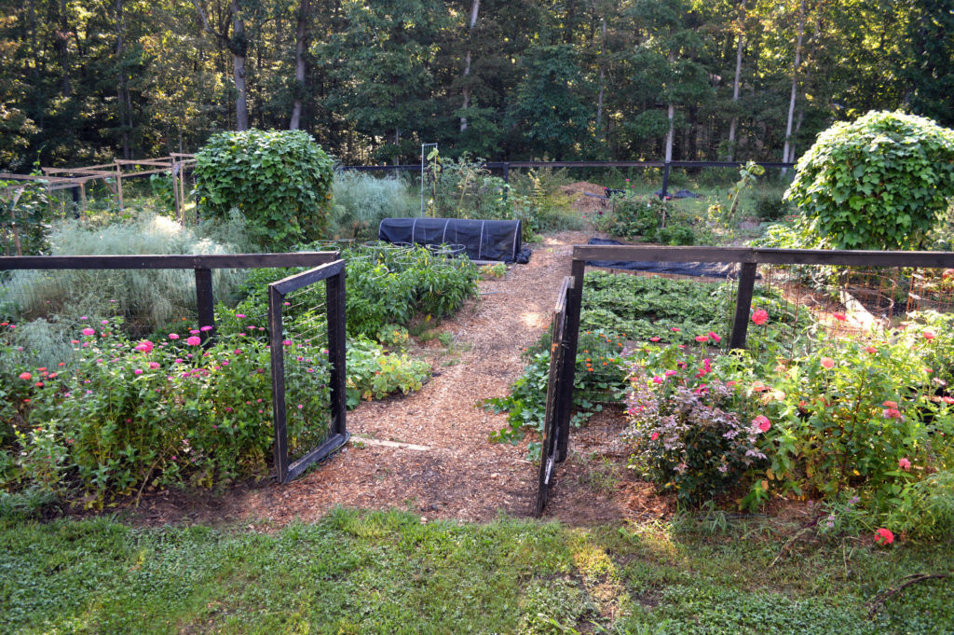
Cultivating Healthy “Gardens” require:
4. Protecting Mt 21:33 “planted a vineyard
and hedged it round about”
Is 5:1-2 “My wellbeloved hath a vineyard in a
very fruitful hill:
² And he fenced it,
and gathered out the stones,
and planted it with
the choicest vine…”

Slide 21
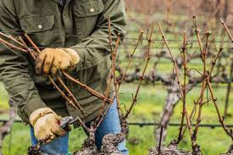
Cultivating Healthy “Gardens” require:
5. Pruning Jn 15:2 “Every branch in me that beareth not fruit
and every branch that beareth fruit,
he purgeth it,
he taketh away:
that it may bring forth more fruit.”

Slide 22
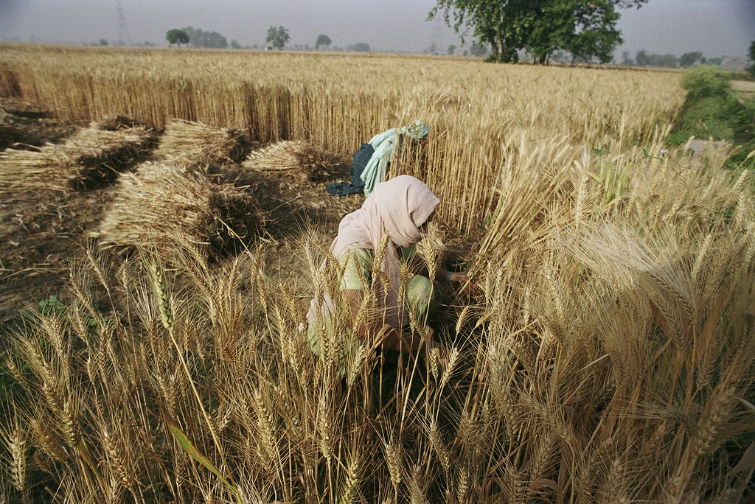
Cultivating Healthy “Gardens” require:
6. Picking (Harvesting) Matthew 3:12
“he will thoroughly purge his floor,
and gather his wheat into the garner;
but he will burn up the chaff with unquenchable fire.”
See also Mt 13:30

Slide 23
Cultivating Healthy “Gardens” require:
7. Preserving Mt 13:41-43 “they shall gather out of his kingdom all things that offend…,
42 And shall cast them into a furnace of fire: there shall be wailing and gnashing of teeth.
43 Then shall the righteous shine forth as the sun in the kingdom of their Father.
Who hath ears to hear, let him hear.”

Slide 24
How committed are you to the
Planning, Preparing, Planting
Protecting, Pruning, Picking
and Preserving of the Garden of your soul?
You can tell by what’s
growing there!

Slide 25
You can’t fake fruit!
Mt 12:33 “Either make the tree good,
and his fruit good; (kalos: virtuous)
or else make the tree corrupt,
and his fruit corrupt (sapros: rotten)
for the tree is known by his fruit.”
34 for out of the abundance of the heart
the mouth speaketh.

Slide 26
You can’t fake fruit!
“A good man out of the good treasure of the heart bringeth forth good things:
and an evil man out of the evil treasure bringeth forth evil things.
36 every idle word that men shall speak,
they shall give account thereof
in the day of judgment.”

Slide 27
You can’t fake fruit! Gal 5:19-21
“the works of the flesh are manifest, … Adultery, fornication, uncleanness, lasciviousness,
Idolatry, witchcraft, hatred, variance, emulations, wrath, strife, seditions,
heresies, Envyings, murders, drunkenness, revellings, and such like…”

Slide 28
“Love, Joy, Peace, Longsuffering
Gentleness, Goodness, Faith, Meekness, Temperance.” 22,23

Slide 29
Most gardens just seem to “grow up” with little planning
and even less preparation.
Since “the whole world lieth in wickedness” (1 Jn 5:19) then some worldly seeds will inevitably drift into our souls.
The longer we neglect them,
the stronger they will grow! (Mk 4:19)

Slide 30
John 15:5
“I am the vine,
ye are the branches.
John 15:16
“I have chosen you,
that ye should
bring forth fruit”

Slide 31
Application: Harvest time is coming!
We have a limited “season” to cultivate the soil of our souls.
(Ps. 90:12; Jer. 8:20; Eph. 5:15-18)
Will you prayerfully join me on this journey as we cooperate with the Shepherd
(1 Pt 2:25) and “Husbandman” (Jn 15:1) to “restore our soul”. (Ps. 23:3)

