Slide 1
The Bible is God’s revelation about Himself,
His Plan, His People, and His Enemy.

Slide 2
It doesn’t reveal every detail about everything;
But it reveals enough for us to know Him,
As well as His (our) Enemy.
Ps 16:11 “Thou wilt show me the path of life.
In thy presence is fulness of Joy!”
Ps 16:4 “Their sorrows shall be multiplied
that hasten after another god:”

Slide 3
Deut. 11:26-28 “Behold, I set before you this day
a blessing (berākâ’: prosperity, protection, peace)
and a curse; (qelālâ’: to make vile)
A blessing, if ye obey the commandments of the LORD your God, which I command you this day:
…And a curse, if ye will not obey the commandments of the LORD your God,
but turn aside out of the way which I command you
to go after other gods…”

Slide 4
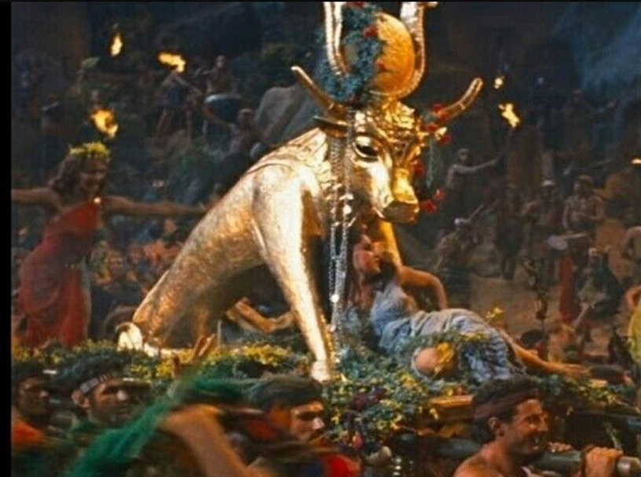
Who are these “other gods”?
Dt. 32:16-17 “They provoked him to jealousy with strange
gods, (zûr: profane, adultery)
with abominations (tôʿēbâ’: disgusting)
They provoked they him to anger.
{See James 4:4}
{Dt 22:5}
Exodus 32
They sacrificed unto devils” (shed: demons)
From shûd: to swell up, waste
Apis in Egypt
Baal in Canaan

Slide 5
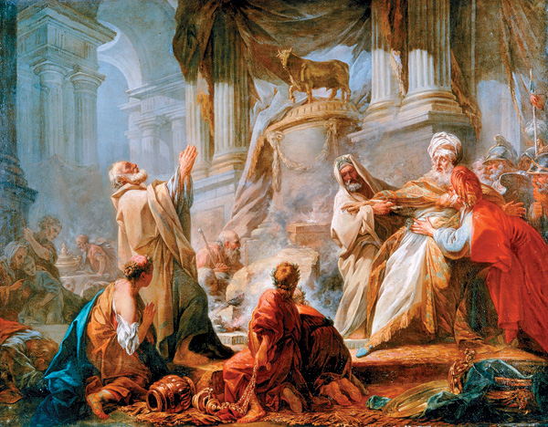
1 Kings 12:28 Jeroboam “made two calves of gold, and said unto them, It is too much for you to go up to Jerusalem:
behold thy gods, O Israel, which brought thee up out of the land of Egypt.”
2 Chr 11:15 Jeroboam “ordained him priests for the high places,
and for the devils,…
the calves which he made.”

Slide 6
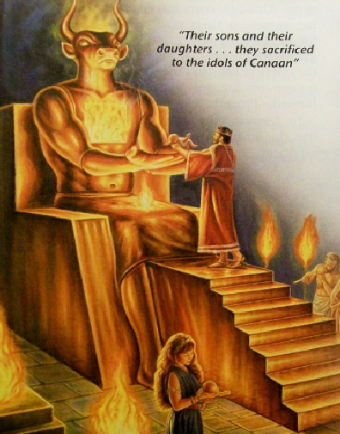
Who are these “other gods”?
Ps 106:36-37 “they served their idols: which were a snare …
they sacrificed their sons and their daughters to devils”
Shēd: malignant demons
1 Cor 10:20 “The things the gentiles sacrifice,
they sacrifice to devils” (daimon’ion: demons!)

Slide 7
Who are these “other gods”?
1Cor 10:20 “they sacrifice to devils” (daimon’ion: demons!)
What were they created for?
Heb 1:14 “Are they not all ministering spirits…”
How are they (organized). Eph. 6:12
“For we wrestle …against principalities, against powers, against the rulers of the darkness of this world,
against spiritual wickedness in high places.”

Slide 8
What do they want?
To distract and deceive
John 10:10 “The thief cometh not,
but for to steal, and to kill, and to destroy:
I am come that they might have life,
and that they might have it
more abundantly.”
Perissos’: superabundant (Ro. 8:37)
in order to destroy!

Slide 9
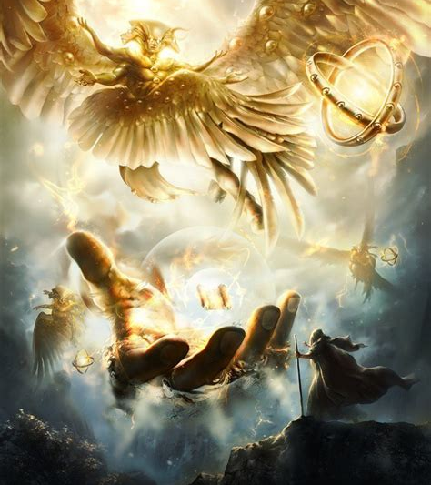
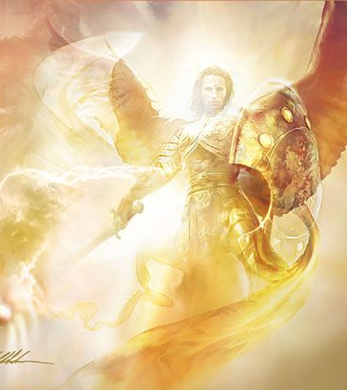
Understanding Fallen Angels.

Slide 10
Understanding Fallen Angels
1. Angels/Demons are organized.
A. God describes some as Princes or Principalities.
OT: Prince (Daniel 10:13) sar: chief captain.
Principalities Jer. 13:18b (meraʾashôt’) dominions
NT: Principalities (Ro. 8:38; Eph. 6:12)
Archē: chief magistrate, power
1) These are generals or Governing Authorities
over specific regions or municipalities.
{Daniel 10:13; Eph. 6:12})

Slide 11
1. Angels & Demons are organized like an army.
B. Satan is the “Chief” of his demon army.
1) The Jewish leaders falsely accused Jesus: Mt 9:34
“He casts out devils through the prince of the devils.”
2) Jesus described him as: “the prince of this world” Jn 14:30 “the prince of this world cometh,
and hath nothing in me.” Jn 12:31; 16:11
3) 2 Cor 4:4 “the god (theos: magistrate) of this world”
Eph. 2:2 “the prince of the power of the air, the spirit that now worketh in the children of disobedience:”

Slide 12
Satan is promoted and popular.

Slide 13
2. Where did Satan come from?
Satan has ruled as the “Chief Prince”
through human leaders in the past, (Ezek. 28)
and will in the future. (Rev. 13:2)
“and the dragon gave him (the antichrist)
his power, and his seat, and great authority.”
Ezek. 28 is written to describe the judgment on the proud, human “prince (nagid: governor) of Tyrus” (1-10)
and the spiritual “king (melek) of Tyrus” (11-19)
Notice how God describes this “King”.

Slide 14
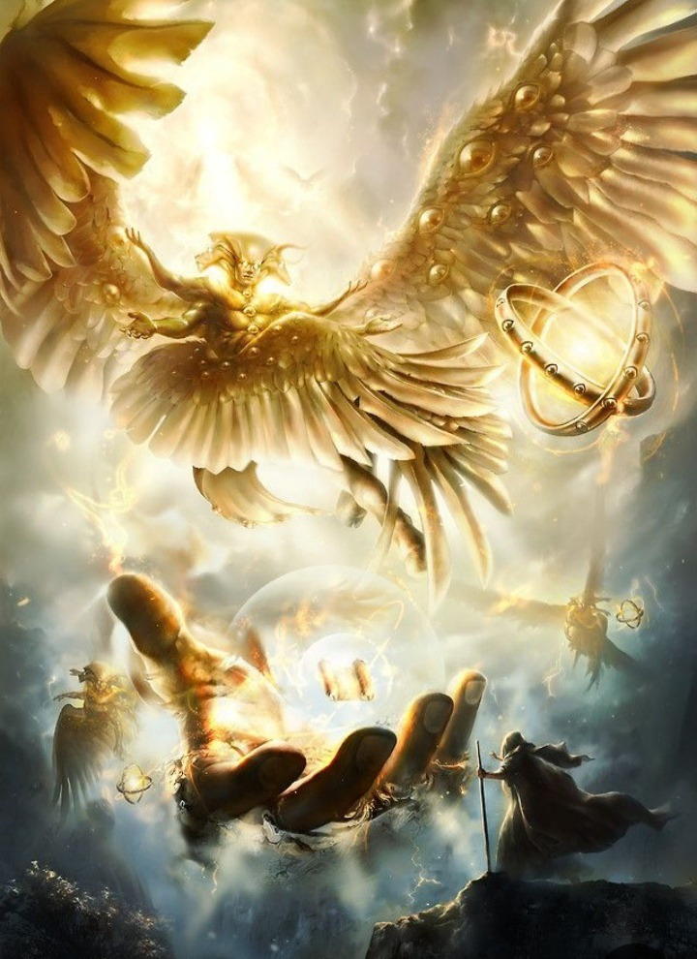
He was created as an “anointed cherub”
Ezekiel 28:13,14 “Thou hast been in Eden…;
every precious stone was thy covering,
…the workmanship of thy tabrets
and of thy pipes was prepared in thee in the day that thou wast created.
14 Thou art the anointed cherub
that covereth;
and I have set thee so:”

Slide 15
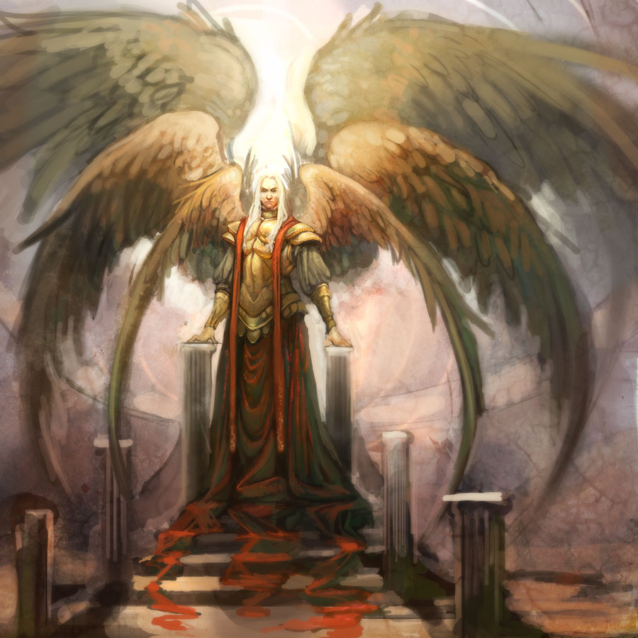
Ez. 28: 14 “Thou art the anointed cherub that covereth; and I have set thee so.
thou wast upon the holy mountain of God;
thou hast walked up and down in the midst of the stones of fire.
15 Thou wast perfect in thy ways from the day that thou wast created,

Slide 16
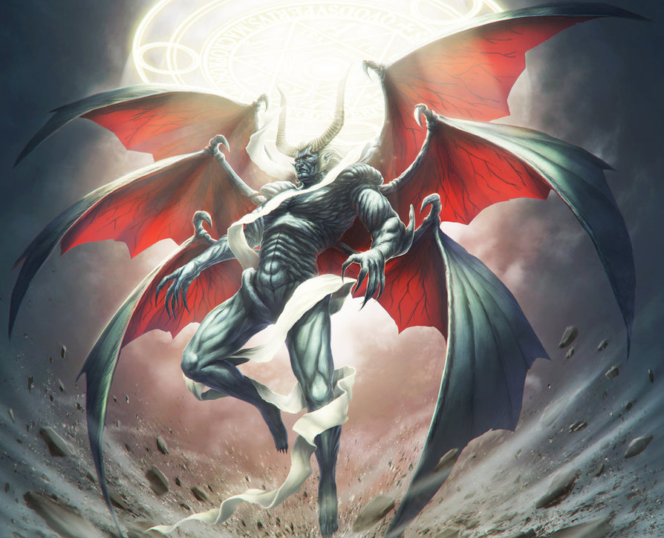
15 Thou wast perfect in thy ways from the day that thou wast created,
“til iniquity (ʿevel)
was found in thee.”

Slide 17
B. He became proud and Rebellious. Ez. 28
15 “Thou was perfect… till iniquity was found in thee.
16 …filled the midst of thee with violence,
and thou hast sinned:
therefore I will cast thee as profane out of the mountain of God: and I will destroy thee, O covering cherub,
from the midst of the stones of fire.
17 Thine heart was lifted up because of thy beauty,
thou hast corrupted thy wisdom by …thy brightness:…
18 Thou hast defiled thy sanctuaries
by the multitude of thine iniquities, …”

Slide 18
B. He became proud and rebelled against God. Isaiah 14:12-15 “How art thou fallen from heaven, O Lucifer, son of the morning! How art thou cut down to the ground, which didst weaken the nations!
For thou hast said in thine heart,
I will ascend into heaven,
I will exalt my throne above the stars of God:
I will sit also upon the mount of the congregation…
I will ascend …I will be like the most High.
Yet thou shalt be brought down to hell”

Slide 19
3. Where did he get his power/authority?
A. From the Angels who joined him. Rev. 12
He’s the master deceiver/manipulator.
Rev. 12:9 “which deceives the whole world”
planao: cause to roam (from safety, truth, virtue)
a) Deception inevitably produces Division.
2) He led the original rebellion against God,
ensnaring 1/3 of all the angels. (Rev 12:4)

Slide 20
2) He led others in his rebellion. Rev 12:1,2
“there appeared a great wonder in heaven; a woman clothed with the sun, and the moon under her feet,
and upon her head a crown of twelve stars:
2 And she being with child cried, travailing in
birth, and pained to be delivered.
5 she brought forth a man child, who was to rule all nations with a rod of iron:
and her child was caught up unto God, and to his throne.”

Slide 21
2) He led others in his rebellion. Rev 12:3-4
“And there appeared another wonder in heaven;
…a great red dragon, having seven heads and ten horns, and seven crowns upon his heads.
4 And his tail drew the third part of the stars of heaven,
and cast them to the earth:…”
Job 38:7 “the morning stars sang ..the sons of God shouted for joy”

Slide 22
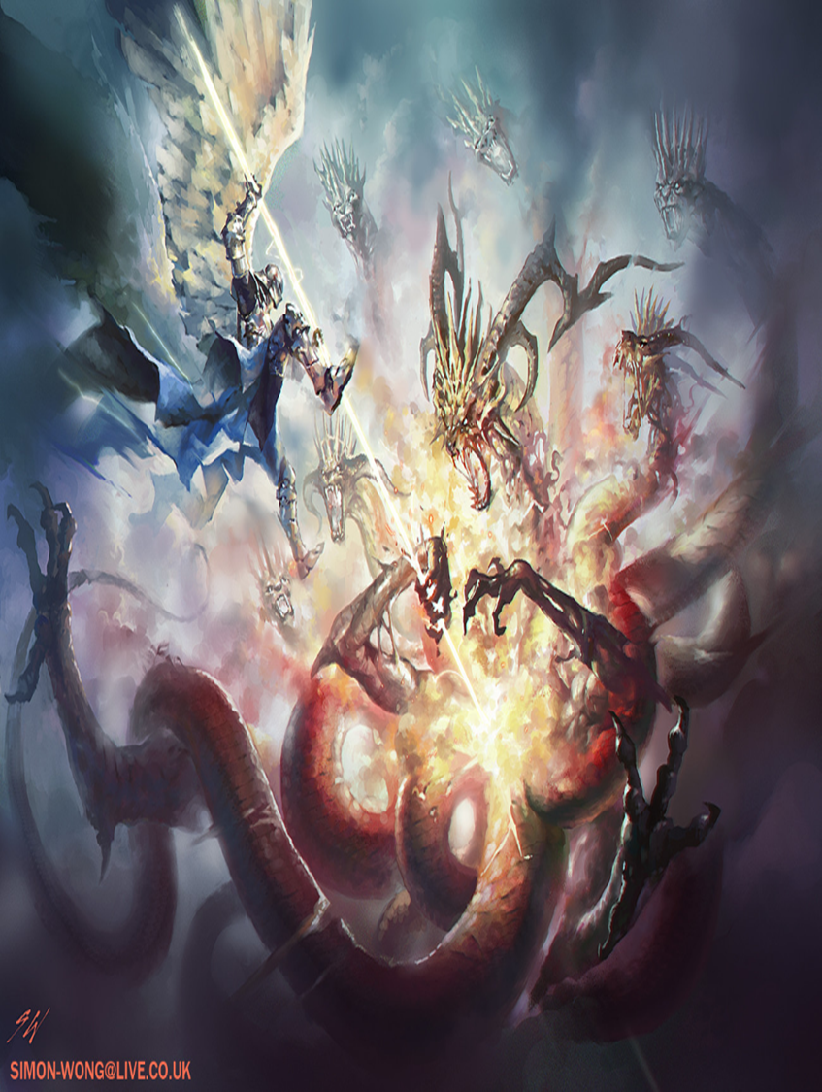
Rev. 12:7,8
“there was war in heaven: Michael and his angels fought against the dragon;
and the dragon fought
and his angels,
And prevailed not;
neither was their place found any more
in heaven.”

Slide 23
Rev. 12:9
“And the great dragon was cast out, that old serpent, called the Devil, (diabolos: slanderer)
and Satan, (Satanas: adversary)
which deceives the whole world:
he was cast out into the earth,
and his angels (angelos) were cast out with him.”
“Devils” (Daimons: demons)
Rev. 9:20; 16:14; 18:2

Slide 24
3. Where did he get his power/authority?
A. From the Angels who joined him. Rev. 12
B. From the people who “join” him.
1) God gave man “dominion” Gen 1:26
“Let us make man in our image,
and let them have dominion…”
Gen. 3:1 “Now the serpent was more subtil…
and he said… yea hath God said…”
4 Ye shall not die…ye shall be as gods”

Slide 25
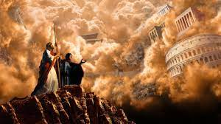
B. From the people who join him.
2) Remember Jesus’ temptation Luke 4:5-6
“And the devil, taking him up into an high mountain, shewed unto him all the kingdoms of the world ….
All this power will I give thee, and the glory of them:
for that is delivered
unto me…”
(Paradid’ōmi: surrendered)

Slide 26
“for that is delivered (surrendered) unto me…”
a) Who surrendered it?
Ro 6:16 “Know ye not, that to whom ye yield yourselves servants to obey, his servants ye are…
whether of sin unto death,
or of obedience unto righteousness?”
b) How do we surrender it? 1 Sam 15:23 “Rebellion is as the sin of witchcraft”
We did (and do)! Ro 5:12

Slide 27
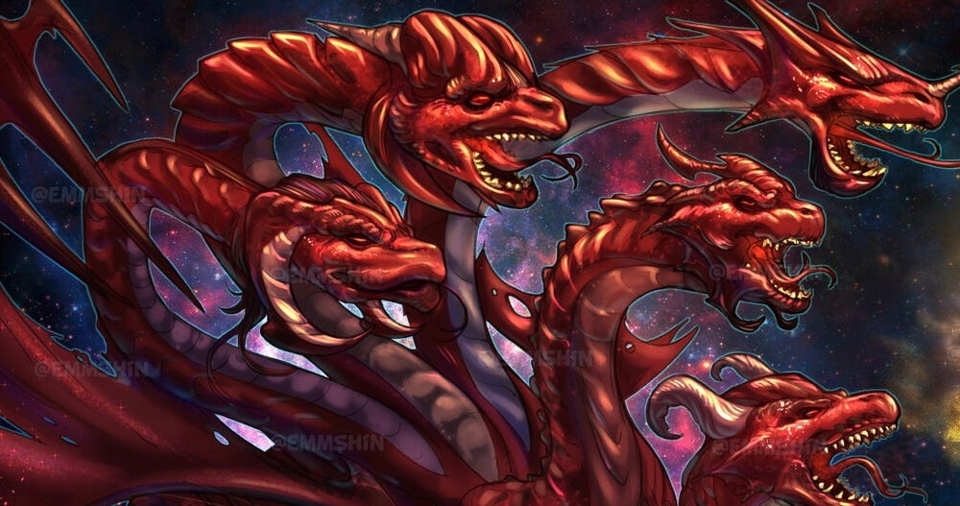
Conclusion:
Rev 12:12 “Woe to the inhabiters of the earth…!
the devil is come down to you, having great wrath,
because he knows he hath but a short time.
17 “And the dragon was wroth with the woman,
and went to make war with the remnant of her seed,
which keep the commandments of God,
and have the testimony of Jesus Christ.”

Slide 28
Since he’s coming for us,
we need to prepare!
Since he’s the destroyer (Rev. 9:11)
and the deceiver (Rev. 12:9)
What hope or chance do we have against him?
1 Jn 4:4 “Ye are of God, little children, and have overcome them: because greater is he that is in you, than he that is in the world.
1 Jn 5:4 “this is the victory that overcometh the world,
even our faith.”

Slide 29
Eph 6:10-12 “Finally, my brethren, be strong in the Lord, and in the power of his might.
Put on the whole armor of God, that ye may be able to stand against the wiles (tricks) of the devil.
12 For we wrestle not against flesh and blood,
but against principalities, (archē: chief captains)
against powers, (exousi’a: authorities)
against the rulers of the darkness of this world,
(kosmokratōr: world leaders) against spiritual wickedness (pomeria: depravity) in high places.”

Slide 30
“Wherefore take unto you the whole armor of God,
that ye may be able to withstand
in the evil day”
Eph 6:13

Slide 31
We’re going to go through a type of spiritual “boot camp”, through which we’ll learn to:
Recognize the enemy 2 Cor 2:11
“Lest Satan should get an advantage of us:
for we are not ignorant of his devices.”
2) Re-enlist in God’s Army. James 4:7
“Submit yourselves therefore to God.
3) “Resist (anthis’tēmi: stand against) the devil”

Slide 32
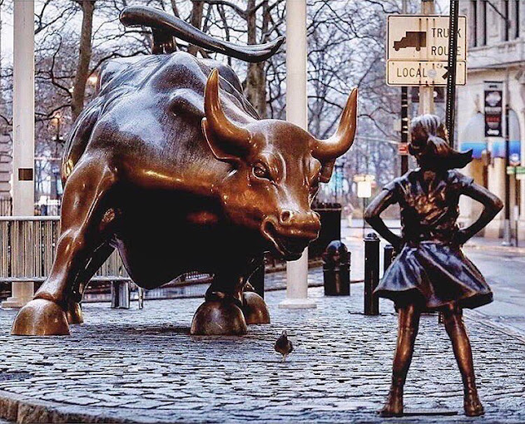
Ps 106:37 “they sacrificed their sons & daughters unto devils”
What (or who)
are we Sacrificing ours to?
1989 Arturo Di Modica

Slide 33
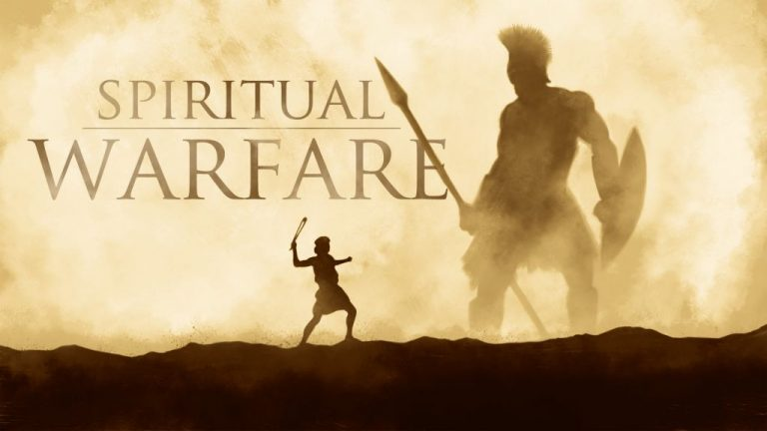
“Be strong in the Lord and in the power of His might”
Eph. 6:10

