Slide 1
The Privilege (and Price)
Of partnering with God.

Slide 2
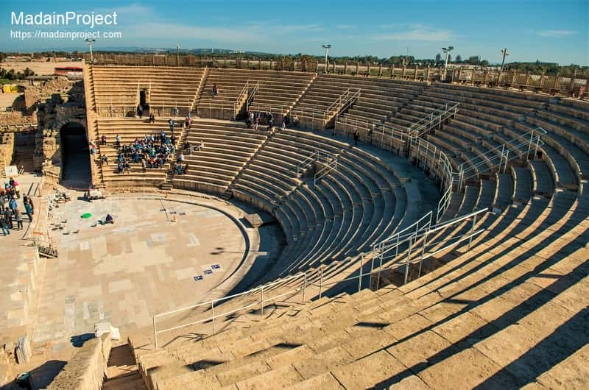
“All the world's a stage,
And all the men and women merely Players;
They have their exits and their entrances,
and one man, in his time, plays many parts.”
Jaques in “As you like it” Act 2, Scene 7
William Shakespeare
Ancient Theatre built by Herod in Caesarea, Israel. (seated 4000)

Slide 3
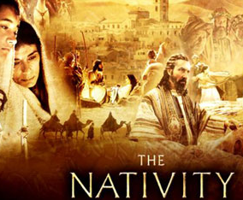
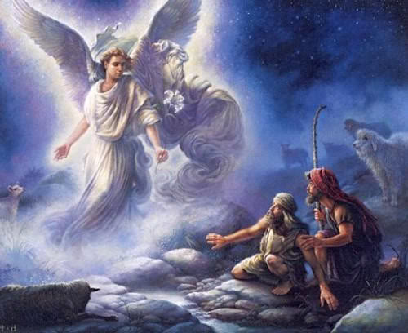
Several had “parts” to play in the drama of the Incarnation.

Slide 4
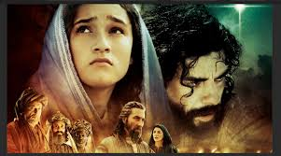
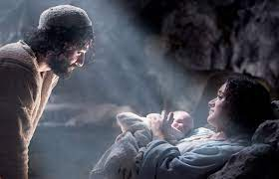
But no part/partnership (other than Jesus’) was as important as Mary’s and Joseph’s.

Slide 5
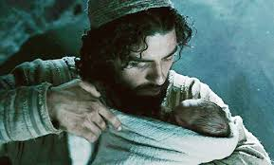
If God gave out “Oscars” for life’s best productions,
I believe Joseph
would win one for
“Best supporting actor!”

Slide 6
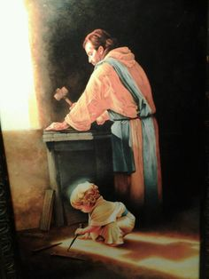
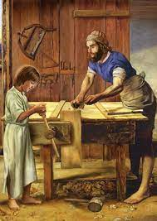
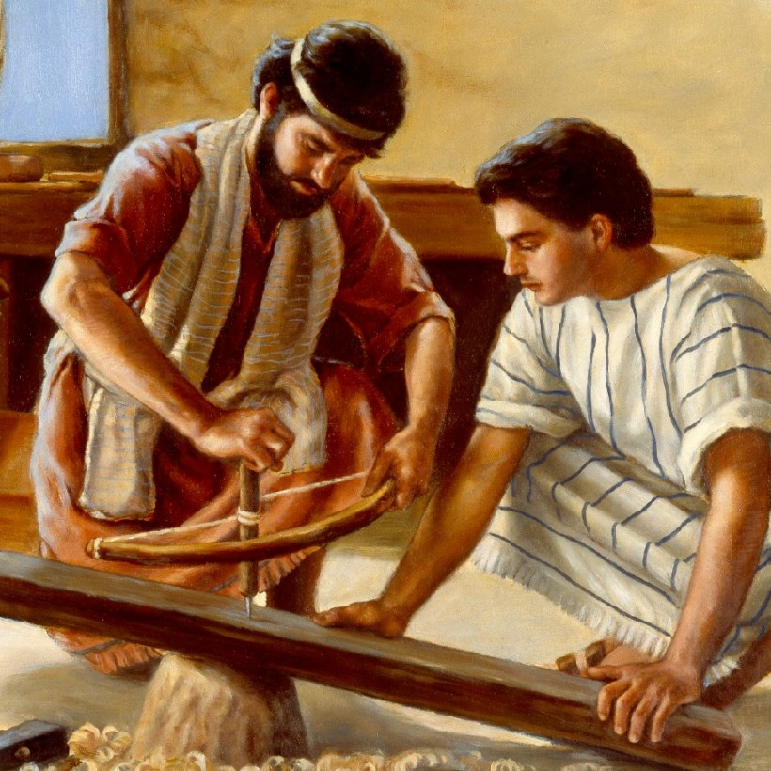
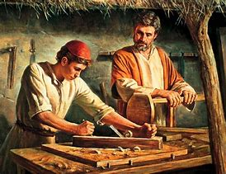
What kind of man did God choose to raise His son?

Slide 7
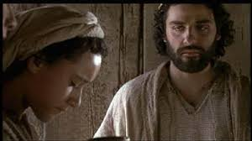
Joseph Was a “Just” Man Mt 1:18
“Now the birth of Jesus Christ was on this wise:
When as his mother Mary was espoused to Joseph,
before they came together,
she was found with child of the Holy Ghost.”

Slide 8
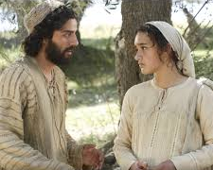
Joseph Was a “Just” Man Mt 1:19
“Then Joseph her husband, being a just man,
and not willing to make her a public example,
was minded to put her away privily.”

Slide 9
A. Joseph Wanted To Do What Was Right.
“Then Joseph … being a just man”
1) When he discovered that Mary was pregnant,
his culture offered him only two acceptable choices:
a) Public divorce resulting in humiliating Mary,
but exonerating himself.
b) Private divorce, basically annulling the marriage.
Either choice would communicate his innocence,
and Mary’s guilt!
δίκαιος (dik’aios) equitable in character or act

Slide 10
2) He wanted to do what was right before God,
not just what was “right” for him.
“Just” (dik’aios) equitable in character or act
When we feel wronged, do we focus on what’s right before God, or just us?
Pr 21:2-3 “Every way of a man is right in his own eyes:
but the LORD pondereth the hearts.
To do justice and judgment is more acceptable to the LORD than sacrifice.”

Slide 11
What kind of man did God choose?
2. Joseph was a “Kind” Man. Vs 19
A. Despite his hurt,
1) Since annulment wouldn’t require or involve
a public condemnation of Mary,
it would leave him open to public “speculation”
about his role in the pregnancy.
“and not willing to make her a public example,
was minded to put her away privily.”
he wanted to protect Mary.

Slide 12
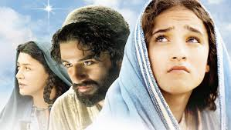
2. Joseph was a “Kind” Man. Vs 19
A. Despite his hurt, he wanted to protect Mary.
B. He was willing to sacrifice his reputation
in order to be kind to her.
1) Gossip/speculation about him and Mary
would affect his business.
And she was pregnant
with someone else’s baby!

Slide 13
2. Joseph was a “Kind” Man. Vs 19
1 Cor 13: 4-5 “Charity suffereth long, and is kind;
charity envieth not; charity vaunteth not itself,
is not puffed up,
Doth not behave itself unseemly,
seeketh not her own,
is not easily provoked,
thinketh no evil…”
Chrēsteu’omai: literally “usefully employed!”

Slide 14
2. Joseph was a “Kind” Man. Vs 19
1 Cor 13: 4-5 “Charity suffereth long, and is kind;
Are we prone to make sacrificial decisions based on our concern for the feelings of others,
Chrēsteu’omai: literally “usefully employed!”
even when we feel we’ve been wronged?

Slide 15
3. Joseph Was a “considerate” Man Mt 1:20,21
“But while he thought on these things,
A. He Didn’t Want To Be Hasty With Such
Important Matters.
1) He realized his choices would affect others!
Mary, Her family, Himself, His Family
and all their futures.
ἐνθυμέομαι (enthyme’omai) to be inspirited, to ponder
en: (prep) in, by, with and thumos: passion

Slide 16
A. He Didn’t Want To Be Hasty With Such
Important Matters.
2) First impressions are often inaccurate.
“Haste makes waste”: (John Ray's 1678 proverb collection)
a) Emotional decisions often lack:
(1) Clarity (To understand the truth/facts)
Jn 7:24 “Judge not according to the appearance…”
(2) Understanding of Consequences.
Pr 22:3 “A prudent man forseeth the evil…:
but the simple pass on, and are punished.”

Slide 17
B. He took the time to look (& listen) to God;
Instead of allowing his passions (hurt/anger)
to cause him to react in angry judgment. Mt 1:20
1) Because he was thoughtful he was receptive to
the angel’s voice and learn/receive God’s:
a) Partnership/Peace: 20 “Joseph…fear not to take
unto thee Mary thy wife..”
b) Process: “for that which is conceived in her
is of the Holy Ghost.” (see Gen. 3:15)

Slide 18
1) Because he was “thoughtful” he was receptive to
the angel’s voice to learn/receive God’s:
a) Partnership/Peace: “fear not to take unto thee Mary..”
b) Process “that which is conceived in her is of the Holy Ghost.”
c) Prophetic Promise: 21 “she shall bring forth a son,
and thou shalt call his name JESUS:
for he shall save his people from their sins.”
What might we be missing
when we’re not “thoughtful”?
Ps. 46:10 “be still and know that I am God.”

Slide 19
What kind of man did God choose?
Just 2. Kind 3. Considerate
4. Joseph was Obedient. Mt 1:24; 2:13,14
A. He did what he was told, when it was told,
and with a good attitude!
1:24 “Then Joseph …did as the angel of the Lord had bidden him, and took unto him his wife:
25 And knew her not till she had brought forth her firstborn son: and he called his name JESUS. “

Slide 20
4. Joseph was Obedient. Mt 1:24; 2:13,14
A. Doing what he was told, when…and with…
B. Obedience involves a cost: It cost Joseph:
1) His reputation and business
(Why did they stay in Bethlehem for 2 years?)
2) His convenience. (Moved 4 times in 4 years)
3) His Safety (Bethlehem was 5 miles from King Herod)
When God told him to flee to Egypt (Mt 2:13,14)
what could have happened if he’d lingered?

Slide 21
4. Joseph was Obedient. Mt 1:24; 2:13,14
Why do we expect our obedience
will cost us nothing?
“Must I be carried to the skies. On flow’ry beds of ease,
While others fought to win the prize,
and sailed through bloody seas?
Are there no foes for me to face? Must I not stem the flood?
Is this vile world a friend to grace, To help me on to God?”
Am I a soldier of the cross? Isaac Watts 1721

Slide 22
What Kind of Man did God choose to raise His son?
1) A Just Man
2) A Kind Man
3) A Considerate Man
4) An Obedient Man

Slide 23
Application:
What might God reveal to us if we purposed to be Just, Kind, and Considerate?
Jn 14:21 “He that hath my commandments,
and keepeth them, he it is that loveth me:
and he that loveth me shall be loved of my Father,
and I will love him,
and will manifest myself to him.”

Slide 24
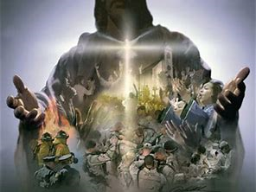
2) What might God accomplish through us
if we purposed to be truly Obedient?
Galatians 5:22,23

Slide 25
The Privilege (and Price)
Of partnering with God.
What price are you willing to pay for the privilege of partnering with God?

