Slide 1
The Power of a Praying Mom

Slide 2
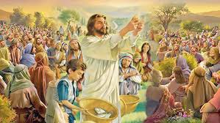
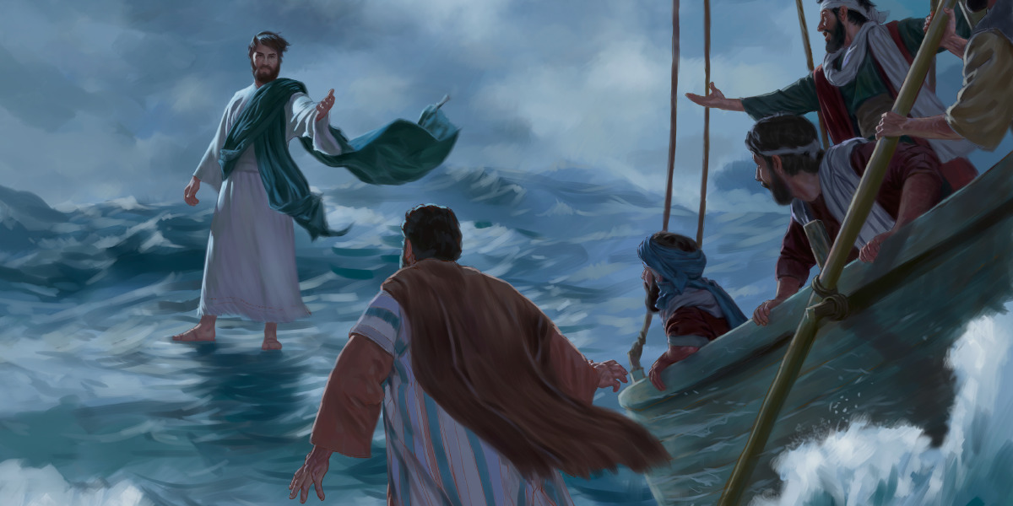
In Mt 14 Jesus feeds
the multitudes
(13-21),
walked through the storm to his disciples (22-33)

Slide 3
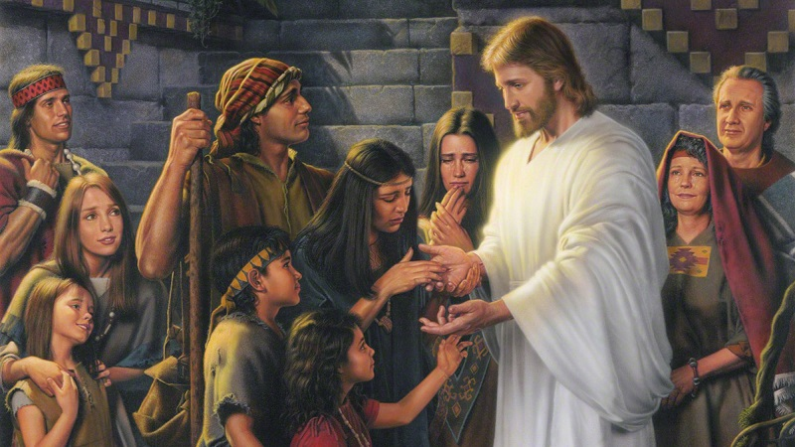
And healed all who came to touch him. (34-36)
“And when the men of that place had knowledge of him, they sent out into all that country round about, and brought unto him all that were diseased;
And besought him that they might only touch the hem of his garment:
and as many as touched were made perfectly whole.”

Slide 4
In Mt 15 Jesus rebukes the Pharisees for their hypocrisy in honoring their traditions
above God’s commandments (Vs 1-9),
specifically focusing on how they rationalized breaking God’s 5th commandment to
“Honor thy Father and Mother” (Ex. 20:12)
Mt 15:9 “in vain they do worship me, teaching for doctrines the commandments of men.”
He then applies this to the importance of a clean heart.

Slide 5
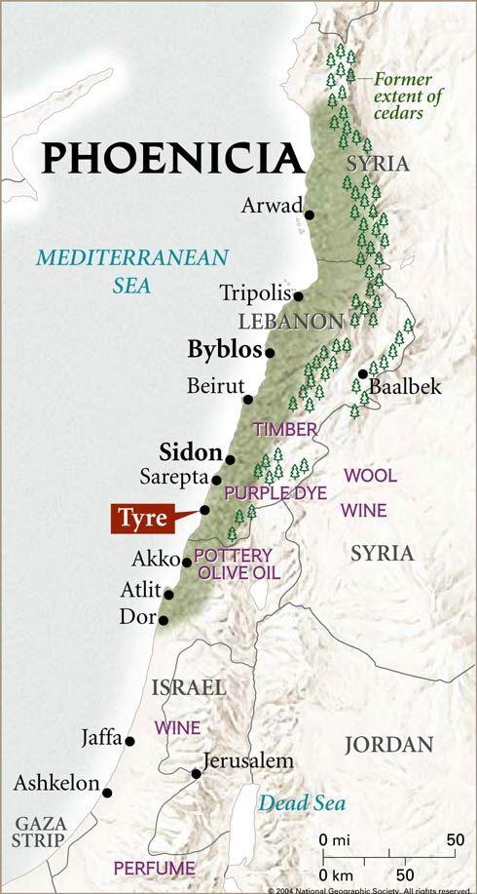
Then Jesus took a detour
North into Sidon. (Lebanon)
Why did he leave Israel
to visit here?
The only Biblical account we have of this trip concerns a desperate but devoted Canaanite mother
who, against all odds, connected with and confronted Jesus.

Slide 6
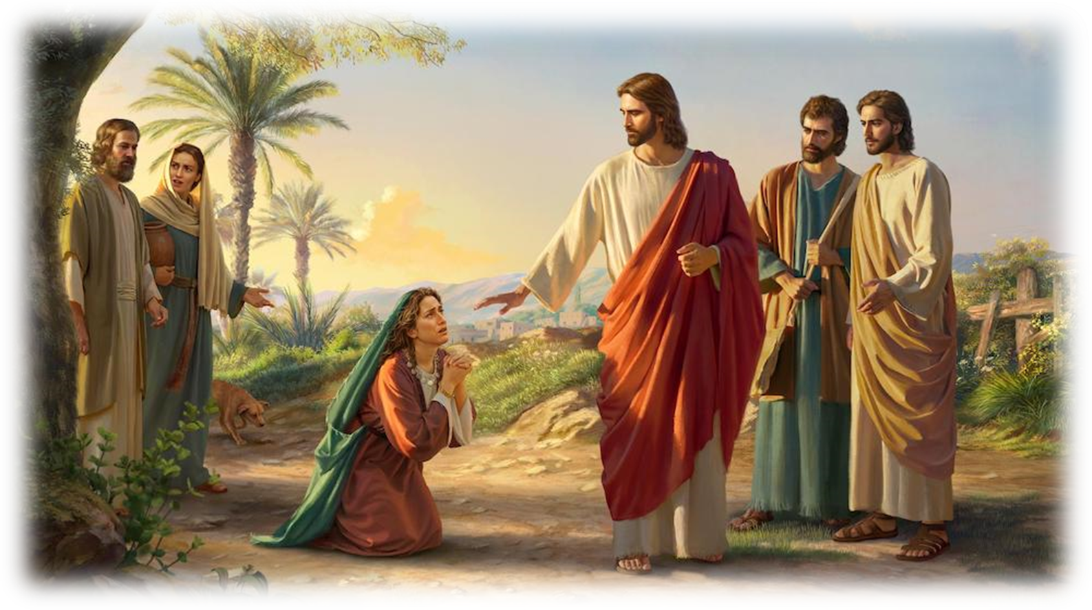
Mt 15:22 “behold, a woman of Canaan came out of the same coasts, and cried Have mercy on me,
O Lord, thou Son of David;
my daughter is grievously vexed with a devil.”

Slide 7
“But he answered her not a word.
And his disciples …besought him, saying,
Send her away; for she crieth after us.
24 But he answered and said,
I am not sent but unto the lost sheep
of …Israel.”

Slide 8
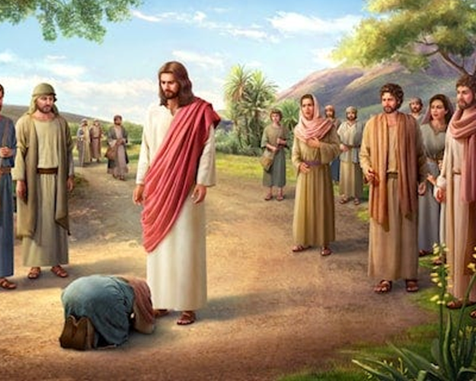
“Then came she and worshipped him, saying, Lord, help me!
26 But he answered and said, It is not meet to take the children's bread, and to cast it to dogs.
And she said,
Truth, Lord:
yet the dogs eat of the crumbs which fall from
their masters' table.”

Slide 9
“Then Jesus answered and said unto her,
O woman, great is thy faith:
be it unto thee even as thou wilt.
And her daughter was made whole from that very hour.”

Slide 10
Marks of a Great Mom

Slide 11
Great Moms overcome Great Barriers
➔ Inadequacy: She couldn’t “fix” her daughter.
➔ Inferiority: She was a Canaanite Woman
bowing before Jewish men.
➔ Uncertainty: Would Jesus reject her?
The Marks of a Great Mom

Slide 12
The Marks of a Great Mom
2. Great Moms are Powered by Great love.
Her love was more powerful than her:
➔ Shame: Remember the women in Mt 9:20-21
➔ Doubt: Mk 9:23 “…help thou mine unbelief”
➔ Fear: 1 Jn 4:18 “perfect love casts out fear”

Slide 13
3. Great Moms are armed with Great
Determination, even in the face of:
Initial silence. Vs 23 “Jesus answered her not…”
Disciple’s rejection. 24 “Send her away!”
Jesus’ explanation. Vs 25 “sent to…Israel…
not meet to give children’s bread to the dogs”
The Marks of a Great Mom

Slide 14
4. Great Moms acknowledge their Great need
➔ She recognized she wasn’t worthy! Vs 27
“Truth, Lord: …
She asked only for mercy and grace.
“… yet the dogs eat of the crumbs which fall from their masters' table.”
The Marks of a Great Mom

Slide 15
5. Great Moms know the power of Prayer!
➔ Acknowledged the Lordship of Jesus. 22
“have mercy ...O Lord, thou Son of David”
Acknowledged her need and His ability. 25
“Lord help me”
Song: “where could I go but to the Lord?”
The Marks of a Great Mom

Slide 16
6. Great Moms triumph with great faith! 28
“O woman, great is thy faith!
be it unto thee even as thou wilt.
And her daughter was made whole from that very hour.”
The Marks of a Great Mom

Slide 17
The Marks of a Great Mom
Jesus’ detour took him to a
desperate, but devoted mother;
who exercised more faith than most of the educated “faithful” Israelites;
And received a Great Blessing from Jesus!

Slide 18
The Marks of a Great Mom
Such Great Faith was true of another mother.
Luke 4:25-26 “many widows were in Israel in the days of Elias, (Elijah)…
But unto none of them was Elias sent, save unto Sarepta, a city of Sidon,
unto a woman that was a widow.”

Slide 19
The Marks of a Great Mom
What Great Barriers are in your way?
What Great Love motivates your prayers?
What Great Determination enables your drive?
What Great Need overwhelms you?

Slide 20
Will you allow these to keep you from
Or drive you to Jesus in “effectual, fervent” (energeo) prayer?
James 5:16

Slide 21
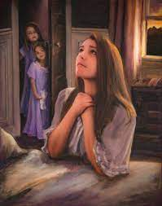
“Lord, who am I to teach the way,
To my children, day by day,
So prone myself, to go astray.
I teach them knowledge, but I know,
How faint they flicker and how low,
The candles of my knowledge glows.
I teach them power to will and do,
But only now to learn anew
My own great weakness through and through.

Slide 22
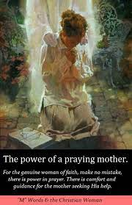
Lord if their guide
I still must be,
Oh, let my precious children see
Their mother
leaning hard
on thee!

Slide 23
Who (or what) are you
leaning on?

