Slide 1
The Exodus story wasn’t about two nations, cultures
or people groups;
It was about two opposite (but not equal) spiritual forces!

Slide 2
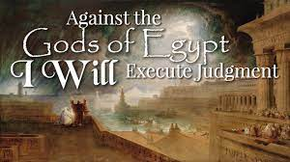
Ex 19:4
“Ye have seen what I did unto the Egyptians,
Ex 12:12
and brought you unto myself.”
God used it to demonstrate His power over all the other false “gods”.

Slide 4
In 1 Cor 10 God uses Israel’s Exodus as an example of the Christian experiences.
After deliverance from 400 years of slavery:
1 Cor 10:5-6 “with many of them God was not pleased:
for they were overthrown in the wilderness.”
Why / How did this happen?
God overthrew the gods (demons) of Egypt,
But they had infiltrated the hearts of God’s people.
God had delivered them from Egypt;
But they took some of “Egypt” with them.

Slide 5
Israel left, not just with the Silver and Gold of Egypt
But with the seduction of the gods of Egypt.

Slide 6
6 Now these things were our examples, to the intent we should not lust after evil things, as they lusted.
7 Neither be idolaters, …as it is written, The people sat down to eat and drink, and rose up to play.
8 Neither let us commit fornication as they…
and fell in one day three and twenty thousand.
9 Neither let us tempt Christ, as some of them also tempted, and were destroyed of serpents.
10 Neither murmur ye, as some of them also murmured, and were destroyed of the destroyer.”

Slide 7
1 Cor 10:11: “Now all these things happened unto them for ensamples: and they are written for all these things our admonition… (warning)
12 Wherefore let him that thinks he stands
take heed (blepo: beware) lest he fall.
13 There hath no temptation taken you but such as is common to man: but God is faithful, who will not suffer you to be tempted above that ye are able;
but will with the temptation also make a way to escape, that ye may be able to bear it.”

Slide 8
Last week we discussed the origin of Satan as the leader of an enemy (demon) army who stands in opposition to God and His will.
Satan literally means “adversary”.
We also discussed how he got his power from seducing 1/3 of the angels in heaven,
As well as the entire human race.
This morning we’re going to examine how he accomplishes this.

Slide 9
Understanding Temptation.
The world glorifies (tempts) Temptation.
“Temptation Island” Episode 1: “Paradise Beckons”
“4 committed couples are tempted to sever old ties
and explore new romances with 30 eligible singles in the Caribbean.”
Currently in Season 5!

Slide 10
Understanding Temptation.
The meaning of Temptation Jms 1
Temptation (pierasmos’) to prove, test;
A. God “tests” to reveal and reinforce
character. (Gen. 22:1; Is. 48:10; James 1:2-3)
“Count it all joy when ye fall into divers temptations;
Knowing the trying of your faith worketh patience.”
or to entice (to evil)

Slide 11
1) When we pass (endure) God’s “tests” we:
a) Grow in Faith James 1:2 “The trying
(doki’mion: testing/trustworthiness) of your faith
b) Grow in Patience: “…worketh patience.
(hupomone: endurance)
c) Become equipped for our faith journey. 3
“let patience have her perfect (telei’os: complete) work,
that ye may be perfect and entire (holokleros: equipped).”
d) Grow in Wisdom. Vs 4 “if you lack wisdom..”

Slide 12
1) When we pass (endure) God’s “tests” we:
e) Receive God’s blessings Jms 1:12 “Blessed (Makarios: fortunate) is the man that endureth temptation:
for when he is tried, (dokimos: tested)
he shall receive the crown of life, which the Lord hath promised to them that love him.” (Ro 8:28,29)
2) God will never “entice us” to evil. Vs 13
“God cannot be tempted with evil, (kakos: worthless)
neither tempteth he any man.” (to do evil)

Slide 13
The Meaning: Temptation (pierasmos’)
“putting to proof”, to test;
B. Satan “tempts” us to entice us to drift/rebel
because he knows that this will:
1) Move us away from God’s Plan/Protection.
Jms 1:16 “Do not err my beloved brethren”
Planoa: to roam, drift (from safety, truth, or virtue)
a) God’s commandments are “for our good always,
that he might preserve us alive (ḥāyâ) Dt 6:24
See Jn 10:10; Ps. 23:3
or to entice.

Slide 14
B. Satan “tempts” us to :
1) Move us away from God’s Plan & Protection.
Jms 1:16 “Do not err my beloved brethren”
James closes with 5:19-20 “Brethren, if any of you do err from the truth, and one convert him; (Epistrephō: turn back (to God’s plan, peace, protection) (Ps 23:3)
20 Let him know, that he which converteth the sinner from the error of his way shall save a soul from death,
and shall hide (calyp’to: cover) a multitude of sins.”

Slide 15
B. Satan “tempts” or entices us to:
1) Move us away from God’s Plan & Protection.
2) Give him more “power/influence”
When we drift from God,
Ro. 6:18 “yield yourselves servants to obey…”
1 Cor 10:13 There hath no temptation taken you but such as is common to man: but God is faithful..
14 Wherefore, my dearly beloved,
(eidōlolatri’a) from ei’dolon: image (of heathen god)
and latrei’a: to minister, serve, and/or worship
we drift toward Satan!
flee from idolatry!”

Slide 16
a) When we yield to Satan’s temptations we:
(1) Isolate ourselves from God’s protection. Is. 59:1,2
(2) Feed our carnal appetites. (Flesh) Gal. 5:17
They can grow to control us!
Pr 5:21-22 “For the ways of man are before the eyes of the LORD, and he pondereth all his goings.
22 His own iniquities shall take the wicked himself,
and he shall be holden with the cords of his sins.”
(This is in the context of immorality! Vs 15-20)

Slide 17
Carnal appetites can grow to control us! Pr. 23:29-35
“Who hath woe? …sorrow? …contentions? …babbling? …wounds without cause? …redness of eyes?
30 They that tarry long at the wine;
they that go to seek mixed wine. …
35 They’ve stricken me, …, and I was not sick;
they have beaten me, and I felt it not:
when shall I awake?
I will seek it yet again!”
Pr 20:1 “Wine is a mocker, strong drink is raging:
and whosoever is deceived thereby is not wise.”

Slide 18
a) When we yield to Satan’s temptations we:
(1) Isolate ourselves from God’s protection. Is. 59:1,2
(2) Feed our carnal appetites. (Flesh) Gal. 5:17
(3) Expose ourselves to demonic activity & influence.
1 Cor. 10:14 “flee idolatry…
20 “…the things which the Gentiles sacrifice,
they sacrifice to devils, (daimonion: demons)
and I would not that ye should have
fellowship (Koinōnos: partaker, partner)
with devils.” (daimon’ion: demons)

Slide 19
b) The more we yield to temptation, (aka: sin)
the more power/pull we surrender to the devil(s).
Ro. 6:16 “to whom ye yield yourselves servants to obey,
his servants (doulos: slave) ye are…”
(1) This is how Satan became “the god of this world”
2 Cor 4:4; Luke 4:6 “that was delivered unto me”
(2) This is why Jesus could say: “The prince of this
world cometh,
and hath nothing in me.” (Jn 14:30)
Illustrate with a magnet.
The more iron, the stronger the attraction.

Slide 20
Temptation: To prove, test, or entice.
Every Temptation involves a Test (proof) of our:
Fidelity (Faithfulness) Job 1,2
Integrity (Commitment to Truth) Joseph Gen. 39
Stability (Strength of Character) Daniel 6
Stupidity! (Foolishness) Pr 7:7-27
7 “I beheld among the simple…void of understanding
26 she hath cast down many wounded…
27 Her house is the way to hell…”

Slide 21
James 1:16-20 “Do not err, my beloved brethren.
17 Every good gift and every perfect gift is from above, and cometh down from the Father of lights, with whom is no variableness, neither shadow of turning.
18 Of his own will begat he us with the word of truth, that we should be a kind of firstfruits of his creatures.
19 Wherefore, my beloved brethren, let every man be swift to hear, slow to speak, slow to wrath: (Eph 4:26)
20 For the wrath of man worketh not
the righteousness of God.”

Slide 22
James 1:21-22 “Wherefore lay apart all filthiness and superfluity of naughtiness,
and receive with meekness the engrafted word,
which is able to save your souls.
22 But be ye doers of the word,
and not hearers only, deceiving your own selves.”
Are you grafting God’s word in your soul?
This is how Jesus defeated Satan’s Temptation. Mt 4
This is how we fight back! (Eph. 6:16,17)

Slide 23
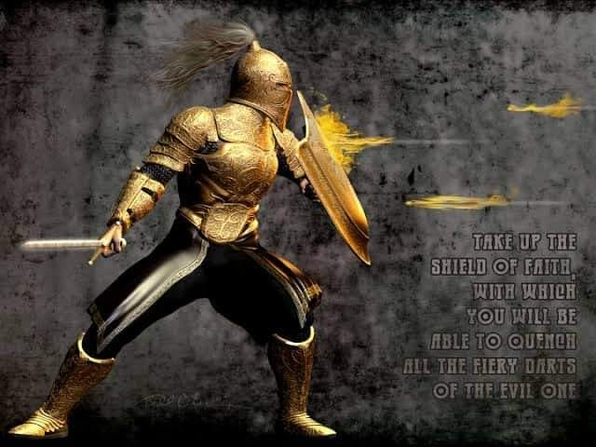
Eph 6:16 ”Above all, taking the shield of faith,
Romans 10:17
“faith comes
by hearing, (akouo: understanding)
and hearing
by the word of God”
wherewith ye shall be able to quench all the fiery darts of the wicked.”
17 “and the sword
of the Spirit,
which is the
word of God”

