Slide 1
The Power and Purposes of Scripture
“Preach the Word...” 2 Tim 4:2
2 Tim. 3:16,17 “All scripture is given by …God
and is profitable for doctrine, reproof, correction, instruction
That the man of God may be perfect,
(artios: complete)
thoroughly furnished
(Exartiz’o: fully equipped)
unto all good works.”
(agathos: useful/beneficial)

Slide 2
The Purpose of Scripture is to:
Perfect (complete) and furnish (equip) us
So that we’re able to have a productive (beneficial) and fulfilling (purposeful) life!
“For the perfecting of the saints,
for the work of the ministry,
for the edifying of
the body of Christ:”
Eph. 4:12

Slide 3
This means that ignorance of God’s word will leaves us
Incomplete, Ill-equipped and Ineffective!
Last week we discussed the:
Causes of Ignorance: (Ignoring God’s Truths)
Consequences of ignorance: (Deceit & Drift)
Correction for ignorance: (Receive/Respond
to Truth!) (Ps 119:130; Jn 8:32; 17:17)

Slide 4
Ignorance can be slain by the
“Sword of the Spirit” (Eph 6:17; Heb 4:12),
But ignorance isn’t our only enemy when it comes to grasping God’s truth.
Another powerful enemy we must overcome is Indifference!
“without interest, importance, concern”

Slide 5
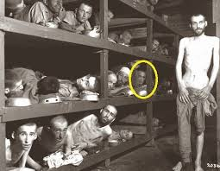
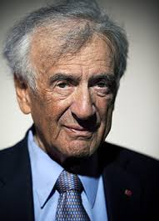
Indifference: “without interest, importance, concern”
it’s indifference.
“The opposite of love isn’t hate,
The opposite of art isn’t ugliness,
it’s indifference.
The opposite of faith is not heresy,
The opposite of life is not death,
Ellie Weisel
Holocaust survivor
it’s indifference.
it’s indifference!

Slide 6
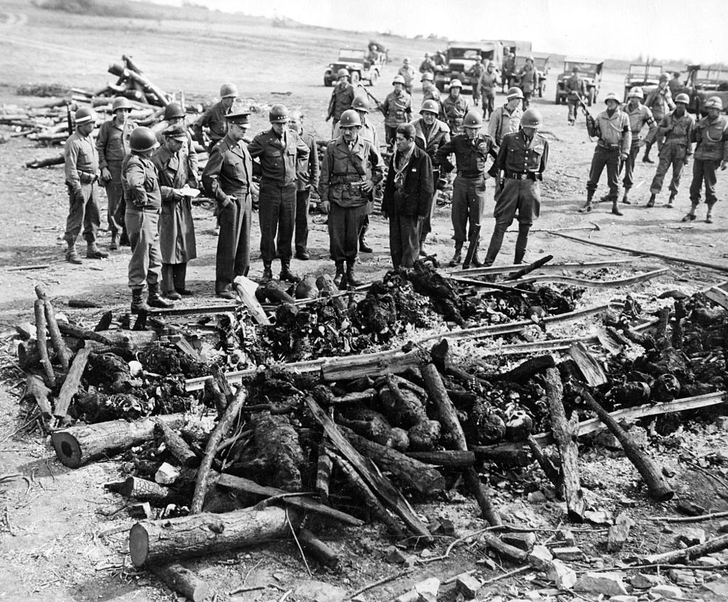
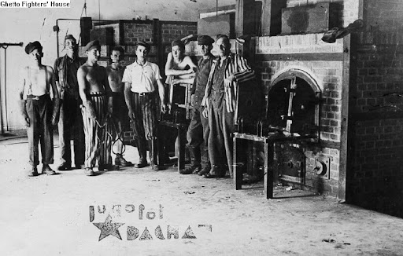
Indifference: “without interest, importance, concern”
“Only guard yourself and guard your soul carefully, lest you forget the things your eyes saw, and lest these things depart your heart all the days of your life. And you shall make them known to your children, and to your children’s children”
Dt. 4:9
Last view as you exit the Holocaust museum
Dachau Ovens

Slide 7
Understanding Indifference
Diagnosis: “Hardening of the heart”
A. Ignorance is related to the head (mind);
but Indifference is a Heart issue!
“To day if ye will hear his voice,
harden not your hearts” (Heb. 3:8,15; 4:7)
1) Not just “I don’t know” but now:
“I don’t care!”

Slide 8
2. Symptoms of indifference:
A. Relational separation/apathy Mt 19:8
“Moses because of the hardness of your hearts
(Sklēro: dry, tough, calloused) & (kardia: thoughts, feelings)
suffered (epitrepō: allowed) you to put away your wives:
but from the beginning it was not so.”
1) The further we drift from someone/something
The less effect/pull they have on us!

Slide 9
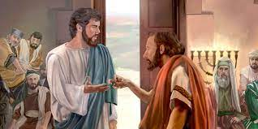
B. Religious Apathy The further we drift from God,
1) The less effect He (His Spirit & Word) has on us.
Mk 3:4-5 “Is it lawful to do good on the sabbath, or to do evil? to save life, or to kill?
And … he had looked round about on them with anger,
But they held their peace.
being grieved for the hardness of their hearts,
He said … Stretch forth thine hand.
he stretched it out:
and his hand was restored whole”

Slide 10
B. Religious (spiritual) Apathy Romans 2:4-6
“despisest thou the riches of his goodness and forbearance and longsuffering; not knowing that
the goodness of God leadeth thee to repentance?
5 But after thy hardness (sklērot’ēs: stubborn, calloused)
and impenitent (ametano’ētos: unrepentant) heart
treasurest up (thēsauros: deposit) unto thyself wrath against the day of wrath
and revelation of the righteous judgment of God;
6 Who will render to every man according to his deeds”

Slide 11
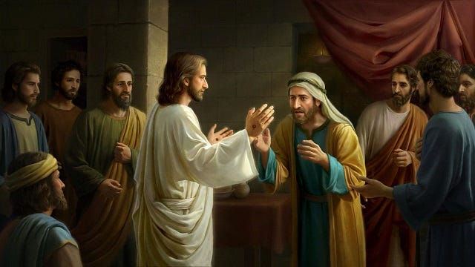
The further we drift from God, the less effect He has.
Mk 16:14 “Afterward he appeared unto the eleven as they sat at meat, and upbraided them with their unbelief and hardness of heart, (sklērokardi’a)
because they believed not them which had seen him after he was risen.
15 …Go ye into all the world, and preach the gospel to every creature.”

Slide 12
3. Prognosis: Indifference (apathy)
A. It distances us from:
1) God: Rev. 2:4 “You have Left your first love”
a) The further we drift from God,
the less we care about anything He values!
2) Each other:
a) The further we drift from each other,
the less influence we have on each other.

Slide 13
3. Prognosis: Indifference (apathy)
A. It Distances us from God (and each other)
B. It defiles/destroys our heart/conscience.
Titus 1:15 “Unto the pure all things are pure:
but unto them that are defiled and unbelieving
is nothing pure; (katharos’: clean, clear) 2 Cor 4:4
but even their mind (nous: understanding)
and conscience (synei’dēsis: co-perception)
is defiled.” (miaino: contaminated)
(Heb. 12:15)

Slide 14
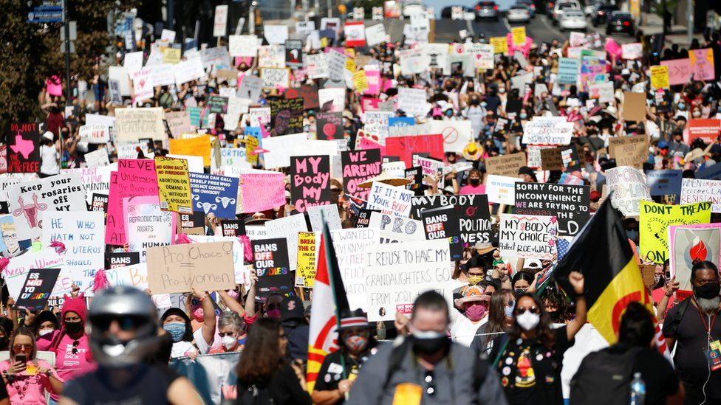
1) Nothing illustrates this like America’s
own Holocaust!
but over 60 million innocent deaths!
Not 6 million,

Slide 15
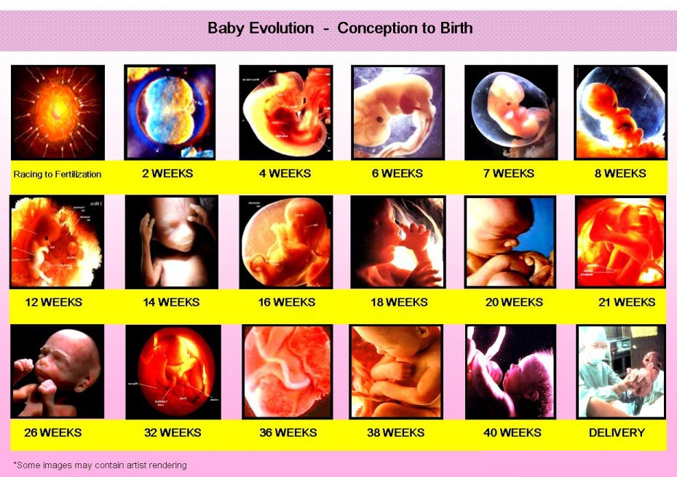
but over 60 million innocent deaths!
Psalm 139:13-16

Slide 16
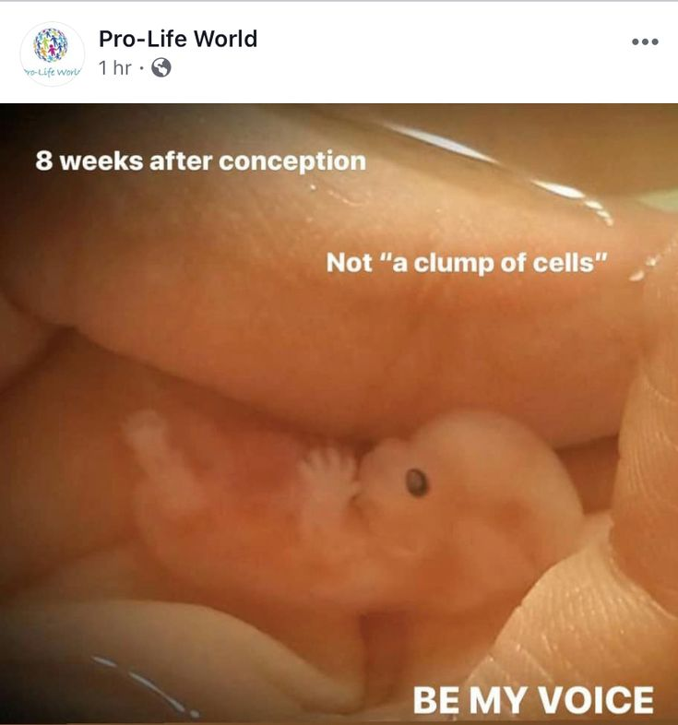
but over 60 million innocent deaths!
Psalm 139:13-16

Slide 17
3. Prognosis: Indifference (apathy)
A. It Distances us from God (and each other)
B. It defiles/destroys our heart/conscience. Ti 1:15
C. It denies God’s Heart/Priorities. Titus 1:16
“They profess that they know God;
but in works they deny (arne’omai: refuse) him,
being abominable, (bdelyktos’: idolatrous)
and disobedient, (apeithēs’: without faith)
and unto every good work reprobate.”
(Adokimos: worthless)
(see James 1:22, 2:20,26)

Slide 18
3. Prognosis: Indifference (apathy)
D. It frustrates God’s Spirit. Eph 4:29, 30
“let no corrupt (sapros: worthless) communication (logos: words, reasoning) proceed…
But that which is good (agathos) to the use of edifying
That it may minister grace…
And grieve (Lype’ō: distress) not the Spirit of God,
whereby ye are sealed unto the day of redemption.”
1Th 5:19 “quench (extinguish) not the Spirit…”

Slide 19
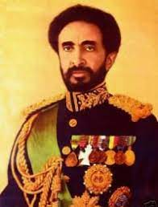
Indifference: “without interest, importance, concern”
“Throughout history it’s been the inaction of those who could have acted; the indifference of those who should have known better;
the silence of the voice of justice
when it mattered most;
that has made it possible for
evil to triumph.”
Haile Selassie
Last King of Ethiopia (1930-1974)

Slide 20
4. Treatment/ Cure for Indifference/Apathy
A. Interest. 1 Jn 3:11,14
“this is the message that ye heard from the beginning, that we should love one another….
We know that we have passed from death unto life,
because we love the brethren.
He that loveth not his brother abideth in death.”
(than’atos: ultimate separation)

Slide 21
3. The Cure for Indifference/Apathy
A. Interest 1 Jn 3:11,14 “love one another” Leads to:
B. Involvement. 1 Jn 3:16 “Hereby perceive we the
love of God, because he laid down his life for us:
(Jn 15:13 “Greater love hath no man than this…”)
and we ought to lay down our lives
for the brethren.”
Gal. 6:10 “let us do good unto all men, especially unto them who are of the household of faith.

Slide 22
3. The Cure for Indifference/Apathy
A. Interest ➔ Involvement. ➔
C. Investment. 1 Jn 3:17 “But whoso hath this
world's good, and seeth his brother have need,
and shutteth up his bowels of compassion from him,
how dwelleth the love of God in him?
18 …let us not love in word, neither in tongue;
but in deed and in truth.”
Mt 6:21 “For where your treasure is,
there will your heart be also.”

Slide 23
Ez. 8 Ezekiel saw God’s people through God’s eyes!
God revealed how His people were worshipping idols (demons), even in God’s temple! 8:5-16
17 “Hast thou seen this? Is it a light thing to the house of Judah that they commit the abominations which they commit here? For they have filled the land with violence, and have returned to provoke me to anger:
18 Therefore will I also deal in fury: mine eye shall not spare, neither will I have pity:
and though they cry …I will not hear”

Slide 24
In Ch. 9 God calls for 6 “destroyers” to stand by to execute judgment but first directs another man standing by the altar “with a writer’s inkhorn” to:
4 “Go through the midst of … Jerusalem and set a mark (tav) upon the foreheads of the men that sigh and that cry (ānaḥ’: groan)
for all the abominations that be done in the midst thereof.”

Slide 25
In Ch. 9 God calls for 6 “destroyers” to execute judgment 5 “And to the others he said ...Go ye after him through the city, and smite: let not your eye spare, neither have ye pity: 6 Slay utterly old and young, …
but come not near any upon whom is the mark;
and begin at my sanctuary!”
Jeremiah 39:3

Slide 26
Exek. 9:4 “set a mark (tav) upon the foreheads…”
1) What distinguished those who would be exempted
from God’s judgment from those who would not?
They “sigh and cry (aka: care!) for abominations that be done in the midst thereof.”
2) What was the effect of the mark (Tav)
(a sign of exemption from judgment)
3) What was the significance of this
Mark? (Tav)

Slide 27
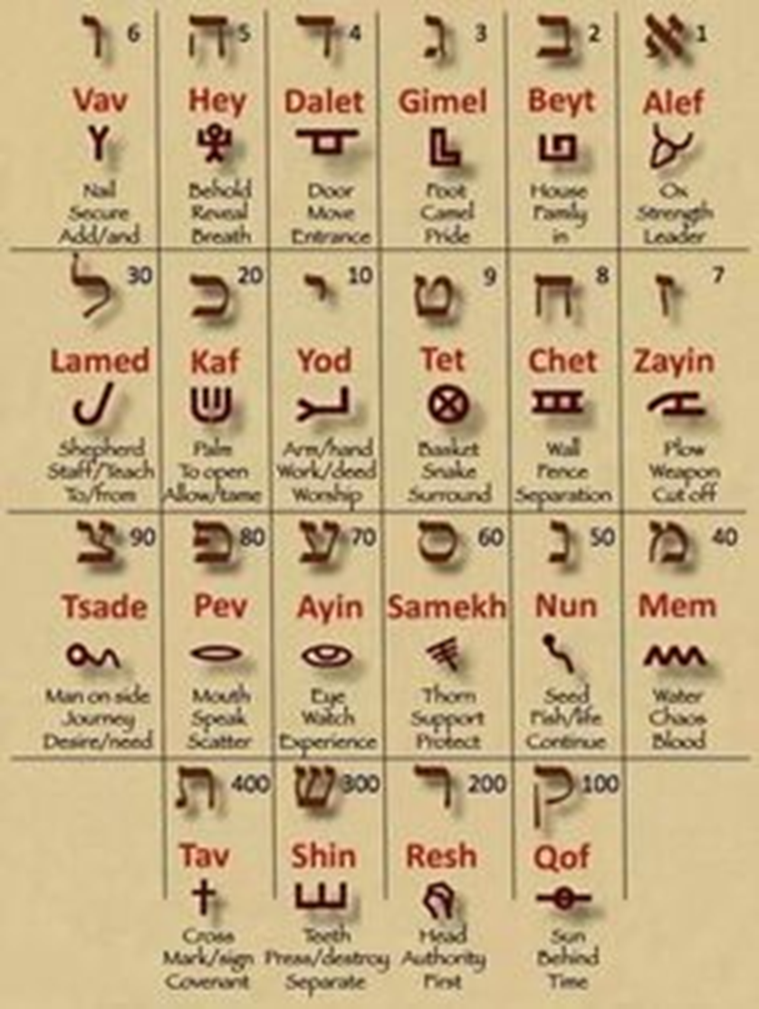
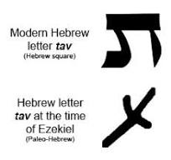
Exek. 9:4 “set a mark (tav) upon the foreheads…”
Cross: Mark/sign of the covenant!
https://www.hebrew4christians.com/Grammar/Unit_One/Pictograms/pictograms.html

Slide 28
History repeats itself! 1 Peter 4:
7 “the end of all things is at hand: be ye therefore sober, (Eph. 5:15-18) and watch unto prayer.
8 And above all things have fervent charity among yourselves: for charity shall cover the multitude of sins!
17 For the time is come that judgment (krima)
must begin at the house of God:
and if it first begin at us,
what shall the end be of them
that obey not the gospel of God?”

Slide 29
Application:
Do you have the “mark” of God on your heart, “exempting” you from God’s Judgment?
Ro. 5:1; Ro. 8:1
2) Are you sensitive to God’s word/Spirit,
making you “effective” in God’s Purposes/plans?
3) Are you indifferent towards Your own sin
or that of our society? (Mt 5:13-16; Lk 14:34,35)
Toward God’s Commands (prescriptions)?

Slide 30
Pr 1:23 “Turn you at my reproof:
Behold I will pour out my spirit unto you,
I will make known my words unto you.
24 Because I have called, and ye refused; I have stretched out my hand, and no man regarded;
25 But ye have set at nought all my counsel,
and would none of my reproof:…
29 For that they hated knowledge,
and did not choose the fear of the LORD:

Slide 31
Pr 1: 30 “They would none of my counsel:
they despised all my reproof.
31 “Therefore shall they eat of the fruit of their own way, and be filled with their own devices.
32 For the turning away of the simple shall slay them, and the prosperity of fools shall destroy them.
33 But whoso hearkeneth (šāmaʿ: listen/obey) unto me shall dwell safely,
and shall be quiet from fear of evil.”

Slide 32
1 Cor 10:11 “These things happened to them for examples and they are written for our admonition….
12 Wherefore let him that thinketh he standeth take heed lest he fall…
14 Wherefore, my dearly beloved,
flee from idolatry.”

