Slide 1
This phrase has interesting roots.
The “Trust” Test

Slide 2
In Nov. 13, 1861 a Pennsylvania Preacher (Rev. Watkinson) wrote the following to Secretary of the Treasury (Mr. Chase)
“Dear Sir: You are about to submit your annual report to the Congress respecting the affairs of the national finances.
One fact touching our currency has hitherto been seriously overlooked.
I mean the recognition of the Almighty God in some form on our coins.”

Slide 3
“You are probably a Christian.
What if our Republic were not shattered beyond reconstruction?
Would not the antiquaries of succeeding centuries rightly reason from our past that we were a heathen nation?
What I propose is that instead of the goddess of liberty we shall have …in the folds of the bars the words GOD, LIBERTY, LAW…”

Slide 4
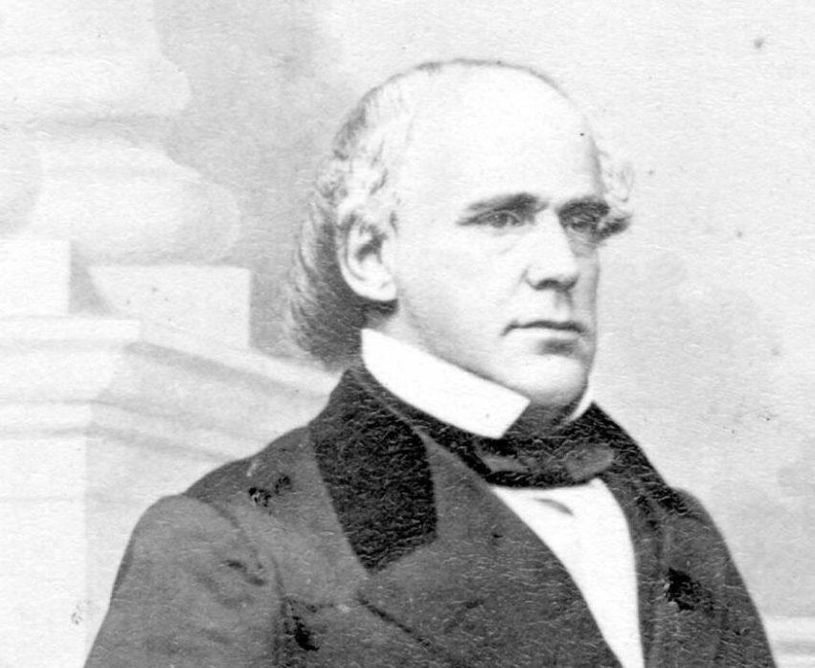
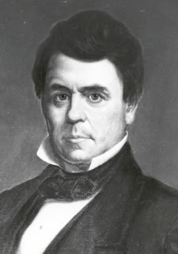
Secretary Chase instructed James Pollock, Director of the Mint at Philadelphia, to prepare a motto,
in a letter dated Nov 20, 1861:
“Dear Sir: No nation can be strong except in the strength of God, or safe except in His defense.
The trust of our people in God should be declared on our national coins.

Slide 5
“You will cause a device to be prepared without delay with a motto expressing in the fewest and tersest words possible this national recognition.”
He chose “In God We Trust”
Eventually adopted as National Motto in 1956
Replacing the original
“E pluribus unum”
(Out of many, One)

Slide 6
This may be our National Motto…
But This appears to be our Natural “Motivation”!

Slide 7
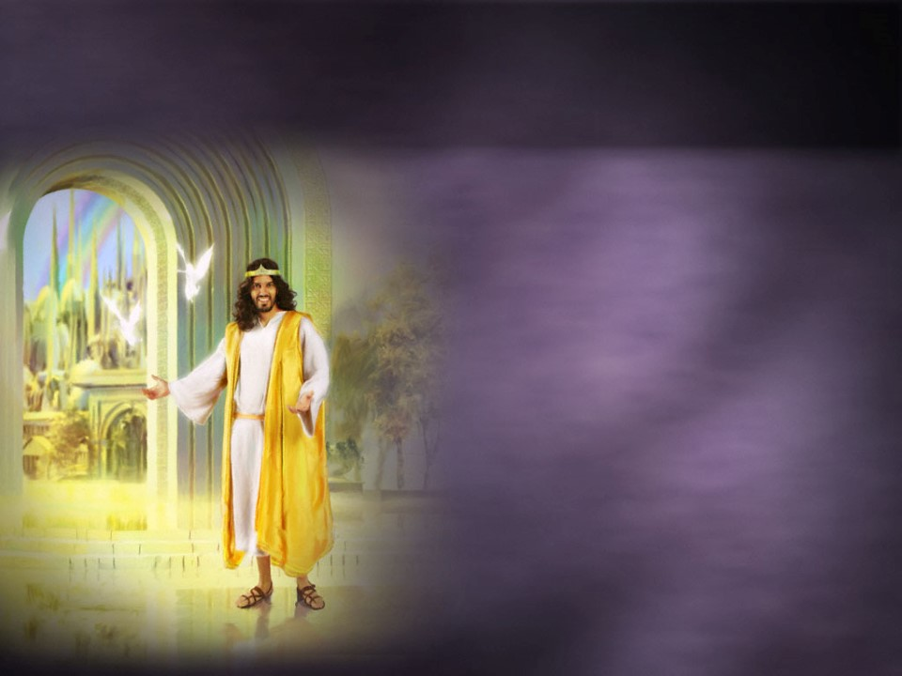
As Christians, we’re often “torn” between these two “Trusts”.
(God or Gold)
Jesus repeatedly spoke of the dangers of this detour!
“Lay not up for yourselves treasures on earth
…but lay up for yourselves treasures in heaven…
For where your treasure is,
there will your heart be also.”
Mt. 6:19,20

Slide 8
Mt 6:22-24 “The light of the body is the eye:
if therefore thine eye be single, (haplous: clear focus)
thy whole body shall be full of light.
But if thine eye be evil, (poneros: infected)
thy whole body shall be full of darkness.
If therefore the light that is in thee be darkness,
how great is that darkness!
No man can serve two masters:
for either he will hate the one, and love the other;
or else he will hold to the one, and despise the other.
Ye cannot serve God and mammon.”
(skotos: obscured)

Slide 9
Money’s been described as a universal:
Passport to everywhere except heaven
Provider for everything except happiness.
God reveals that it can easily become
“filthy lucre” and “Unrighteous Mammon”
Warning in 1 Tim. 6:10 that:
“the love of money is the root of all evil:
which while some coveted after,
they have erred from the faith, and pierced themselves through with many sorrows.“

Slide 10
Money makes a great servant,
but a terrible “master”.
The Laodicean’s chose a “Comfortable Compromise” between these two “Trusts”,
And ended up nauseating God!
See Rev. 3:14-22
Luke 16 reveals how some who are “caught up” in this world,
end up “cast away” in eternity.

Slide 11
How can we make “money” our servant
instead of our master? Luke 16
1. Understand Stewardship. Luke 16
Vs 1 “a certain rich man had a steward…”
A. A Steward manages the resources of another.
Oikonom’os: manager, overseer, fiscal agent
1) He has access to the master’s resources.
2) His needs are provided by the “master”.
3) He invests those resources for the Master.
Lk 19:13 “Occupy (invest, trade) till I come.”

Slide 12
1. Understand Stewardship. Luke 16
B. What’s the primary qualification of
stewards?
1 Cor. 4:2 “It is required in stewards
that a man be found faithful.”
1) The greatest ability is Dependability!
Pistos’: trustworthy!
from peithō: to convince!

Slide 13
1. Understand Stewardship. Luke 16
B. What’s the primary qualification of
stewards?
1 Cor. 4:2 “It is required in stewards
that a man be found faithful.”
1) The greatest ability is Dependability!
Pistos’: trustworthy!
from peithō: to convince!

Slide 14
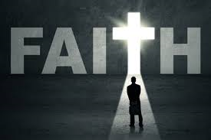
1 Cor. 4:2 “It is required in stewards
that a man be found faithful.”
2) We often struggle to decide if we can really “trust God”
seldom considering whether
God can really trust us!
(Who has the
better track record?)

Slide 15
If Stewardship involves managing the resources of another…
2. What are we to manage for God?
A. “Our” Treasures (Wealth/Resources)
Lk 16:2 “he had wasted his (master’s) goods”
Ps 24:1-2 “The earth is the LORD’S,
and the fulness thereof; the world,
and they that dwell therein.” 1 Cor 4:7; Rev. 4:11

Slide 16
2. What are we to manage for God?
A. “Our” Treasures (Wealth)
1) Forgetful stewards usually become
Faithless Stewards! Deut. 8:14,17-18
“Then thine heart be lifted up, and thou forget
the LORD thy God…And thou say in thine heart,
My power …hath gotten me this wealth.
But thou shalt remember the LORD thy God:
it’s He that giveth thee power to get wealth”

Slide 17
A. “Our” Treasures (Belongs to God)
2) Our Giving is a “gage” (Test) of our faith
and our faithfulness. Luke 16:11-13
“If therefore ye have not been faithful in the unrighteous mammon,
who will commit to your trust the true riches?
And if ye have not been faithful in that which is another man’s,
who shall give you that which is your own?
No servant can serve two masters: …
Ye cannot serve God and mammon.”

Slide 18
A. “Our” Treasures (Belongs to God)
2) Our Giving is a “gage” (Test) of our faith and our faithfulness.
Lev. 27:30 “The tithe…is the Lord’s”
Mal. 3:8,9 “Will a man rob God?
Yet ye have robbed me …in tithes and offerings…
Ye are cursed with a curse” (Haggai 1:4,5)
Deut 14:22,23 “thou shalt truly tithe all thine increase
…that thou mayest learn to fear the Lord thy God…”

Slide 19
3) Because of the seductive nature of wealth, God commands Pastors to: “Charge them that are rich…
({Parangel’lō: command para: with & angelo: messenger})
that they be not high minded,
nor trust in uncertain riches,
but in the living God,
who giveth us richly all things to enjoy;
That they do good, that they be rich in good works,
ready to distribute, (share) willing to communicate;
(koinōnikos’: liberal partnership)
1 Tim. 6:17-19

Slide 20
6:19 “Laying up in store for themselves a good foundation against the time to come,
that they may lay hold on eternal life.”
“For where your treasure is,
there will your heart be also.”
Mt. 6:19,20

Slide 21
2. What are we to manage for God?
B. Our Time. Eph. 5:15-17
“See then that ye walk circumspectly,
not as fools, but as wise,
Redeeming the time, because the days are evil.
pon-ay-ros‘: hurtful, diseased (infected)
Wherefore be ye not unwise,
but understanding what the will of the Lord is.”
Ps 90:12 “So teach us to number our days,
that we may apply our hearts unto wisdom.”

Slide 22
B. Our Time.
Lk 16:3-4 “What shall I do? for my lord taketh away from me the stewardship. I am resolved what to do, that,
when I am put out of the stewardship,
they may receive me into their houses.”
V 8 “The Lord commended the unjust steward”
1) The lesson about the unfaithful steward is that
when he realized he was running out of time,
he did something about it!
vs 8 “for the children of this world are in their generation wiser than the children of light.”

Slide 23
2. What are we to manage for God?
C. Our Talents. 1 Peter 4:10
“As every man hath received the gift,
even so minister the same one to another,
as good stewards of the manifold grace of God.”
1) Most squander their “gifts” on themselves or on getting ahead in “this world”.
Mt. 25:25 “I hid thy talent in the earth…”

Slide 24
2. What are we to manage for God?
D. Our Testimony. (The Gospel) 1 Thess 2:4 “But as we were allowed (dokimazo) of God
to be put in trust with the gospel, so we speak;
not as pleasing men, but God,
which trieth (dokimazo) our hearts.”
1) God has committed the treasure of His truth to us! 2 Cor. 4:7 “We have this treasure
in earthen vessels”
Mt 10:8 “freely you’ve received, freely give”

Slide 25
D. Our Testimony (The Gospel) 1 Thess. 2:4
2) Since God’s committed this treasure to us, we must:
a) Guard it. 1 Tim. 6:20
“Keep that which is committed to thy trust”
Jude 3 “earnestly contend for the faith.”
b) Invest it in others. 2 Tim. 2:2
“What thou hast heard…commit to others”
Lk 19:13 “Occupy until I come”
Pragmateu’omai: busy yourself with (my) business

Slide 26
Conclusion: God entrusts us with:
Treasures (Resources); Time (Opportunities)
Talents (Abilities); and our Testimony (Influence)
So we can use them to “invest”
in the sharing the eternal treasure of the Gospel.
2 Cor. 4:1-2 “seeing we have this ministry, (3:18)
as we have received mercy, we faint not;
But have renounced the hidden things of dishonesty,
not walking in craftiness,
nor handling the word of God deceitfully;

Slide 27
2 Cor 4:2-4“…but by manifestation of the truth
commending ourselves to every man's conscience
in the sight of God.
But Satan seeks to sidetrack us with a preoccupation with the temporary.
But if our gospel be hid, it is hid to them that are lost:
In whom the god of this world hath blinded the minds
(Typhlo’ō: make smoky, obscure)
of them which believe not, (a’pistos)
lest the light of the glorious gospel of Christ…
should shine unto them.”

Slide 28
2 Corinthians 4:5-7
“For we preach not ourselves, but Christ the Lord;
and ourselves your servants...
For God, who commanded the light to shine out of darkness, hath shined in our hearts,
to give the light of the knowledge of the glory of God in the face of Jesus Christ.
But we have this treasure in earthen vessels,
that the excellency of the power
may be of God, and not of us.”

Slide 29
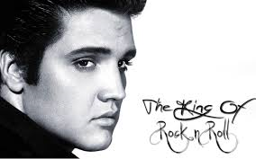
In Jan. 2010, On what would have been Elvis’ 75th Birthday, Priscilla Presley shared with Mat Lauer:
“I think Elvis would always be a part of music, no matter what, It was in his blood.
I don’t know if he’d be doing rock ’n’ roll right now;
I think that maybe he’d be going into gospel.
Maybe even preaching a little bit.
He loved to teach
and loved the Bible.”

Slide 30
Elvis was raised in an Assembly of God church. At the height of his career he told his Pastor:
“Pastor, I’m the most miserable young man ….
I’ve got all the money I’ll ever need to spend.
I’ve got millions of fans. I’ve got friends.
But I’m doing what you taught me not to do,
and I’m not doing things you taught me to do.”
http://hollowverse.com/elvis-presley/

Slide 31
Do you think Elvis (who claimed to be born again)
Was a Faithful Steward of his Treasures, Time, Talents, and Testimony?
Are You?
After his death, Pricilla and Lisa Marie Presley
joined the Church of Scientology. https://www.nickiswift.com/930214/inside-priscilla-presleys-history-with-scientology/

Slide 32
The 3 Grammy awards Elvis won were all for Gospel Music.
In 1972 he won one for the album “He touched Me”.
One of the songs: “He is my Everything” says:
“I remember my days of darkness
Without sunshine or sight to lead the way
But a whisper of His voice softly calling
To the arms of my Maker to stay
He is my reason for living,
Oh He is the king of all kings
I long to be His possession,
Oh, He is my everything”

Slide 33
“After the lighting and thunder,
After the last bell has rung
I want to bow down before Him,
And hear Him say well done.”
He is my reason for living,
Oh He is the king of all kings
I long to be His possession,
Oh, He is my everything”
This is a reference to the final Judgment where God will reward the faithful stewards,
and punish the unfaithful. Mt. 25:14-30

Slide 34
In Mt. 25:26-30 Jesus revealed that unfaithful stewards will hear:
“Thou wicked and slothful servant…
Take …the talent from him,
and give it unto him which hath ten talents.
And cast ye the unprofitable servant into outer darkness: (skotos: obscurity)
there shall be weeping and gnashing of teeth.”
(disappointment, frustration, regret.)
1 Cor. 3:15 “He shall suffer loss…”

Slide 35
Luke 16:1,2
“a certain rich man had a steward…
and the same was accused that
he had wasted his goods”
He called him, and said unto him,
give an account of thy stewardship”
Someday we’ll all here this!
Are you Ready?
2 Cor 5:10 “We must all appear before the judgment seat of Christ.”

Slide 36
Government
Gold
Pr. 3:5-6,9 “Trust in the LORD with all thine heart;
and lean not unto thine own understanding.
6 In all thy ways acknowledge him,
and he shall direct thy paths...
9 Honor the LORD with thy substance,
and with the first fruits of all thine increase:”

Slide 37
The Faith Promise ministry is a practical and effective way
of investing the Treasures, Time, Talents and Testimony God’s entrusted to us to:
“Prove the sincerity of your love” 2 Cor 8:8
“lay up treasure in heaven” Mt 6:20

