Slide 1
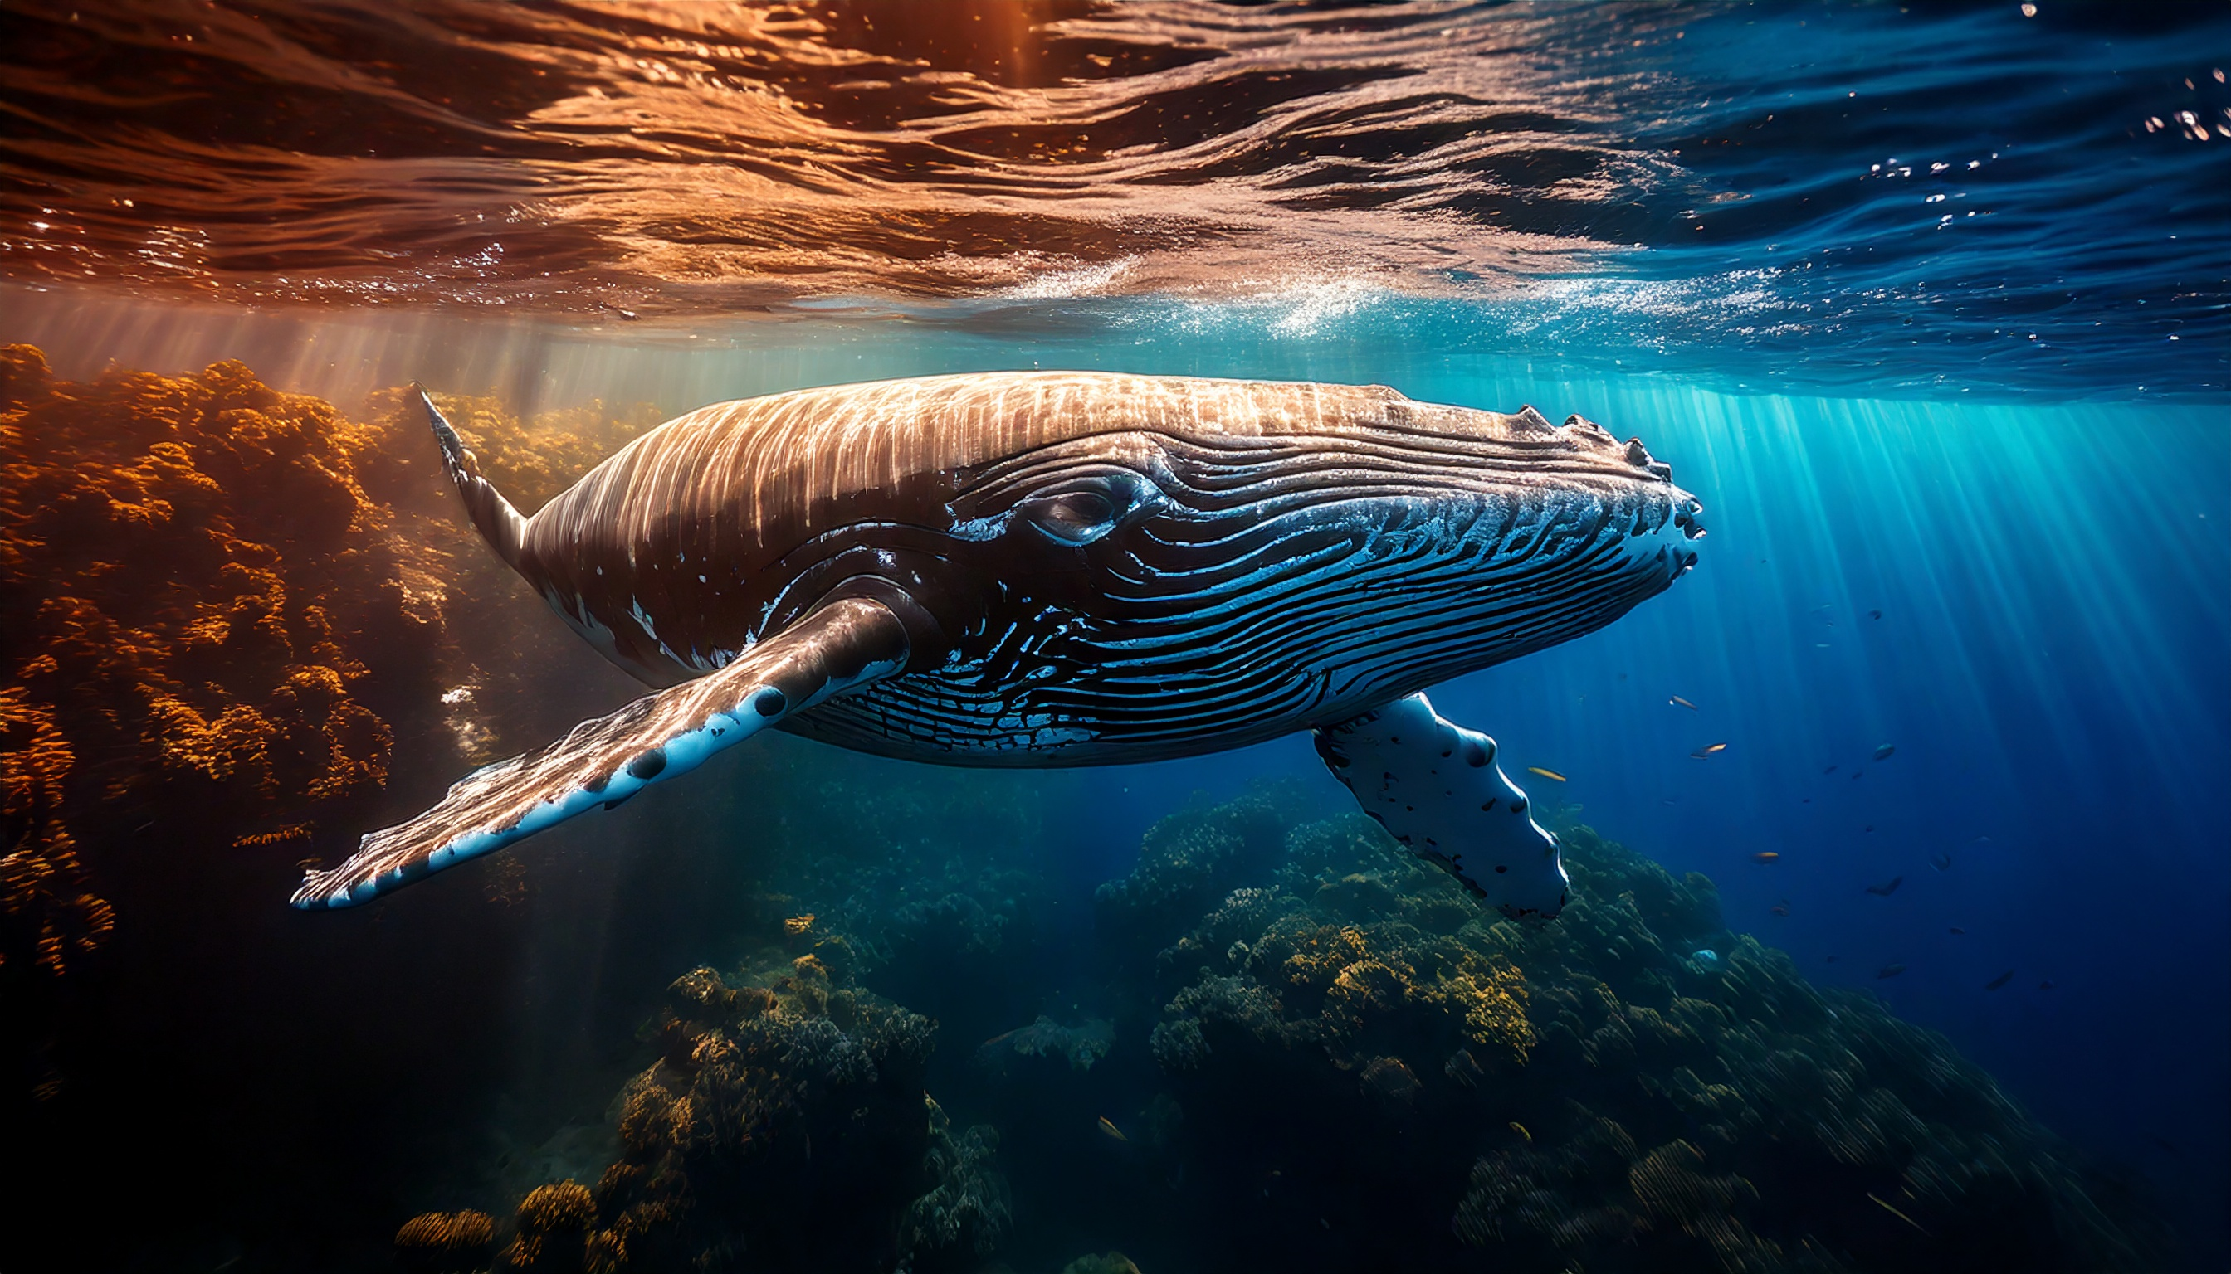

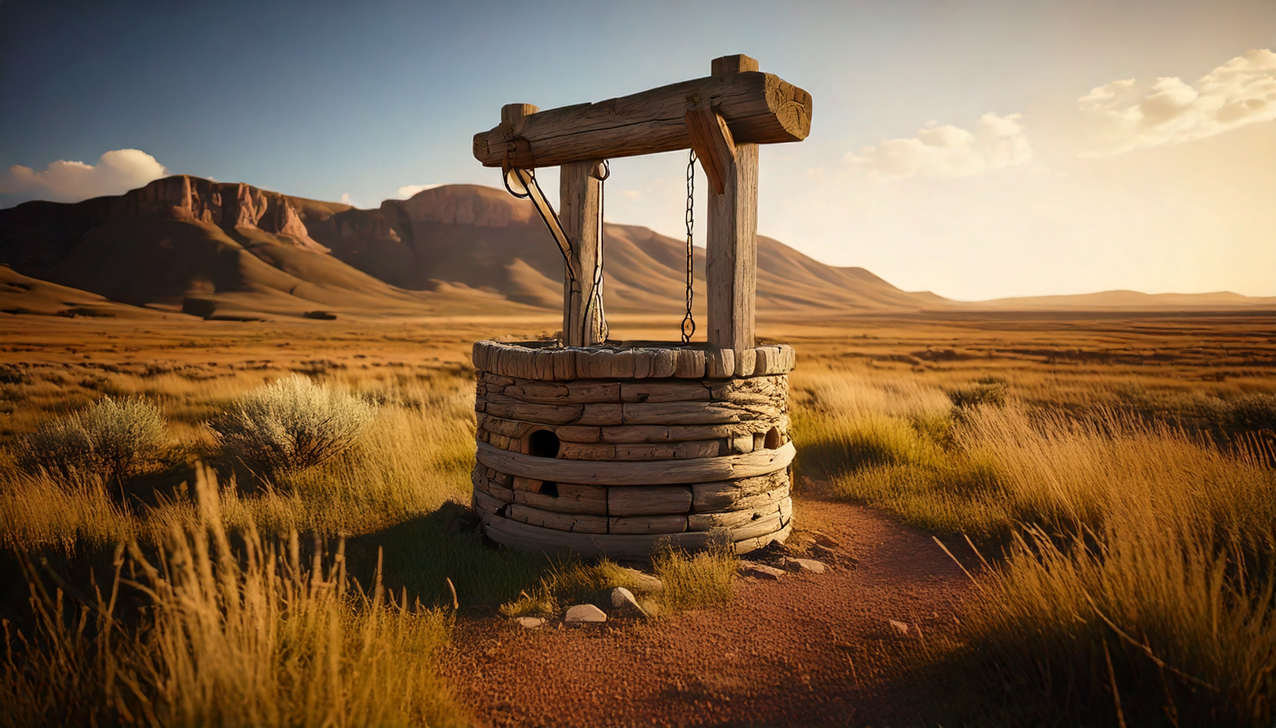
The Reluctant, the Willing, and the Pursuing
By Joseph Peters

Slide 2

Goal
Every Christian should seek to pursue God’s will in Missions
Based on these three examples

Slide 3
Reasons
God Still Used a Reluctant Jonah
God Still Used a Willing Daniel
God Still Used a Pursuing Jesus

Slide 4
God Still Used a Reluctant Jonah

Slide 5
A Reluctant Missionary to a City
But Jonah rose up to flee unto Tarshish from the presence of the LORD, and went down to Joppa; and he found a ship going to Tarshish: so he paid the fare thereof, and went down into it, to go with them unto Tarshish from the presence of the LORD…
And the word of the LORD came unto Jonah the second time, saying, Arise, go unto Nineveh, that great city, and preach unto it the preaching that I bid thee. So Jonah arose, and went unto Nineveh, according to the word of the LORD. Now Nineveh was an exceeding great city of three days’ journey (Jonah 1:3; 3:1–3).

Slide 6
God Still Used a Willing Daniel

Slide 7
A Captive Missionary to an Empire
IN the third year of the reign of Jehoiakim king of Judah came Nebuchadnezzar king of Babylon unto Jerusalem, and besieged it… And the king spake unto Ashpenaz the master of his eunuchs, that he should bring certain of the children of Israel, and of the king’s seed, and of the princes… Now among these were of the children of Judah, Daniel, Hananiah, Mishael, and Azariah (Dan 1:1, 3, 6).
Then king Darius wrote unto all people, nations, and languages, that dwell in all the earth; Peace be multiplied unto you. I make a decree, That in every dominion of my kingdom men tremble and fear before the God of Daniel: for he is the living God, and stedfast for ever, and his kingdom that which shall not be destroyed, and his dominion shall be even unto the end (Dan 6:25–26).

Slide 8
God Still Used a Pursuing Jesus

Slide 9
An Active Missionary to the World
Jesus answered and said unto her, Whosoever drinketh of this water shall thirst again: But whosoever drinketh of the water that I shall give him shall never thirst; but the water that I shall give him shall be in him a well of water springing up into everlasting life… And upon this came his disciples, and marvelled that he talked with the woman: yet no man said, What seekest thou? or, Why talkest thou with her…? In the mean while his disciples prayed him, saying, Master, eat. But he said unto them, I have meat to eat that ye know not of. Therefore said the disciples one to another, Hath any man brought him ought to eat? Jesus saith unto them, My meat is to do the will of him that sent me, and to finish his work (John 4:13–15, 27, 31–34).

Slide 10
Better To Follow Than To Resist
For this is thankworthy, if a man for conscience toward God endure grief, suffering wrongfully. For what glory is it, if, when ye be buffeted for your faults, ye shall take it patiently? but if, when ye do well, and suffer for it, ye take it patiently, this is acceptable with God. For even hereunto were ye called: because Christ also suffered for us, leaving us an example, that ye should follow his steps: Who did no sin, neither was guile found in his mouth…
For it is better, if the will of God be so, that ye suffer for well doing, than for evil doing. For Christ also hath once suffered for sins, the just for the unjust, that he might bring us to God, being put to death in the flesh, but quickened by the Spirit: (1 Pet 2:19-20; 3:17–18).

Slide 11
Conclusion
Every Christian should seek to pursue God’s will in Missions
Based on these three examples

Slide 12
Reasons
God Still Used a Reluctant Jonah
God Still Used a Willing Daniel
God Still Used a Pursuing Jesus

