Slide 1
Pictures of the People of God
Seeing ourselves through God’s Eyes.

Slide 2
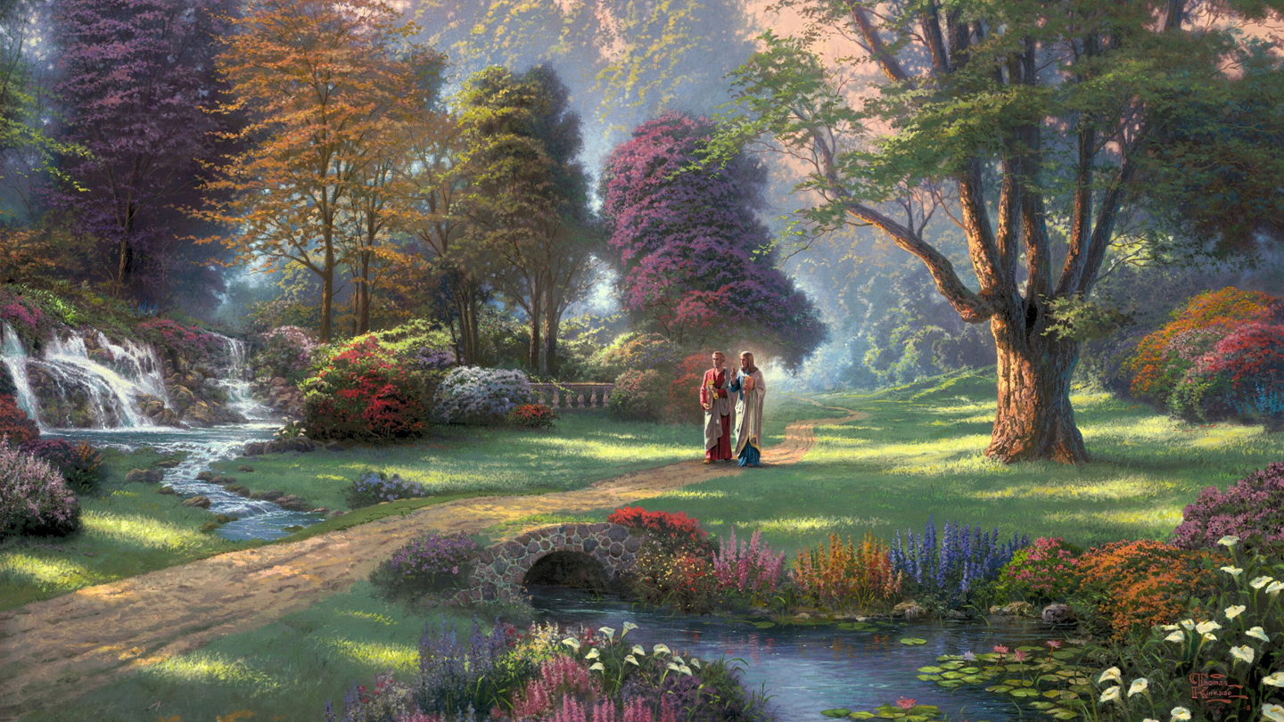
Of the many parables Jesus used,
that of a Vineyard or Farm seemed to be among His favorites.
1 Cor. 3:9 “We are laborers together with God,
“We are His Husbandry”

Slide 3
God loves Gardens!
The Human Story begins (Gen. 2,3) and consummates in a Garden.(Rev. 22)
Our Divine “Love Story” is played out in a Garden. (Song of Solomon)
S of Songs 4:12 “A garden enclosed is my sister, my spouse”

Slide 4
Last week I asked you to consider your life and key relationships in the context of a garden in your back yard.
If you knew that your daily diet would depend on your backyard garden:
What would you plant and what steps would you take to ensure a good harvest?

Slide 5
Jesus told us that we’re chosen
“To bring forth fruit” (Jn 15:16)
Principles for a Growing “Garden”
Aka: A Fruitful Life

Slide 6
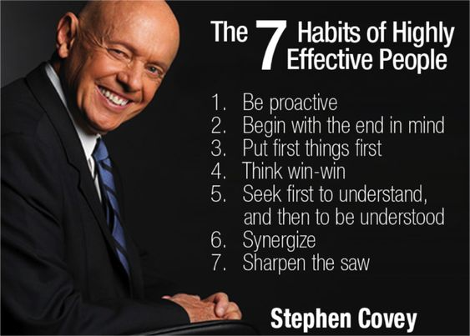
Principles for a Productive Life. Jn 10:10
The Principle of Planning!
Each of these “Habits” involve intentional Planning!

Slide 7
The Principle of Planning!
“Make time for Planning:
Wars are won in the General’s tents!”
“The key is not to prioritize your schedule,
But to schedule your priorities!”
Stephen Covey
Pr. 29:18 “Where there is no vision,
The people perish!”

Slide 8
The Principle of Planning!
Pr 15:22 “Without counsel (sôd: deliberation)
purposes are disappointed:
but in the multitude of counsellors
they are established.” (qûm: confirmed)
Successful projects are built
at least twice!

Slide 9
The Principle of Planning!
1. God has plans for you! Jer. 29:11
“I know the thoughts (maḥashābâ’: purpose/plan)
that I think (ḥāshab: to weave together)
toward you, saith the LORD,
thoughts of peace, and not of evil,
to give you an expected end.” (tiqwa: hope)
Romans 8:28,29

Slide 10
1. God has plans for you! Jer 29:11
A. He uses Growing things to illustrate.
Is 61:1-3 “the LORD hath anointed me
1) Notice How He finds us: (Luke 4:18)
“to bind up the brokenhearted,
to proclaim liberty to the captives,
and the opening of the prison
to them that are bound;

Slide 11
1. God has plans for you!
A. He uses Growing things to illustrate.
Is 61:1-3 “the LORD hath anointed me to:
2) What He does for us: vs 3
“To appoint unto them that mourn in Zion,
to give unto them beauty for ashes,
the oil of joy for mourning,
the garment of praise
for the spirit of heaviness;”

Slide 12
1. God has plans for you!
A. He uses Growing things to illustrate them.
Is 61:1-3 “the LORD hath anointed me to:
3) Why He does this for us: 3
“that they might be called
trees of righteousness,
the planting of the LORD,
that he might be glorified.”

Slide 13
1. God has plans for you!
B. Notice God’s Plans for his vineyard.
Is 5:1-4 “My wellbeloved hath a vineyard
in a very fruitful hill:
he fenced it, and gathered out the stones
and planted it with the choicest vine,
and built a tower in the midst of it,
and also made a winepress therein...”

Slide 14
The Principle of Planning!
Since “We’re laborers together with God…”
2. How Much Of Your “Yard” (life)
Will You Dedicate To God’s Garden?
A. Most recognize the value of prioritizing
key relationships in our lives,
but Few make enough room
for them to grow healthy.

Slide 15
Eph. 5:15-17 “see then that ye walk circumspectly,
not as fools, but as wise,
Redeeming the time,
because the days are evil. (poneros 1Jn 5:19)
Wherefore be not unwise, But understanding what the will of the Lord is.
(thel’ema: desire, purpose)

Slide 16
B. Most Prioritize (make too much room for)
the wrong things!
We get caught in the thick of “thin things”.
The “wood, hay, stubble” of 1 Cor 3:10-15
Ph 3:18,19 “many walk…Whose end is destruction, (apolio: ruin, waste)
whose God is their belly…glory is their shame,
who mind (froneo: regard) earthly things.”
Epi’geios: superimposed soil!

Slide 17
B. Most Prioritize the wrong things!
We get caught in the thick of “thin things”.
2) Worldly weeds choke out eternal fruit.
These are the “weights” of Heb. 12:1
It’s OK to have flowers or “toys” in your yard,
but if your life depended on your garden,
then it should take priority in size and location over all of the other “things”
that tend to take up space. (Mk 4:19)

Slide 18
C. God considers dedicating our lives to Him
Our “Reasonable (logikos) service” Ro. 12:1
Doing so enables us to:
1) Recognize and Resist the world’s
Diseased value system. 1 Jn 2:16; 5:19
“the whole world lies in wickedness”
v 2 “Be not conformed to this world”
syschēmatiz’ō: fashioned, conditioned like

Slide 19
2) Renovate (weeding/reseeding) our soul
with Divine Truth. (Jn 8:32) Ro. 12:2
“but be ye transformed (metamorphoo)
meta (with) morphoō: (fashioned, transformed)
(1 Cor 3:9 “we’re Laborers together with God!)
by the renewing (anakai’nōsis: renovating)
(remove weeds/lies, replanting with truth)
of your mind” (nous: thought, feeling, will)

Slide 20
C. Dedicating our lives to God is reasonable.
Doing so enables us to:
3) Recognize the Desirable value of eternity.
“that ye may prove (dokimazo: discern, approve)
what is that good, (agathos: beneficial)
And acceptable (euar’estos: fully agreeable)
And perfect (telios: complete, mature)
will of God” (thelema: purpose, plan)
Rev 4:11

Slide 21
Conclusion: Another word for “Planning” is to “Consider”.
Ps 64:9 “declare the work of God;
…wisely consider of his doing”
Isaiah 1:3 “The ox knoweth his owner, and the ass his master's crib:
but …my people doth not consider.”
Bîn: distinguish, understand

Slide 22
Since we’re “Laborers together with God”
Take some time to consider:
1. God’s Plans for You! (Jer. 29:11; Ro. 8:28,29)
2. Your Plans for God!
How Much Of Your “Yard” (life)
Will You Dedicate To God’s Garden?

Slide 23
Since we’ll “reap what we sow” Gal. 6:7
What are you “planning to plant”
(In the hope of a healthy, lasting legacy)?
A. Spiritually? (God, eternity)
B. Physically? (Physical/Mental Health)
C. Relationally? (Family, Friends)
D. Emotionally? (Where’s your heart?)
E. Practically: (Work, Retirement)

Slide 24
2) How much “room” will you dedicate to each of these priorities? Mt 6:33
“Seek ye first the Kingdom of God
(proton: 1st in order, time, importance)
and His righteousness;
And all these things
shall be added unto you”

Slide 25
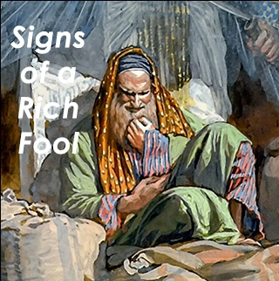
Failing to Plan for the inevitable/critical
Is essentially Planning to Fail!
Remember the Rich Farmer in Luke 12:16-21?
Vs 20 “But God said unto him, Thou fool, this night thy soul shall be required of thee:
then whose shall those things be, which thou hast provided?”

Slide 26
Vs 21 “So is he that layeth up treasure for himself,
and is not rich toward God!”
Mt. 6:21 “for where your treasure is,
there shall thy heart be also.”

