Slide 1
Pictures of the People of God
Seeing ourselves through God’s Eyes.

Slide 2
1 Cor 3:9 “we’re laborers together with God.
We are God’s husbandry”
Jn 15:16 “I have chosen you
… To bring forth fruit”
Principles for a Productive life
John 10:10

Slide 3
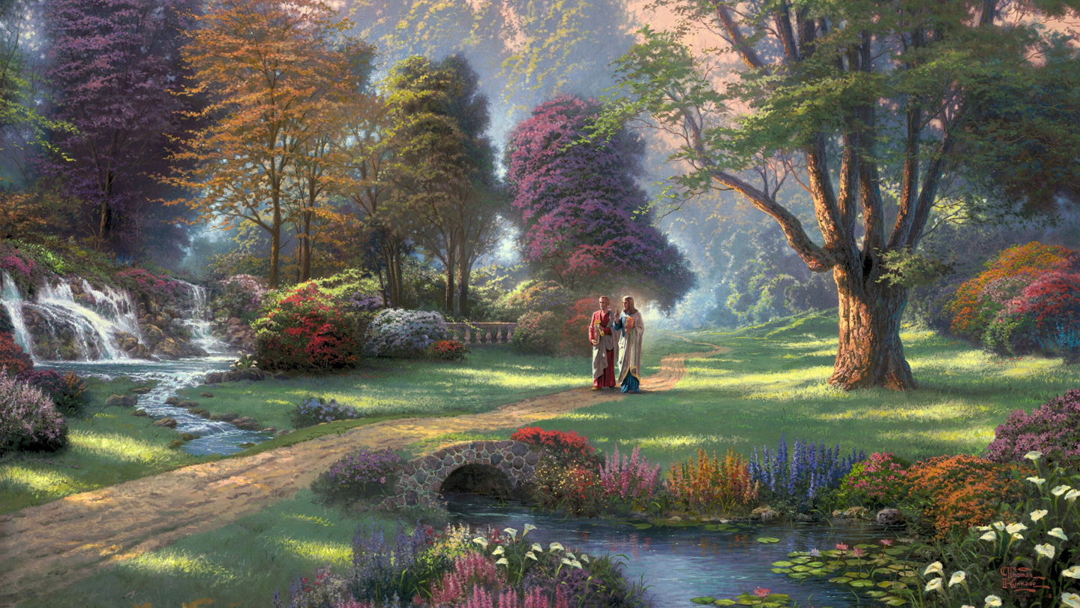
Productive lives Require: Proactive Planning. Pr. 29:18
(based on Priority!)
What (relationships) will I cultivate?
How much room/effort will I give to each?
Mt 6:19-33

Slide 4
Practical Preparation.
Hosea 10:12 “Break up your fallow ground, for it is time to seek the Lord…”
Identification/ Decision phase. Lk 14:33
Investigation/ Conviction phase. Ps. 139:23,24
Application/Expulsion phase. 2 Cor. 10:3-6
Fertilization/Neutralization stage.
(1 Cor. 11:28; 2 Cor 13:5; Heb. 12:15)

Slide 5
Purposeful Planting. Gal. 6:7-8
“for whatsoever a man sows,
that shall he also reap.”
Be intentional, informed, and aware that
what gets planted in the soil of our souls:
➔Will Grow
➔Will Bear Fruit
➔Will Spread
➔ Will Reproduce

Slide 6
The Principle of Protection.
How do you protect a garden?
Is 5:1,2 “My wellbeloved hath a vineyard in a
very fruitful hill:
Job 1:10 “Hast not thou made
an hedge about him?”
Ps. 80:12 “…broken down her hedges, so that all they which pass by the way do pluck her?”
And he fenced it”

Slide 7
Pr 24:30-32 “I went by the field of the slothful, and by the vineyard of the man void of understanding; …it was all grown over with thorns, and nettles covered it…,
and the stone wall was broken down.
Then I saw, and considered it well:
I looked upon it,
And received instruction.”

Slide 8
The Principle of Protection Pt 1.
Hedges (fences) are important because:
They Identify Boundaries
(Territory and Responsibilities)
Healthy Relationships Have
clear Boundaries.
“Fences make good neighbors!”

Slide 9
Boundaries Mark Territory lines.
1) Identify ownership/responsibility.
Satan was referring to this in Job 1:10
“Hast not thou made an hedge about him, and about his house, and about all that he hath…”
Ps 34:7 “The angel of the LORD encampeth round about them that fear him,
and delivereth them.”

Slide 10
Boundaries Mark Territory lines
2) Clearly marked boundaries help
eliminate border disputes.
Who’s responsible for what happens on your side of the “fence”?
Pr 22:9 “Remove not the ancient landmark
which thy fathers have set”

Slide 11
Hedges (fences) are important because:
They Keep The “Crops” From
Becoming cross-contaminated.
A. Some Crops (relationships) Tend To
Spread If Not Contained.
1) Grape vines can spread great
distances if not “tied off”.

Slide 12
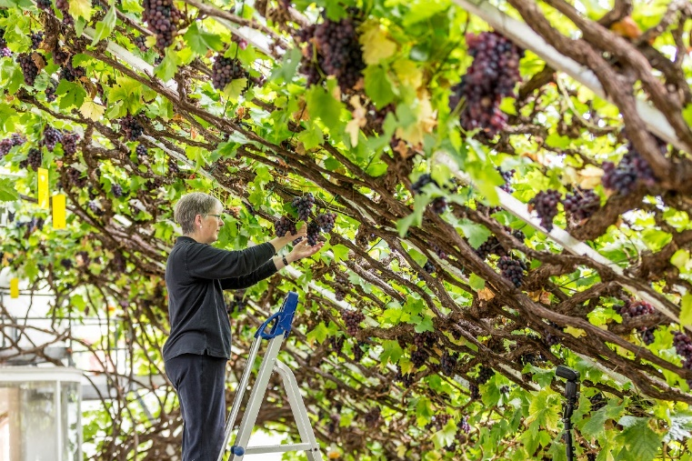
1) Grape vines can spread great
distances if not “tied off”.
In 1768, a cutting arrived at Hampton Court Palace, from vine at Valentine's Mansion in Ilford, Essex.
It's now 13 ft, thick with spurs measuring over 118 ft.

Slide 13
2) Grape vines must be “directed”
(tied off) in order to be Protected
and Productive!
Pr. 22:6 “Train up a child (ḥānak: to narrow
{dedicate}) in the way he should go: …”
Pr 29:15 “The rod and reproof give wisdom:
but a child left to himself
brings his mother to shame.”

Slide 14
B. Some “crops” (relationships) need to be
“exclusive” in order to be effective.
1) Spouses (SS 2:16; Jms 4:4; 1Jn 2:15)
2) Parents (Mt 23:9,10; Eph. 4:6)
3) Even some types/levels of friendships.
This is the principle behind 2 Cor 6:14-18!
“come out from among them and be separate
…and I will be a Father unto you…”

Slide 15
They Protect The Crops.
A. Fences provide a “safe place” to grow and develop. Eph 5:28-29
“…He that loveth his wife loveth himself.
For no man ever yet hated his own flesh; but nourisheth and cherisheth it,
(to brood, foster growth)
even as the Lord the church:”

Slide 16
They Protect The Crops.
B. If the fences are damaged or removed,
it leaves the plants/fruit vulnerable.
Is. 5:3 “I will take away the hedge thereof, and it shall be eaten up;
and break down the wall thereof,
and it shall be trodden down:”

Slide 17
They Protect The Crops.
C. This protection is Critical during
specific seasons of development.
Song of Sol. 2:15,16 “take us the little foxes, that spoil (ḥābal: destroy) the vines:
for our vines have tender grapes.
My beloved is mine and I am His!”

Slide 18
C. This protection is Critical during
specific seasons of development.
1) One of Satan’s most effective
temptations is to “eat the fruit” of
relationships before they mature.
Premarital intimacy is the equivalent of picking blossoms before they develop into satisfying fruit! (1 Cor. 7:1,2)

Slide 19
Song of Sol. 2:15,16 “take us the little foxes, that spoil (ḥābal: destroy) the vines:”
2) Not all “enemies” are enemies:
a) Children, pets, etc. can still reek
havoc in a garden.
b) Well meaning family / friends can crowd out or hinder other relationships.

Slide 20
Song of Sol. 2:15,16 “take us the little foxes, that spoil (ḥābal: destroy) the vines:”
3) Not all “enemies” look like enemies:
(Wolves in sheep clothing Mt 7:15)
1) Most of us enjoy seeing a fox, deer,
or raccoon,
2 Cor. 11:14 “Satan himself is transformed into an angel of light…”
but not in our gardens!

Slide 21
D. Some “little foxes” to guard against.
1) Over commitment. (Busy-ness)
“Redeeming the time…” Eph. 5:16
a) To Redeem implies to pay a price or
exchange for something more valuable.
b) This is the whole premise of this series.
We must “Redeem” time / energy in order to cultivate the “crops” that are truly valuable.

Slide 22
D. Some “little foxes” to guard against.
2) Stress/worry.
Mt. 6:28 “why take ye thought…”
Phil 4:6 “Be careful for nothing; …
miramnao: anxious {From merimna: distracted}
Stress/worry distracts us
from what’s truly important!
(Fruitful/Productive)

Slide 23
F. Some “little foxes” to guard against.
3) Fantasy: (Material, Romantic, Sexual)
This can lead to dissatisfaction
and triangulation.
(allowing a third party {real or not} into your “garden of Eden”.)

Slide 24
“Fences” are important because they:
Identify Boundaries (responsibilities)
2) Keep “crops” from becoming cross
contaminated. (infected)
3) Protect the crops (relationships)

Slide 25
What’s true of physical Boundaries
is also true of emotional and relational
“boundaries.”
https://www.boundaries.me/

Slide 26
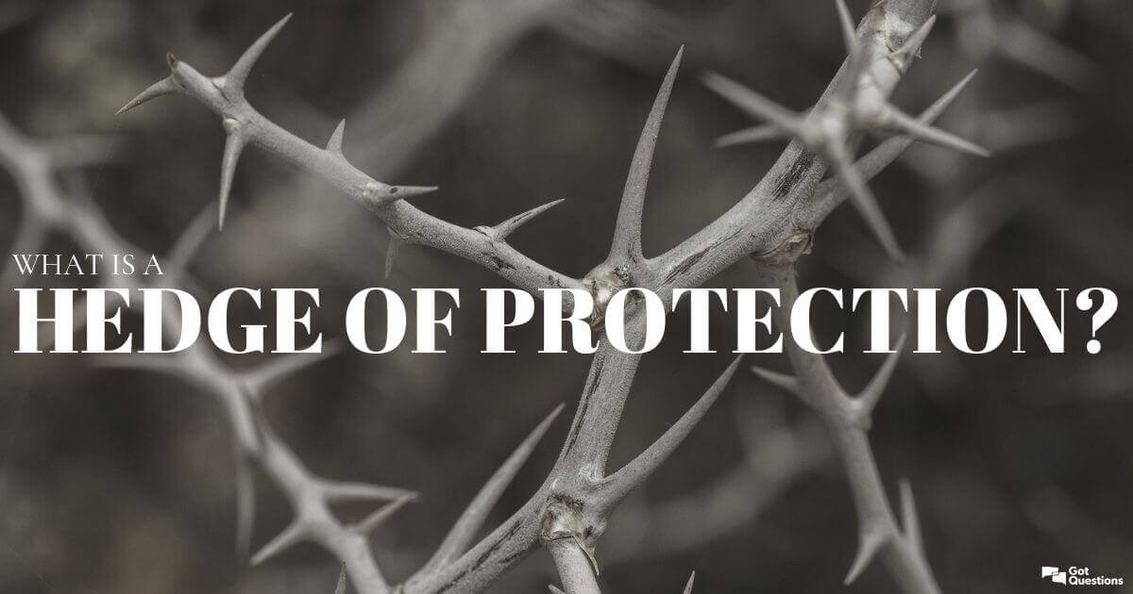
The Hebrew word for “hedge” is śûk;
Which literally means “to entwine”.
They were often made of sections of vines and briars woven together
to form a “wall”
or fence.

Slide 27
Relational “Fences” are made up of commitments and experiences that are woven together to form a shared “barrier.”
This is true of our human relationships:
Malachi 2:14 “the LORD hath been witness between thee and the wife of thy youth,
against whom thou hast dealt treacherously:
yet is she thy companion, (from ḥābēr: knit together)
and the wife of thy covenant.”

Slide 28
This is also true of our relationship with God.
Our shared commitments and experiences work together to form a
“hedge of protection”.
This is at the heart of the word “Fellowship”:
Koinonia: partnership, fellowship, communion.
Mt. 11:29 “Take my yoke upon you
and learn of me…”
(Jn 14:16; 1 Jn 1:5-10)

Slide 29
Many ignore or minimize this protection phase in their lives/relationships.
Those that do so invite both foxes
(and foes) into their gardens.
It takes time & effort to build fences,
but they ultimately pay for themselves.
No fence is impregnable,
So wise “gardeners” keep a close watch.

Slide 30
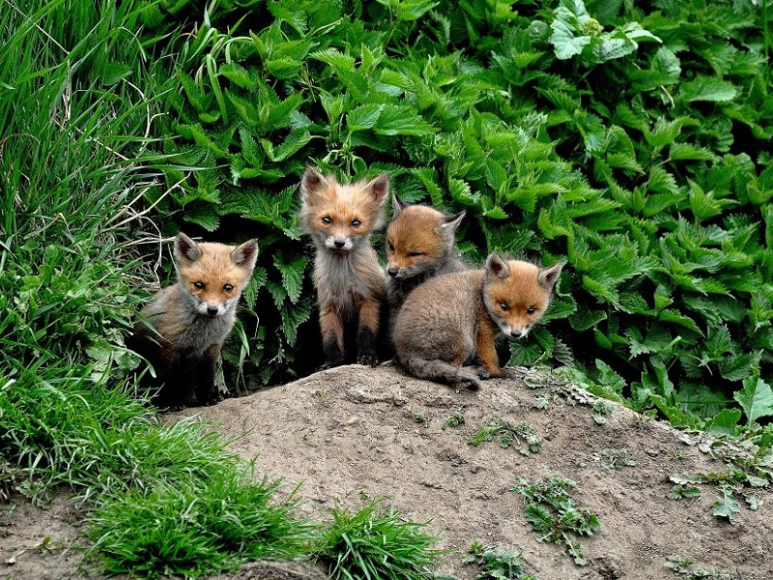
Take an honest and objective look at your relational gardens.
(with God and others)
1) Do you see evidence of some “foxes”?
Are you willing to “chase them out?”

Slide 31
Take an honest and objective look at your relational gardens.
2) Take some time this week to “walk the fences” of your critical relationships.
Are there any “holes” where some “foxes” can get in?
If so purpose to patch the wholes.

Slide 32
3) Every fence is subject to wear and
“occasional” breaks.
We must spend time “mending the fences” in our relationships with:
Honest Communication (Eph 4:15),
Humble Confession, (1 Jn 1:9)
and Sincere Forgiveness. (Eph. 4:32)

