Slide 1
Principles for Productive Living

Slide 2
The Passion (Open Heart) Principle! Col. 3:16-24 “Whatsoever ye do, do it heartily
as unto the Lord and not unto men; knowing of the Lord ye shall receive the reward…
For ye serve the Lord Christ.”
The Purpose (Open Hand) Principle.
Ex 4:2 “What’s in thine hand…”
Give it to me (See Ro. 12:1,2; Rev. 4:11)

Slide 3
The Path (Open Door) Principle
Rev. 3:7-13

Slide 4
The Path (Open Door) Principle
Rev 3:7 “to the angel of the church in Philadelphia write;
These things saith he that is holy,
he that is true,
he that hath the key of David,
he that openeth,
and no man shutteth;

Slide 5
“and shuteth
and no man openeth”

Slide 6
God’s “Open doors” involve opportunity, particularly for ministry.
1 Cor 16:9 “For a great door
and effectual is opened…
and there
are many
adversaries.”

Slide 7
Understanding the “Open Door” principle.
1. The Preamble: Vs 7 Jesus declares His:
Divinity. “He that is Holy”
(hagios: pure, sacred)
Sincerity: “He that is True” (alēthinos’: truthful)
(From alēthēs’: not concealing)
aka: Trustworthy

Slide 8
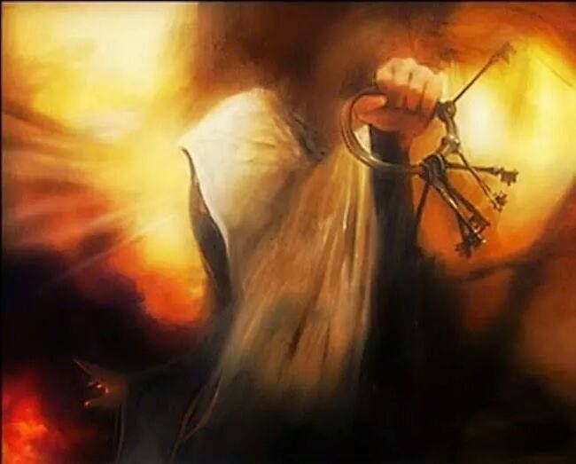
2. The Picture. Keys represent authority!
Rev 1:18 Jesus presents himself as the one who holds:
In Rev. 3:7 he presents himself as:
“He that hath the key of David”
“The keys (authority)
of hell and of death”
Authority to open and close doors to direct us toward God’s “expected end”. (Jer. 29:11)

Slide 9
The Problems (locks or barriers)
1 Cor 16:9 “For a great door and effectual is
opened unto me,
(antik’eimai: from anti: opposite or instead
and keimai: to lie outstretched {reach after}, wait
A. External “adversaries”:
1) Satan: (mentioned 938 x in 666 passages.
Greek: Σατανᾶς (Satanas’) accuser (Rev. 12:10)
and there are many adversaries.”
from Hebrew שָׂטָן‎ (śāṭān) adversary

Slide 10
The Problems (locks or barriers)
1) Satan: Satanas: accuser
a) He’s the master of deception, distraction, doubt
and despair (Jn 8:44; Jn 10:10; Eph. 2:1-3)
and adept at influencing us to second guess God
(Gen. 3:1) “Yea hath God said…?”
and ourselves!
2 Cor 11:13,14 “such are …deceitful workers…
And no marvel; for Satan himself is transformed into an angel of light.”

Slide 11
2) Society: (Eph. 6:12)
a) “The god of this world” (2 Cor 4:4) uses worldly
resources to accomplish his agenda. 1 Jn 2:15,16
(1) He used the religious leaders to oppose Jesus,
and the early church.
(2) He used the Jews in Philadelphia to oppose the
believers. Rev. 3:9 “the synagogue of Satan”
(3) Throughout history he’s used social pressure to
get us to “conform to this world” (Ro. 12:1,2)

Slide 12
2) Society: 2 Cor 2:11 “Lest Satan should get an advantage of us: for we’re not ignorant of his devices.”
(noema: perception and purpose)
b) His tools (devices) include:
(1) Infiltration. “certain crept in unaware…” Jude 3
Wheat and tares. Mt 13:24-30
Mustard Seed Mt 13:31-32;
Leaven Mt 13:33
(2) Intimidation. “The fear of man brings a snare”
Pr. 29:25 (see 1 Peter 5:8)

Slide 13
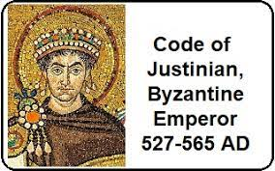
Emperor Justinian Code (529 AD) Book 1: Title VI: 1.6.2
“If any person shall be discovered to rebaptize anyone imbued with the mysteries of the Catholic faith
he, together with him who has permitted this infamous crime, provided the person persuaded to be rebaptized be of an age capable of crime-
shall be punished by death”
This policy continued for over 1000 years!

Slide 14
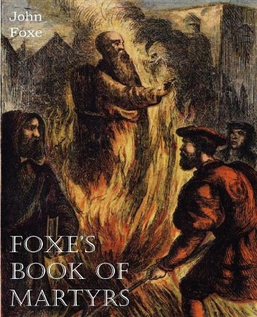
Infiltration ➔ Intimidation
“shall be punished by death”
In 1563 John Fox produced an 1800 page account of the martyrdom of tens of thousands of Christians
(at the hand of the Church!)

Slide 15
(3) Preoccupation. Mt 13:7,22 “cares of this world…
Choke the word, and he becometh unfruitful”
Phil. 3:18,19 “for many walk, of whom I have told you often, and now tell you even weeping,
that they are the enemies of the cross of Christ:
Whose end is destruction, whose God is their belly,
and whose glory is in their shame,
who mind (phroneo: focus, regard, disposed toward) earthly things.” (Epig’eios)
Epi: to superimpose and ge: soil, earth

Slide 16
The Problems (adversaries)
B. Internal Sources: Self!
Our “flesh” fights against God. Gal. 5:17
“the flesh lusteth against the Spirit, and the Spirit against the flesh: and these are contrary …”
Epithume’o: desire, covet. from epi: superimpose
& thumos: to set your heart on
Ro 7:18-19 “For I know that in me (that is, in my flesh,) dwelleth no good thing: …For the good that I would I do not: but the evil which I would not, that I do.”

Slide 17
The Problems
B. Internal Adversary: Self!
Why do we so often sabotage God’s opportunities?
1) Folly: We want to open our own doors.
(After all, we know what is best.)
a) We can’t see past the key-holes of life’s choices.
1 Cor 13:12 “we see through a glass darkly”
Jer. 17:9 “the heart is deceitful above all things…”
b) That’s why wisdom directs us to look to God.
Pr. 3:5,6; and Heb. 12:1,2

Slide 18
Why do we so often miss God’s opportunities?
1) Folly: We want to open our own doors.
2) Frustration: Open doors are often cluttered with
problems or challenges. (“strait gate” Mt. 7:13)
a) We often miss God’s open doors because of the
“obstacles”. (Kadesh Barnea Numbers 13:33)
Acts 14:22 “Confirming the souls of the disciples, and exhorting them to continue in the faith, and that we must through much tribulation (thlipsis: pressure)
enter into the kingdom of God.”

Slide 19
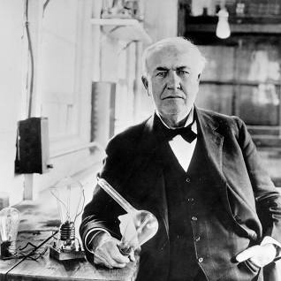
“Opportunity is missed by most people
because
it’s dressed in overalls
and looks like work!”
Thomas Edison

Slide 20
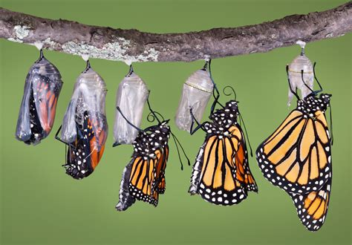
b) The caterpillar becomes a butterfly through
the process of metamorphosis
and the pressure of freeing itself from the chrysalis.
Ro 12:2 “be not conformed to this world:
but be ye transformed (metamorphoo)
by the renewing of your mind,
that ye may prove what is that good, and acceptable, and perfect, will of God.”

Slide 21
3) Finite time limits: Doors (opportunities) don’t
remain open indefinitely. (Nu 14: Rev. 3:20,21)
Gen. 6:3 “My spirit shall not always strive with man”
Heb. 3:7,15; 4:7 “To day if ye will hear his voice,
Harden not your hearts as in the provocation”
Jn 9:4 “I must work the works of him that sent me, while
it is day: the night cometh, when no man can work.”
Gal 6:10 “As we have therefore opportunity, (Kairos’: a set time or season) let us do good unto all men,
especially unto them who are of the household of faith.”

Slide 22
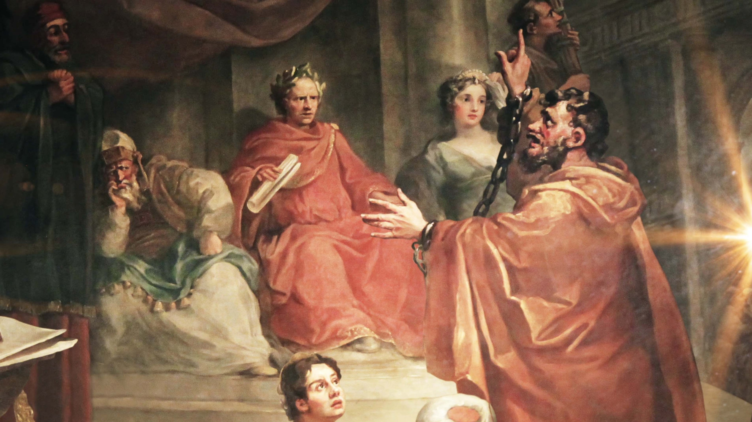
3) Finite Time Limitations
a) Hesitation often becomes procrastination
and leads to devastation. Acts 24: 25
“And as he reasoned of righteousness, temperance, and judgment to come, Felix trembled, and answered,
Go thy way for this time;
when I have a convenient season, I will call for thee.”
Acts 26:28 (Agrippa) “almost thou persuadest me to be a Christian”
Our reservations are the damnations of our dedications

Slide 23
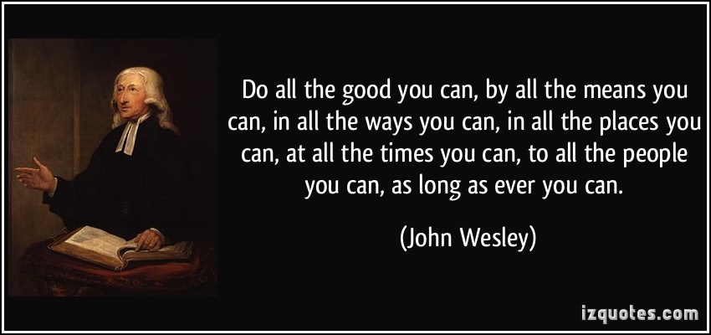
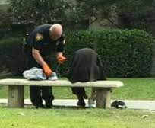
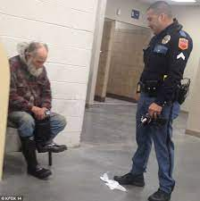
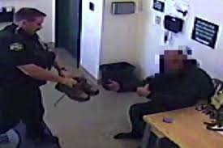

Slide 24
Why do we so often miss God’s opportunities?
1) Folly: We want to open our own doors.
2) Frustration: Doors are often cluttered with problems.
Finite time limits: We procrastinate and miss out.
Fear: We want to stay where it’s safe.
This is what Kept Israel wandering for 40 years!
(Numbers 13,14)
Song: “My house is full, but my fields are empty.”

Slide 25
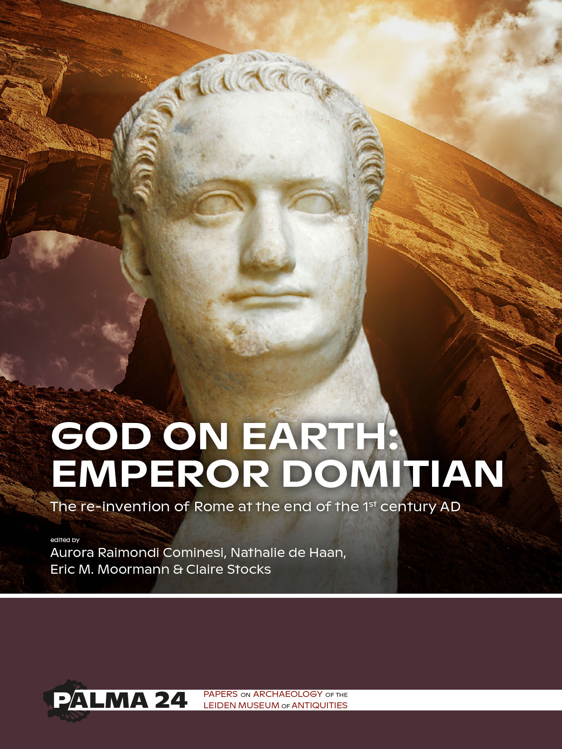
4) Fear
a) Persecution was raging when John wrote this.
The Emperor Domitian succeeded his brother Titus
(who destroyed Jerusalem)
reigned from AD 81 to 96.
He declared himself
“Lord and God”
commanding all people to publicly declare him such.

Slide 26
b) John refused and was exiled to the Island of Patmos. Rev 1:9 “I John, …your brother, and companion in tribulation, and in the kingdom and patience of Jesus, was in the isle that is called Patmos, for the word of God, and for the testimony of Jesus Christ.”
c) Every believer faced the choice of compromise
(compliance) or consequences ranging from
fines to imprisonment or even death.

Slide 27
d) The Philadelphian believers felt inadequate to
the task of representing and reflecting Jesus in
the face of such pressure.
Mt 28:18-20 “all power is given me…go ye therefore”
(1) Jesus’ letter encouraged them to stand firm.
Rev 3:8 “I know thy works: behold, I have set before thee an open door, and no man can shut it:
for thou hast a little strength, (mikros dynamis)
and hast kept my word, and hast not denied my name.”

Slide 28
(2) Their commitment would test and grow their strength and faith. 2 Cor 12: 9,10
“My grace is sufficient for thee:
for my strength is made perfect in weakness.
Most gladly therefore will I rather glory in my infirmities, that the power of Christ may rest upon me.
Therefore I take pleasure in infirmities, in reproaches,
in necessities, in persecutions, in distresses for Christ…
for when I am weak, (astheneo: feeble)
then am I strong.” (dynatos’: capable, powerful)

Slide 29
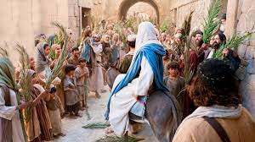
The scene on Palm Sunday is a vivid example of how effectively we can be deceived into believing that God wants exactly what we want.
Mt 21:9 “Hosanna to the son of David…”
From Yasha
{open wide, free, save us!}
and Na: Now!

Slide 30
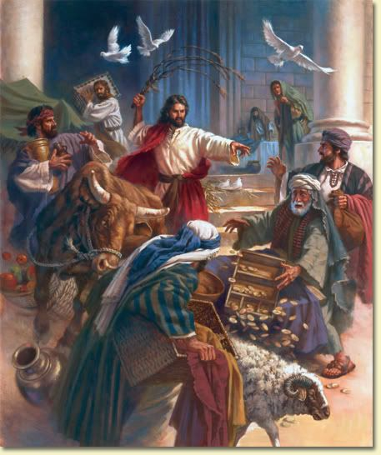
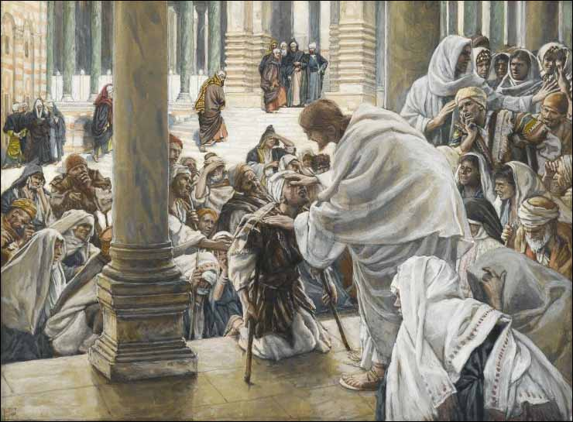
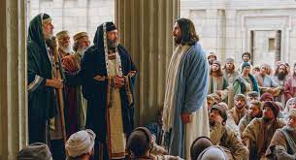
Then Jesus went to the Temple and
Cleansed it of the crooked moneychangers (Vs 12,13);
Annoyed the Priests (vs 15);

Slide 31
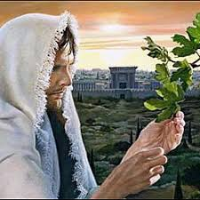
And the next day cursed the fruitless fig tree
Mt 21:19 “And when he saw a fig tree in the way, he came to it, and found nothing thereon,
but leaves only, and said
‘Let no fruit grow on thee henceforward for ever.’
And presently the fig tree withered away.”

Slide 32
and later wept over the barrenness of Jerusalem.
Mt 23:37-38 “O Jerusalem, thou that killest the prophets, and stonest them which are sent unto thee, how often would I have gathered thy children together,
even as a hen gathereth her chickens under her wings,
and ye would not!
Behold, your house is
left unto you desolate.”
I wonder if he ever weeps over our barrenness? (Jn 15:16)

Slide 33
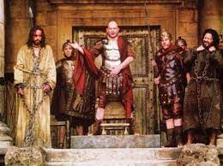
When it became clear that Jesus wasn’t going to cooperate with what they wanted,
“What will ye then that I shall do unto him
whom ye call the King of the Jews?
And they cried out again, Crucify him!
many turned on him! Mk 15:12-14
Then Pilate said, Why,
what evil hath he done?
And they cried out the
more exceedingly,
Crucify him!”

Slide 34
We, like the early believers, face both opportunities, and opposition (1 Cor 16:9)
from Satan, Society, and our own selfish flesh.
These work together to blind us to God’s open doors
(Through infiltration, intimidation, or distraction)
And bind us to our own (or ultimately Satan’s).
(through folly, frustration, finite time limits, or fear)
Satan, Society and “Self” offer us “easier paths” that will ultimately rob us of God’s Paths, power and promises. (Pr. 14:12; Jn 10:10)

Slide 35
No Wonder God’s “Path Principle” reminds us to:
“Trust in the Lord with all thine heart,
And Lean not unto thine own understanding.
In all thy ways acknowledge him,
(yada: consider, recognize and respond)
And He shall direct thy paths.” Pr 3:5,6
(Yashar: make straight, right, clear, prosper)
Heb. 12:3 “For consider him…”
(Analogiz’omai contemplate, proportion, prioritize)

Slide 36
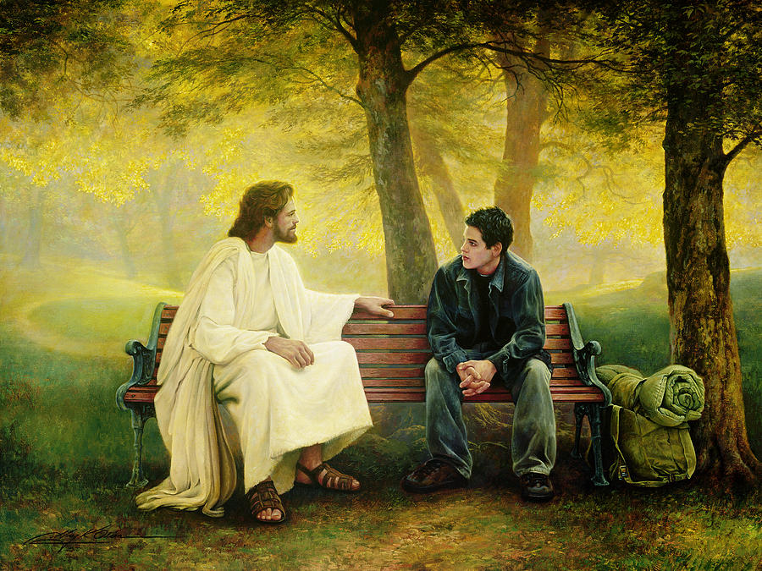
Are you willing to honestly “consider” Christ?
https://sethadamsmith.com/2015/07/29/lost-and-found/
Greg Olson

