Slide 1
Rev 3:21 “He that hath an ear, let him hear what the Spirit saith unto the churches.”
“Speak Lord, for thy servant heareth”
1 Samuel 3:10

Slide 2
On Jan 1st we contrasted two paths outlined for us in Proverbs 4:
The Path of Wisdom 4:1-13; 18-27
7 “Wisdom is the principal thing;
therefore get wisdom…
18 “the path of the just is as the shining light,
that shineth more and more unto the perfect day.”
The Path of Wickedness. 4:14-17,24
19 “The way of the wicked is as darkness:
they know not at what they stumble.”

Slide 3
Biblical Principles act as a “moral compass”
to guide us on the path of wisdom.
Ps 16:11 “Thou wilt shew me the path of life:
in thy presence is fulness (śōbaʿ: satisfaction) of joy;
at thy right hand there are pleasures forever.”
(nāʿîm {delights} nēṣ’aḥ: perpetual confidence)
From nāṣaḥ: the goal (Jer. 29:11)
“I know the thoughts (maḥashābâ’: purposes)
that I think toward …, thoughts of peace …
to give you an expected (Tiqwâ’: a cord, hope) end” (aḥarît’: future rewards)

Slide 4
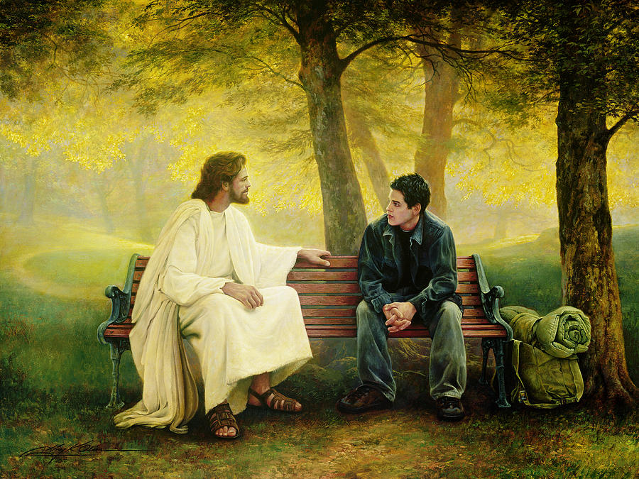
What “Principles” are you using to guide (and guard) your journey?
What “goal” are you working toward?
Greg Olson

Slide 5
Principles for Powerful Living
Principles for Powerful and Productive Living.

Slide 6
Principle 1: The Passion Principle!
Col. 3:16,17 “Let the word of Christ dwell in you richly (Plousi’ōs: copiously) in all wisdom
(Sophia: from saphes: clarity)
teaching and admonishing one another…
with Grace (charis: God’s influence) in your hearts.
17 …And whatsoever ye do in word or deed,
do all in the name of the Lord Jesus,
(On’oma: authority and character)
giving thanks to God and the Father by him”

Slide 7
Principle 1: The Passion Principle!
Col. 3:23,24 “And whatsoever ye do, do it heartily,
(ek psyche: from the soul, innermost being)
as to the Lord, (kurios: supreme authority)
and not unto men;
Knowing that of the Lord ye shall receive
the reward (Antapod’osis: requital)
of the inheritance: (klēronomi’a: patrimony)
for ye serve (douleu’ō) the Lord Christ.”

Slide 8
Spiritual Passion is difficult to maintain in a Secular (Satanic) World. (Jn 12:31; 14:30; 2 Cor 4:4)
A. Jesus acknowledged this. Lk 13:24, Mt. 7:13,14
Lk 13:24 “Strive (agoniz’omai) to enter into the strait gate”
Mt 7:13,14 “wide is the gate, and broad is the way, that leadeth to destruction, and many there be which go in thereat:
Because strait (stenos: cluttered with obstacles) is the gate,
and narrow (thlibo: troubled) is the way, which leadeth unto life,
and few there be that find it.”
(Heuris’kō: perceive and/or obtain)

Slide 9
B. History (experience) confirms this.
1) Israel passed through several deserts before arriving
in the Promised Land. (1 Cor 10:11-13)

Slide 10
2) Difficult Desert “Detours” have a way of
“cooling” our spiritual passion!
a) They test our spiritual tenacity! (commitment)
Jms 1:3 “the trying of your faith worketh patience.”
hypomonē’: cheerful endurance!
b) They tempt us to return to comfort of “Egypt”!?!
Nu. 14:3-4 “…were it not better for us to return into Egypt?
And they said one to another, Let us make a captain,
and let us return into Egypt.”
(Bondage!)

Slide 11
2. Symptoms of Spiritual Apathy
(From Luke warm Laodicea) Rev. 3:17,18
A. Self Reliance. Vs 17 “thou sayest, I am rich, and
increased with goods, and have need of nothing;”
Pr. 3:5-7 “trust in the LORD with all thine heart and lean not to thine own understanding…
Be not wise in thine own eyes, fear the Lord…”
Pr. 16:18 “Pride goeth before destruction,
and a haughty spirit, before a fall.”

Slide 12
2. Symptoms of Spiritual Apathy Rev. 3:17,18
A. Self Reliance. Proverbs 22:3-5
“A prudent man foreseeth the evil, and hideth himself:
but the simple pass on, and are punished.
By humility and the fear of the LORD are riches, and honor, and life.
Thorns and snares are in the way of the froward:
Iqqēsh’: distorted, false, deceived
he that doth keep his soul shall be far from them.“

Slide 13
2. Symptoms of Spiritual Apathy Rev. 3
B. Spiritual Blindness: 17 “and knowest not that thou art wretched, miserable, poor, blind, and naked:”
1) There is none so blind as they that will not see!
Jn 9:39-41 “For judgment I am come …, that they which see not might see; and that they which see might be made blind.
And some of the Pharisees which were with him heard these words, and said unto him, Are we blind also?
Jesus said unto them, If ye were blind, ye should have no sin: but now ye say, We see;
therefore your sin remains.”

Slide 14
Mt. 13:13-15 “I speak to them in parables: because they seeing see not; and hearing they hear not,
neither do they understand. And in them is fulfilled the prophecy of Esaias, which saith…
For this people's heart is waxed gross, and their ears are dull of hearing, and their eyes they have closed;
lest at any time they should see with their eyes,
and hear with their ears,
and should understand with their heart,
and should be converted, and I should heal them.”
From Isaiah 6:9-11 (See also 2 Cor 3:14,15)

Slide 15
2. Symptoms of Spiritual Apathy
C. Disregard of Godly Counsel. Rev. 3:18
“I counsel thee to buy of me gold tried in the fire,
that thou mayest be rich; and white raiment,
that thou mayest be clothed,
and that the shame of thy nakedness do not appear;
and anoint thine eyes with eye-salve,
that thou mayest see.”
Ble’pō: be aware, beware, take heed

Slide 16
2. Symptoms of Spiritual Apathy
C. Disregard of Godly Counsel. Pr 1:23-25
“Turn you at my reproof: behold, I will pour out my spirit unto you, I will make known my words unto you.
Because I have called, and ye refused;
I have stretched out my hand, and no man regarded;
But ye have set at nought all my counsel,
(ʿēṣâ’: my purpose, plan, prudence)
And would none of my reproof:
(Tôwkêchâh’: correction)

Slide 17
C. Disregard of Godly Counsel. Pr 1:29-32
“For that they hated knowledge,
and did not choose the fear of the LORD:
They would none of my counsel:
they despised all my reproof.
Therefore shall they eat of the fruit of their own way, and be filled with their own devices.
For the turning away of the simple shall slay them,
and the prosperity of fools shall destroy them.”

Slide 18
Notice the Bible “But” in Pr. 1:33
“But: whoso hearkeneth unto me
(shāmaʿ: to hear intelligently and obediently)
shall dwell safely, (beṭah’:̣ securely)
and shall be quiet (shāʾan’: peaceful)
from fear of evil.”

Slide 19
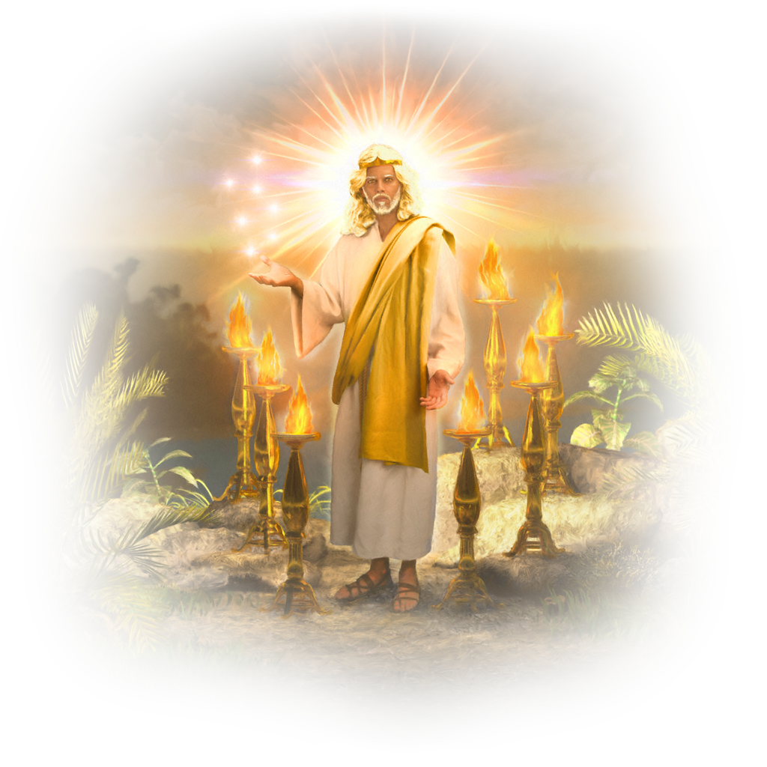
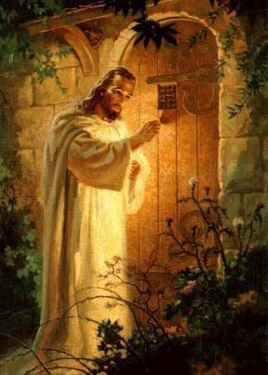
3. Causes of Spiritual Apathy.
(Diminished spiritual appetites & interests.
A. The Principle of Entropy
(Entropy causes Apathy!)
1) In Rev. 1:12,13 Jesus is in the
“midst of the candlesticks”
2) In Rev. 2:4 “you’ve left your first love…”
(aphi’ēmi: to neglect, lay aside, or Forsake)
3) By Rev. 3:20 Jesus is outside the church
of Laodicea, seeking entrance!

Slide 20
3. What causes our spiritual appetites/interests
to diminish.
B. The Principle of Gravity
1) The larger the object (accumulated Mass)
the stronger the attraction or pull. Ps 34:33
“magnify the LORD with me, and let us exalt his name”
2) The closer you are to an object,
the stronger the attraction or pull.
Mt 6:21 “For where your treasure is,
there will your heart be also.”

Slide 21
C. The Principle of Appetite / Nutrition
1) Feeding on the junk food of worldly wisdom
diminishes our spiritual appetite & energy.
Col 2:8-10 “ Beware lest any man spoil you through philosophy and vain deceit, after the tradition of men,
after the rudiments of the world, and not after Christ.
For in him dwelleth all the fulness of the Godhead bodily.
And ye are complete in Him…”
(Plēroō: replete, filled, satisfied!)

Slide 22
1. What causes Spiritual Apathy?
D. The Principle of Poison. Sin in our lives
weakens our spiritual appetite/energy. 1 Cor 11:30-31
“For this cause many are weak and sickly among you
(asthenēs: without strength or appetite)
and many sleep.
For if we would judge ourselves,
(Diakrinō: separate thoroughly, withdraw from.)
we should not be judged.” (krino: sentenced)

Slide 23
All of these (Entropy, Gravity, Appetite, Poison) were at work: In ancient Israel.
Num. 11:5 “we remember…what we did eat in Egypt…
But now our soul is dried away: there is nothing at all except this manna before our eyes.”
Numbers 21:5 “And the people spake against God, and against Moses, Wherefore have ye brought us up out of Egypt to die in the wilderness? for there is no bread, neither is there any water;
and our soul loatheth this light bread.”
Nu. 14:3 “…were it not better for us to return into Egypt?”

Slide 24
All of these were at work in Laodicea!
Entropy: Rev. 3:15-16
”I know thy works, that thou art neither cold nor hot:
I would thou wert cold or hot.
¹⁶ So then because thou art lukewarm…
(apathetic)
I will spue thee out
of my mouth.”

Slide 25
All of these were at work in Laodicea!
Rev. 3:17,18
“Because thou sayest, I am rich, and increased with (worldy) goods, and have need of nothing;
and knowest not that thou art wretched, and miserable, and poor, and blind, and naked:
I counsel thee to buy of me gold tried in the fire, that thou mayest be rich; and white raiment, that thou mayest be clothed, and that the shame of thy nakedness do not appear;
and anoint thine eyes with eyesalve,
that thou mayest see.”

Slide 26
All of these are at work in our lives!
1 John 2:15-17 “Love not the world, neither the things that are in the world.
If any man love the world,
the love of the Father is not in him.
For all that is in the world, the lust of the flesh,
and the lust of the eyes, and the pride of life,
is not of the Father, but is of the world.
And the world passeth away, and the lust thereof:
but he that doeth the will of God abideth for ever.”

Slide 27
All of these are at work in our lives!
Phil 3:17-19 “Brethren, be followers …of me, and mark them that walk so as you have us for an example.
(For many walk, of whom I have told you often, and now tell you even weeping,
that they are the enemies of the cross of Christ:
Whose end is destruction, whose God is their belly, and whose glory is in their shame,
who mind (phroneo: value, regard) earthly things.)

Slide 28
A worldly appetite spoils spiritual discernment!

Slide 29
Titus 1:15-16 “unto them that are defiled and unbelieving is nothing pure; but even their mind and conscience
(synei’dēsis: co-perception) is defiled. (miai’no)
They profess that they know God; but in works they deny him, being abominable, (bdelyk’tos: idolatrous) and disobedient,
and unto every good work reprobate.” (adokimos: worthless)

Slide 30
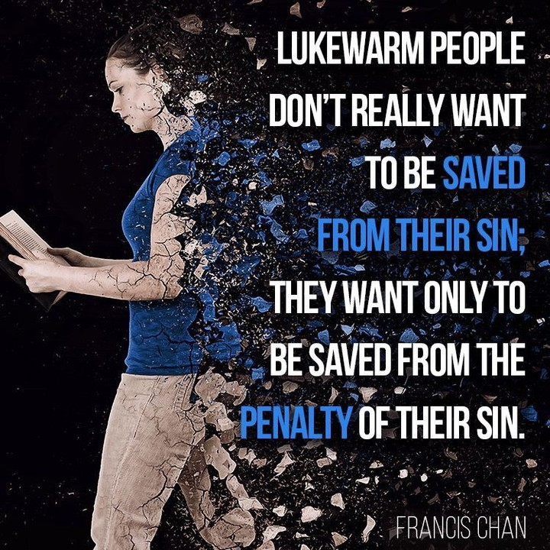
Luke warm people don’t want to be saved from the Power of their Sin;
They only want to be saved from the Penalty (consequences) of their sin.
Rev 3:19
“As many as I love,
I rebuke and chasten:
be zealous therefore,
(Zēlo’ō: Passionate)
and repent.”
(Metanoeō: reconsider)

Slide 31
Notice God’s invitation. Rev 3:20-22
“Behold, I stand at the door, and knock:
if any man hear my voice,
and open the door, I will come in to him,
and will sup with him, and he with me.
To him that overcometh
(nika’ō: to subdue, conquer, prevail)
will I grant to sit with me in my throne,
even as I also overcame,
and am set down with my Father in his throne.”

Slide 32
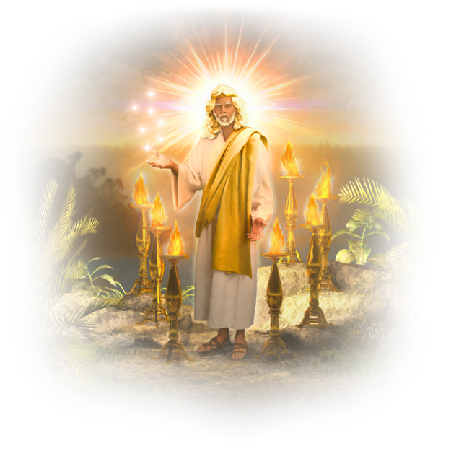
How can we possibly overcome such odds?
1 Jn 4:4 “Ye are of God, …and have overcome them:
because greater is he that is in you, than he that is in the world.”
1 Jn 5:4 “This is the victory that overcomes the world,
Even our Faith!”

Slide 33
Notice God’s challenge to the luke-warm Laodiceans of every age. Rev 3:22
“He that hath an ear, let him hear what the Spirit saith unto the churches.”
What’s His Spirit saying to you?

Slide 34
What are you “saying” to God’s Spirit?
“Speak Lord, for thy servant heareth”
1 Samuel 3:10

