Slide 2
The Passion Principle!
Col. 3:16 “Let the word of Christ dwell in you richly in all wisdom teaching and admonishing one another…with Grace in your hearts.
17 …And whatsoever ye do in word or deed,
do all in the name of the Lord Jesus,
giving thanks to God and the Father by him…
23 And whatsoever ye do, do it heartily,
as to the Lord, and not unto men;
24 Knowing that of the Lord ye shall receive
the reward of the inheritance:
for ye serve the Lord Christ.” ”

Slide 3
1. The Scope of our Passion. 17-22
17 “Whatsoever ye do”
Compound word from Hostis (any) & pas (all):
Relationships (vs 18-22)
Words (Vs 19)
Works (Choices/Actions) (Vs 19)

Slide 4
2. The Strength Of Our Passion. Vs 23
“do it heartily …”
from: ek (the source or origin)
and psyche: the soul (mind, will, and emotions.)
Eccl 9:10 “Whatsoever thy hand findeth to do,
do it with thy might…”
(kō’aḥ: vigor, force, capacity)

Slide 5
3. The Secret Of Our Passion
“as unto the Lord”
A. We Do What We Do For Jesus!
1) When we serve others, we’re serving Jesus.
Mt 25:40 “Inasmuch as ye have done it unto
one of the least of these my brethren,
ye have done it unto me.”

Slide 6
A. We Do What We Do For Jesus. This Means:
2) No act or motive is missed. Col. 3:22
“not with eyeservice, as menpleasers;
but in singleness of heart, fearing God:”
3) Our rewards have an eternal dimension.
Vs 24 “knowing that of the Lord
ye shall receive the reward of the inheritance:
For ye serve the Lord Christ!”

Slide 7
B. Our service is compelling,
Vs 24 “For ye serve the Lord Christ.”
(douleuō: (v) slave, involuntary or voluntary)
1) Involuntary Slavery involves being conquered /
captured and sold into slavery. (or born into it)
a) All of humanity are born under sin’s “bondage”
Ro. 3:10;23; 5:12; 6:23; 8:21-22
b) Our actions demonstrate / reinforce this bondage. Jn 8:34 “Whosoever committeth sin
is the servant of sin…”
but not compulsory.

Slide 8
c) We must be redeemed to be free!
We can never work off or pay our debt,
so Jesus paid it for us! (Ro. 6:23)
Jn 8:36 “If the Son therefore shall make you free,
ye shall be free indeed.”
Mark 10:45 “the Son of man came … to give his life a
ransom for many.” (Lk 19:10; 2 Cor 5:21; 1 Peter 1:19)
Gal. 4:4 “God sent forth his Son, …, made under the law,
5 To redeem them that were under the law,
that we might receive the adoption of sons.”

Slide 9
2) Voluntary slavery involves indentured service.
(Selling ourselves/ labor in exchange for something.)
a) Our choices (even after being redeemed)
can shackle and enslave us! Ro 6:16
“Know ye not, that to whom ye yield yourselves servants to obey,
his servants ye are to whom ye obey;
whether of sin unto death,
or of obedience unto righteousness?
(1 Cor 11:30; 1 Jn 5:16)

Slide 10
a) Our choices (even after being redeemed)
can shackle and enslave us!
Ro 6:17 “But God be thanked, that ye were the servants of sin,
but ye have obeyed from the heart that form of doctrine (truth) which was delivered you.
18 Being then made free from sin,
ye became the servants of righteousness.”

Slide 11
a) Our choices (even after being redeemed)
can shackle and enslave us! Hebrews 12:1,2
“let us lay aside every weight, (on’kos: mass, hindrance)
and the sin (hamartia, from hamartano: to miss the mark)
which doth so easily beset us, (euperis’tatos:
Keep us standing around, detain, thwart)
and run with patience the race that is set before us,
Looking unto Jesus
the author and finisher of our faith”

Slide 12
a) Our choices can shackle & enslave us! Pr. 5:22
“His own iniquities shall take the wicked himself,
and he shall be holden with the cords of his sins.”
Heb. 12:1 “the sin which doth so easily beset us…”
(1) Lust Pr. 7; 23:27-28; 1Thes. 4:1-7
(2) Alcohol Pr. 23:26-35
(3) Drugs (Rev. 21:8)
(4) Even Food! (Pr 23:2) “put a knife to thy throat,
if thou be …given to (ba’al: mastered by) appetite.”
Phil. 3:19 “their god is their belly…mind earthly things”

Slide 13
The Scope of our Passion. “whatsoever”
2. The Strength Of Our Passion. “Heartily…”
3. The Secret Of Our Passion “ye serve the Lord”
4. The Source Of Our Passion. “The Lord Jesus”
A. The Example of Jesus encourages us. Heb. 12:2,3
“Looking unto Jesus the author and finisher of our faith; who for the joy that was set before him endured the cross, despising the shame, and is set down at the right hand of the throne of God.
3 For consider him who endured…”

Slide 14
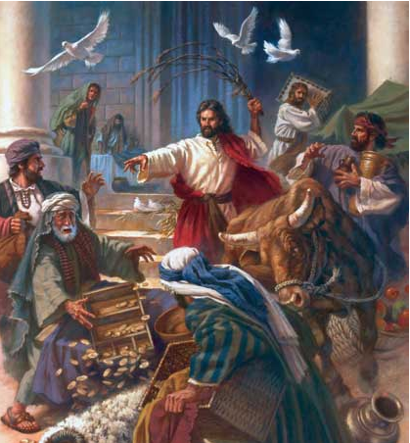
1) 2X He cleansed the temple Jn 2:15-17 “ he drove them all out of the temple, and the sheep, and the oxen;
and poured out the changers' money, & overthrew the tables; 17 And his disciples remembered that it was written,
The zeal of thine house hath eaten me up.”
Also Mt. 21:12,13
(See Ps 69:9)

Slide 15
The Example of Jesus encourages us.
2) His final days on are known as “his passion”!
Luke 9:51 “it came to pass,
when the time was come
that he should be received up,
he stedfastly set his face
(stērizō: turned resolutely)
to go to Jerusalem.”

Slide 16
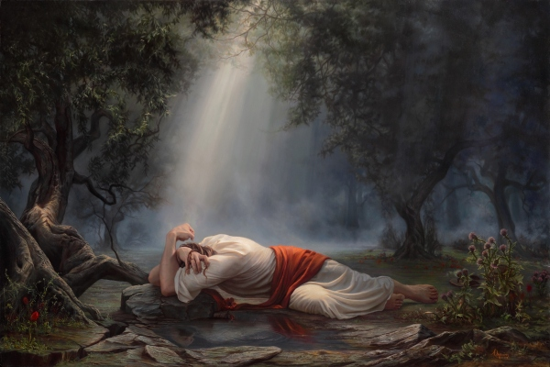
3) Remember Gethsemane? Luke 22:42-44 “Father, if thou be willing, remove this cup from me: nevertheless not my will, but thine, be done…
44 And being in an agony he prayed more earnestly (ektenes’teron: fervently)
and his sweat was as it were great drops of blood falling down to the ground.”
See Heb. 5:7

Slide 17
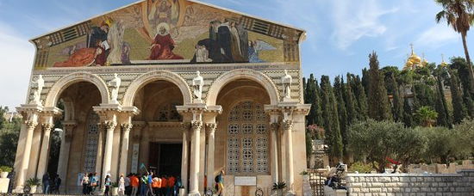
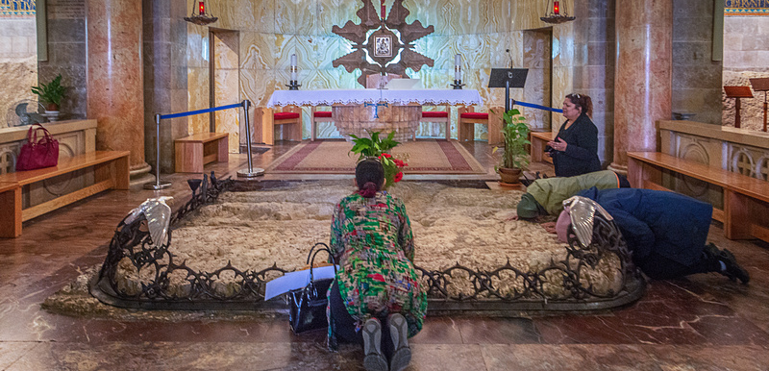
Basilica of the Agony
(Church of all Nations)

Slide 18
B. The Spirit of Jesus ENABLES US. (Acts 1:8)
“ye shall receive power, after that the Holy Ghost is come upon you: and ye shall be witnesses unto me”
1) The power of the Spirit Transformed the apostles!
Phil. 4:13 “I can do all things through Christ
which strengtheneth me.” (endynamo’ō: empowers)
He can transform us as well! 2 Cor. 3:18
a) Enthusiasm from en: (Within) & Theos (God)
Phil. 2:13 “It is God which worketh in you,
Both to will and to do of His good pleasure.”

Slide 19
2) We must cooperate with Him for this process
of transformation. (1 Cor 3:9; Mt. 11:28,29)
Ro. 12:1,2 “Be not conformed to this world but be ye
transformed by the renewing of your mind”
Jn 15:4-5 “Abide in me, and I in you. As the branch cannot bear fruit of itself, except it abide in the vine;
no more can ye, except ye abide in me.
I am the vine, ye are the branches: He that abides in me, and I in him, the same bringeth forth much fruit:
for without me ye can do nothing.”

Slide 20
3) This is at the heart of Grace! 1 Cor 15:10
“But by the grace of God I am what I am:
his grace which was bestowed upon me was not in vain;
but I labored more abundantly than they all:
yet not I, but the grace of God which was with me.”
Charis: “the divine influence upon the heart,
and its reflection in the life; including gratitude) :
Gal. 2:21 “I do not frustrate the Grace of God”
Do we?

Slide 21
4. The Source Of Our Passion. “The Lord Jesus”
A. The Example of Jesus encourages us. Heb. 12:2,3
B. The Spirit of Jesus ENABLES US. (Acts 1:8)
C. The Love Of Christ Constrains Us. (2 Cor 5:14)
“For the love of Christ constraineth us; (synech’ō: holds together, compels, preoccupies) because we thus judge,
that if one died for all, then were all dead:
15 And that he died for all, that they which live
should not henceforth live unto themselves,
but unto him which died for them, and rose again.”

Slide 22
Paul repeatedly compared our lives to a long race.
(Heb. 12:1,2; 1 Cor 9:27-27; 2 Tim.4:7-8)
In Phil 3 he gives his testimony and a type of “before and after” picture. Notice vs 12,13
“Not as though I had …attained, either were… perfect…
but I follow after, (dioko: pursue) if I may apprehend
that for which also I am apprehended”
13 I count not myself to have apprehended: but this one thing I do, forgetting those things which are behind,
and reaching forth unto those things which are before,

Slide 23
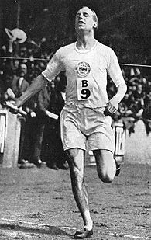
14 “I press toward (dioko kata: pursue against opposition)
the mark (skopos’: goal) for the prize of the high calling of God in Christ Jesus.
Let us therefore, as many as be perfect, (teleios) be thus minded:…”
What “mark” are you moving toward?
Are you “Pressing” or Drifting?

Slide 24
Horace (Quintus Horatius Flaccus) wrote of “Carpe Diem”
meaning to “Seize the day”.
We need to embrace a new logo:
“Carpe deus”: “seize God”!
Phil. 3:12 “if I may apprehend
(katalambano: seize, possess)
that for which also I am apprehended”
See also Jn 15:16

Slide 25
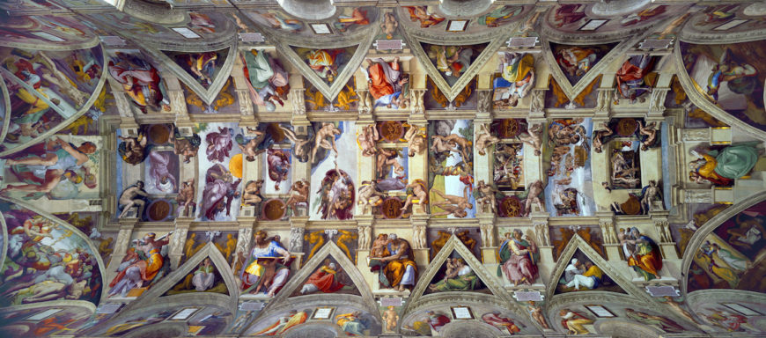
Michelangelo, Ceiling of the Sistine Chapel, 1508-12

Slide 26
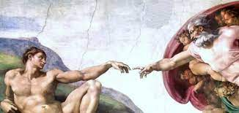
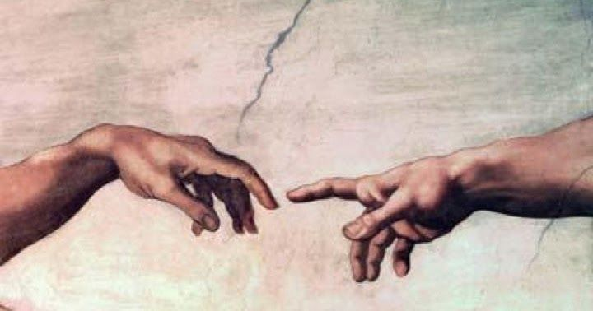
The creation of Adam
Phil. 3:14 “I press toward the mark for the prize…”
How Passionately are you pressing toward (and responding to) the one who created, redeemed and loves you?

