Slide 1
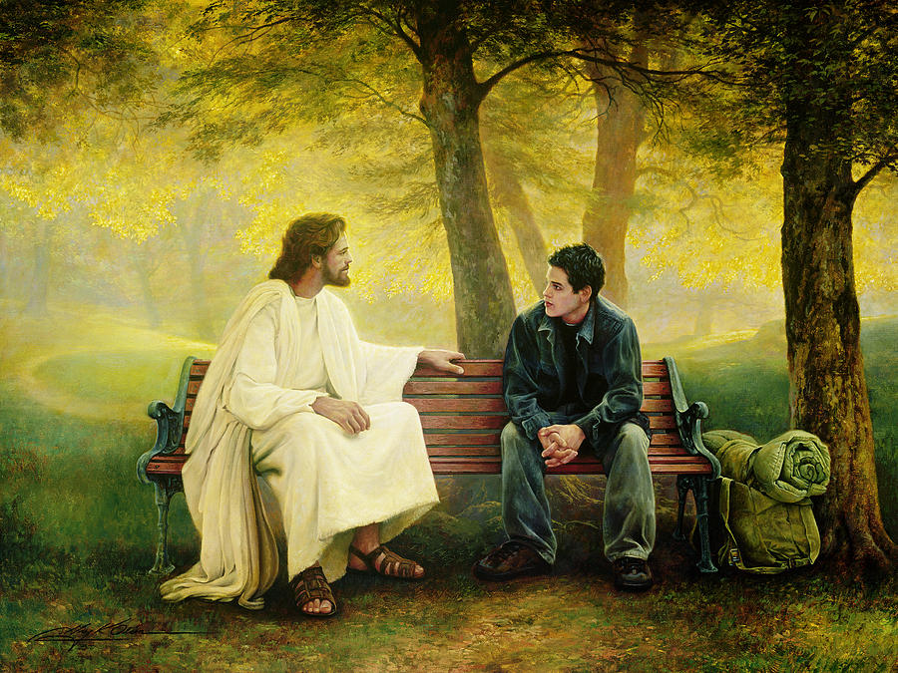
Pr 4:26 “Ponder the path of thy feet, and let all thy ways be established.”
kûn: prepared
Biblical Principles are like a “Moral Compass”
To help guide (establish) us.
Greg Olson

Slide 2
Positive change requires effort and energy to overcome the entropy of selfishness and sin.
Such change involves weaving into the fabric of our soul biblical principles by which we purpose to operate.
These principles enable us to rise above the mediocrity of life and as such are timeless and inherently practical.
They apply universally and are what our founding fathers called “self-evident truths.”

Slide 3
Principles for Powerful Living

Slide 5
The Passion Principle!
Col. 3:16 “Let the word of Christ dwell in you richly in all wisdom teaching and admonishing one another…with Grace in your hearts.
17 …And whatsoever ye do in word or deed,
do all in the name of the Lord Jesus,
giving thanks to God and the Father by him…
23 And whatsoever ye do, do it heartily,
as to the Lord, and not unto men;
24 Knowing that of the Lord ye shall receive
the reward of the inheritance:
for ye serve the Lord Christ.” ”

Slide 6
The Passion Principle!
Col. 3:16-25
The Scope of our Passion.
17 “Whatsoever” (ὅστις πᾶς)
Hostis (any) pas (all)

Slide 8
God makes no such distinction!
Ps 148:7-10 “Praise the LORD from the earth, …
Fire, and hail; snow, and vapor;
stormy wind fulfilling his word:
Mountains, and all hills;
fruitful trees, and all cedars:
Beasts, and all cattle; creeping things,
and flying fowl:

Slide 9
Ps 148:12-14 “Kings of the earth, and all people;
princes, and all judges of the earth:
young men, and maidens; old men, and children:
Let them praise the name of the LORD:
for his name alone is excellent;
his glory is above the earth and heaven.”
Ps 150:6 “Let every thing that hath breath
praise the LORD.
Praise Ye the LORD!”
(Hālal’: Glory; root means to make/be clear, shine.)

Slide 11
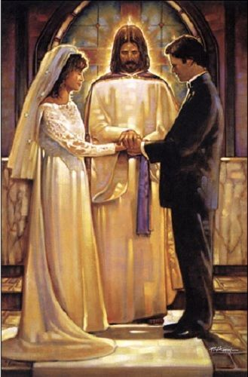
1. The Scope of our Passion. 17
“Whatsoever” involves:
A. Every Relationship.
1) Marriage. Vs 18,19;
a) “wives submit yourselves (v)
unto your own husbands…”
(hypotasso: subordinate {hypo: under
and Tasso: to arrange, assign, ordain})
Eph. 5:22 adds: “as unto the Lord”

Slide 12
1) Marriage. Vs 18,19
b) “husbands, love your wives.”
Love here is agapao: {from agab} to love much
(1) It’s a verb (requiring action)
(2) It’s in an imperative mood (command)
(3) It’s in the perfect tense
(action completed at a specific past point
with results continuing into the future.)

Slide 13
1) Marriage. Vs 18,19;
b) “husbands, love your wives.”
Eph. 5:25 adds: “even as Christ loved the church
and gave himself for it”
agapao is the verb form of agape.
The Noun “agape” is described
in 1 Cor 13 and means
“benevolent affection” (charity!)

Slide 14
A. Every Relationship.
2) Family Vs 20
a) “Children, obey (hypokouo: hearken under)
your parents in all things:
for this is well pleasing unto the Lord. “
Eph. 6:2: “Honour (timao: prize) thy father and mother;
(which is the first commandment
with promise;) (Ex. 20:12)
3 That it may be well with thee”

Slide 15
A. Every Relationship
2) Family Vs 21
b) “Fathers, provoke not your children to anger,
lest they be discouraged.”
(athymeō: without passion; apathetic)
Eph 6:4 adds: “but bring them up
in the nurture and admonition
of the Lord.”

Slide 16
A. Every Relationship
3) Our Jobs. Vs 22,23 “Servants, obey in all
things your masters according to the flesh;
not with eyeservice, as menpleasers;
but in singleness of heart, fearing God:
… heartily, as to the Lord…”
Eph 6:5-9 adds: “as the servants of Christ,
doing the will of God from the heart;
With good will doing service,
as to the Lord, and not to men:…”

Slide 17
“Whatsoever” involves: A. Every Relationship.
B. Every Word “Whatsoever ye do in word…”
(logos: something said {including the thought})
1) Our words are related to our thoughts. (Mt 12:34)
“out of the abundance of the heart, the mouth speaks”
(see also 2 Cor. 10:5; Heb. 4:12)
2) This is why David prayed in Ps 19:14
“Let the words of my mouth,
and the meditation of my heart,
be acceptable in thy sight, O LORD”

Slide 18
1. The Scope of our Passion. Col. 3:17
“Whatsoever” involves:
A. Every Relationship.
B. Every Word “Whatsoever ye do in word…”
C. Every Choice (activity) “…or deed”
(ergon: work, effort, action)
Pr 20:11 “Even a child is known by his doings, whether his work be pure, and whether it be right.”

Slide 19
1. The Scope of our Passion. Col. 3:17 “Whatsoever”
2. The Strength Of Our Passion. “Heartily…”
A. Our Passion Comes From Our Soul.
1) Heartily is a compound word from:
ek (the source or origin)
and psyche: the soul (mind, will, and emotions.)
“Heartily” means that “whatever we do”
Should come from the depths of our soul.

Slide 20
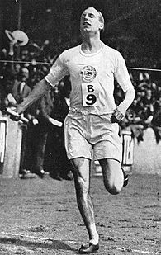
Scottish Missionary and runner Eric Liddell ran in the 1924 Olympics.
His sister feared that his running would interfere with his missionary work. He explained
“Jenny, I want you to know that I’ve committed
myself to be a missionary to China.
But I’ve got a lot of running to do first.
I believe God made me for a purpose,
but he also made me fast!
I feel His pleasure when I run.”

Slide 21
“I feel His pleasure when I run.”

Slide 22
After being pressured to compromise in order to compete he wrote:
“Circumstances may appear to wreck our lives and God’s plans,
But God is not helpless among the ruin.
God’s love is still working!
He comes in and takes the calamity,
and uses it victoriously,
working out His wonderful plan of love. “
Eric Liddell
After serving for 20 years as a missionary to China,
he died in a China Internment camp at the age of 43

Slide 23
B. Such Passion Pleases God. (Heb. 11:6; Rev. 4:11)
1) What has God made you “fast at?”
(Teaching, parenting, comforting,
managing, organizing, etc.?)
2) What we do “heartily” (from the heart)
pleases God!!!! Eccl 9:10
“Whatsoever thy hand findeth to do,
do it with thy might…”
(kō’aḥ: vigor, force, capacity)

Slide 24
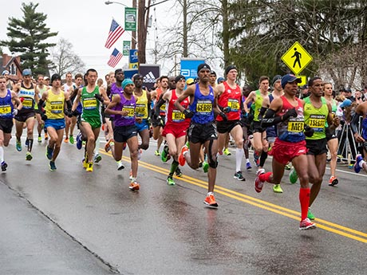
The Bible often uses the analogy of a race to describe our Christian journey. In 1 Cor. 9:24-25 Paul writes:
“Know ye not that they which run in a race run all, but one receives the prize?
So run, that ye may obtain.
And every man that strives for the mastery is temperate in all things.
They do it to obtain a corruptible crown;
but we an incorruptible.

Slide 25
The Bible often uses the analogy of a race to describe our Christian journey. In 1 Cor. 9:26-27 Paul writes:
“I therefore so run, not as uncertainly;
so fight I, not as one that beats the air:
But I keep under my body, and bring it into subjection: lest that by any means, when I have preached to others,
I myself should be a castaway.”
(adokimos: unapproved, disqualified, reprobate)

Slide 26
God has chosen you for this race
and equipped you for victory!
Ro. 8:28-37; 1 Jn 4:4; 5:4
Eph. 4:7,8 “But unto every one of us is given grace
according to the measure of the gift of Christ.
Wherefore he saith, When he ascended up on high,
he led captivity captive, and gave gifts unto men.”

Slide 27
1 Peter 4:10 “As every man hath received the gift,
even so minister the same one to another,
as good stewards of the manifold grace of God.”
What has God given you?
Why did He give it to you?
What are you doing with it?
Jesus warned that the “Cares of this world…”
would compete and seek to “choke the word”
And it’s affect on us. (Mark 4:19)

Slide 28
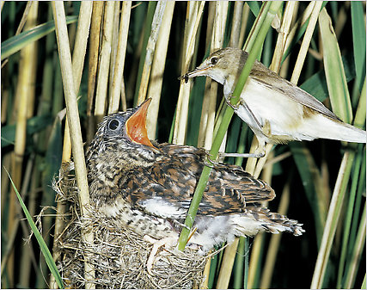
The European Cuckoo lays her eggs in the nests of smaller birds such as hedge sparrows.
When the young cuckoo hatches, its first act is to dispose of any other eggs: pushing them from the nest,
leaving itself as the sole occupant.
It then begins to dominate the “foster mom’s” attention.
Are there any “Cuckoo’s”
in your life
competing for your attention?

Slide 29
Heb 12:1,2 “Let us lay aside every weight (cuckoos) and the sin which would so easily beset us, And run with patience the race set before us, Looking unto Jesus,
the author and finisher of our faith…
3 “For consider Him…”
Analogiz’omai: think or proportion appropriately
What “proportion” of your heart does Jesus have?

Slide 30
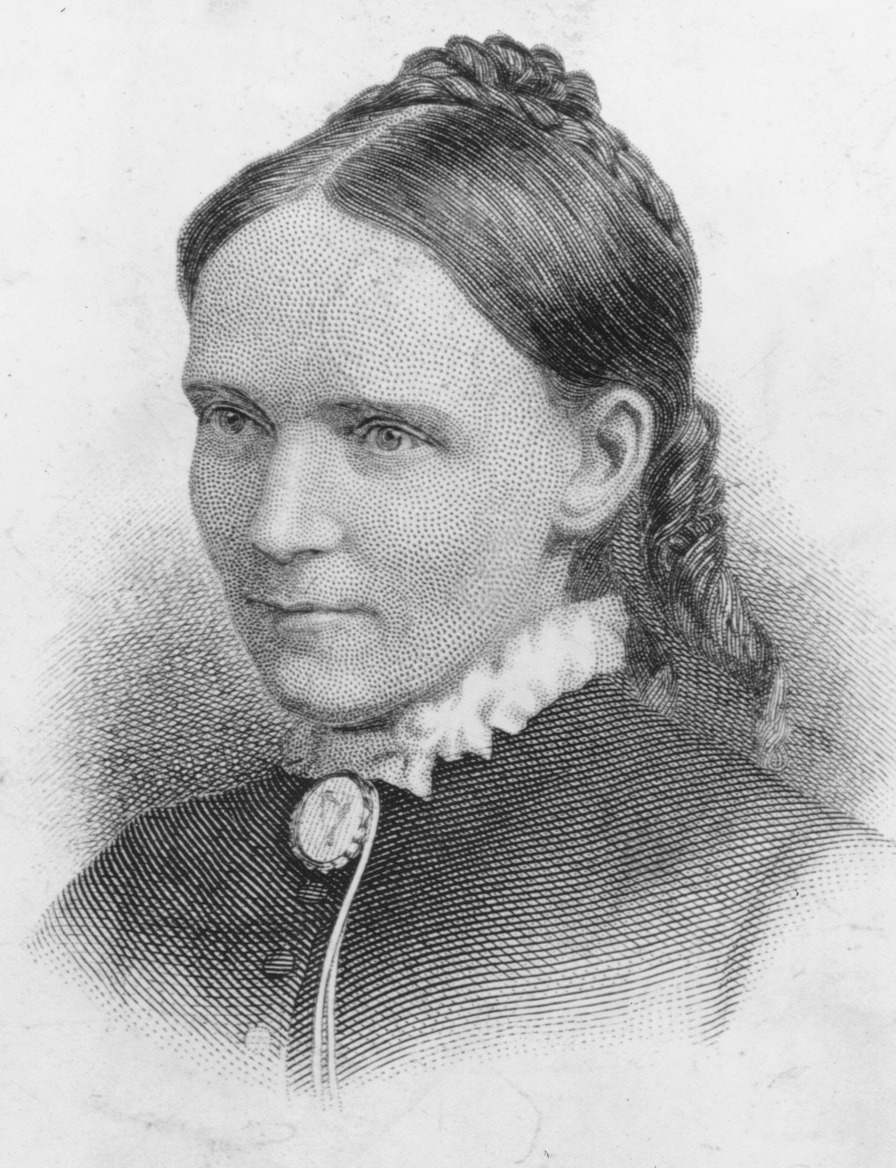
Another year is dawning; dear Father, let it be,
In working or in waiting, another year with thee.
Another year of progress, another year of praise,
Another year of proving thy presence all the days.
Another year of service, of witness for thy love;
Another year of training for holier work above.
Another year is dawning; dear Father, let it be,
on earth, or else in heaven, another year for thee.
Frances Ridley Havergal (1836-1879)
Authored the song “Take my life and let it be consecrated”

