Slide 1
Principles for Powerful Living

Slide 2
The Bible reveals Spiritual principles to help guide us to God and His plans.
Passion (Open Heart) Principle. (Col. 3:16-24)
Purpose (Open Hand) Principle. (Ex. 3,4)
Path (Open Door) Principle. (Rev. 3:7-13)
Preparation (Soil/Seed) Principle. (Mt 13:3-30)
The Cultivation Principle. (Mt 13; 1Cor 3:9)

Slide 3
These principles are timeless and universal.
3000 years ago Solomon wrote in Pr 4:20-27:
“My son, attend to my words; incline thine ear unto my sayings. Let them not depart from thine eyes;
keep them in the midst of thine heart. (Passion)
For they are life unto those that find them, and health…
Keep (nāṣar: guard) thy heart with all diligence;
(Cultivation)
for out of it are the issues of life.” (Purpose)
(ḥay tôṣāʾôt’: boundary, source of life & strength)

Slide 4
Pr 4:24 “Put away from thee a froward mouth,
and perverse lips put far from thee.
25 Let thine eyes look right on, and let thine eyelids look straight before thee.
26 Ponder the path of thy feet, and let all thy ways be established. (kûn: Prepared)
27 Turn not to the right hand nor to the left: remove thy foot from evil.”
(The Path Principle)
Preparation

Slide 5
Without any cultivation, the hard soil wouldn’t allow the seed to even penetrate it
and the “fowls” quickly devoured it. (Mt 13:4, 19)
In 2 of the 3 areas of the field Jesus described
(the rocky and thorny soil)
the seed was able to “penetrate” the soil (heart)
and it even began to “germinate” (grow),
but it was never able to propagate
(produce fruit). (vs 5-7 & 20-22)

Slide 6
“Good seed” needs “good ground” in order to Penetrate, Germinate, and Propagate.
Good ground requires Cultivation!
The fruitfulness of a farm, family, friendship and even our Faith will be in direct proportion to the amount of care and cultivation they receive.

Slide 7
A few weeks ago we discussed that the three distinct dimensions of Cultivation include:
Preparing: Soil for growth (of plants). Hos. 10:12
Protecting: Foster/improve growth by labor, care
or study. “Nourish and Cherish” Eph. 5:29
Partnering: Seek the society of or make friends with.
This involves “Cultivating” Relationships”
(Gen. 2:18; Eccl 4:7-12)

Slide 8
The Partnership Of Cultivation
God invites us to Partner with Him!
Mt. 11:28,29 “Take my yoke upon you and learn of me..”
1. In our own “gardens” (lives). 1 Cor 3:9; Jn 15:5
“I am the vine, ye are the branches: He that abideth in me, and I in him, the same bringeth forth much fruit:
for without me ye can do nothing.”
We are working with God in our own “garden” (Soul);
We are expected to “cultivate it”.

Slide 9
God invites us to work with Him! Jn 14:18
In our own “gardens” (lives).
A. God partners with us. 1 Cor 3:9 “we are laborers
together with God, Ye are God’s husbandry” (farm)
1) God’s part is to Reveal (the weeds, rocks, roots,
and Rot (Sin)!) 1 Jn 1:5,6; Ps. 139:23-24
“Search me, O God, and know my heart:
(ḥāqar: examine intimately)
try me, (bāḥan: test) and know my thoughts:
see if there be any wicked way (ʿōṣeb: idol) in me...”

Slide 10
A. God partners with us.“laborers together with God”
1) God’s part is to Reveal (1 Jn 1:5,6; Ps. 139:23-24)
a) Our part is to Respond (Recognize, Repent,
Realign and/or
“If any man will come after me, let him deny himself, and take up his cross, and follow me.
For whosoever will save his life shall lose it: and whosoever will lose his life for my sake shall find it.
For what is a man profited, if he gain the whole world, and lose his own soul?”
Relinquish) Heb 12:1,2; Mt 16:24-26

Slide 11
a) Our part is to Respond. (Recognize, Repent,
Realign and/or Relinquish) Luke 14:33-35 “whosoever of you that forsaketh not all that he hath,
(from apotasso: arrange in proper order)
he cannot be my disciple.
Salt is good: but if the salt have lost his savour, wherewith shall it be seasoned?
It’s neither fit for the land, nor the dunghill;
but men cast it out.
He that hath ears to hear, let him hear.”
(akouō: understand, respond, obey)

Slide 12
A. God partners with us.“laborers together with God”
2) God’s part is to Convict (Reprove); Jn 16:8 “of sin
and righteousness and of judgment.” (Krisis: justice)
a) Our Part is to Cooperate: (Repent) 1 Jn 1:9
“If we confess our sins, he is faithful and just to forgive us our sin, and to cleanse us from all unrighteousness”
(1) Repent (metanoeō) comes from meta (to change)
and noeo (your mind, your thinking).
(2) This is mandatory for any substantial “change”
to last. (Isaiah 55:6-9)

Slide 13
A. God partners with us.“laborers together with God”
3) God’s Part is to Direct Ps 32:8 “I will instruct thee
and teach thee in the way which thou shalt go:
I will guide thee with mine eye.”
Jn 10:27 “My sheep hear my voice and I know them…”
a) Our part is to Decide to follow (Submit)
Josh 24:15 “choose…who ye will serve…”
1 Kings 18:21 “How long halt ye between two opinions”
Pr. 3:5,6 “In all thy ways acknowledge Him…”
Jn 10:27b “my sheep ….. follow me”

Slide 14
A. God partners with us.“laborers together with God”
4) God’s Part is to Lead Ps. 5:8 “Lead me Lord”
Ps 23:3 “He leadeth me in paths of righteousness”
Ps 139:24 “lead me in the way everlasting”
Nāḥâ’: to guide and govern!
a) Our Part is to Follow (Ps 23); Feed (Heb 5:12-14);
and Weed. (Heb 12:1,2; 2 Tim. 2:19-21)
19 “Nevertheless the foundation of God standeth sure, having this seal, The Lord knoweth them that are his.
And, Let every one that nameth the name of Christ depart from iniquity.”

Slide 15
5) God’s Part is to Keep/ Protect, (Jn 17:12; Jude 24)
“Now unto him that is able to keep you from falling, and to present you faultless before the presence of his glory with exceeding joy…”
Our Part is to Cultivate (Jer. 4:3) “Break up your fallow ground and sow not among thorns….”
and Pursue (Phil. 3:14) “Press toward the mark for
the prize of the high calling of God in Christ”
Mt 25:21 “Well done, thou good and faithful servant. You’ve been faithful …enter into the joy of thy Lord”

Slide 16
A. God partners with us.“laborers together with God”
B. God partners with others to work in our lives
1) Partners in Ministry! 1 Cor 3:5,6,9
“Who then is Paul…and …Apollos, but ministers by whom ye believed, even as the Lord gave to every man?
I’ve planted, Apollos watered;
9 “We are laborers together with God”
Eccl 4:7-12 vs 9: “Two are better than one;
because they have a good reward for their labor….
10 “…but woe to him that is alone when he falls…”
but God gave the increase.

Slide 17
1) Partners in Ministry! Hebrews 13:7,17
“Remember them (mnēmoneu’ō: rehearse, recall)
which have the rule over you,
(hēgeomai’: to lead / command with official authority)
who have spoken unto you the word of God: …
¹⁷ Obey (peitho: trust) them that have the rule over you,
and submit yourselves: (hypeik’ō: yield)
for they watch for your souls,
as they that must give account,
that they may do it with joy, and not with grief:
for that is unprofitable for you”
WHY?

Slide 18
Partners in Ministry!
a) This goes beyond “professional Preachers”
Heb 3:12-13 “Take heed, brethren, lest there be in any of you an evil heart …, in departing from the living God.
But exhort one another daily, …lest any of you be hardened through the deceitfulness of sin.”
10:23-25 “Let us hold fast the profession of our faith without wavering; …24 And let us consider one another to provoke unto love and to good works:
25 Not forsaking the assembling of ourselves together..”

Slide 19
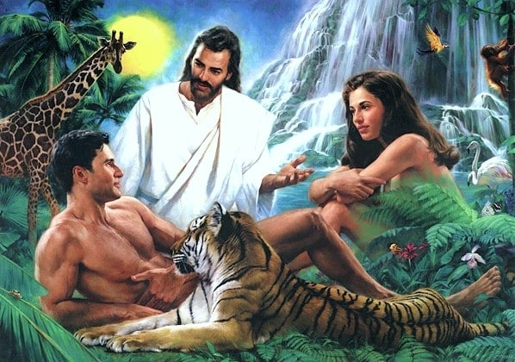
2) Partners in Marriage! Gen 2:18
“It is not good that the man should be alone;
a) I will make him an help meet (ʿēzer) for him.”
(Fromʿāzar’: to surround, protect, aid,
a variant!
If we always agreed,
we couldn’t aid & protect!
²² And the rib, which the LORD God had taken from man,
made he a woman,
and brought her unto the man.”

Slide 20
2) Partners in Marriage! Gen 2:18
b) Satan sought (and still seeks) to divide this
partnership. Gen. 3:1-6
(1) Where was Adam during this conversation?
1 Tim 2:14 “Adam was not deceived,
but the woman being deceived
was in the transgression.”

Slide 21
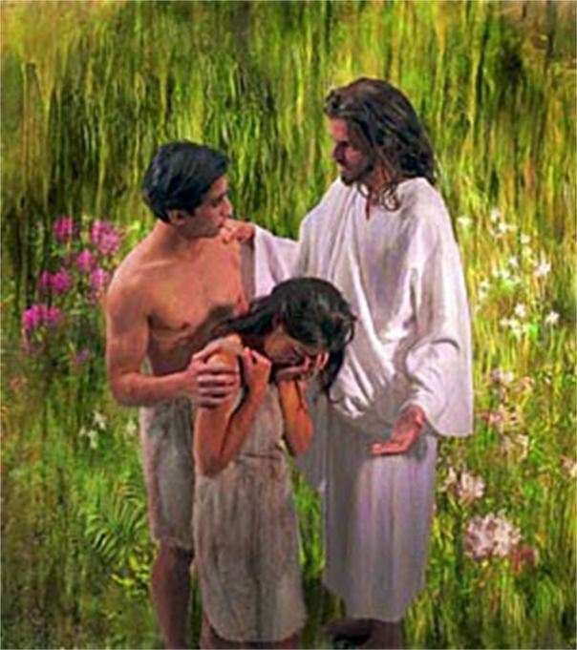
b) Satan seeks to divide this partnership. Gen. 3
(2) Sin makes this easier for him.
Notice that the curse (consequence) of Eve’s choice
complicates this partnership.
Gen 3:16 “…thy desire (Teshûqâ’) shall be to thy husband,
(from shûq: to run or reach after)
and he shall rule over thee.”
(māshal’: govern)
or over!)

Slide 22
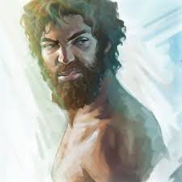
This same phrase is repeated by God in Gen. 4 to Cain
Gen 4:6,7 “the LORD said unto Cain, Why art thou wroth? and why is thy countenance fallen?
If thou doest well, shalt thou not be accepted?
and if thou doest not well, sin lieth at the door.
And unto thee shall be his desire,
(Teshûqâ)
and thou shalt rule (māshal’)
over him.” (Sin and/or Satan)

Slide 23
b) Satan seeks to divide that partnership. Gen. 3
c) This tension is inevitable
(1) We’re all inherently (and occasionally) selfish.
See Romans 3, 6 and 7
(2) Paul acknowledges this pressure in 1 Cor 7:28
reminding us that marriage will produce:
“trouble (thlipsis: pressure) in the flesh”
and commands the married couple to focus on each
other’s pleasure instead of their own. (Vs 33-34)

Slide 24
d) This tension is intentional!
(1) Marriage is the best platform for growth B/C:
➔ It exposes our own natural (carnal) selfishness.
➔ This requires Growth and Grace to overcome.
(Jms 4:5-8) “The spirit that dwelleth in us lusteth to envy?
6 But he giveth more grace. Wherefore he saith,
God resists the proud, but gives grace unto the humble.
7 Submit yourselves therefore to God.
Resist the devil, and he will flee from you.
8 Draw nigh to God, and he will draw nigh to you. “

Slide 25
2) Partners in Marriage! Gen 2:18
e) This tension is navigable!
God’s solution is to let him “mashal” each of us.
Eph. 5:18-33 vs 21 “submitting yourselves one to another
(hupotasso: subordinate, line up in order)
in the fear (phobos) of God.”
22 “wives, submit…as unto the Lord…
25 “husbands, love…as Christ loves the church…”
1 Pt 3:1-7 “dwell…according to knowledge, giving honor
…as being heirs together of the grace of life…”

Slide 26
Tomorrow is Memorial Day,
Initiated during the not so “civil” war.
After this (and every war/conflict) our focus should shift from how we were hurt (or hurt) to healing.
Joel 2 opens with judgement, (vs 1-11)
pleads for repentance (vs 12-17)
and concludes with the promise of restoration (18-32)
25 “I will restore to you the years that the locust have eaten…
And pour out my Spirit…” (vs 28)

Slide 27
God wants to work in & through us to accomplish His plans for our good and His glory. Ph 2:13; Jer 29:11
1 Cor 3:9 “We are laborers together with God”
The next several verses remind us that what we grow and/or build out of our lives will be tested. Vs 10-13
Fruitfulness / usefulness will be rewarded. (vs 14)
“he (she) shall receive a reward” (misthos: payment)
Selfishness, shallowness will cost us in the end. (vs 15)
“he shall suffer loss” (zēmio’ō: detriment)

Slide 28
1 Cor 3:16 “Know ye not that ye are the temple of God, and that the Spirit of God dwelleth in you?”
Will you purpose to Partner with Him,
as well as those He seeks to use,
to cultivate (prepare) you for the life (and eternity) that Jesus designed and desires for you?
Jn 10:10 “The thief comes…to steal, kill, destroy.
I am come that they might have life,
And that they might have it more abundantly!”

