Slide 2
The Resurrection is Central to our Faith and Hope!
“”If Christ be not raised, your faith is vain; ye are yet in your sins….
If in this life only we have hope in Christ,
we are of all men most miserable.”
1 Cor 15:17-19

Slide 3
“Most miserable” certainly seems to describe the disciples during those 3 days.
They had to go through a process before they could comprehend and experience the power of the resurrection.

Slide 4
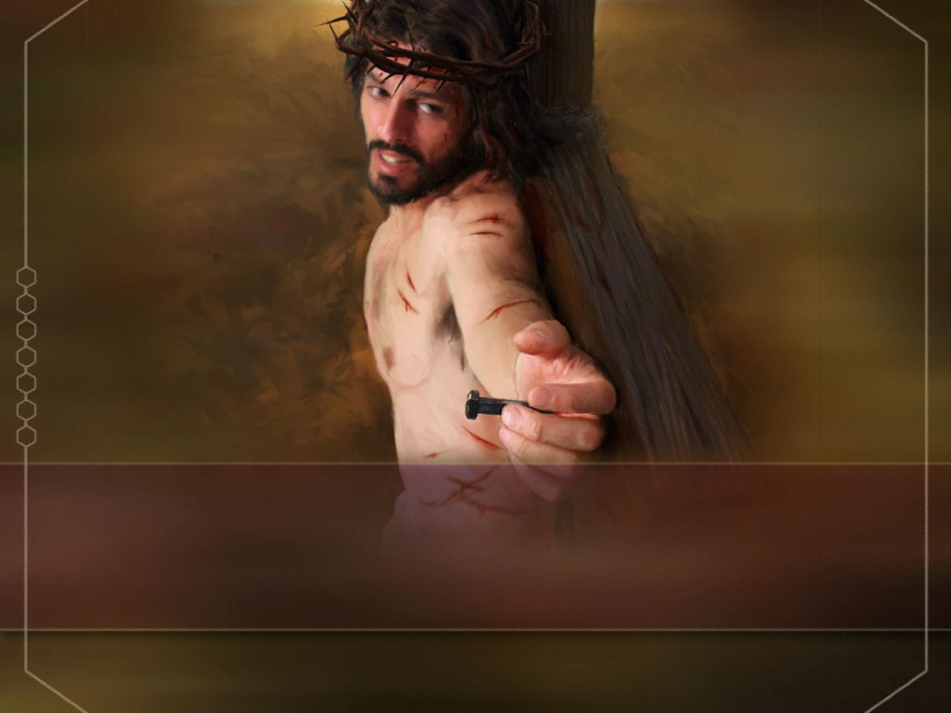
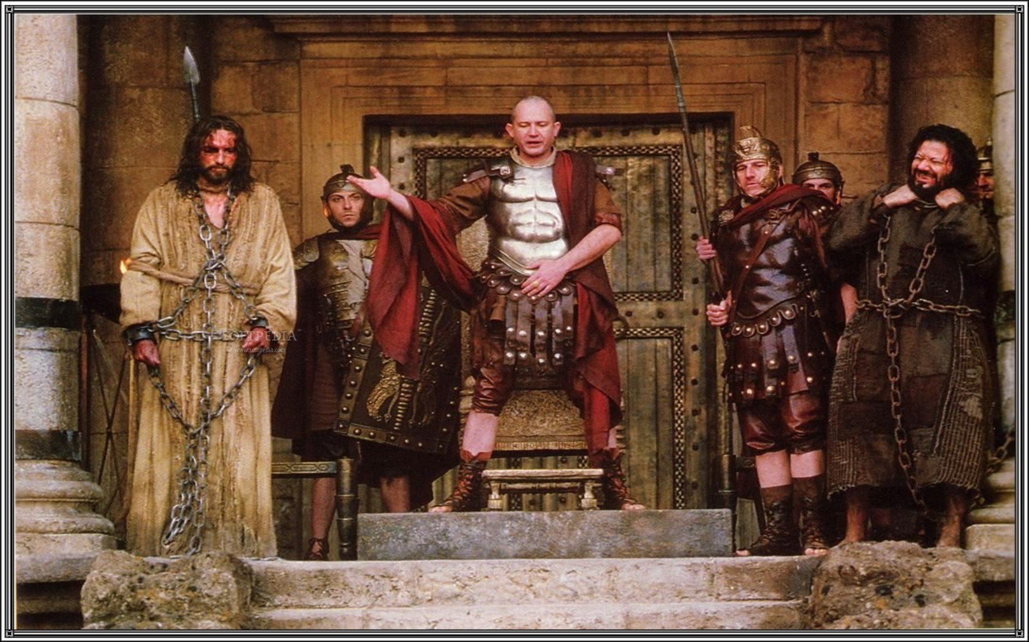
Jn 19:13-15,19 “Pilate …saith …behold your king.
But they cried out, Away with him, crucify him.
Pilate saith, Shall I crucify your King?
We have no king
but Caesar”

Slide 5
Jn 19:19-22 “Pilate wrote a title, and put it on the cross. And the writing was,
Jesus Of Nazareth The King Of The Jews.
This title then read many of the Jews:
it was written in Hebrew, Greek, and Latin.
Then said the chief priests of the Jews to Pilate,
Write not, The King of the Jews…
Pilate answered, What I have written I have written.”

Slide 6
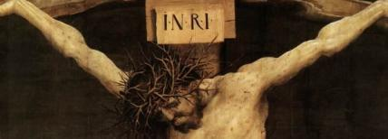
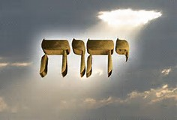
Latin
“Iesus Nazarenus Rex Iudaeorum”
Yahweh
I AM!
Translated “LORD”
6792 times
Hebrew:
(Yeshua ha-Notzri vu'Melekh ha Yehudim)
The abbreviation would be the sacred
Hebrew Tetragrammaton! Ex. 3:14

Slide 7
Jesus had claimed this title repeatedly!
Jn 6:35 “I am (eimi’) the bread of life”
Jn 8:12 “I am the light of the world”
Jn 8:24 “if ye believe not that I am (he),
ye shall die in your sins.”
Jn 8:58 “Before Abraham was, I am.”
Jn 10:9 “I am the door…”
Jn 10:11,14 “I am the good shepherd…”
Jn 10:36 “…I am the Son of God”

Slide 8
Jesus had claimed this title repeatedly!
Jn 11:25 “I am the resurrection and the life”
Jn 13:13 “Ye call me Master & Lord: ye say well;
for (so) I am.”
Jn 13:19 “Now I tell you before it come, that, when it is come to pass, ye may believe
that I am (he).”
Jn 14:6 “ I am the way, the truth, and the life:”
Jn 15:1,5 “I am the true vine”

Slide 9
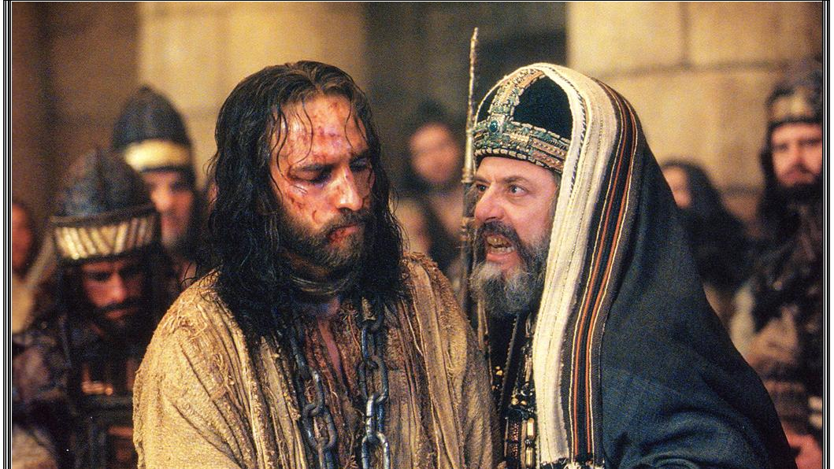
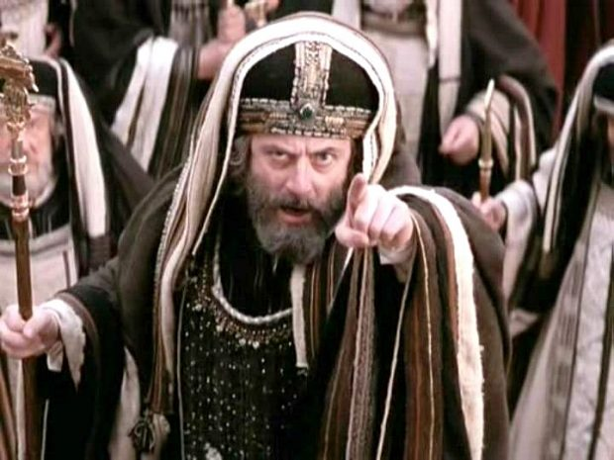
His enemies recognized he made this claim.
“Art thou the Christ,
the Son of the Blessed?
And Jesus said, I am!”
“If he be the King of Israel,
let him now come down from the cross, and we will believe him.
⁴³ He trusted in God; let him deliver him now, if he will have him:
for he said, I am the Son of God.”
Mk 4:61
Mt 27:42,43

Slide 10
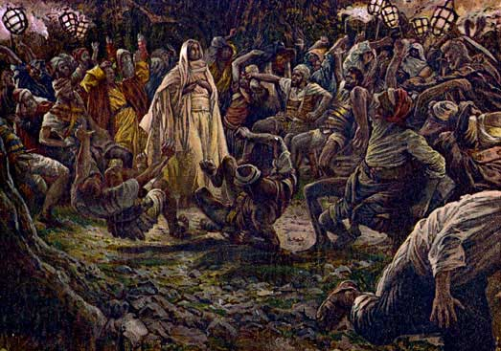
John 18:4-6 “Whom seek ye?... Jesus of Nazareth.
Jesus saith unto them, I am (he).
As soon then as said…I am he,
they …fell to the ground.“

Slide 11
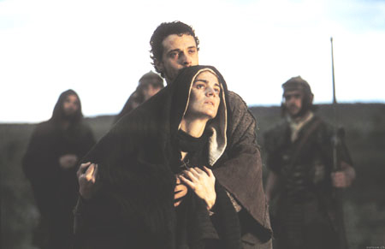
John was the only apostle who stood by Jesus at the Cross.
Jn. 19:26

Slide 12
Some 60 years later Jesus comes to John. (Rev 1:17-18) “when I saw him, I fell at his feet as dead.
he laid his hand upon me, saying…, Fear not;
I am the first and the last:
¹⁸ I am he that liveth, and was dead; and, behold,
I am alive for evermore,
and have the keys
of hell and of death.”

Slide 13
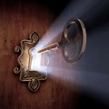
“I have the Keys” Rev. 1:18
Keys symbolize Authority.
Jesus’ Resurrection proved that he has the
authority over life and death. (Rev. 3:7,8)
"These things saith he that is holy, he that is true,
he that hath the key of David,
he that openeth, and no man shutteth;
and shutteth, and no man openeth;
I have set before thee an open door…“

Slide 14
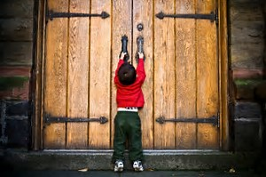
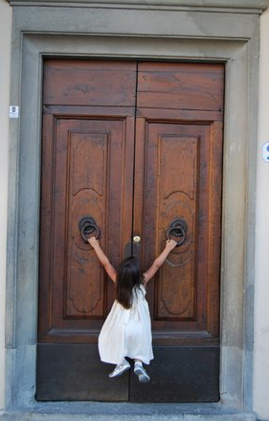
Life has a way of slamming doors on us!
On that first Easter Morning, Jesus used those “keys” to unlock some “difficult” doors.

Slide 15
A. The women were the first at the tomb.
1. THE DOOR OF DISCOURAGEMENT:
He opens the tomb. Luke 24:1-12
They were
Devoted
in spite of
feeling defeated!

Slide 16
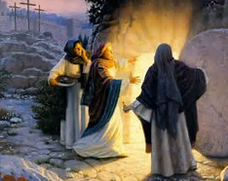
1. THE DOOR OF DISCOURAGEMENT:
A. The women were the first at the tomb.
2) Their Fears were Futile. Mk 16:3
“Who shall roll away the stone from the door?”
Jesus had already told them in Jn 14:1
“Let not your heart be troubled:
ye believe in God,
believe also in me.”
Pisteuo: credit, trust, commit

Slide 17
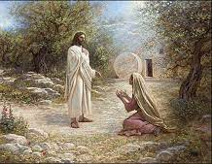
1. THE DOOR OF DISCOURAGEMENT:
A. The women were the first at the tomb.
3) Their Tears were Temporary: Jn 20:15,16
“why weepest thou? … Jesus saith unto her, Mary. She turned herself, and saith unto him… Master.”
Ps. 30:5 “weeping may endure
for a night,
but joy cometh in
the morning.”
(Isaiah 35:10; Rev. 21:4)

Slide 18
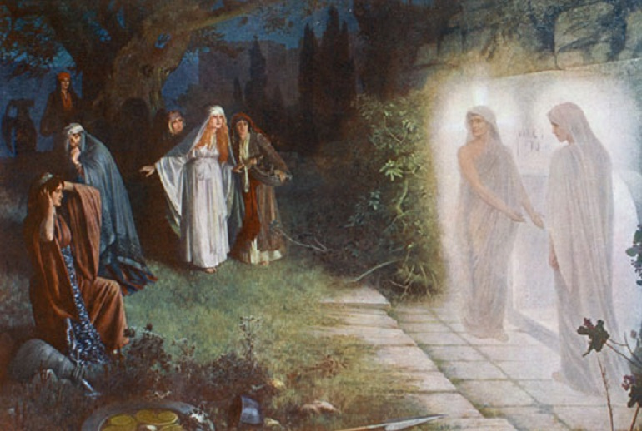
1. THE DOOR OF DISCOURAGEMENT:
B. Their Remorse Was Replaced With A Reminder.
Lk 24:5-8 “Why seek ye the living among the dead?
He is not here, but is risen:
remember how he spake unto you … Saying, The Son of
man must be …crucified,
and the third day rise again.
And they remembered his words”

Slide 19
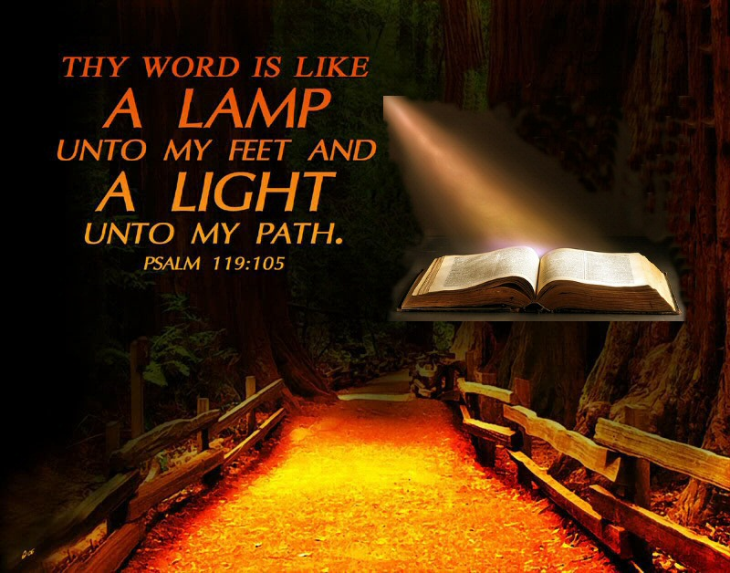
We’ll all face seasons of darkness and discouragement.
Purpose not to forget in the darkness,
What you learned in the light!”
“Who is among you that feareth the LORD, that obeyeth the voice of his servant,
that walketh in darkness,
and hath no light?
let him trust in the name of the LORD, and stay upon his God.”
Isaiah 50:10

Slide 20
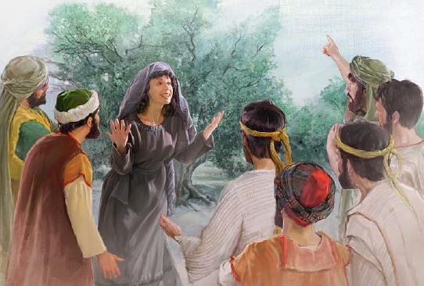
1. THE DOOR OF DISCOURAGEMENT:
A. The women were Devoted in their defeat.
B. Their Remorse Was Replaced With Reminders.
C. Their Devotion led to a Delightful “Duty.” Lk 24:9
1) Duty to God is a Privilege!
"go …tell his disciples … that he goeth before you into Galilee:
there shall ye see him" (Mark 16:7)

Slide 21
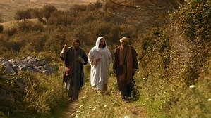
2. THE DOOR OF DOUBT Vs 13-35
He opens their eyes! (Vs 13-35)
A. Their Doubt Was Complicated By:
1) A Transition: Doubt pressured them to focus on
human reasoning rather than Divine Revelation.
This allowed their:
a) Feelings to overwhelmed
their Faith.
b) Intellect to replaced
God’s Inspiration.

Slide 22
2. The Door of Doubt Vs 13-35
A. Their Doubt Was Complicated By:
1) Their Transition.
2) The Revelation (of their selfish motives) They wanted:
a) A Messiah, not a Master.
b) Security, (Freedom for Rome) not a Savior!
Lk 24:21 “But we trusted that it had been he which
should have redeemed Israel:”
Redemption comes at a Price!
Mt 20:28 “the Son of man came …
to give his life a ransom for many.”

Slide 23
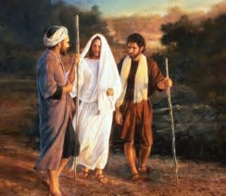
2. The Door of Doubt Vs 13-35
B. The Great Physician:
1) Diagnose their problem: Faithlessness. Vs 25-26
“O fools, and slow of heart to believe all that the prophets have spoken: Ought not Christ to have suffered these things, and to enter into his glory?
Their real problem was not in their heads,
but in their hearts!
Pr 4:23 “Keep thy heart with all diligence;
for out of it are the issues of life.”

Slide 24
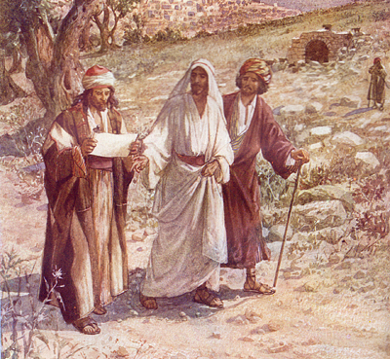
2. The Door of Doubt Vs 13-35
B. The Great Physician:
2) Prescribes the solution. God’s Word. 27-28
“beginning at Moses and all the prophets,
he expounded unto them in all the scriptures
the things concerning himself. “
Ro 10:17 “faith cometh by hearing,
and hearing by the word of God.“
God’s word has the solutions
to our problems!
entolē: authoritative prescription.

Slide 25
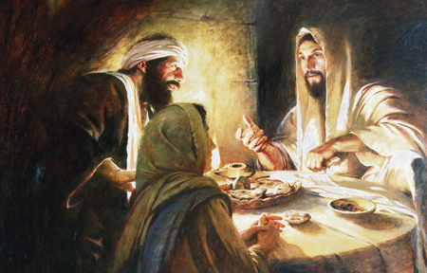
2) Prescribes the solution. God’s Word. 27-28
a) This was ultimately “Heart” medication.
Vs 32 “Did not our hearts burn within us..
while he opened the scriptures”
b) It penetrates deeper than any medicine. Heb. 4:12,13
“the word of God is quick, and powerful, and sharper than any two-edged sword, piercing even to the dividing
asunder of soul and spirit…,
and is a discerner of the thoughts and intents of the heart.”
Mt 22:29 “Ye err, not knowing the scriptures,
nor the power of God.”

Slide 26
2. The Door of Doubt Vs 13-35
C. When They Opened Their Hearts,
God Opened Their Eyes! (2 Cor 3:14-18)
1) They already had the evidence of the promises of Jesus, the empty tomb, the angels, the women’s witness, and the Scriptures.
How much more “evidence” do you need?
Man says “seeing is believing”,
but God says “believing is seeing!”

Slide 27
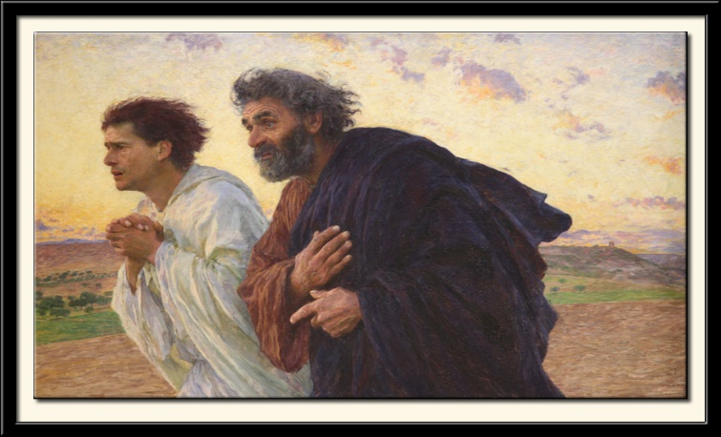
2) They immediately returned to share with others!
(a 16 mile round trip!) Luke 24:33-35
“they rose up the same hour, and returned to Jerusalem, and found the eleven gathered together, and them that were with them, Saying, The Lord is risen indeed, and hath appeared to Simon. And they told what things were done in the way”
The best evidence that we have understood the Bible and met the living Christ is that we have
something exciting to share with others.
Ps. 107:2 “Let the redeemed of the Lord
Say so!”

Slide 28
Doubt makes the mountain which faith moves.
Doubt sees the obstacles;
Faith sees the way.
Doubt sees the darkest night;
Faith sees the day.
Doubt dreads to take a step;
Faith soars on high;
Doubt questions, "Who believes?“
Faith answers, "I."

Slide 29
3. The Door of Distress. Vs. 36-45
“they were terrified and affrighted…” 37
Christ’s Peace. 36 “Peace be unto you””
1) Remember “Peace” means to Partner! (eiro:“to join”)
B. God’s Process (for finding peace.) Vs 39
1) Encouragement. “Behold my hands and my feet, that
it is I myself, handle me, and see.”
2) Chastisement. “he upbraided them with their unbelief
and hardness of heart, because they believed not them
which had seen him after he was risen." (Mk 16:14)

Slide 30
3. The Door of Distress. Vs. 36-45
“terrified and affrighted…” 37
A. Christ’s Peace. “Peace be unto you.”36
B. Christ’s Process. Vs 39
1) Encouragement…. 2) Chastisement
3) Enlightenment: Vs 44,45
“Then opened he their understanding,
that they might understand the scriptures”
(nooce: mind, intellect, perception.)
He opens their mind!

Slide 31
Are you trapped behind the door of:
Discouragement?
Doubt?
Distress?
“I am he that openeth
and no man shutteth…”
Rev. 3:7
Look to the Open Tomb!
Open your eyes (heart) to God’s Promise
Open your mind (heart) to God’s Presence! Heb 13:5

Slide 32
Easter Means
That God has a Plan! Jer. 29:11; Pr. 3:1-4
“…keep my commandments… write them on thine heart:”
That Plan involves a Process! Pr. 3:5
“Trust in the LORD with all thine heart;
and lean not unto thine own understanding. “
That Process involves a Path! Pr. 3:6
“in all thy ways acknowledge Him, he’ll direct thy paths”
Pr. 4:18 “The path of the just…”

Slide 33
What Does Easter Mean?
That Path involves Personal Choices!
Pr 3:7 “Be not wise in thine own eyes:
fear the LORD, and depart from evil.”
1) Sin carries a death penalty. Ro. 6:23; Rev. 20:14,15
2) Jesus death paid that debt. Ro. 5:8; 1 Cor 15:3; 2 Cor 5:21
“It is finished” Jn 19:30 teleo: completed, debt is discharged!
3) We must choose to accept this gift of grace. John 3:16-18
“He that believeth (trusts) on him is not condemned.
He that believeth not is condemned already”

Slide 34
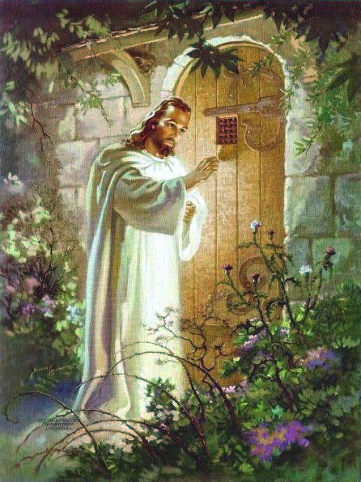
There’s one door even God can’t open!
Because it only opens from the Inside! (Ro. 10:10)
Revelation 3:20 ”Behold, I stand at the door, and knock:
if any man hear my voice,
and open the door,
I will come in to him.”

Slide 35
He opens the doors of discouragement, doubt, & distress to encourage us to walk through:
The Door of Devotion. Vs. 36-45
He Opens their Lips. (Vs 46-49)
A. Our Part: Pray and Obey. Vs. 49; Acts 1
(They/we were to be witnesses) (29 times in Acts.)
B. God’s Part: Enlighten and Empower. (Acts 1:8)
"ye shall receive power, after that the Holy Ghost is come upon you: and ye shall be witnesses unto me“

Slide 36
Are you willing to Walk through the door of Devotion?
If you have opened your heart to Him…
“I have set before thee an open door”
Rev. 3:8

Slide 37
Easter reminds us that “Faith” involves a Journey that includes a “Cross” (Lk 9:23)….
But leads to a Crown! 2 Tim. 4:6-8
Ron DiCianni

