Slide 1
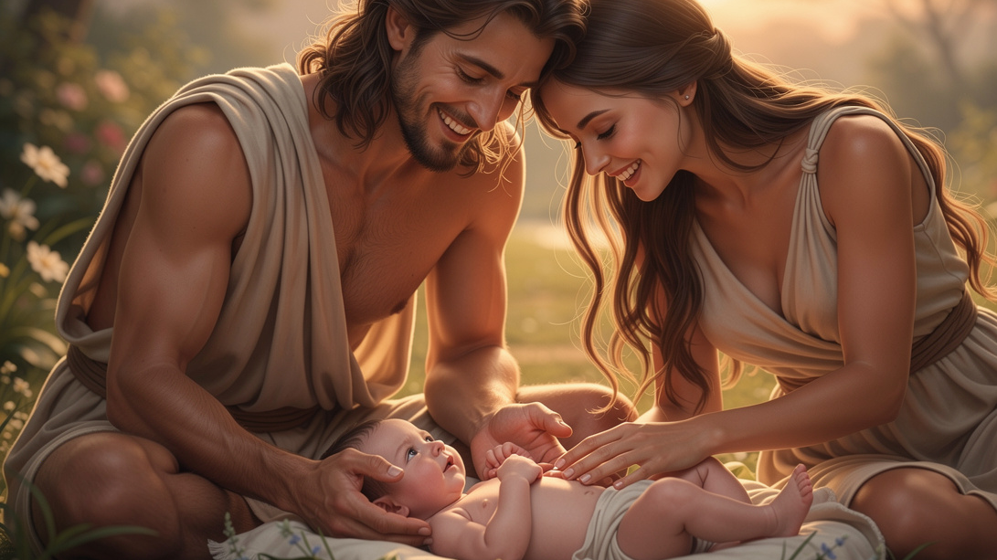
The Hope of Motherhood
By Joseph Peters

Slide 2

Objective
Everyone should know that mothers have difficult tasks
Based on these three examples

Slide 3

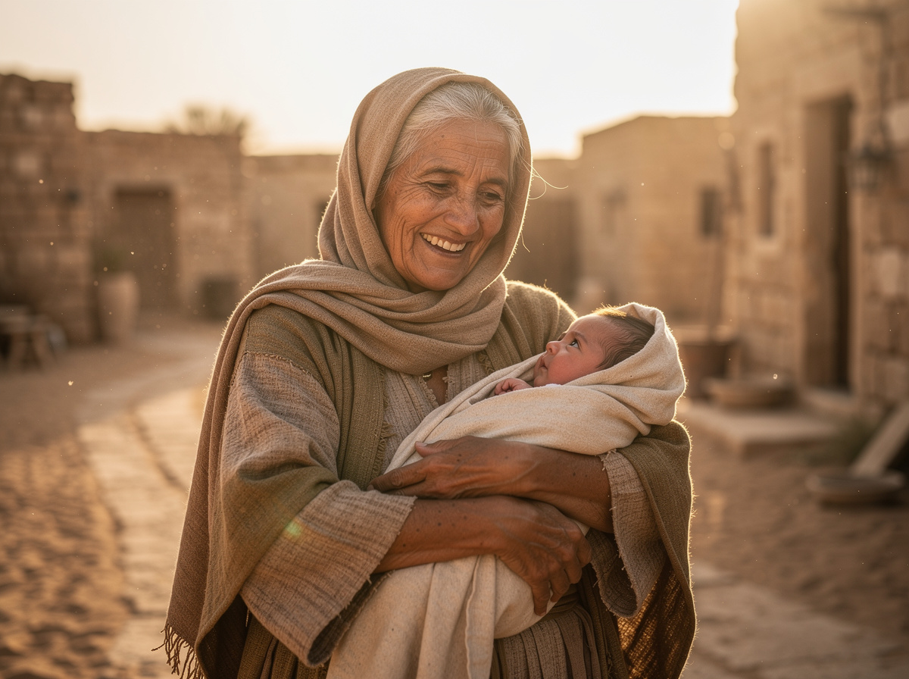
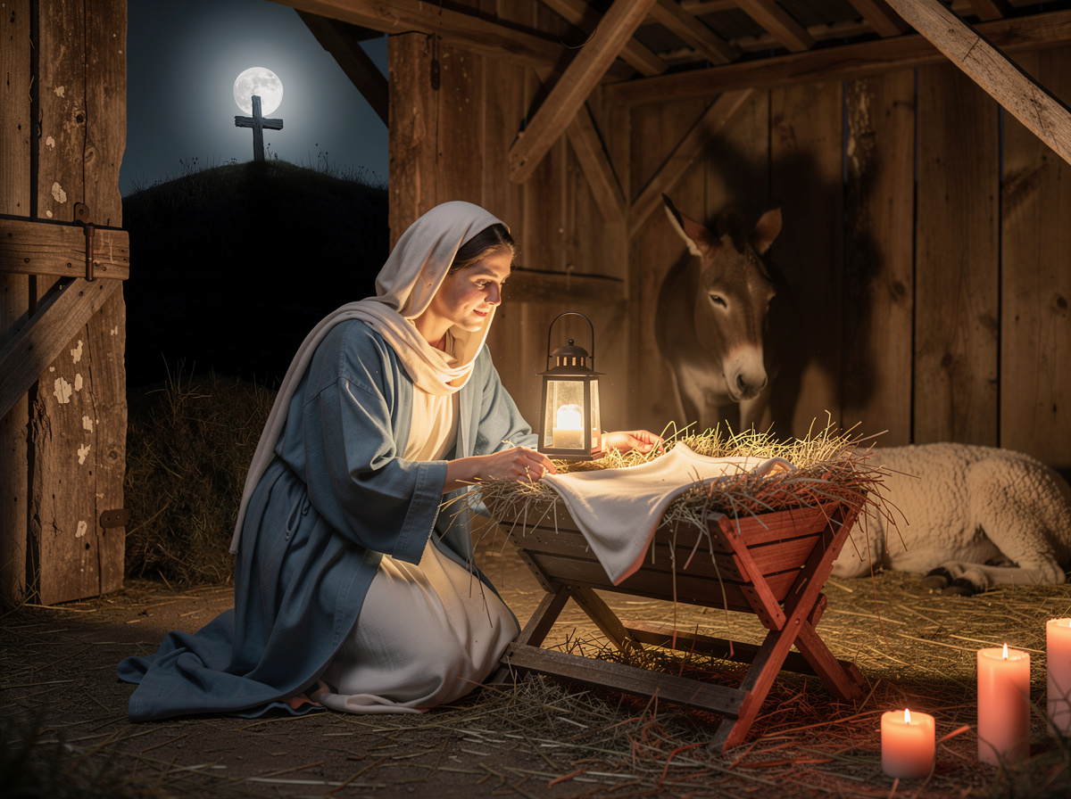
Reasons
The Hope and Disappointment of Eve
The Disappointment and Hope of Naomi
The Hope and Disappointment of Mary

Slide 4

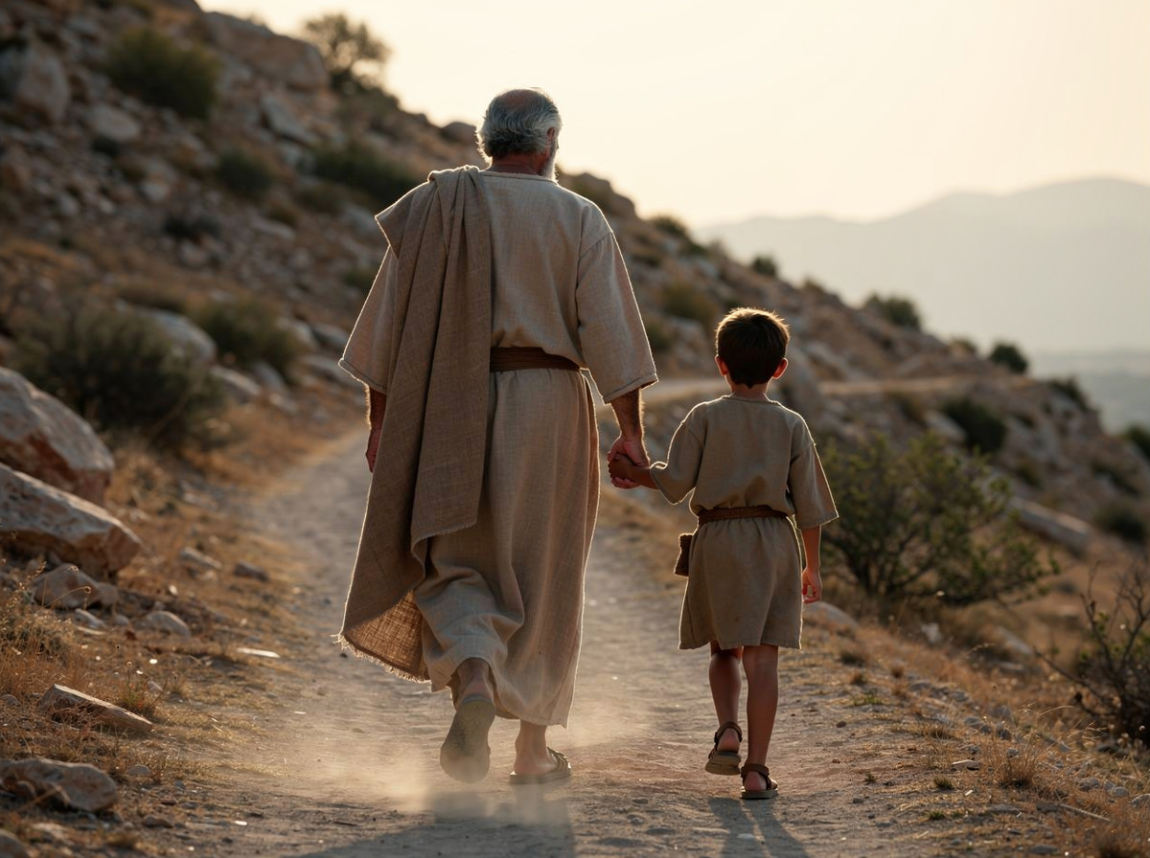
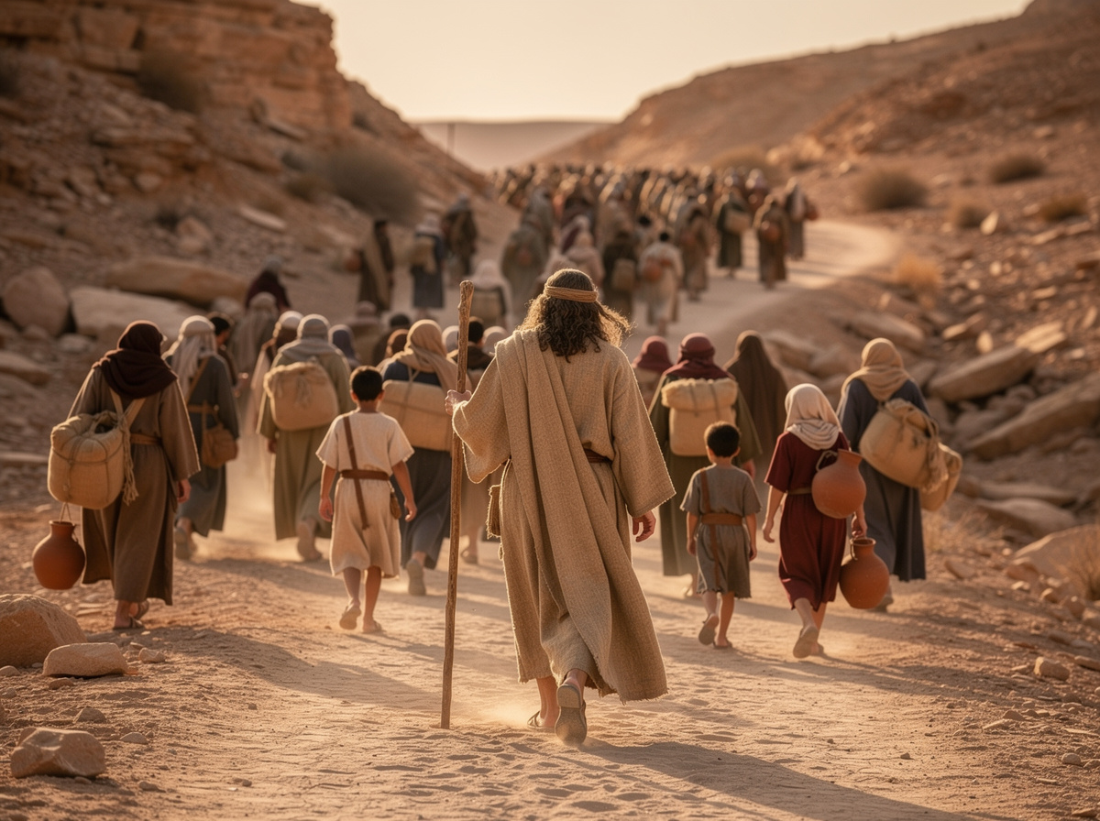
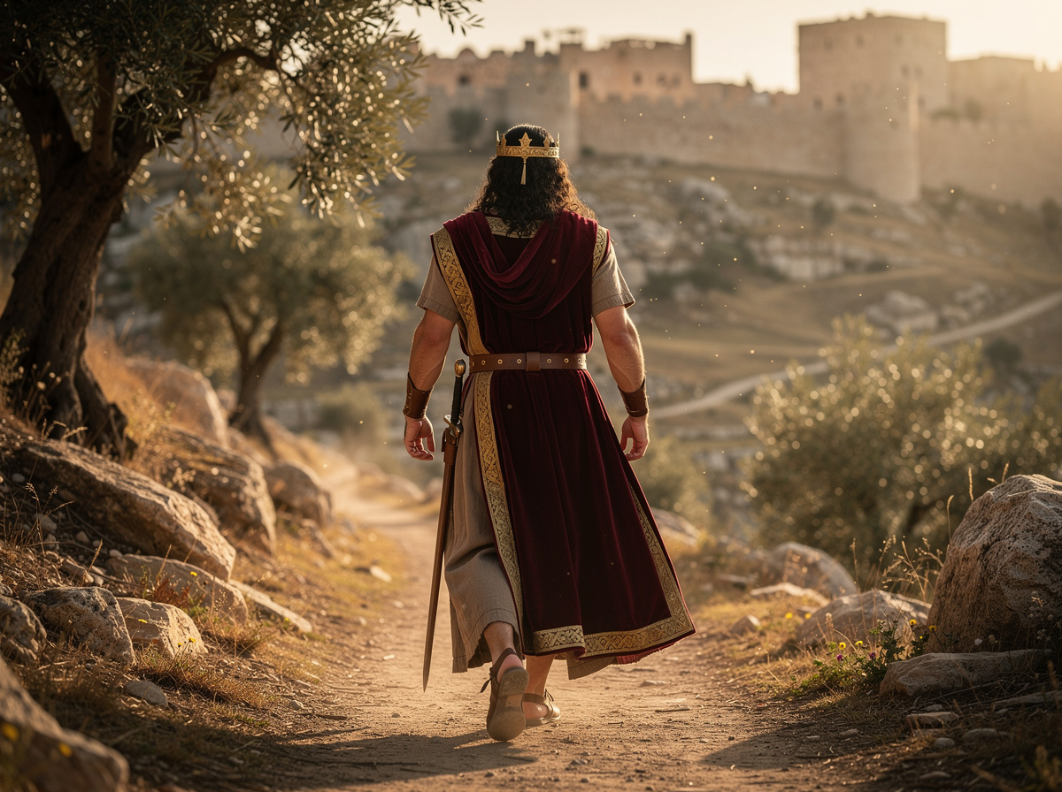
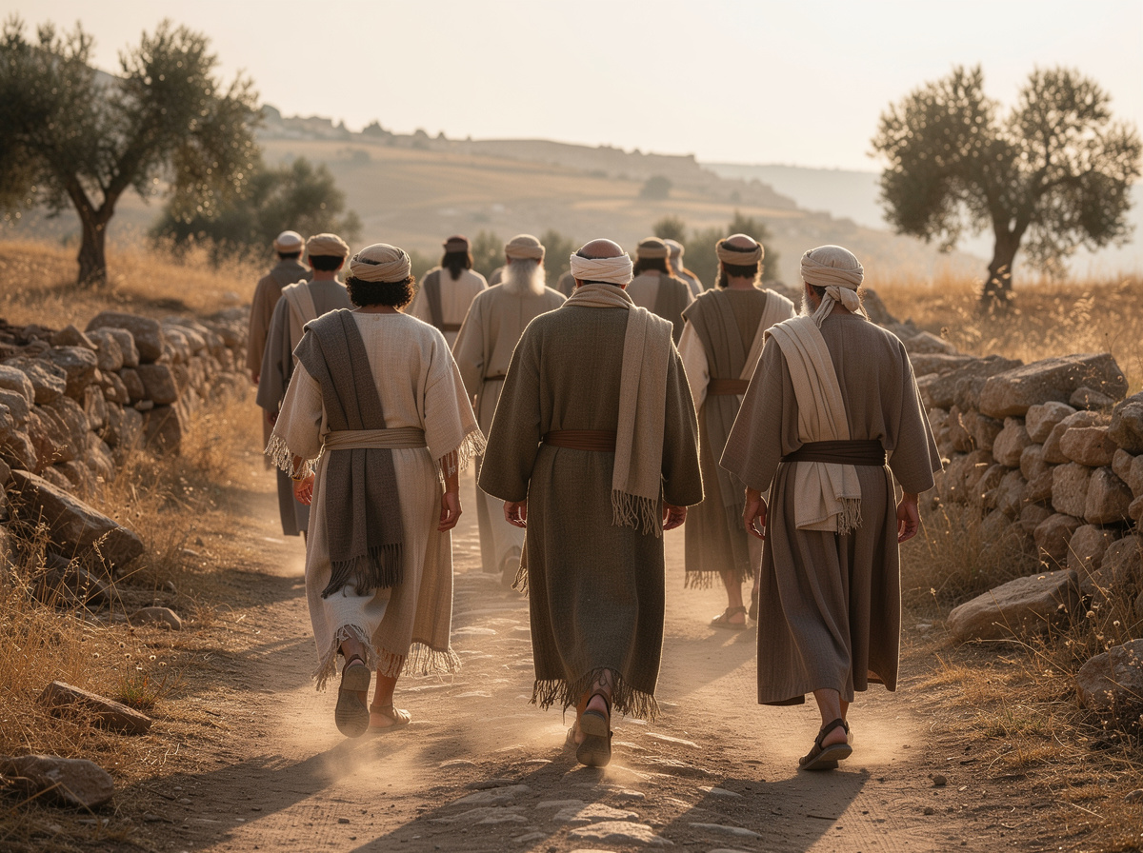


A Quick Gospel Detour

Slide 12
The Hope and Disappointment of Eve

Slide 13
The Promise of Victory
And the LORD God said unto the serpent, Because thou hast done this, thou art cursed above all cattle, and above every beast of the field; upon thy belly shalt thou go, and dust shalt thou eat all the days of thy life: And I will put enmity between thee and the woman, and between thy seed and her seed; it shall bruise thy head, and thou shalt bruise his heel (Gen 3:14–15).

Slide 14
Glimpses of Hope
And Adam knew Eve his wife; and she conceived, and bare Cain, and said, I have gotten a man from the LORD. And she again bare his brother Abel. And Abel was a keeper of sheep, but Cain was a tiller of the ground (Gen 4:1-2).

Slide 15
Envy and Anger
And in process of time it came to pass, that Cain brought of the fruit of the ground an offering unto the LORD. And Abel, he also brought of the firstlings of his flock and of the fat thereof. And the LORD had respect unto Abel and to his offering: But unto Cain and to his offering he had not respect. And Cain was very wroth, and his countenance fell (Gen 4:3–5).

Slide 16
God Reasons with Cain
And the LORD said unto Cain, Why art thou wroth? and why is thy countenance fallen? If thou doest well, shalt thou not be accepted? and if thou doest not well, sin lieth at the door. And unto thee shall be his desire, and thou shalt rule over him (Gen 4:6–7).

Slide 17
Hope Turned to Disappointment
And Cain talked with Abel his brother: and it came to pass, when they were in the field, that Cain rose up against Abel his brother, and slew him… And Cain went out from the presence of the LORD, and dwelt in the land of Nod, on the east of Eden (Gen 4:8, 16).

Slide 18
A Glimpse of Hope Restored
And Adam knew his wife again; and she bare a son, and called his name Seth: For God, said she, hath appointed me another seed instead of Abel, whom Cain slew. And to Seth, to him also there was born a son; and he called his name Enos: then began men to call upon the name of the LORD (Gen 4:25–26).

Slide 19
The Disappointment and Hope of Naomi

Slide 20
A Fight for Survival
Now it came to pass in the days when the judges ruled, that there was a famine in the land. And a certain man of Beth-lehem-judah went to sojourn in the country of Moab, he, and his wife, and his two sons. And the name of the man was Elimelech, and the name of his wife Naomi… (Ruth 1:1–2).

Slide 21
The Loss of Loved Ones
And Elimelech Naomi’s husband died; and she was left, and her two sons. And they took them wives of the women of Moab; the name of the one was Orpah, and the name of the other Ruth: and they dwelled there about ten years. And Mahlon and Chilion died also both of them; and the woman was left of her two sons and her husband (Ruth 1:3–5).

Slide 22
The Disappointment of Naomi
And she said unto them, Call me not Naomi, call me Mara: for the Almighty hath dealt very bitterly with me. I went out full, and the LORD hath brought me home again empty: why then call ye me Naomi, seeing the LORD hath testified against me, and the Almighty hath afflicted me (Ruth 1:20–21)?

Slide 23
Naomi’s Glimpse of Hope
And Naomi said unto her daughter in law, Blessed be he of the LORD, who hath not left off his kindness to the living and to the dead. And Naomi said unto her, The man is near of kin unto us, one of our next kinsmen (Ruth 2:20).

Slide 24
Naomi’s Hope Restored
And the women said unto Naomi, Blessed be the LORD, which hath not left thee this day without a kinsman, that his name may be famous in Israel. And he shall be unto thee a restorer of thy life, and a nourisher of thine old age: for thy daughter in law, which loveth thee, which is better to thee than seven sons, hath born him. And Naomi took the child, and laid it in her bosom, and became nurse unto it (Ruth 4:14–16).

Slide 25
The Hope and Disappointment of Mary

Slide 26
A Message of Hope
And the angel said unto her, Fear not, Mary: for thou hast found favour with God. And, behold, thou shalt conceive in thy womb, and bring forth a son, and shalt call his name JESUS. He shall be great, and shall be called the Son of the Highest: and the Lord God shall give unto him the throne of his father David: And he shall reign over the house of Jacob for ever; and of his kingdom there shall be no end (Luke 1:30–33).

Slide 27
An Additional Messenger
And, behold, there was a man in Jerusalem, whose name was Simeon; and the same man was just and devout, waiting for the consolation of Israel: and the Holy Ghost was upon him. And it was revealed unto him by the Holy Ghost, that he should not see death, before he had seen the Lord’s Christ. And he came by the Spirit into the temple: and when the parents brought in the child Jesus, to do for him after the custom of the law (Luke 2:25–27).

Slide 28
A Hopeful Future
Then took he him up in his arms, and blessed God, and said, Lord, now lettest thou thy servant depart in peace, according to thy word: For mine eyes have seen thy salvation, Which thou hast prepared before the face of all people; A light to lighten the Gentiles, and the glory of thy people Israel (Luke 2:28–32).

Slide 29
A Message of Disappointment
And Joseph and his mother marvelled at those things which were spoken of him. And Simeon blessed them, and said unto Mary his mother, Behold, this child is set for the fall and rising again of many in Israel; and for a sign which shall be spoken against; (Yea, a sword shall pierce through thy own soul also,) that the thoughts of many hearts may be revealed (Luke 2:33–35).

Slide 30
Conclusion
Everyone should know that mothers have difficult tasks
Based on these three examples

Slide 31
Reasons
The Hope and Disappointment of Eve
The Disappointment and Hope of Naomi
The Hope and Disappointment of Mary

