Slide 1
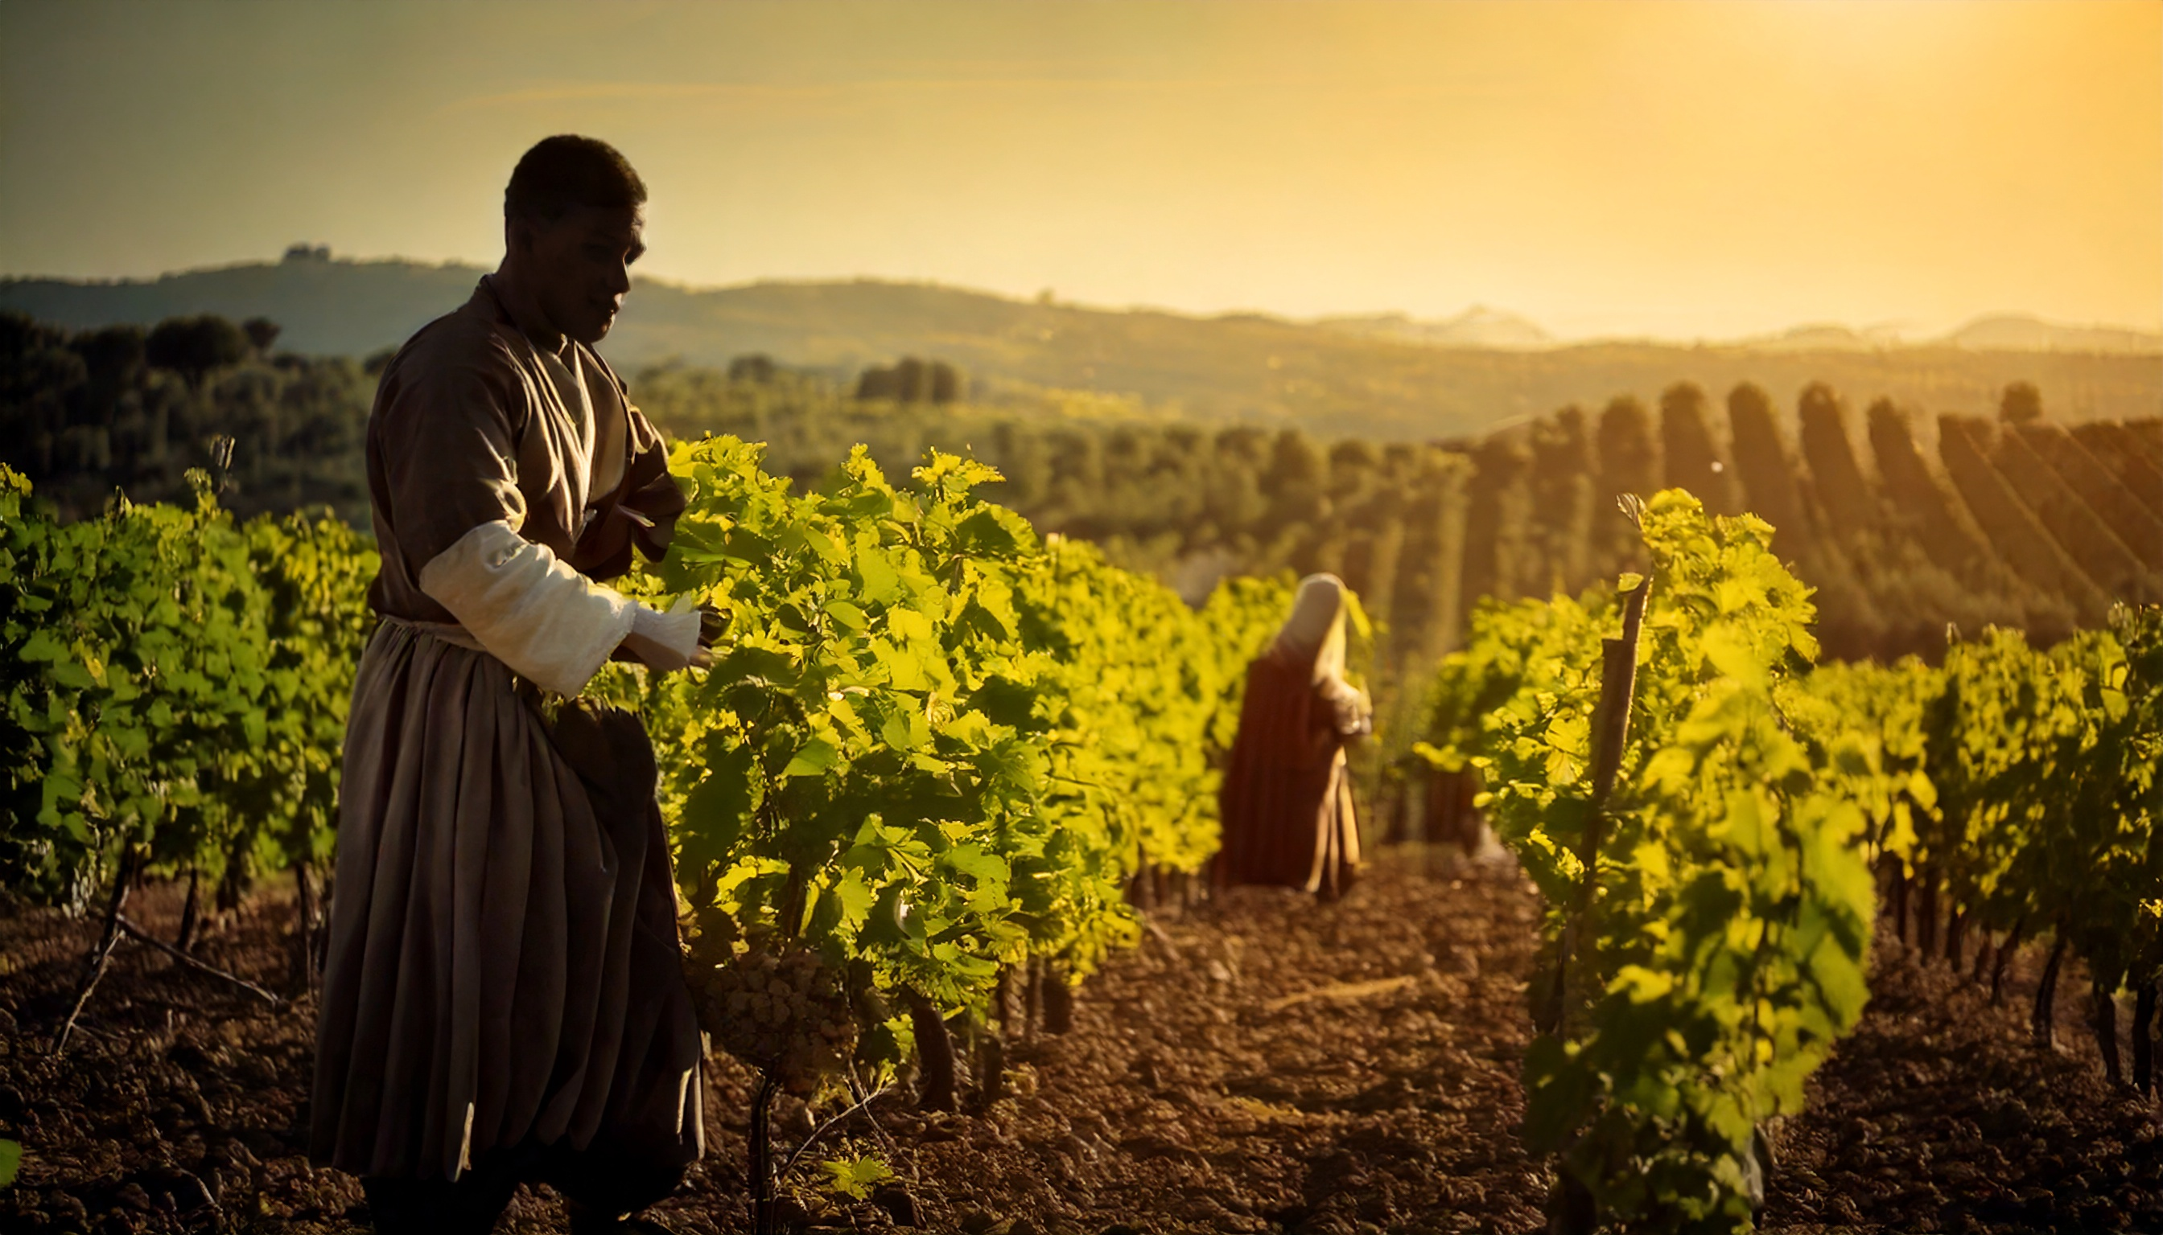
ἢ ὁ ὀφθαλμός σου πονηρός ἐστιν ὅτι ἐγὼ ἀγαθός εἰμι.
By Joseph Peters

Slide 2
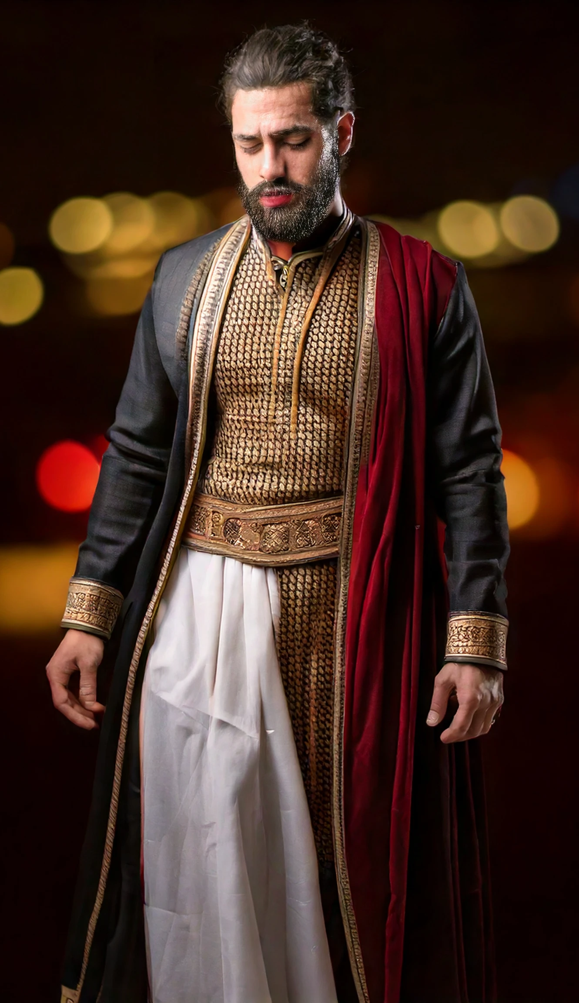
Context
23 Then said Jesus unto his disciples, Verily I say unto you, That a rich man shall hardly enter into the kingdom of heaven…
25 When his disciples heard it, they were exceedingly amazed, saying, Who then can be saved?…
27 Then answered Peter and said unto him, Behold, we have forsaken all, and followed thee; what shall we have therefore?...
29 And every one that hath forsaken houses, or brethren, or sisters, or father, or mother, or wife, or children, or lands, for my name’s sake, shall receive an hundredfold, and shall inherit everlasting life. 30 But many that are first shall be last; and the last shall be first (Mat 19:23, 25, 27, 29–30).

Slide 3
Objective
Every Christian should celebrate the generous grace of God
For these three reasons

Slide 4
Rationale
Because God is the reverser of expectations
Because God is just, never giving people less than what they deserve
Because God is gracious, often giving people more than they deserve

Slide 5
The First Crew (6AM)
For the kingdom of heaven is like unto a man that is an householder, which went out early in the morning to hire labourers into his vineyard. And when he had agreed with the labourers for a penny a day, he sent them into his vineyard (Mat 20:1–2).

Slide 6
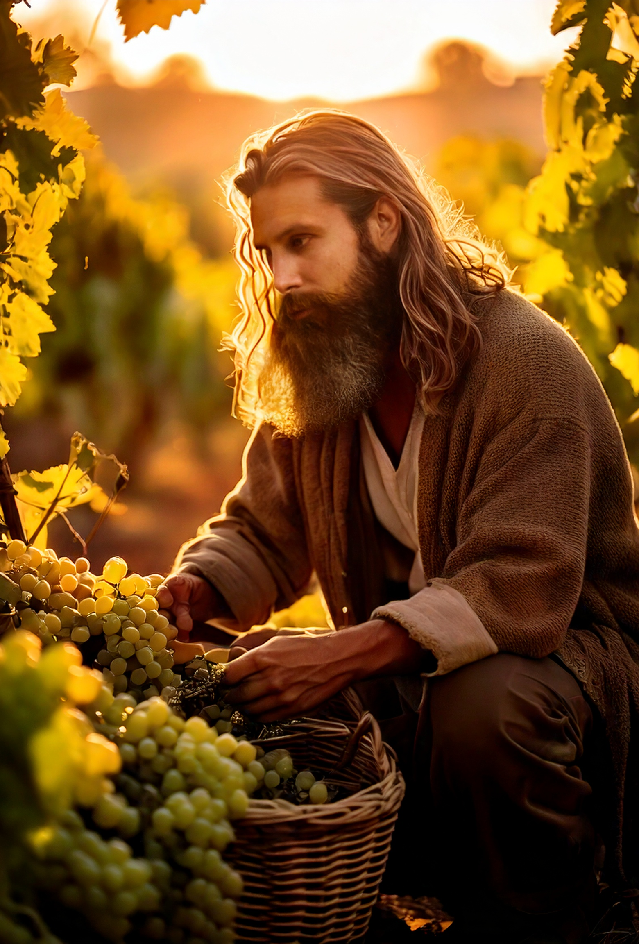
The Next 3 crews (9AM, 12PM, 3PM)
And he went out about the third hour, and saw others standing idle in the marketplace, And said unto them; Go ye also into the vineyard, and whatsoever is right I will give you. And they went their way. Again he went out about the sixth and ninth hour, and did likewise (Matt 20:3–5).

Slide 7
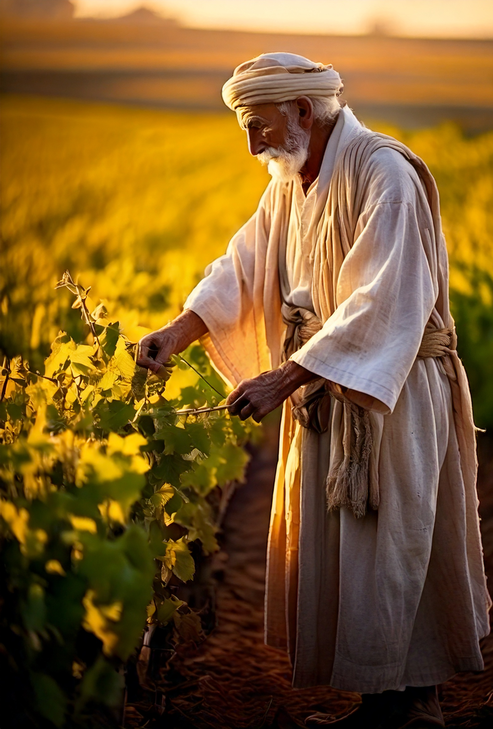
The Final Crew (5PM)
And about the eleventh hour he went out, and found others standing idle, and saith unto them, Why stand ye here all the day idle? They say unto him, Because no man hath hired us. He saith unto them, Go ye also into the vineyard; and whatsoever is right, that shall ye receive (Matt 20:6–7).

Slide 8
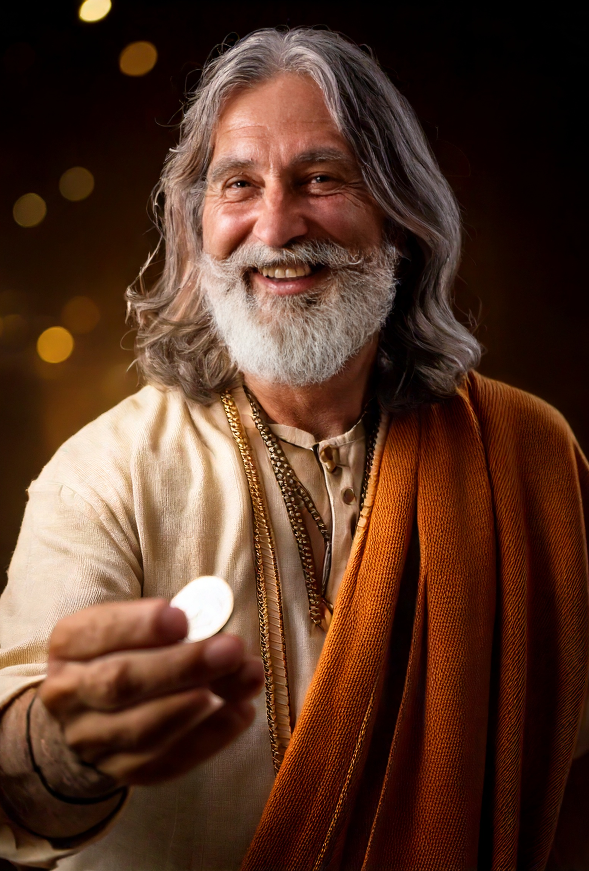
Paying the Late Workers
So when even was come, the lord of the vineyard saith unto his steward, Call the labourers, and give them their hire, beginning from the last unto the first. And when they came that were hired about the eleventh hour, they received every man a penny (Matt 20:8–9).

Slide 9
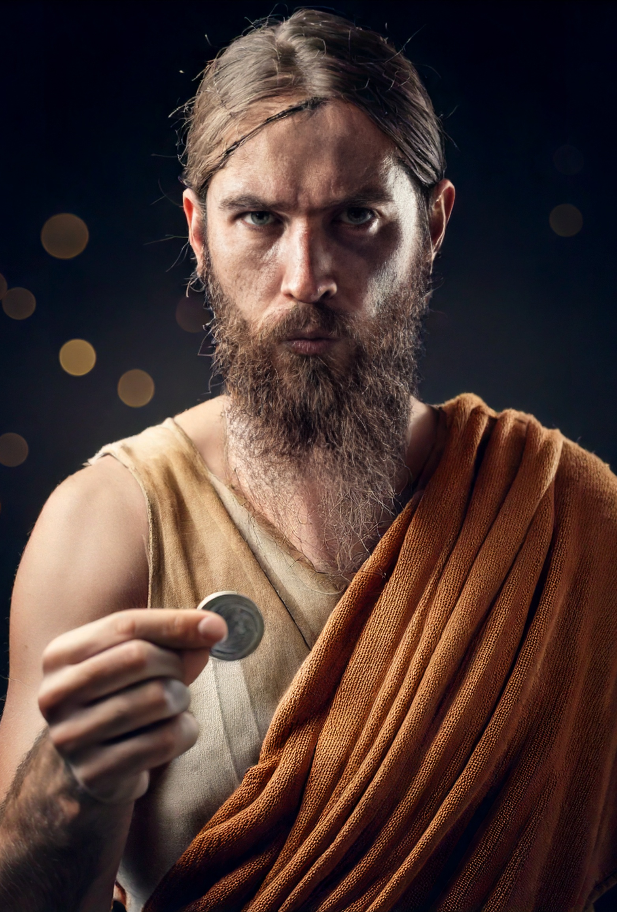
Paying the Early Workers
But when the first came, they supposed that they should have received more; and they likewise received every man a penny. And when they had received it, they murmured against the goodman of the house, Saying, These last have wrought but one hour, and thou hast made them equal unto us, which have borne the burden and heat of the day (Matt 20:10–12).

Slide 10
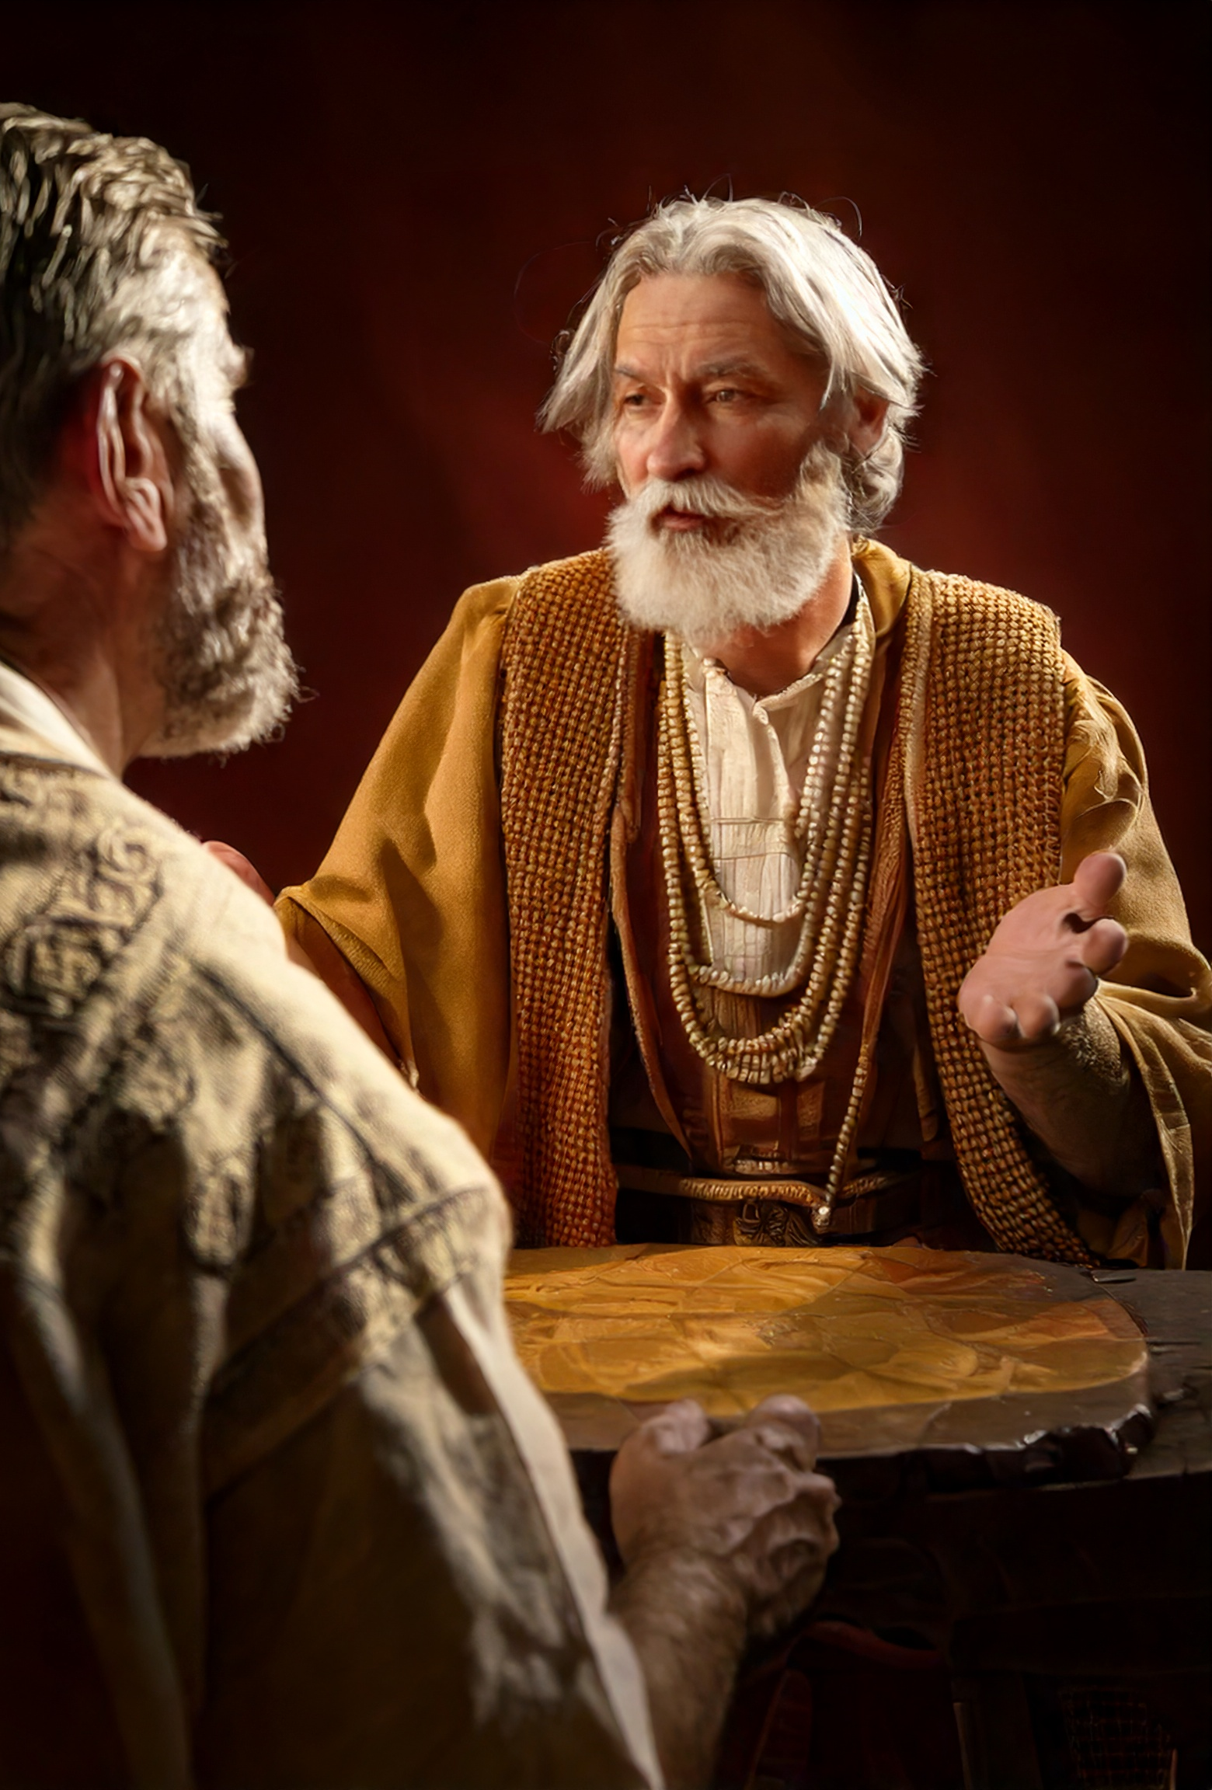
Inappropriately Judging Generosity
But he answered one of them, and said, Friend, I do thee no wrong: didst not thou agree with me for a penny? Take that thine is, and go thy way: I will give unto this last, even as unto thee. Is it not lawful for me to do what I will with mine own? Is thine eye evil, because I am good? So the last shall be first, and the first last: for many be called, but few chosen (Matt 20:13–16).

Slide 11
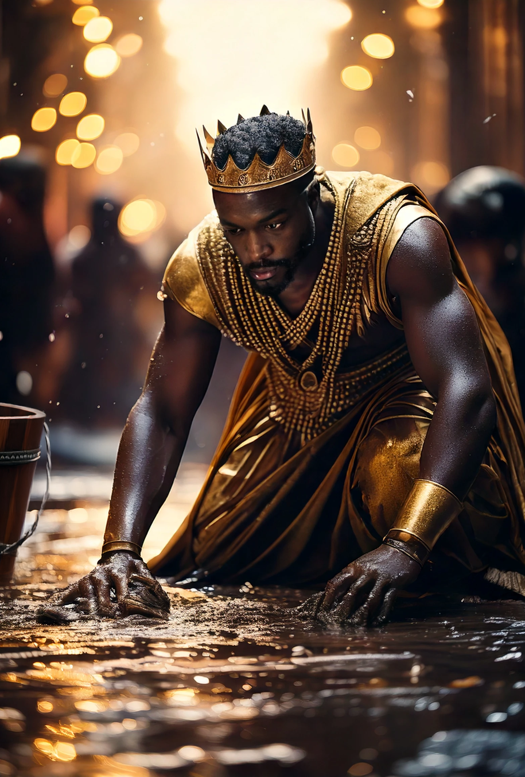
Later Context
“…but to sit on my right hand, and on my left, is not mine to give, but it shall be given to them for whom it is prepared of my Father…
But Jesus called them unto him, and said, Ye know that the princes of the Gentiles exercise dominion over them, and they that are great exercise authority upon them. But it shall not be so among you: but whosoever will be great among you, let him be your minister; And whosoever will be chief among you, let him be your servant: Even as the Son of man came not to be ministered unto, but to minister, and to give his life a ransom for many” (Mt 20:23, 25–28).

Slide 12
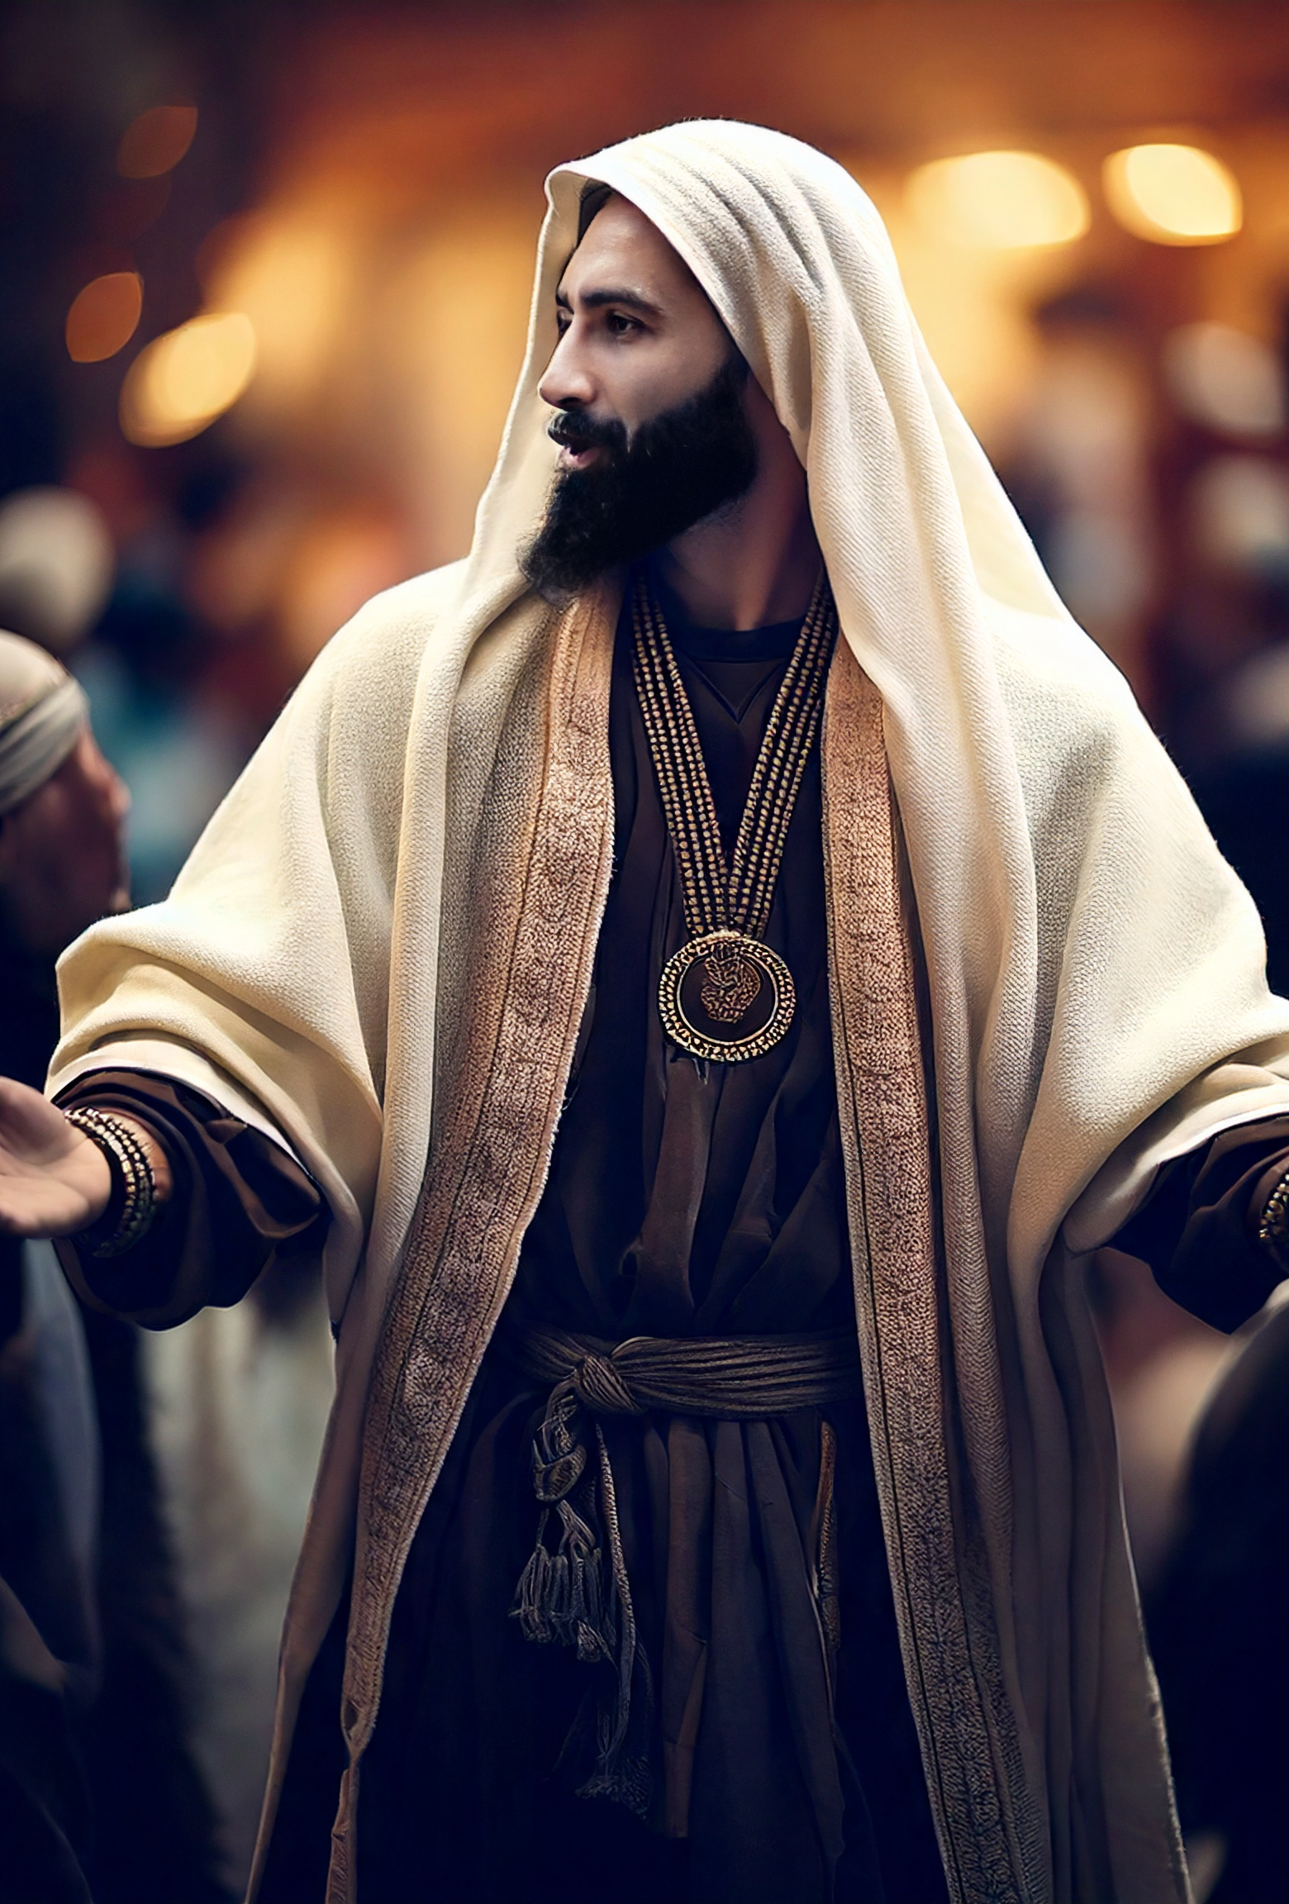
The Context of the Prodigal Son
Then drew near unto him all the publicans and sinners for to hear him. And the Pharisees and scribes murmured, saying, This man receiveth sinners, and eateth with them. And he spake this parable unto them, saying… (Luke 15:1–3).

Slide 13
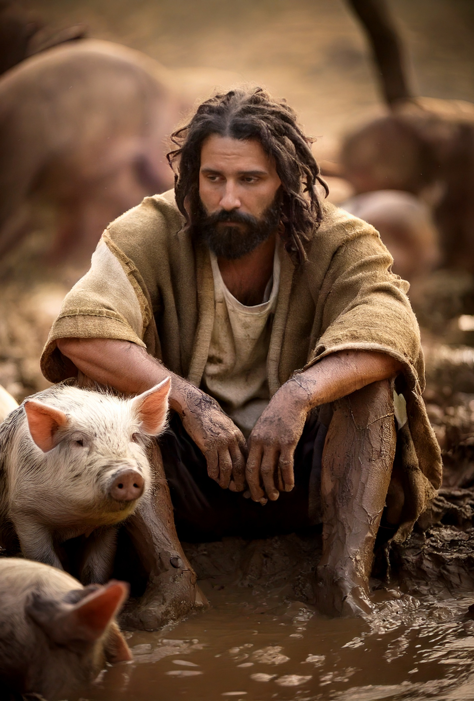
The Prodigal Son
And he went and joined himself to a citizen of that country; and he sent him into his fields to feed swine. And he would fain have filled his belly with the husks that the swine did eat: and no man gave unto him. And when he came to himself, he said, How many hired servants of my father’s have bread enough and to spare, and I perish with hunger! I will arise and go to my father, and will say unto him, Father, I have sinned against heaven, and before thee, And am no more worthy to be called thy son: make me as one of thy hired servants (Luke 15:15–19).

Slide 14
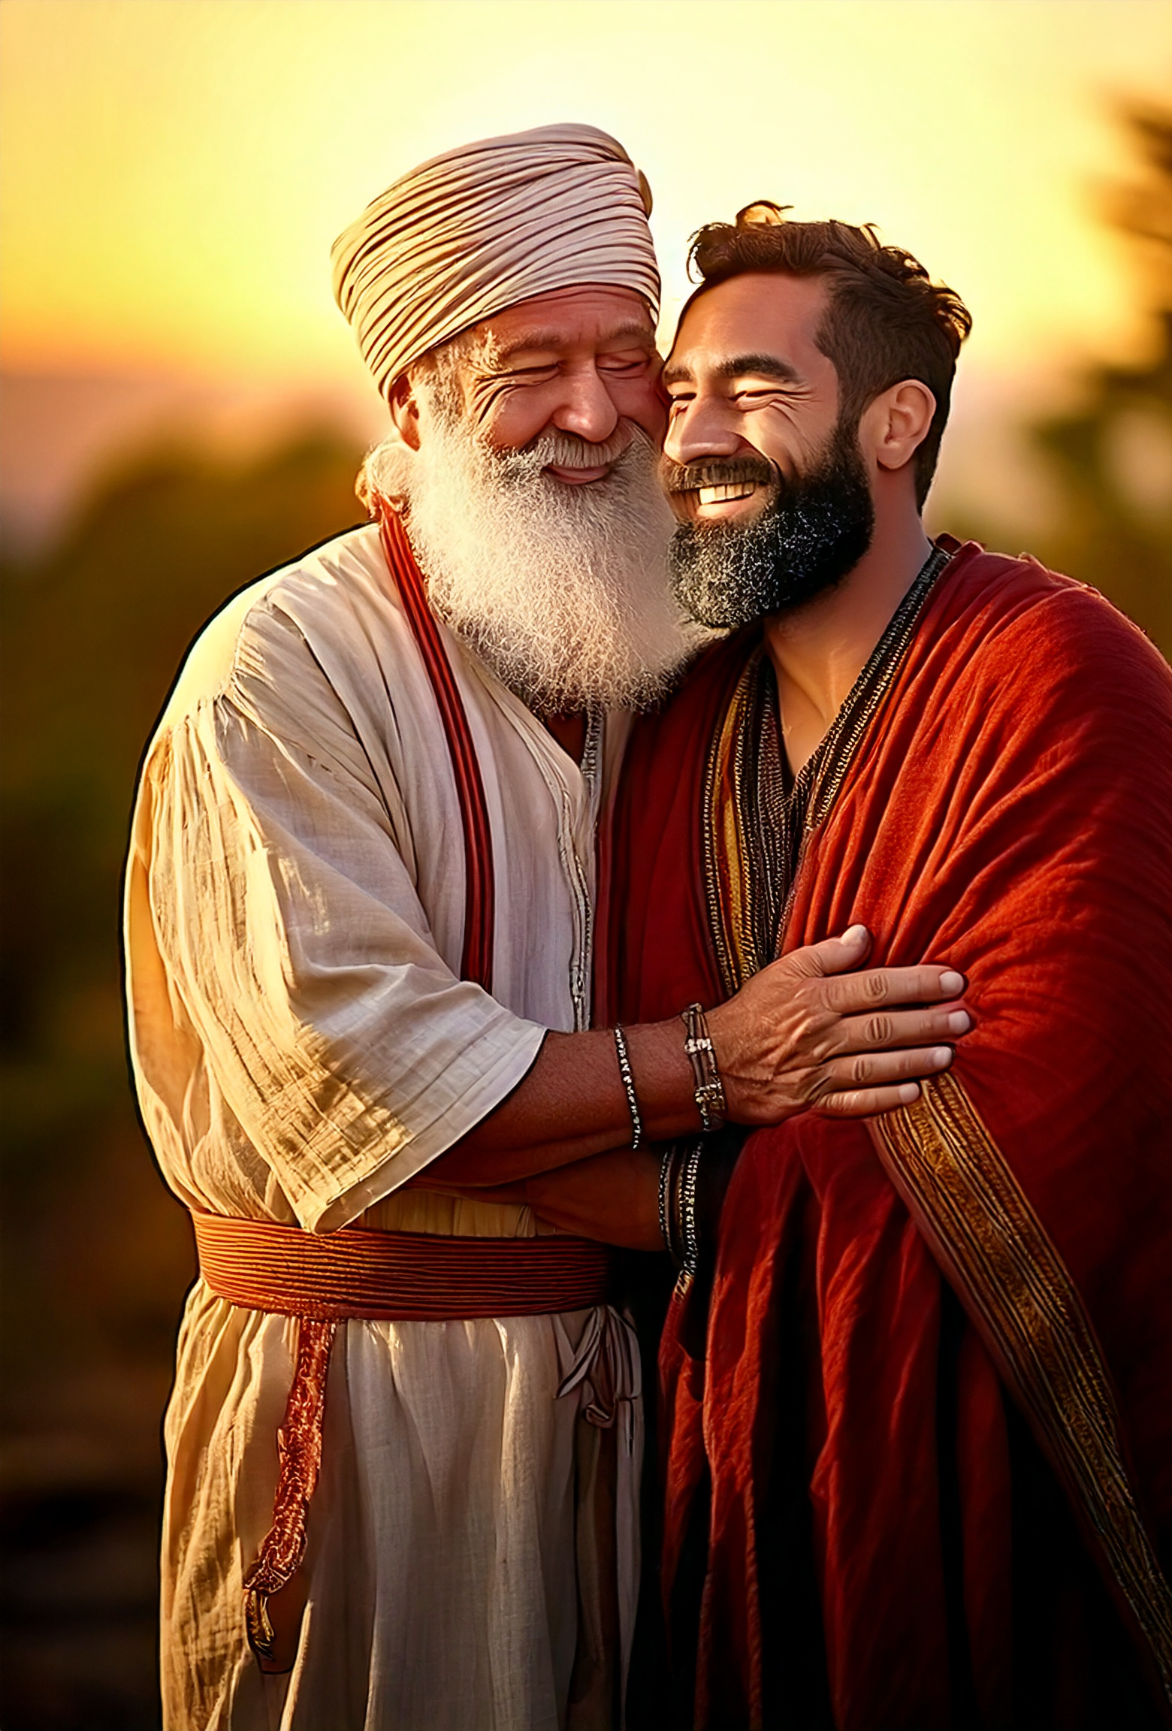
The Prodigals Return
And he arose, and came to his father. But when he was yet a great way off, his father saw him, and had compassion, and ran, and fell on his neck, and kissed him. And the son said unto him, Father, I have sinned against heaven, and in thy sight, and am no more worthy to be called thy son. But the father said to his servants, Bring forth the best robe, and put it on him; and put a ring on his hand, and shoes on his feet: And bring hither the fatted calf, and kill it; and let us eat, and be merry: For this my son was dead, and is alive again; he was lost, and is found. And they began to be merry (Luke 15:20–24).

Slide 15
The Elder Brother
And he was angry, and would not go in: therefore came his father out, and intreated him. And he answering said to his father, Lo, these many years do I serve thee, neither transgressed I at any time thy commandment: and yet thou never gavest me a kid, that I might make merry with my friends: But as soon as this thy son was come, which hath devoured thy living with harlots, thou hast killed for him the fatted calf (Luke 15:28–30).

Slide 16
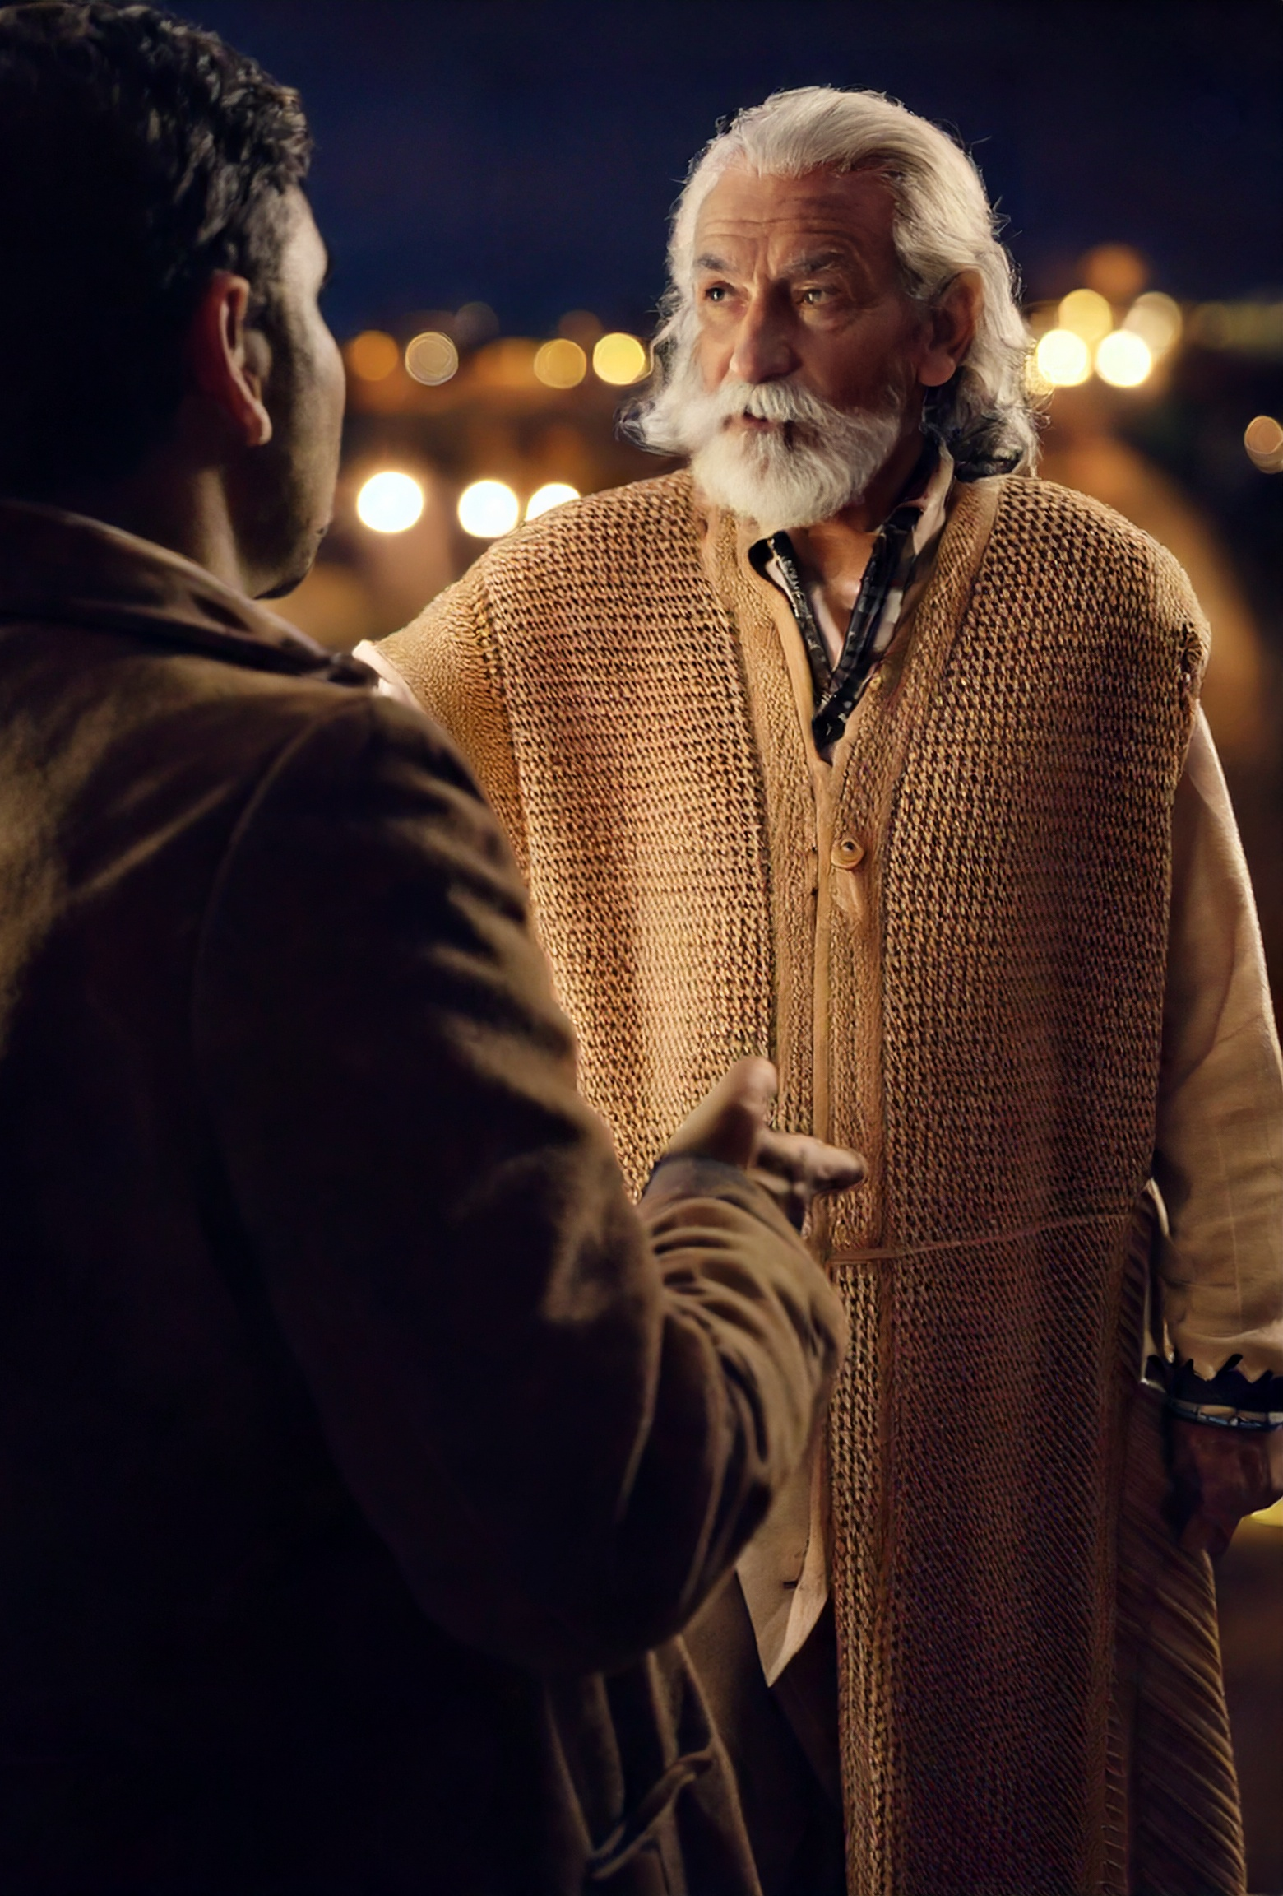
The Fathers Response
And he said unto him, Son, thou art ever with me, and all that I have is thine. It was meet that we should make merry, and be glad: for this thy brother was dead, and is alive again; and was lost, and is found (Luke 15:31–32).

Slide 17
Conclusion
Every Christian should celebrate the generous grace of God
For these three reasons

Slide 18
Conclusion
Because God is the reverser of expectations
Because God is just, never giving people less than what they deserve
Because God is gracious, often giving people more than they deserve

