Slide 1
Pictures of the People of God
Seeing ourselves through God’s Eyes.

Slide 2
Ekklesia: a called out assembly
belonging to the Lord.

Slide 3
God gives us many pictures to help us grasp how God sees/loves/deals with us.
Precious pictures
(Mt. 13:44-46; Mal. 3:17)
Progressive Pictures
(Ps. 23; Is. 64:8; Eph. 2:10)
Personal Pictures
(Eph. 3:15; Ro. 8; Eph. 5; Rev. 19)

Slide 4
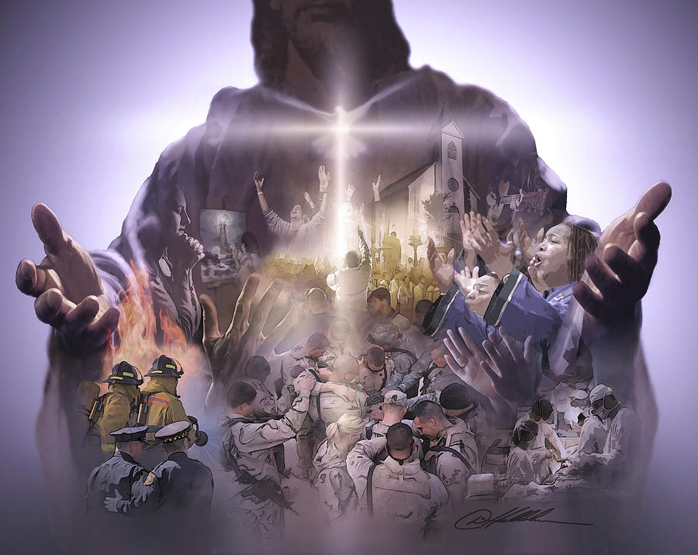
Practical Pictures
“Ye are the body of Christ,
and members in particular”
1 Cor 12:27

Slide 5
Being part of the “Body” of Christ involves:
 | Design: | Distinction: | Development:
1 Corinthians | 12:1-13 | 12:14-31 | 13:1-13
Romans | 12:1-5 | 12:6-8 | 12:9-21
Ephesians | 4:1-6 | 4:7-12 | 4:13-16
Unity
Diversity
Maturity
Maturity should produce Ability (Ministry 4:12)
and Stability! (Commitment 4:14)

Slide 6
God’s word is infinitely practical!
He doesn’t intend it just to be read, discussed, or even studied:
But to be obeyed!
2 Cor. 3:18; Ro. 12:2

Slide 7
Not doing so can result in:
Deception: Jms 1:22 “Be doers of the word
and not hearers only,
Deceiving your own selves!”
Death: James 2:26
“For as the body without the spirit is dead,
so faith without works is dead also.”

Slide 8
Our Walk with Christ
Ephesians 4-6
Our Wealth in Christ
Called by Grace to be part of His family (Ch. 1)
Raised from spiritual death (ch. 2)
Reconciled to God and each other (2:11-22)
Mystery of God’s Power in/through us. (3)
Ephesians 1-3
Walk Worthy 4:1-16
Walk in Purity 4:17-5:17
Walk in Harmony
5:18-6:9
Walk in Victory
Eph. 6:10-24

Slide 9
The Development of the body.
Eph 4:11-16
Churches, like Bodies, need to develop in:
Maturity (Christlikeness) Eph. 4:12
“For the perfecting of the saints
for the work of the ministry,
for the edifying of the body of Christ”

Slide 10
Eph. 4:13 “Till we all come in the unity of the faith, and of the knowledge of the Son of God, unto a perfect man,
(teleios: mature, complete)
From telos: to achieve the goal or purpose!
unto the measure of the stature of the fulness of Christ:”

Slide 11
Maturity Produces Ability & Stability
“That we henceforth be no more children,
tossed to and fro, and carried about with every wind of doctrine,
by the sleight of men,
and cunning craftiness,
whereby they lie in wait to deceive;”
Eph 4:14

Slide 12
Maturity should Produce Stability
Satan is the master manipulator.
A. He’s the author of “misinformation”
Gen. 3:1-5; John 8:44 “he is the father of lies”
He has incredible influence. 1 Jn 2:15-17
2Cor. 4:4 “god of this world blinds the minds”
1 Jn 5:19 “The whole world lies in wickedness”
poneros’: “the wicked one” 6x; “diseased”

Slide 13
2) He has many “disciples of deceit”
2Cor 11:13-15 “such are …deceitful workers, transforming themselves into the apostles of Christ. And no marvel;
for Satan himself is transformed
into an angel of light.
Therefore it is no great thing if his ministers also be transformed as the ministers of righteousness…”

Slide 14
Satan is a master manipulator.
2. The purpose of Misinformation is
Misdirection
A. He uses deception to affect our
Decisions and Direction.
1) He seeks to infiltrate our minds
so he can influence our behavior/choices.
(Eph. 4:25-27)

Slide 15
2. Misinformation ➔ Misdirection
A. He uses deception to affect our direction.
B. God Created us:
For His Glory (Rev 4:11) “for your pleasure”
For our Good. (Eph. 2:10; Ro 8:28; Jn 10:10)
Ps. 16:11“Thou wilt shew me the path of life:
in thy presence is fulness of joy;
…there are pleasures for evermore.”

Slide 16
A. He uses Deception to affect our Direction.
B. We’re created for God’s Glory and our Good.
C. Satan seeks to rob us of both!
Jn 10:10 “Thief comes to steal, kill, destroy”
1) He does this through seduction Jms 1:12-16
“every man is tempted (peirazo: examined scrutinize)
when he is drawn away of his own lust
(epithymia: desire, set heart upon)
and enticed (Deleazo: deluded, entrapped)

Slide 17
1) Satan deludes to seduce us. Jms 1:14
“drawn away of our own lust and enticed.”
2) Seduction’s goal is Sin. James 1:15,16
“When Lust hath conceived,
Hamartia: offend.
(to miss the mark and so not share in the prize)
and sin, when it’s finished, brings forth death.
Do not err (planao: caused to roam, drift)
my beloved brethren.”
it brings forth sin,
From Hamartano: to trespass,

Slide 18
3. This will only get worse!
2 Tim 3:1,13 “This know also,
that in the last days perilous times shall come….
13 But evil men and seducers shall wax worse and worse,
deceiving, and being deceived.”

Slide 19
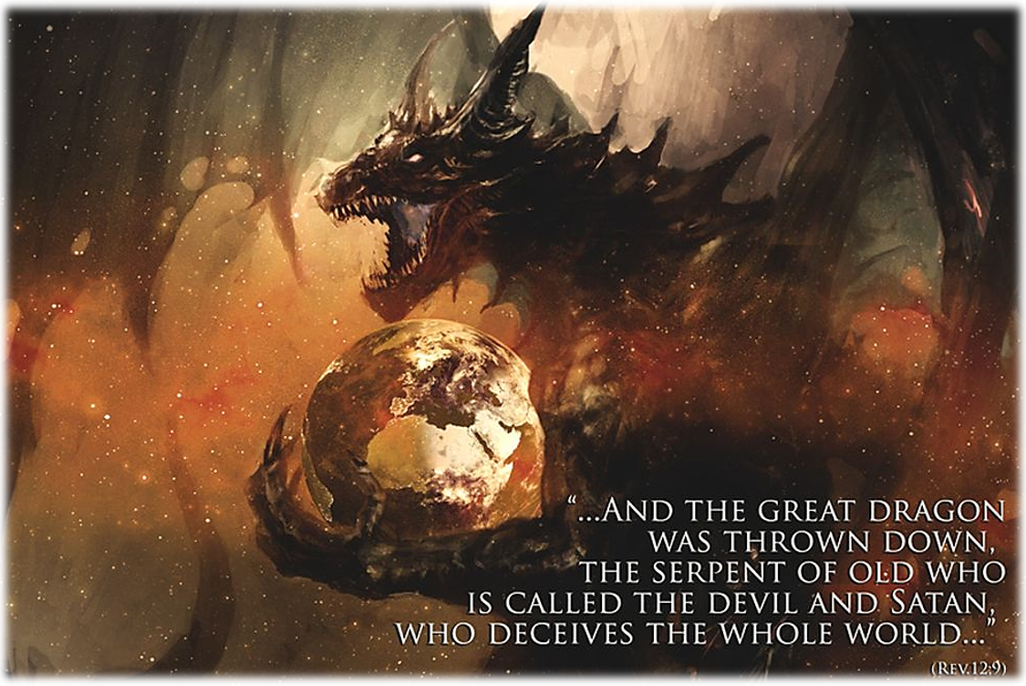
Rev 12:12 “Woe to the inhabiters of the earth!
for the devil is come down unto you,
having great wrath,
because he knoweth that he hath but a short time.

Slide 20
2 Thes 2:9-10
“Even him, whose coming is after the working of Satan with all power and signs and lying wonders
And with all deceivableness of unrighteousness in them that perish;
because they received not the love of the truth, that they might be saved.

Slide 21
3. This will only get worse! 1 Tim 4:1-2
“in the latter times some shall depart from the faith, giving heed to seducing spirits, (planos: deceiving) and doctrines of devils;
Speaking lies in hypocrisy;
having their conscience (Syneidesis: co perception)
Seared with a hot iron” (kauteriaz’o: cauterized)

Slide 22
Conclusion: The Great “Collusion”
1. Satan is the master manipulator.
As the “father of lies” & “god of this world”
He’s the author of misinformation
With many disciples of deceit.
2. Misinformation ➔ Misdirection
Satan uses seductions and delusions to
Move us away from God’s desire & design.

Slide 23
The Great Collusion!
3. This will only get worse! 2 Tim 3:13 “evil men and seducers shall wax worse…
deceiving, and being deceived!”
Planao: cause to drift, roam
Many Cults “kidnap” God’s children,
Because they’re not mature/stable enough
“to discern good and evil” Heb. 5:14.

Slide 24
God’s Great Solution!
Spiritual Maturity ➔ Spiritual Stability
“That we henceforth be no more children, tossed to and fro, and carried about with every wind of doctrine, by the sleight of men, and cunning craftiness,
whereby they lie in wait to deceive;”
Eph 4:14

Slide 25
God’s Great Solution! Eph 4:15 “But speaking the truth in love,
may grow up into him in all things,
which is the head, even Christ:”

Slide 26
The Problem: Satanic Deception
1 Jn 4:1 “Believe not every spirit but try the spirits, whether they are of God:
For many false prophets are gone out into the world.”
The Promise: Divide Protection 1 Jn 4:4
“Greater is He that is in you,
than he that is in the world”.

Slide 27
The Process: A Deep Conviction
1Jn 5:3-4 “this is the love of God,
that we keep his commandments:
and his commandments are not grievous.
…and this is the victory that overcometh the world,
even our faith.” Pistis: trust
From peitho: conviction, trust, confidence

Slide 28
Spiritual Maturity ➔ Stability built on a foundation of faith/truth.
2 Tim. 3:16,17 “All scripture is given by inspiration of God, and is profitable
for doctrine, for reproof, for correction,
for instruction in righteousness:
That the man of God may be perfect,
(artios: complete) thoroughly furnished
(exartizo: equipped) unto all good works.”

Slide 29
Such Faith becomes our defensive and offensive weapon. Eph. 6:16-17
“Above all, taking the shield of faith, wherewith ye shall be able to quench all the fiery darts of the wicked.
And take the helmet of salvation,
and the sword of the Spirit,
which is the word of God:”

Slide 30
1 Jn 4:4 “This is the victory that
overcomes the world,
Such faith is formidable & foundational!
Heb. 11:1 “Now faith is the substance
(hupostasis: footing) of things hoped for
The evidence (el’enchos: proof, conviction)
of things not seen.”
Even our Faith!”

Slide 31
Such a solid foundation of Faith enables us to become discerning.
1 Jn 4:1 “try the spirits whether they be of God”
4:6 “We’re of God: he that knows God hears us;
he that is not of God heareth not us.
Hereby know we the spirit of truth,
and the spirit of error.”
Plan’e: deception, fraud, straying.

Slide 32
Notice how Jesus concluded his first recorded sermon.
1) Strait and narrow gates. Mt 7:13,14
2) Beware of False Prophets vs 15-20
3) Many will be deceived. Vs 21-23
4) The wise or foolish foundations! Vs 24-27
Based on hearing and doing!

Slide 33
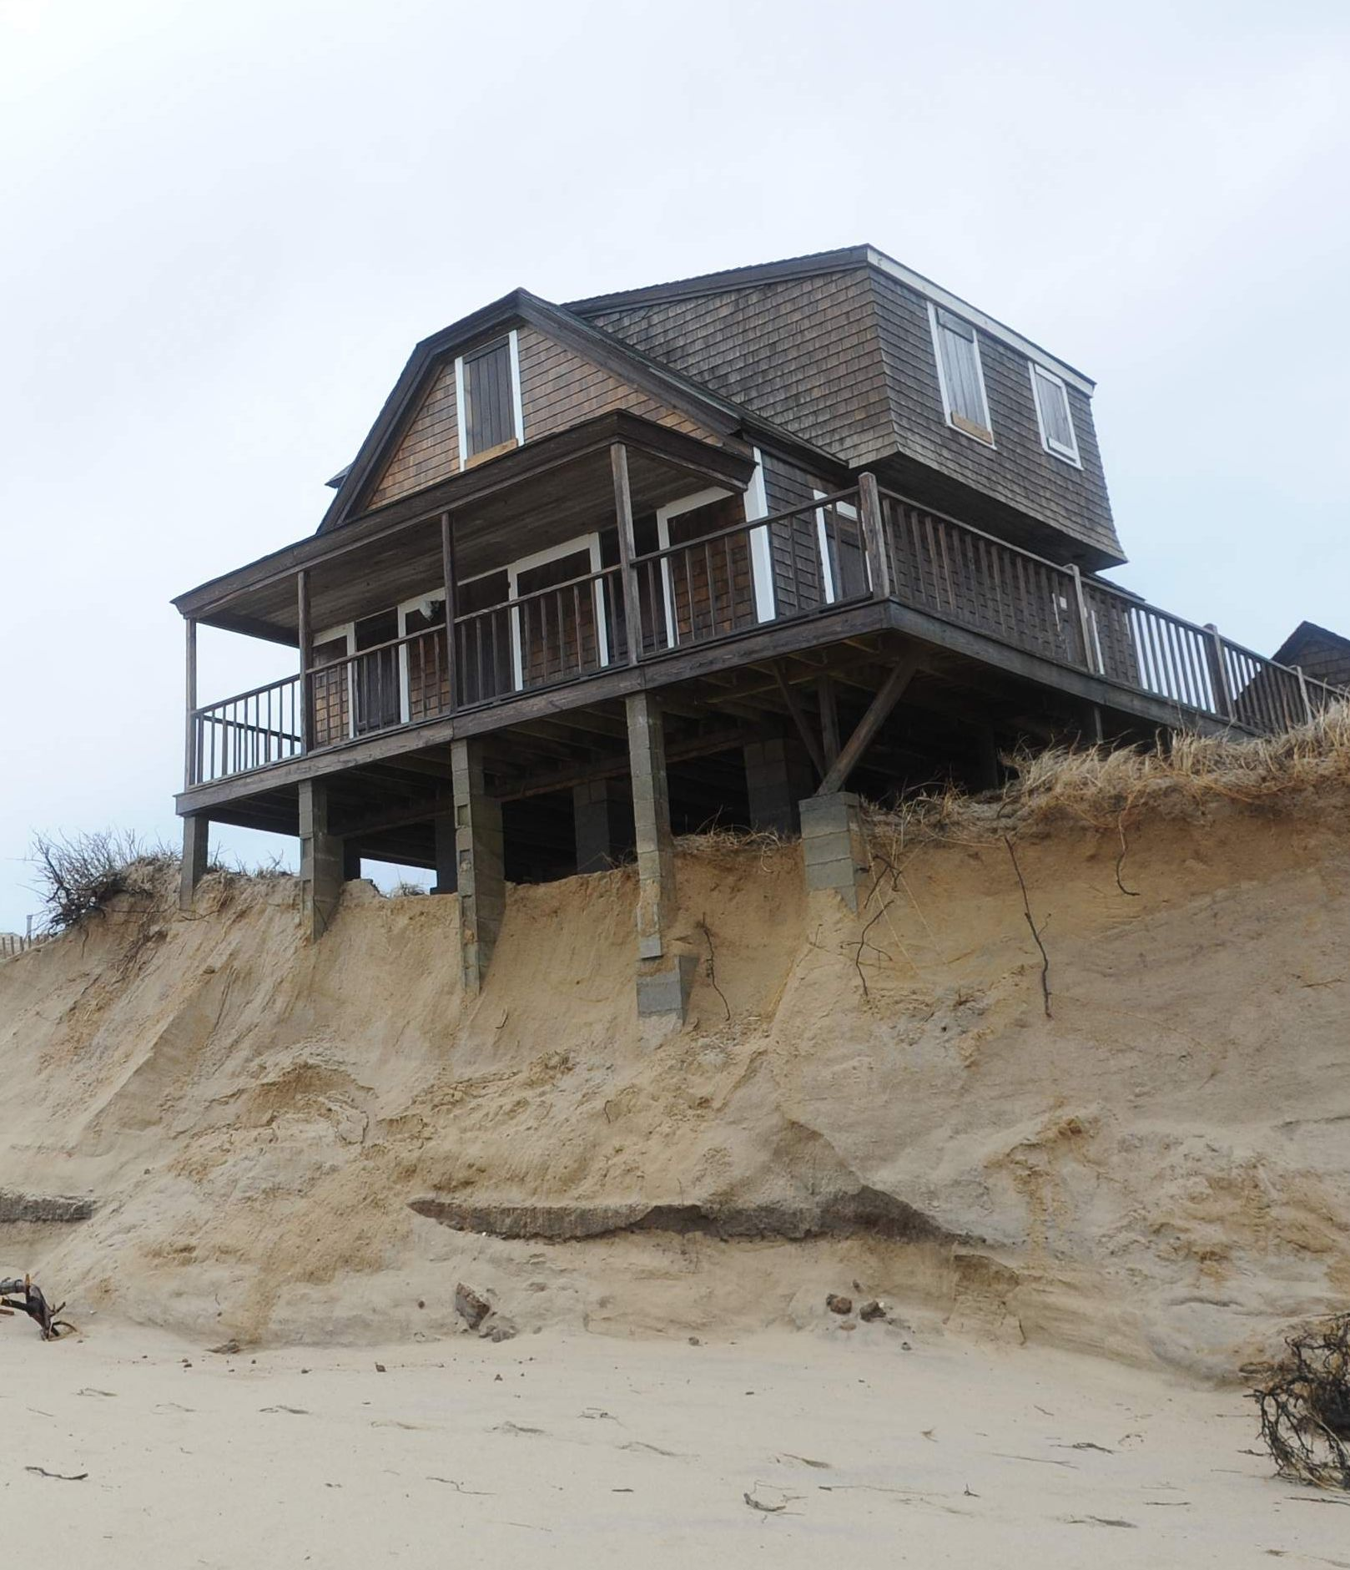
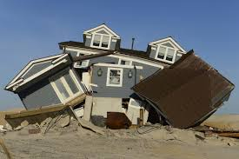
“every one that heareth these sayings of mine,
and doeth them not,
shall be likened unto a foolish man,
which built his house upon the sand:”

Slide 34
24 “Therefore whosoever heareth these sayings of mine, and doeth them,
I will liken him unto a wise man,
which built his house upon a rock:”

Slide 35
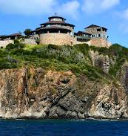
Satanic Storms will come.
Do you have a stable foundation that can withstand them?

