Slide 1
Pictures of the People of God
Seeing ourselves through God’s Eyes.

Slide 3
Ekklesia: a called out assembly
belonging to the Lord.

Slide 4
Pictures of God’s People
“I will build my church;
and the gates of hell shall not prevail against it.”
Mt 16:7

Slide 5
Isaiah 55:7-9 and 1 Cor 2:14 reminds us that we won’t naturally “get” God and his ways.
The only way we can genuinely comprehend God is if He takes the initiative to reveal himself to us.
Thankfully, He has and continues to do this through:

Slide 6
Ro 1:20 “the invisible things of him from the creation of the world are
clearly seen, being understood by the things that are made, even his
eternal power and Godhead;
so that they are without excuse…”

Slide 8
Most Clearly through His Son.
“Hath …spoken unto us by his Son,
whom he hath appointed heir of all things, by whom also he made the worlds;
3 Who being the brightness of his glory, and the express image of his person, upholding all things by …his power”

Slide 9
His Holy Spirit continues to reveal Him and His purposes to His people.
1 Cor 2:9-10
“Eye hath not seen, nor ear heard, neither have entered into the heart of man,
the things which God hath prepared for them that love him.
But God hath revealed them unto us by his Spirit:”
Jn 16:13 “He shall guide you into all truth.”

Slide 10
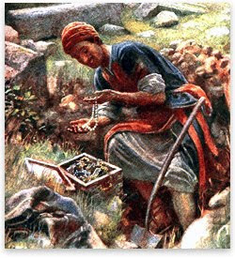
He gives us many pictures to help us grasp how God sees/loves/deals with us.
Precious pictures.
(Mt. 13:44-46; Mal. 3:17)

Slide 11
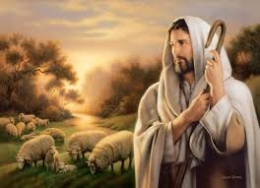
He gives pictures to help us “see”.
Progressive Pictures
(Ps. 23; Jn 10)
(Is. 64:8; Eph. 2:10)

Slide 12
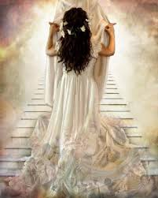
He gives pictures to help us “see”:
Personal Pictures
(Eph. 3:15; Ro. 8)
Eph. 5; Rev. 19

Slide 13
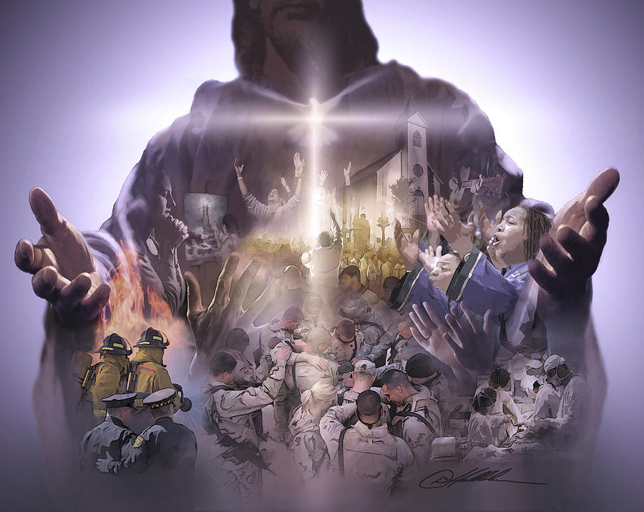
Practical Pictures
“Ye are the body of Christ,
and members in particular”
1 Cor 12:27

Slide 14
Last week we discussed the Distinction of the Church.
Individual churches are different.
Individual People (members) of a church “body” are different
By Design! (1 Cor. 12)

Slide 15
The Development of the body.
Eph 4:11-16
Churches, like Bodies, need to develop in:
Maturity (Christlikeness) Eph. 4:12
“For the perfecting of the saints”
katartismos’: complete furnishing/equipping.
from katartiz’o: to complete, repair, adjust.

Slide 16
Eph. 4:12 “For the perfecting of the saints”
The process of Maturity involves:
1. A Healthy Diet. You are what you eat!
God’s word is soul food! Jer. 15:16
“Thy words were found and I did eat them;
and thy word was unto me
the joy and rejoicing of mine heart:
for I am called by thy name!”

Slide 17
God’s word is compared to food:
Milk (1 Pt 2:2) “Desire the sincere milk of the word
Some never outgrow this stage! (Heb. 5:12,13)
b) Bread (Jn 6:48) “I am the bread of life”
53- 63 “the words that I speak unto you,
they are spirit and they are life”
that ye may grow thereby”

Slide 18
A. God’s word is compared to food:
3) Meat (Heb. 5:14) “strong meat belongs to those that are of a full age
(telios: complete, mature)
who by reason of use (hexis: practice)
have their senses exercised to discern both good (kalos: intrinsically valuable)
and evil” (kakos: intrinsically worthless)

Slide 19
B. It’s not what you eat, but what you
digest that benefits you. (Josh. 1:8)
Spiritual growth requires spiritual resources.
2 Tim 2:15-17 “Study (spoudazō: effort) to shew thyself approved (dokimos: tried) unto God,
a workman (ergat’ēs: toiler/teacher)
that needeth not to be ashamed,
rightly dividing the word of truth. “

Slide 20
1. A Healthy Diet. You are what you eat!
C. What we ingest, affects us!
Garbage in ➔ Garbage out! 2 Tim2:16,17 “But shun profane and vain babblings:
for they will increase unto more ungodliness.
And their word will eat as doth a canker:” (gan’graina: gangrene)

Slide 21
The process of Maturity involves:
1. A Healthy Diet. You are what you eat!
2. Exercise: 12 “for the work (ergon: effort)
of the ministry” (diakonia: service)
A. Maturity enables:
1) Ministry! Heb. 5:14 “those that are of a
full age who by reason of use…
2) Clarity! “to discern good and evil”

Slide 22
2. Exercise: 12 “for the work of the ministry”
B. Jesus modeled this: Lk 2:52 “increased in wisdom…stature…favor with God and man”
Jn 5:17 “My Father worketh hitherto,
and I work”
Jn 9:4 “I must work the works
of him that sent me, while it is day:
the night cometh, when no man can work.”

Slide 23
2. Exercise: 12 “for the work of the ministry”
C. We’re commanded to follow his example. Col 3:23-24 “whatsoever ye do,
do it heartily, (ek psyche: from the soul)
as to the Lord, and not unto men;
Knowing that of the Lord ye shall receive the reward of the inheritance:
for ye serve the Lord Christ.”

Slide 24
Maturity (Christlikeness) Eph. 4:12
Requires:
1. Healthy Diet “Perfecting of the saints”
2. Regular Exercise “work of the ministry”
3. A Meaningful Purpose. Eph. 4:12
“for the edifying of the body of Christ:”
(oikodome’: building up)

Slide 25
3. A Meaningful Purpose. Eph. 4:12
What’s your real “purpose” in life?
Rev. 4:11 “Thou art worthy, O Lord, to receive glory and honor and power:
for thou hast created all things,
and for thy pleasure
(thel’ema: purpose {Jer 29:11})
they are and were created.”

Slide 26
3. A Meaningful Purpose. Eph. 4:12
“for the edifying of the body of Christ:”
Gal 6:1-2 “Brethren, if a man be overtaken in a fault, ye which are spiritual, restore such an one in the spirit of meekness; considering thyself, lest thou also be tempted.
Bear ye one another's burdens,
and so fulfil the law of Christ.

Slide 27
3. A Meaningful Purpose. Eph. 4:12
Gal 6:10 “As we have therefore opportunity, (Kairos: season)
let us do good unto all men,
Ergaz’omai agathos’ (engaged in benefiting)
especially (mal’ista: particularly) them who are of the household of faith.”
Who are you “building up?”

Slide 28
3. A Meaningful Purpose. Eph. 4:12 B. Remember “Church” (ekklesia) is a called out assembly, belonging to the Lord.
1) What are we called for? 2 Cor 6:1
“We then as workers together with him,
beseech you also that ye receive not the grace of God in vain…”
See also Eph. 2:1-10!

Slide 29
3. A Meaningful Purpose. Eph. 4:12 B. Remember “Church” (ekklesia) is a called out assembly, belonging to the Lord.
2) What are we called from?
2 Cor 6:17 “wherefore come out from among them
and be ye separate…”

Slide 30
Church: A called out assembly…
1 Pt 2:9-11 “ye are a chosen generation, a royal priesthood, an holy nation, a peculiar people;
that ye should shew forth the praises of him who hath called you out of darkness
into his marvellous light: …
Dearly beloved, I beseech you as strangers and pilgrims, abstain from fleshly lusts,
which war against the soul;”

Slide 31
3. A Meaningful Purpose. Eph. 4:12 C. This was on Jesus’ heart! Jn 15:16 “Ye have not chosen me, but I have chosen you, and ordained you,
that ye should go and bring forth fruit”
Mt 7:16,17 “Ye shall know them by their fruit!
...every good tree brings forth good fruit”

Slide 32
3. A Meaningful Purpose. Eph. 4:12
C. This was on Jesus’ heart! Jn 15:16
1) The mark of maturity in every organism (plant and animal)
is the ability to reproduce!
Who’ll be in heaven
because of you? (2 Tim. 2:1,2)

Slide 33
Notice God’s goal for our maturity: vs 13
“Till we all come in the unity of the faith, and of the knowledge of the Son of God, unto a perfect man,
(Telei’os: complete, mature:
from tello: to set out for a specific point or goal. {Jer. 29:11})
Are you progressing toward God’s goal?

Slide 34
Notice God’s goal for our maturity: vs 13
“unto the measure of the stature (hēliki’a: maturity) of the fulness of Christ:”
(plē’rōma: replete, complete;
from pleroo: Influence
Eph. 5:17 “understanding the will of the Lord is.
18 “…Be filled (pleroo) with the Spirit”

Slide 35
Paul described the church as a body in three of the epistles he wrote.
In each he revealed the same three truths:
 | Unity | Diversity | Maturity
1 Cor | 12:1-13 | 12:14-31 | 13:1-13
Romans | 12:1-5 | 12:6-8 | 12:9-21
Ephesians | 4:1-6 | 4:7-12 | 4:13-16

Slide 36
Eph. 4:11 God gave “pastors and teachers:
1) 12 “For the perfecting of the saints”
katartismos’: complete furnishing/equipping. from katartiz’o: to complete, repair, adjust.
Are you willing to partner with God’s Spirit to make some repairs and adjustments to your spiritual life in order to “be better furnished”?

Slide 37
Eph. 4:11 God gave “pastors and teachers:
2) 12 “For the work of the ministry”
Are you willing to partner with God as he seeks to get you in “SHAPE” for His service to others?
(Spiritual Gift, Heart, Abilities, Personality, Experiences)

Slide 38
Eph. 4:11 God gave “pastors and teachers:
3) 12 “For the edifying of the body of Christ”
Are you willing to partner with God and invest yourself in the edifying (building up) of others in His church?
Pray (reach up)!
and then Obey (reach out)!

