Slide 1
“We hold these truths to be self evident…”

Slide 2
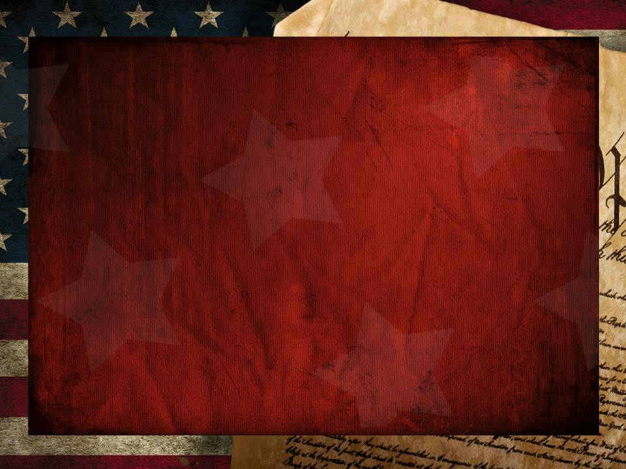
History has an uncanny way of repeating itself…
because there are spiritual forces at work behind human history seeking to shape it.
1 Jn 5:19 “the whole world lieth in wickedness.”
2 Cor. 4:4 “The god of this world blinds the minds…”
Eph. 6:12 “we wrestle …against principalities…powers,
against the rulers of the darkness of this world,
against spiritual wickedness in high places.”
Ponēria: depravity, disease

Slide 3
Because of this, there’s a remarkably predictable pattern behind the rise and fall of
Societies (civilizations)
God stopped Israel at the brink of the Promised land to review this cycle in Deuteronomy 8
1. Revelation: God reveals himself and his will.
8:1,2 “All the commandments…shall ye observe to do
that ye may live, and multiply, and possess the land…
Thou shalt remember all the way which the
LORD thy God led thee…”
and even individual “souls”.

Slide 4
1. Revelation: God reveals himself and his will.
8:2 “Thou shalt remember all the way which the
LORD thy God led thee…”
God initiates this Revelation. Heb. 1:1; Jn 6:37,44
“no man can come to me except the Father draw him”
B. God’s Revelation is always our “Invitation”!
2 “…to humble thee, and to prove thee,
to know what was in thine heart, whether thou wouldest keep his commandments, or no.”
Shamar: protect, hedge about

Slide 5
The Cycle of Souls and Societies Deut. 8
1. Revelation: God reveals himself and his will.
2. Response: We decide if (or how) we will
respond to God and His revelation.
Vs 1 “All these commandments …shall ye observe to do
עָשָׂה‎ שָׁמַר (shamar asa) guard and obey/commit
that ye may live and multiply”
Freedom of Choice is God’s gift to us. Josh 24:15
“Choose you this day whom ye will serve…”

Slide 6
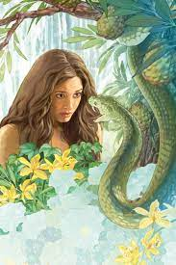
12. Response: We decide if (or how) we will
respond to God and His revelation.
Freedom of Choice is God’s gift to us.
This Freedom is Satan’s greatest opportunity.
Genesis 3:1-6 “Now the serpent was more subtil than any beast which the LORD God had made. And he said unto the woman,
Yea, hath God said, Ye shall not eat of every tree of the garden?”

Slide 7
The Cycle of Souls and Societies Deut. 8
Revelation: 2 . Response:
3. Reward: If we respond obediently, God blesses
(that heart, home, or society).
Vs 2 “ye shall multiply and possess the land…”
7… the LORD thy God bringeth thee into a good land,
10 When thou hast eaten and art full, then thou shalt
bless the LORD for the good land …”

Slide 8
The Cycle of Souls and Societies Deut. 8
3. Reward: If we respond obediently, God blesses
(that heart, home, or society). Deut 10:12-13 “what doth the LORD thy God require of thee,
but to fear the LORD thy God, to walk in all his ways, and to love him, and to serve the LORD thy God with all thy heart and with all thy soul,
To keep the commandments of the LORD, …which I
command thee this day
A. Honoring God is Good for US! Pr. 14:34
for thy good?”

Slide 9
“Whose God
is the LORD!”
Ps. 33:12

Slide 10
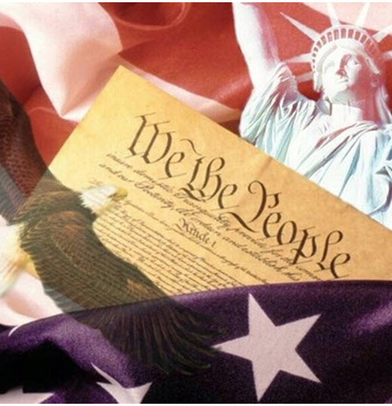
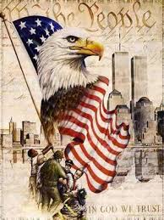
“America, America, God shed His Grace on Thee”

Slide 11
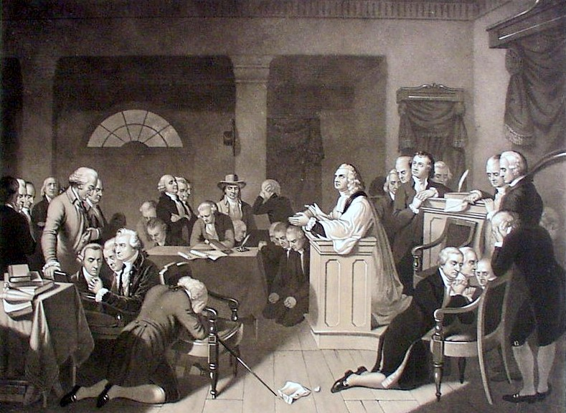
“Congress votes to invite Gospel preachers to lead in worship each day at the Capital,
And to specifically pray for God’s intervention in the affairs of the Country!”
Reverend Jacob Duché, September, 1774

Slide 12
Declaration of Independence July 4, 1776
“We hold these truths to be self evident,
That all men are created equal and are endowed by their creator with certain unalienable rights,
That among these are life, liberty
and the pursuit of happiness.
That to secure these rights, Governments are instituted among Men, deriving their just powers from the consent of the governed…”

Slide 13
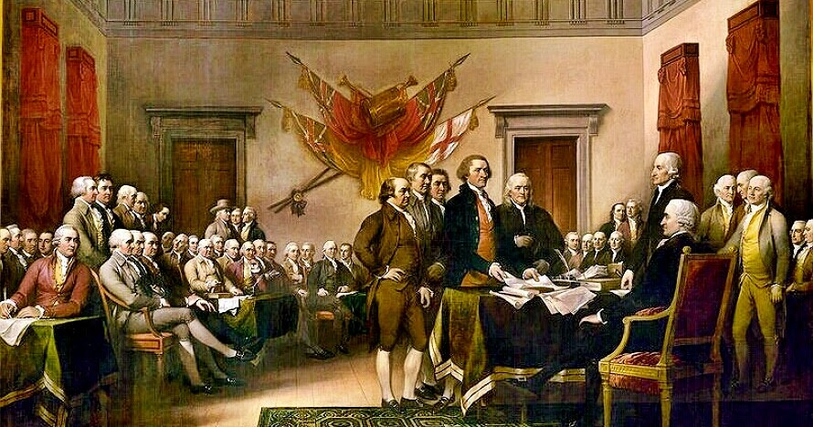
“And for the support of this Declaration, with a firm reliance on the protection of divine Providence,
we mutually pledge to each other our Lives,
our Fortunes and our sacred Honor.”

Slide 14
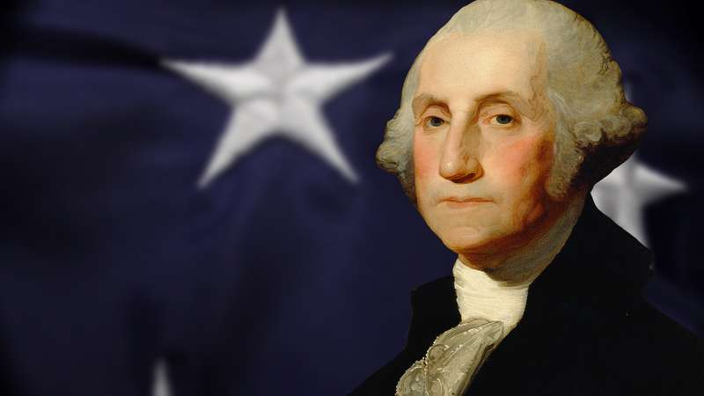
“It is impossible to rightly govern …without God and the Bible.”
George Washington

Slide 15
“Legislation was passed today in Congress to affirm that, The Congress of the United States approves of and recommends …
the Holy Bible for use in the schools.’”
Congress: 1782
(Paid for by federal funds)

Slide 16
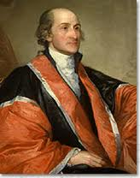
“Divine Providence has given to our people the choice of their rulers, and it is the duty of our Christian nation to select and prefer
Christians for their rulers.“
(John Jay, Supreme Court
Chief Justice)
Oct. 12, 1816

Slide 17
Almost every state legislature passed laws requiring all elected officials to take this oath:
“I do profess faith in God the Father,
and in the Lord Jesus Christ His only Son…
and I do acknowledge the holy scriptures of the Old and New Testaments
to be given by divine inspiration.’"

Slide 18
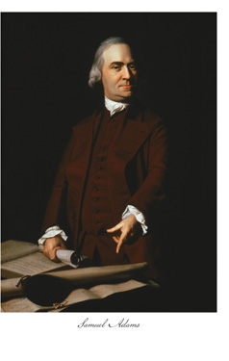
“A general dissolution of principles and manners will more surely overthrow the liberties of America than the whole force of the common enemy.
While people are virtuous, they cannot be subdued;
but when once they lose their virtue then will be ready to surrender their liberties to the first external or internal invader. “
Samuel Adams February 12, 1779.

Slide 19
“Our laws and our institutions must necessarily be based upon and embody the teachings of the Redeemer of mankind.
It is impossible that it should be otherwise.
In this sense and to this extent,
our civilizations and our institutions are emphatically Christian.”
Richmond v. Moore, Illinois Supreme Court, 1883

Slide 20
Revelation: 2 . Response: 3. Reward:
4. Rebellion: We shift loyalties!
A. We grow proud of “our” successes and
forget that it was God that blessed us.
Dt 8: 11 “Beware that thou forget not the LORD …
17 And thou say in thine heart, My power and the
might of mine hand hath gotten me this wealth.
18 “remember it is the LORD
that giveth the power to get wealth…”

Slide 21
4. Rebellion:
B. Rebellion causes us to replace God,
for Satan! 1 Sam 15:23 “For rebellion
{merî (rebellion) comes from marah (Bitter)}
as the sin of witchcraft,
stubbornness is as iniquity and idolatry.
Because thou hast rejected the word of the LORD,
He hath also rejected thee from being king.”
Pr 13:10 “Only by pride (zadon: arrogance) comes contention”

Slide 22
Rebellion eventually produces:
5. Rebuke: God tries to get our attention.
Dt 8:5 “consider …that, as a man chasteneth his son,
so the LORD thy God chasteneth thee.”
A. God Loves Us To Much To Let Us Go Unchallenged.
Rev 3:19 “As many as I love, I rebuke and chasten:
be zealous therefore, and repent.”
2 Tim. 3:16 “all scripture is given by inspiration of God and is profitable for doctrine…reproof, …correction,
for instruction in righteousness…”

Slide 23
5. Rebuke: God tries to get our attention.
A. God Loves Us To Much To Let Us Go Unchallenged.
Ps 90:3 “Thou turnest man to destruction; (dakkā’)
(Crushing Consequences that lead to contrition)
and sayest, Return, ye children of men.”
Mal 3:7 “Even from the days of your fathers ye are gone
away from mine ordinances, and have not kept them.
Return unto me, and I will return unto you,
saith the LORD of hosts.”

Slide 24
1. Revelation 2 . Response 3. Reward 4. Rebellion 5. Rebuke
6. Reconsider: We determine how we’ll respond.
Dt 8:6 “Therefore thou shalt keep the commandments
of the LORD…walk in his ways, and to fear him.”
A. If we repent, the cycle repeats! (Restores/blesses)
Pr. 2:23 “Turn you at my reproof: behold, I will pour out my
Spirit unto you, I will make known my words unto you.”
1) God delights to draw us back to him. 2 Chron 7:14
“If my people….humble themselves, pray, seek my face and turn from their wicked ways.
Then I will hear…forgive their sin, and heal their land”

Slide 25
6. Reconsider: We determine what we’ll do.
A. If we repent, the cycle repeats! James 4:7-8
“Submit yourselves therefore to God.
(hupotasso: subordinate, line up under)
Resist the devil, and he will flee from you.
(Anthis’tēmi: to stand or fight against.)
Draw nigh to God, and he will draw nigh to you.
Cleanse your hands, ye sinners;
and purify your hearts, ye double minded.”
Instead we tend to “resist God” which leads us to “drawing nigh to the Devil”.

Slide 26
150 years ago America was in the “Reproof” stage.
On Aug. 12th 1861 President Lincoln declared a
“Day of National Humiliation, Fasting, and Prayer.”
“I do earnestly recommend to all the people, and especially to all ministers and teachers of religion of all denominations and to all heads of families, to observe and keep that day according to their several creeds and modes of worship in all humility and with all religious solemnity, to the end that the united prayer of the nation may ascend to the Throne of Grace and bring down plentiful blessings upon our country.”

Slide 27
On March 30, 1863 He declared another.
“We have grown in numbers, wealth and power,
as no other nation has ever grown.
We have forgotten the gracious hand which preserved us in peace, and multiplied,
enriched and strengthened us;
and we have vainly imagined, in the deceitfulness of our hearts, that all these blessings were produced by some superior wisdom and virtue of our own.
But we have forgotten God.

Slide 28
Intoxicated with unbroken success, we’ve become too self-sufficient to feel the necessity of redeeming and preserving grace,
too proud to pray to the God that made us!
…All this being done in sincerity and truth, let us then rest humbly in the hope authorized by the divine teachings that the united cry of the nation will be heard on high and answered with blessings no less than the pardon of our national sins and the restoration of our now divided and suffering country
to its former happy condition of unity and peace.”

Slide 29
God answered and Healed our land.
B. If we continue to “Rebel”, the result is
7. (Eventual) Reprobation! Deut 8:11-20
A. Definition:
1) English: Unprincipled, Rejected, Disapproved
2) OT Hebrew: Jer 6:30 “Reprobate silver
shall men call them,
because the LORD hath rejected them. “
Maas’: despised, rejected, useless

Slide 30
A. Definition: “Reprobate”
3) NT: Ro 1:28 “even as they did not like to retain
God in their knowledge,
God gave them over to a reprobate mind…”
Titus 1:16 “They profess that they know God; but in works they deny him, being abominable, and disobedient,
and unto every good work reprobate.”
Adokimos: unapproved, disqualified, rejected,
castaway, worthless

Slide 31
7. (Eventual) Reprobation!
B. Declaration (God’s Warning) Deut 8:11 “Beware thou forget not the LORD thy God, in not keeping his commandments… judgments, …statutes”
19 “And it shall be, if thou do at all forget the LORD thy God, and walk after other gods, and serve them,
and worship them, I testify against you this day
that ye shall surely perish.”
Ābad’: lose / destroy yourselves (Mt 7:13)

Slide 32
7. (Eventual) Reprobation! Dt 8: 19,20
that ye shall surely perish.
20 As the nations which the LORD destroyeth
before your face,
because ye would not be obedient unto the voice of the LORD your God.”
1) History is filled with Examples of the
sad ending of this cycle!
so shall ye perish;

Slide 33
Psalm 78 is a historical review of this cycle over the first 500 years of Israel’s existence.
In it we’re told to remember this cycle so that
“the generation to come might know them…
That they might set their hope in God, and not forget the works of God but keep his commandments:
and might not be…stubborn and rebellious.” Ps. 78:6-8
Unfortunately, all it takes is one generation to “drop the ball” and Satan gains an advantage.

Slide 34
Where do you think America is in this Cycle?
1. Revelation 2. Response 3. Reward
4. Rebellion 5. Reproof 6. Reconsider
7. Reprobation
An honest and objective review of our History will show us!

Slide 35
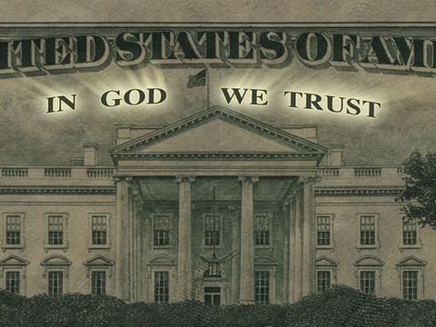
The Official Motto of the USA was changed to "In God We Trust" in 1956 after a careful review of our history
and as a response to Russia’s Atheism.
It was reaffirmed by the Senate in 2006
Reaffirmed by the House in 2011
by a vote of 396-9

Slide 36
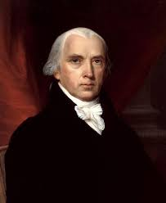
“We have staked the whole future of American,
not upon the power of government,
far from it.
We have staked the future of all of our political institutions upon the capacity of each and all of us to govern ourselves ...according to the
Ten Commandments of God. “
James Madison
(Author of the US Constitution!)

Slide 38
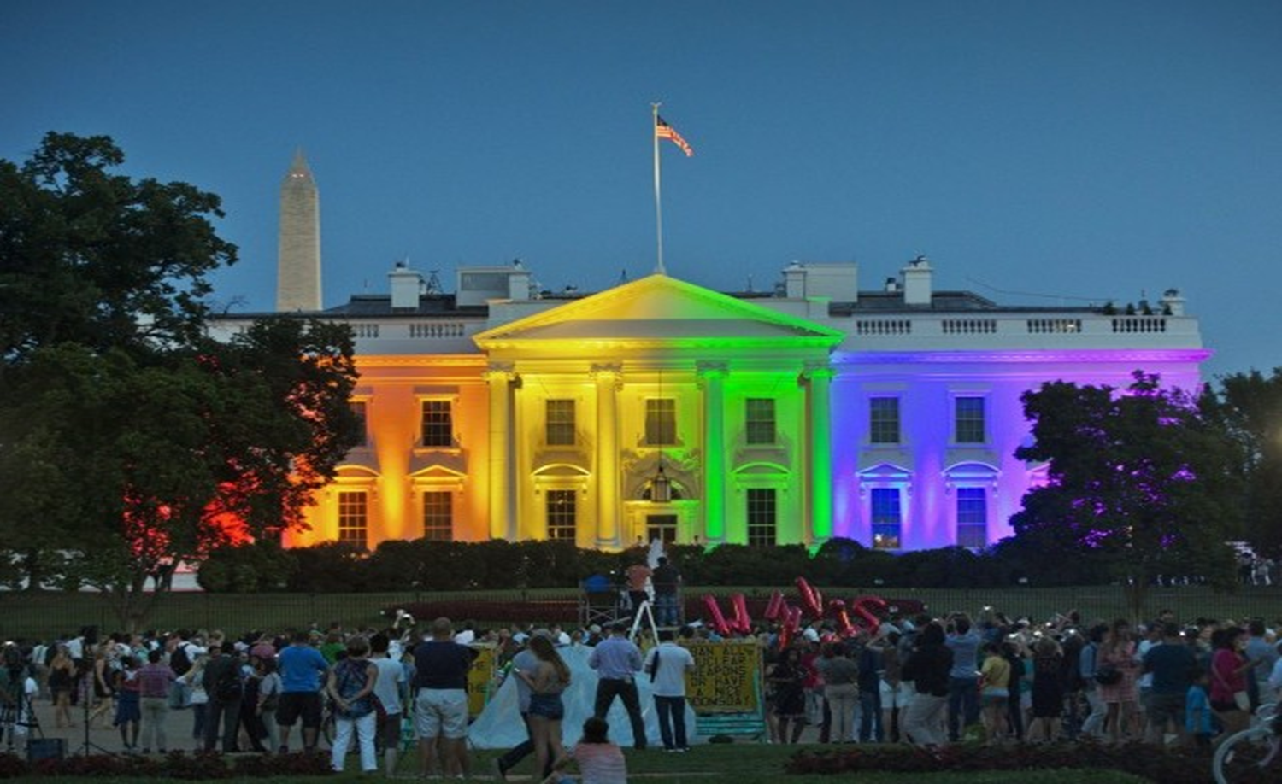
“Tonight the White House was lit to demonstrate our unwavering commitment to progress and equality…
June 25, 2015
The pride colors reflect the diversity of the LGBT community and tonight celebrate a new chapter in the history
of American Civil Rights”

Slide 39
Romans 1:21-32 Reveal the diagnosis and prognosis for Reprobation. ²¹ ”when they knew God, they glorified him not as God, …; but became vain in their imaginations,
and their foolish heart was darkened.
²² Professing themselves to be wise, they became fools,
²³ And changed the glory of the uncorruptible God into an image made like to corruptible man…
²⁴ Wherefore God also gave them up to uncleanness through the lusts of their own hearts,
to dishonor their own bodies between themselves:

Slide 40
7. (Eventual) Reprobation! Romans 1:21-28 (KJV) ²⁵ Who changed the truth of God into a lie, & worship and served the creature more than the Creator…
For this cause God gave them up unto vile affections:
for even their women did change the natural use into that which is against nature:
likewise the men, leaving the natural use of the woman, burned in their lust one toward another; men with men working that which is unseemly, (shameful)
and receiving in themselves that recompence of their error which was meet.” (die: necessary)

Slide 41
7. (Eventual) Reprobation! Romans 1:21-28 (KJV) ²⁸ And even as they did not like to retain God in their knowledge, God gave them over to a reprobate mind.
29 Being filled with all unrighteousness, fornication, wickedness, covetousness, maliciousness; full of envy, murder, debate, deceit, malignity; whisperers,
30 Backbiters, haters of God, despiteful, proud, boasters, inventors of evil things, disobedient to parents,
31 “Without understanding, covenantbreakers,
without natural affection, implacable, unmerciful:

Slide 42
Who knowing the judgment of God,
that they which commit such things are worthy of death, not only do the same,
but have pleasure in them that do them.”
(Syneudoke’ō: affirm, approve of)
This has now become the official policy position of our Country’s Laws and Leaders.
7 years ago this month the “Supreme Court” decided to outlaw the DOMA law
and redefine marriage.

Slide 43
The real “Supreme” Judge has declared:
Is 5:20-21 “Woe unto them that call evil good,
and good evil; that put darkness for light, and light for darkness; that put bitter for sweet, and sweet for bitter!
Woe unto them that are
wise in their own eyes, “

Slide 44
Application:
Psalm 11:1-3 “In the LORD put I my trust: how say ye to my soul, Flee as a bird to your mountain?
(That’s our natural tendency)
For, lo, the wicked bend their bow, they make ready their arrow upon the string, that they may privily shoot at the upright in heart.
If the foundations be destroyed,
what can the righteous do? “
We can recognize and respond to this Cycle!

Slide 45
Where are YOU in this cycle? Ro. 1
Revelation: What has God “revealed” to you?
“for God hath shewed it unto them.” v. 19
2. Response: How are you responding to God?
“glorified him not as God.” vs 21
3. Reward: What have you done with God’s
Blessings?
“neither were thankful” vs 21

Slide 46
Where are YOU in this cycle? Ro. 1
4. Rebellion: Are you responding in obedience?
“served the creature more than the creator” vs 25
5. Rebuke: Is God trying to “get your attention?”
“Wherefore God also gave them up to…” vs 24
(The natural Consequences of their choices. Gal. 6:7,7)
Response? Will you sincerely “reconsider” your paths and priorities? Jeremiah 6:16,17

Slide 47
God’s Solution: Reconsider Jer. 6:16,17
“Thus saith the LORD, Stand ye in the ways, and see, and ask for the old paths, where is the good way, and walk therein,
and ye shall find rest for your souls.
But they said, We will not walk therein!
¹⁷Also I set watchmen over you, saying, Hearken to the sound of the trumpet.
But they said, We will not hearken!”

Slide 48
Saying No to God and His will is to say
“Yes” to Satan! (and his plans and will)
This has become America’s official public policy!
Jer 6:18-19 “Therefore hear, ye nations, and know, O congregation, what is among them.
…behold, I will bring evil upon this people,
even the fruit of their thoughts,
because they have not hearkened unto my words, nor to my law, but rejected it.”
Aka: Reprobation

Slide 49
"God who gave us life gave us liberty.
Can the liberties of a nation be thought secure when we have removed their only firm basis,
a conviction in the minds of the people
that these liberties are the gift of God;
That they are not to be violated
but by his wrath?”

Slide 50
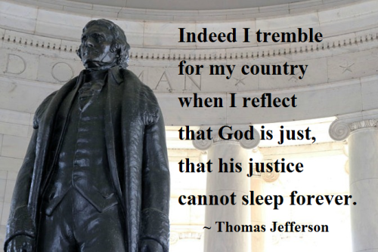

Slide 51
Deuteronomy 30:19 “I call heaven and earth to record this day against you, that I have set before you
life and death, blessing and cursing:
therefore choose life,
that thou and thy seed may live:”

