Slide 1
Eph 6:10-18; 2 Cor 10:3-5; 2 Cor 2:11
“Lest Satan should get an advantage of us:
for we are not ignorant of his devices.”

Slide 2
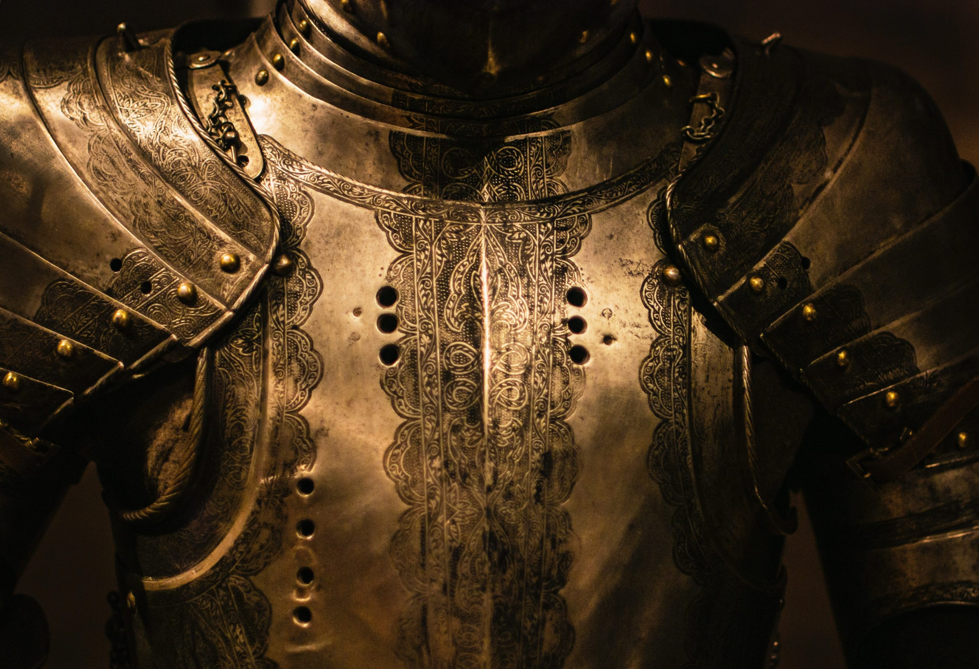
Jn 16:33 “These things I have spoken unto you,
that in me ye might have peace.
(Eirene: “to join”)
In the world ye shall have tribulation:
(thlipsis: pressure, affliction, persecution)
but be of good cheer;
I have overcome the world.”

Slide 3
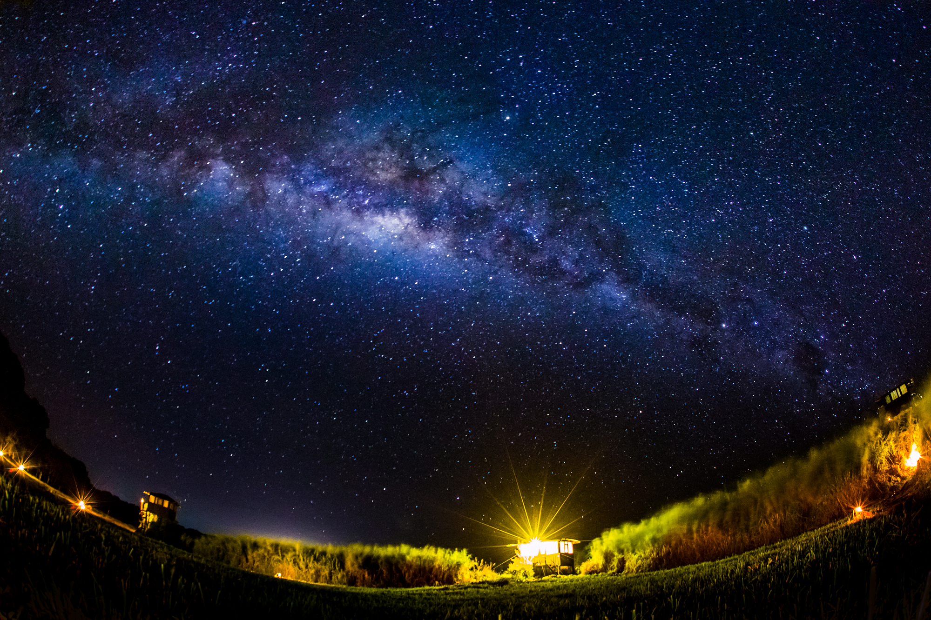
Peace is not the absence of Pain or Problems,
but an awareness that we’re on the right side of this cosmic conflict, in partnership with
“The Prince of Peace”! (Is. 7:14; 9:6)
Jesus came to make this partnership possible!
(Luke 2:8-14)

Slide 4
Since Peace (from eiro) literally means to join;
Our Peace (Or lack thereof)
is related to who (what side)
we choose to join/partner with.

Slide 5
Is 7:14 “Behold, a virgin shall conceive, and bear a son, and shall call his name Immanuel.” (God with Us!)
Isaiah 9:6 “Unto us a child is born,
unto us a son is given: and the government
shall be upon his shoulder:
and his name shall be called:
Wonderful, Counsellor,
The mighty God,
The everlasting Father,

Slide 6
Shālôm: Peace, safety
from shalem: to pay, restore
Peace always comes at a cost!

Slide 7
Jesus came to pay the price for our peace! (partnership) Isaiah 53
5 “he was wounded for our transgressions,
he was bruised for our iniquities:
the chastisement of our peace was upon him;
and with his stripes we are healed.
⁶ All we like sheep have gone astray;
we have turned every one to his own way;
and the LORD hath laid on him the iniquity of us all”.

Slide 8
These incredible promises (Is. 7:14; 9:6)
were originally given to King Ahaz (735-715 BC)
Review: 1. Ahaz’ choices 2 Kings 16:2,3
“ Ahaz…did not that which was right
in the sight of the LORD his God…
he walked in the way of the kings of Israel,
yea, and made his son to pass through the fire,
according to the abominations of the heathen”

Slide 9
Review: 2. Ahaz’s Challenges/Chastening
A. God chastens those he loves! Heb. 12:6,7
B. This came in the form of war. Isaiah 7:2,3
“Syria is confederate with Ephraim. And his heart was moved (shaken) and the heart of his people.”
1) Sin always affects others! (Ro 14:7)
C. God has to shake us up to wake us up!
God’s goal is not condemnation, but restoration!

Slide 10
Review: 3. God’s “second” chance.
A. Even after Ahaz’ sinful choices,
Isaiah was sent to counsel him to accept God’s offer of peace (partnership). Isaiah 7:4-11
7 “Thus saith the Lord, It shall not stand,
neither shall it come to pass.
11 Ask a sign of the LORD thy God; ask it either in the depth, or in the height above.”

Slide 11
B. He rejected God’s offer of peace (partnership)
7:12 “I will not ask, neither will I tempt the LORD.”
1) He did this primarily because he had already
formed another partnership…
With the enemies of God’s people and God!
Is. 8:19,20 “should not a people seek unto their God?”
2) This led to a poisonous partnership that brought pain, treachery and conflict for decades.

Slide 12
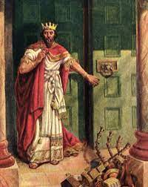
Ahaz’ Corrupting Compromise
1. He chose Practical Compromise over
Principled Character.
A. He Robbed God’s Temple to do this. 2 Kgs 16:8
So Ahaz took the silver and gold
in the house of the LORD…
and sent it for a present to the king of Assyria.”

Slide 13
1. He chose Practical Compromise over
Principled Character.
A. He Robbed God’s Temple to do this. 2 Kgs 16:8
B. He also robbed God of an opportunity to
demonstrate His Power!
1) King Asa made the same compromise 200
years earlier (2 Chr 16:9)
2) How often do we make this compromise?
Mal. 3:8-12 “Will a man rob God? Yet ye have robbed me.”

Slide 14
2. Corrupting Compromises often appears
to “work”
A. It produced relief (“victory”?) for Ahaz!
1) Assyria invaded Syria and defeated them.
2) Assyria went to war against Israel and eventually
defeated them as well. (2 Kings 17)
3) This took the immediate pressure off Ahaz,
but made him (and Judah) a vassal to Assyria.
in the short term.

Slide 15
3) This took the immediate pressure off Ahab,
but made him (Judah) a vassal to Assyria.
a) A vassal is defined as:
(1) “A person who held land from a feudal lord and
received protection
(2) A bondman; slave.
(3) subordinate or dependent.
Ro 6:16 “know ye not that to whom ye yield yourself …
his servants ye are..”
1 Cor. 10:20 “…fellowship with devils”
in return for homage and allegiance.

Slide 16
2. Corrupting Compromise appears to “work”
A. It relieved the pressure on Ahaz
B. This is the bait/snare Satan often uses!
1) Asaph struggled over this paradox. Ps 73
3 “I was envious …when I saw the prosperity of the wicked...
16 When I thought to know this, it was too painful for me;
17 Until I went into the sanctuary of God;
then understood I their end.”
Finish the story!

Slide 17
2. Corrupting Compromise often appears
to “work” (short term)
It produced relief (“victory”?) for Ahaz
This is the bait/snare Satan often uses!
2) The Pleasures of Sin are seasonal! Heb. 11:24-27
26 Moses “Esteemed the reproach of Christ greater riches
than the treasures in Egypt:
for he had respect unto the recompence of the reward.
27 By faith he forsook Egypt, … for he endured,
as seeing him who is invisible.”

Slide 18
3. Compromise Brings Consequences.
It (like peace) also comes at a price!
“Politics makes strange bedfellows”
comes from Shakespeare’s play “The Tempest”:
“Misery acquaints a man with
strange bedfellows.”
It was spoken by shipwrecked man who finds
himself seeking shelter
beside a sleeping monster!

Slide 19
3. Compromise Brings Consequences:
A. In our “Feelings” (Thinking/Reasoning)
1) Compromising (principles) produces “callouses”.
a) This “clouds” (or cauterizes) our conscience.
1 Tim 4:1-2 “The Spirit speaketh expressly, that in the latter times some shall depart from the faith,
giving heed to seducing spirits, and doctrines of devils;
Speaking lies in hypocrisy; having their conscience
(Synei’dēsis: perception) seared with a hot iron…”
Pr. 20:27 “the spirit of man is the candle of the LORD”

Slide 20
3. Compromise Brings Consequences.
B. In our Faith: 2 Kings 16
1) Ahaz replaced the Altar in God’s Temple with
one similar to what the Syrians used in their temple
to worship devils! Vs 10,11
a) If the Syrian “gods” couldn’t help them
against the Assyrians,
why would he trust and worship them?

Slide 21
3. Compromise Brings Consequences.
C) In Our Family. (Ex. 20:5)
1) His son “inherited” this vassal relationship.
(Requiring an annual “tribute” offering)
2) Hezekiah initially refused, then capitulated:
“Sennacherib king of Assyria came up against all the fenced cities of Judah, and took them. And Hezekiah king of Judah sent to the king of Assyria to Lachish, saying, I have offended; return from me:
that which thou puttest on me will I bear.
And the king of Assyria appointed unto Hezekiah three hundred talents of silver and thirty talents of gold. “ 2 Kings 18:13-14

Slide 22
C) In Our Family. (Ex. 20:5)
1) Hezekiah inherited this vassal relationship
a) To pay this, he also robbed God’s Temple.
2 Kings 18:15,16 “Hezekiah gave him all the silver that was found in the house of the LORD…”
See Ex. 20:5 “the iniquities of the fathers”
b) Assyria took the money and came anyway!
17 And the king of Assyria sent …
a great host against Jerusalem…”
You can’t win in a deal with the devil! Jn 10:10

Slide 23
Isaiah met Ahaz with God’s promise by the Is. Is. 7:3 “conduit of the upper pool…
in the highway of the fuller’s field”
Notice where the Assyrians met Hezekiah!
“And the king of Assyria sent …from Lachish to king Hezekiah with a great host …. And they went up and came to Jerusalem. And when they were come up, they came and stood
by the conduit of the upper pool,
which is in the highway of the fuller's field.”
2 Kings 18:17

Slide 24
Many, like Ahaz, try to purchase their own
Peace (“stairway to heaven” )
not realizing who’s actually “selling it”.
Jimmy Page/ Robert Plank (Led Zeppelin) 1971 “Stairway To Heaven”
“There's a lady who's sure, All that glitters is gold,
And she's buying a stairway to heaven.
When she gets there she knows, if the stores are all closed,
With a word she can get what she came for.
There's a sign on the wall, But she wants to be sure;
Cause you know sometimes words have two meanings!

Slide 25
“…And it's whispered that soon, If we all call the tune,
Then the piper will lead us to reason.
And a new day will dawn For those who stand long And the forests will echo with laughter.
If there's a bustle in your hedgerow, don't be alarmed now.
It's just a spring clean for the May queen. (?)
There are two paths you can go by, But in the long run,
There's still time to change the road you're on!?”
(Is there?) Gen. 6:3
Led Zeppelin – 1971 Stairway To Heaven

Slide 26
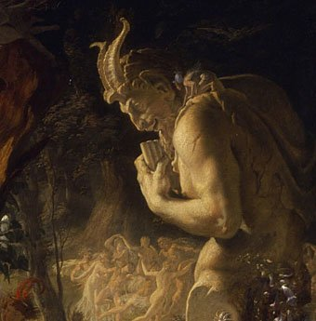
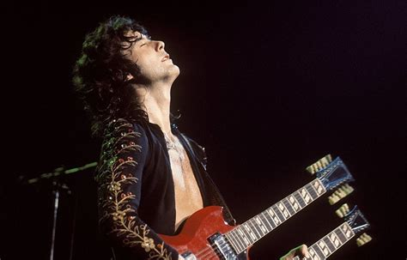
The piper’s calling you to join him!”
“Your head is humming
and it won't go
In case you don't know
Jimmy Page was fascinated
with the occult!
Owned Occultic stores
and Satanist Aleister
Crowley’s mansion.
“Ohhh, and it makes me wonder!”

Slide 27
“there are two paths you can go by, But in the long run,
There's still time to change the road you're on!?
Hezekiah decided to “change the road” he was on and look to the LORD for help. 2 Kings 19:1
“when king Hezekiah heard it, that he rent his clothes, and covered himself with sackcloth,
and went into the house of the LORD.”
God sent 1 angel and destroyed the 186,000 Assyrians camped against Jerusalem.
2 Kings 19:31

Slide 28
Both Ahaz &Hezekiah faced an overwhelming force.
God sent Isaiah to counsel and comfort both.
Both heard the same promises of Is. 7:14 and 9:6.
⁶ ”For unto us a child is born, unto us a son is given: and the government shall be upon his shoulder: and his name shall be called Wonderful, Counsellor, The mighty God,
The everlasting Father, The Prince of Peace.”
Only one Chose to believe God!

Slide 29
As "Prince of Peace" he adds CONTROL
for the many DISTURBANCES of life. (Jn 14:27)
Isaiah 9:7 “Of the increase of his government and peace there shall be no end…”
Your “government” and (ability to maintain) peace will eventually end.
So why not submit to His Authority and Receive His Help and Peace. (Mt. 11:28,29)

Slide 30
Is 30:15-17 “For thus saith the Lord GOD…
In returning and rest shall ye be saved;
in quietness and in confidence shall be your strength:
and ye would not.
But ye said, No; for we will flee upon horses…
We will ride upon the swift;
therefore shall they that pursue you be swift. “

Slide 31
“Yes, there are two paths you can go by,
But in the long run,
“There's still time to change the road you're on.”
(But for how long?)
…The Piper’s calling you to join him”
Led Zeplin “Stairway to heaven”

Slide 32
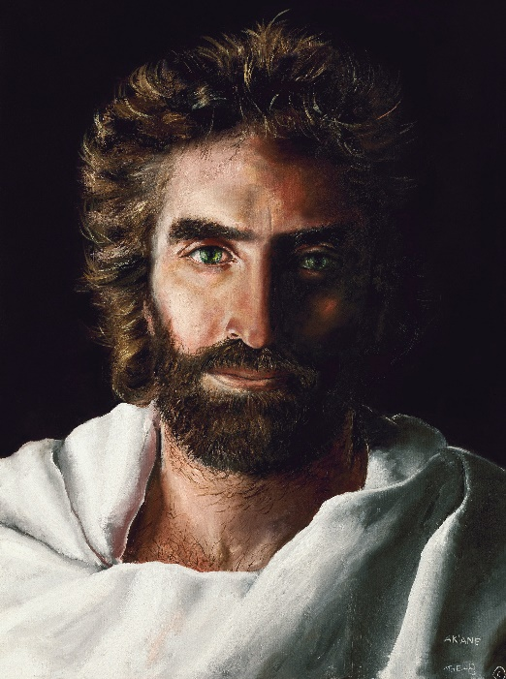
Who will partner with (follow?)
“The Piper”?
Or the “Prince of Peace”?
John 10:10a
John 10:10b

Slide 33
Three promises of God’s Partnership, Three fulfilments.
Is. 7:14 “A virgin shall conceive…and call his name Immanuel” (Mt 1:23)
Is 9:2 “people that walked in darkness have seen a great light: they that dwell in the land of the shadow of death, upon them hath the light shined.” (Mt. 4:16, 17)
Is. 9:6 “unto us a child is born….Prince of Peace” (Mt 11:28,29)
After rejecting Satan’s Corrupting Compromises (Mt 4:1-10)
“Get thee hence, Satan: …Thou shalt worship the Lord thy God,
and him only shalt thou serve.”
being rejected in Nazareth (Mt 4:11; Luke 4:16-30)
he went to Capernaum to fulfil another prophetic partnership. (Is. 9:2)
(Mt 4:13-16) “From that time Jesus began to preach, and to say,
Repent: for the kingdom of heaven is at hand.”

Slide 34
Matthew 4:18-20 “And Jesus, walking by the sea of Galilee, saw two brethren, Simon called Peter, and Andrew his brother, casting a net into the sea: for they were fishers.
And he saith unto them,
Follow me, and I will make you fishers of men.
And they straightway left their nets, and followed him.”
What’s he saying to you?
Jn 10:10; 27

