Slide 1
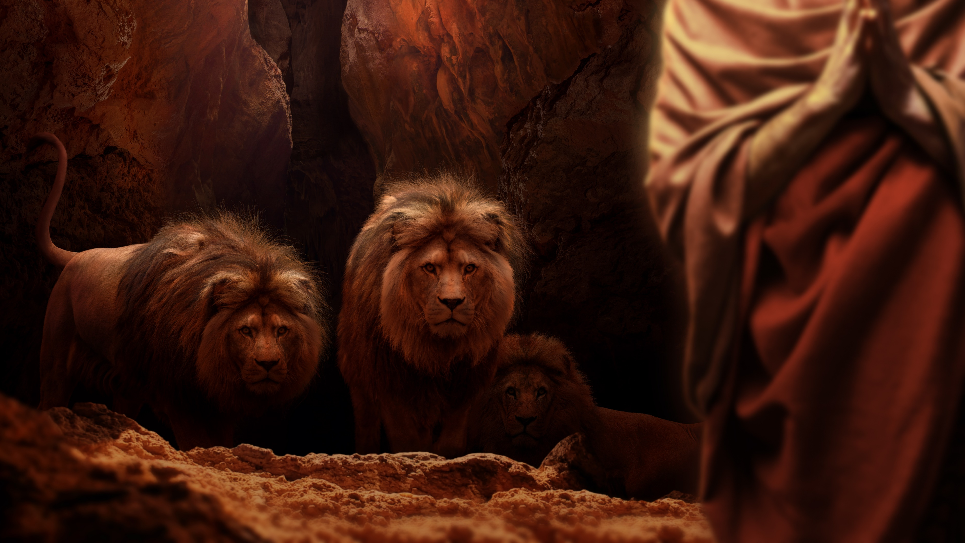
הַבְּרָכָ֖ה וְהַקְּלָלָ֑ה
By Joseph Peters

Slide 2
Objective
Everyone of God’s people should take God seriously
For these three reasons

Slide 3
Rationale
God has the authority to judge
God has the authority to bless
God has the authority to change his verdict

Slide 4
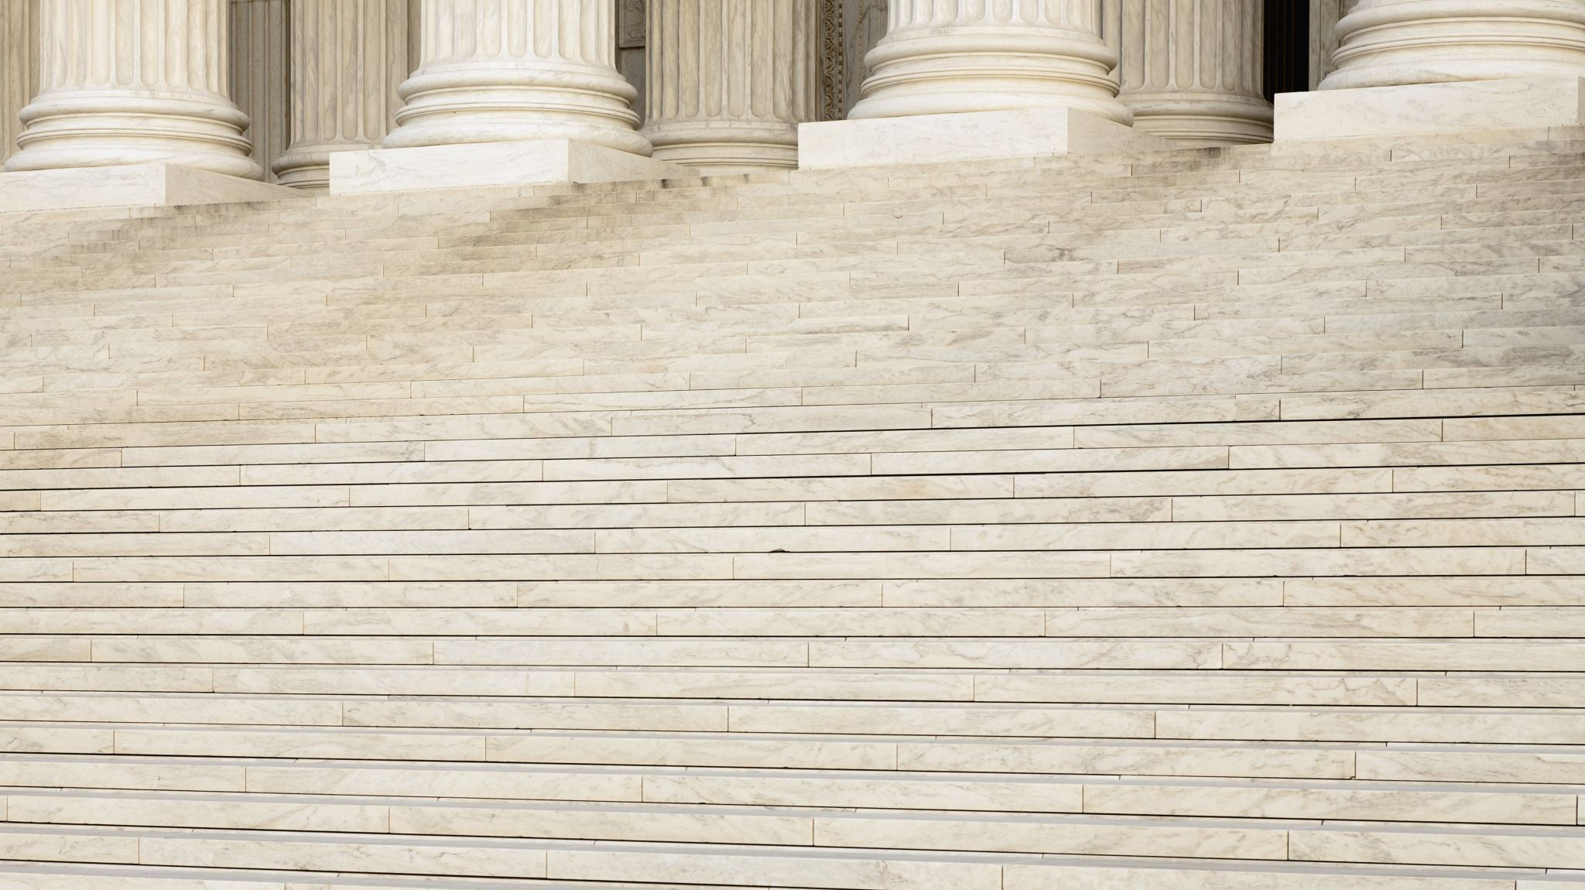
God has the Authority to Judge

Slide 5
God Chooses Jeremiah
Then the word of the LORD came unto me, saying, Before I formed thee in the belly I knew thee; and before thou camest forth out of the womb I sanctified thee, and I ordained thee a prophet unto the nations…
…And I will utter my judgments against them touching all their wickedness, who have forsaken me, and have burned incense unto other gods, and worshipped the works of their own hands. Thou therefore gird up thy loins, and arise, and speak unto them all that I command thee: be not dismayed at their faces, lest confound thee before them. (Je 1:4–5, 16-17)

Slide 6
Jerusalem’s Judgement
And burned the house of the LORD, and the king’s house; and all the houses of Jerusalem, and all the houses of the great men, burned he with fire: And all the army of the Chaldeans, that were with the captain of the guard, brake down all the walls of Jerusalem round about. Then Nebuzar-adan the captain of the guard carried away captive certain of the poor of the people, and the residue of the people that remained in the city, and those that fell away, that fell to the king of Babylon, and the rest of the multitude. Je 52:13–16.

Slide 7
Judah’s Judgement
In the third year of the reign of Jehoiakim king of Judah came Nebuchadnezzar king of Babylon unto Jerusalem, and besieged it. And the Lord gave Jehoiakim king of Judah into his hand, with part of the vessels of the house of God: which he carried into the land of Shinar to the house of his god; and he brought the vessels into the treasure house of his god (Da 1.1-2)

Slide 8
God has the Authority to Bless

Slide 9
Jeremiah’s Blessing
And they shall fight against thee; but they shall not prevail against thee; for I am with thee, saith the LORD, to deliver thee (Je 1:19)…
But the LORD is with me as a mighty terrible one: Therefore my persecutors shall stumble, and they shall not prevail: They shall be greatly ashamed; for they shall not prosper: Their everlasting confusion shall never be forgotten (Je 20:11).

Slide 10
Jeremiah’s Blessings P2
11 Now Nebuchadrezzar king of Babylon gave charge concerning Jeremiah to Nebuzar-adan the captain of the guard, saying, Take him, and look well to him, and do him no harm; but do unto him even as he shall say unto thee. (Je 39:11–12).

Slide 11
Daniel’s Blessings
And the king spake unto Ashpenaz the master of his eunuchs, that he should bring certain of the children of Israel, and of the king’s seed, and of the princes…
…Now God had brought Daniel into favour and tender love with the prince of the eunuchs (Da 1:3, 9).
…Then the king made Daniel a great man, and gave him many great gifts, and made him ruler over the whole province of Babylon, and chief of the governors over all the wise men of Babylon (Da 2:48).

Slide 12
Daniel’s Blessings P2
Then commanded Belshazzar, and they clothed Daniel with scarlet, and put a chain of gold about his neck, and made a proclamation concerning him, that he should be the third ruler in the kingdom (Da 5:29).
So this Daniel prospered in the reign of Darius, and in the reign of Cyrus the Persian (Da 6:28).

Slide 13
Judah’s Blessings in the Exile
And seek the peace of the city whither I have caused you to be carried away captives, and pray unto the LORD for it: for in the peace thereof shall ye have peace (Je 29:7).
If ye will still abide in this land, then will I build you, and not pull you down, and I will plant you, and not pluck you up: for I repent me of the evil that I have done unto you. Be not afraid of the king of Babylon, of whom ye are afraid; be not afraid of him, saith the LORD: for I am with you to save you, and to deliver you from his hand. And I will shew mercies unto you, that he may have mercy upon you, and cause you to return to your own land. (Je 42:10–12).

Slide 14
Judah’s Blessings After the Exile
For thus saith the LORD, That after seventy years be accomplished at Babylon I will visit you, and perform my good word toward you, in causing you to return to this place. For I know the thoughts that I think toward you, saith the LORD, thoughts of peace, and not of evil, to give you an expected end. Then shall ye call upon me, and ye shall go and pray unto me, and I will hearken unto you. And ye shall seek me, and find me, when ye shall search for me with all your heart. Je 29:10–13.

Slide 15
God has the Authority to Change His Verdict

Slide 16
When People Change
At what instant I shall speak concerning a nation, and concerning a kingdom, to pluck up, and to pull down, and to destroy it; If that nation, against whom I have pronounced, turn from their evil, I will repent of the evil that I thought to do unto them. And at what instant I shall speak concerning a nation, and concerning a kingdom, to build and to plant it; If it do evil in my sight, that it obey not my voice, then I will repent of the good, wherewith I said I would benefit them (Je 18:7–10).

Slide 17
Daniel’s Intercessory Prayer of Repentance
In the first year of his reign I Daniel understood by books the number of the years, whereof the word of the LORD came to Jeremiah the prophet, that he would accomplish seventy years in the desolations of Jerusalem. And I set my face unto the Lord God, to seek by prayer and supplications, with fasting, and sackcloth, and lashes: And I prayed unto the LORD my God, and made my confession, and said… (Da 9:2–4).

Slide 18
Conclusion
God has the authority to judge
God has the authority to bless
God has the authority to change his verdict

