Slide 1
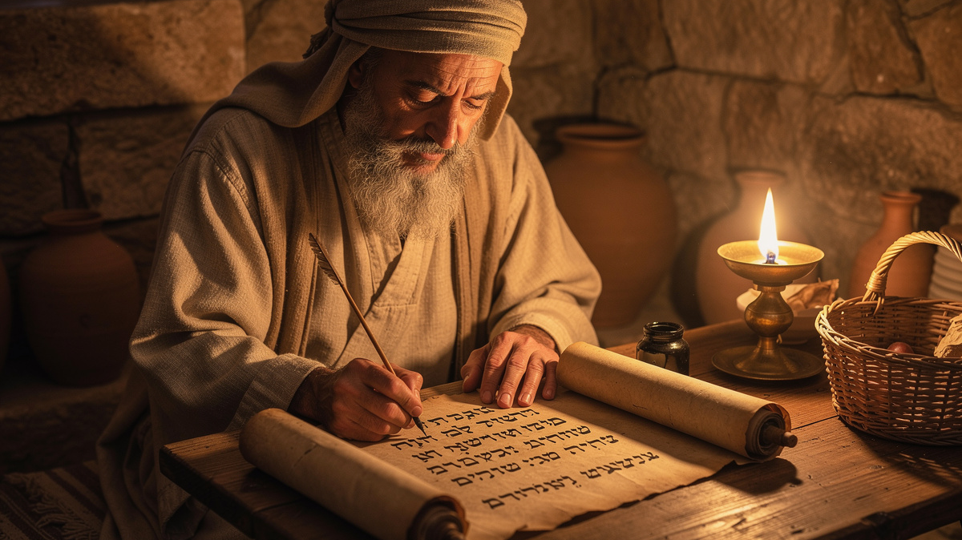
Studying God’s Word
By Joseph Peters

Slide 2
Studying God’s Word
Study to shew thyself approved unto God, a workman that needeth not to be ashamed, rightly dividing the word of truth (2 Tim 2:15).

Slide 3

Objective
Every Christian can study God’s Word more effectively
By paying attention to these three concepts in word studies

Slide 4
Rationale
Pay Attention to the Context
Pay Attention to the Semantic Field
Pay Attention to the Semantic Range

Slide 5

Pay Attention to the Context

Slide 7


Slide 8


Slide 9


Slide 10
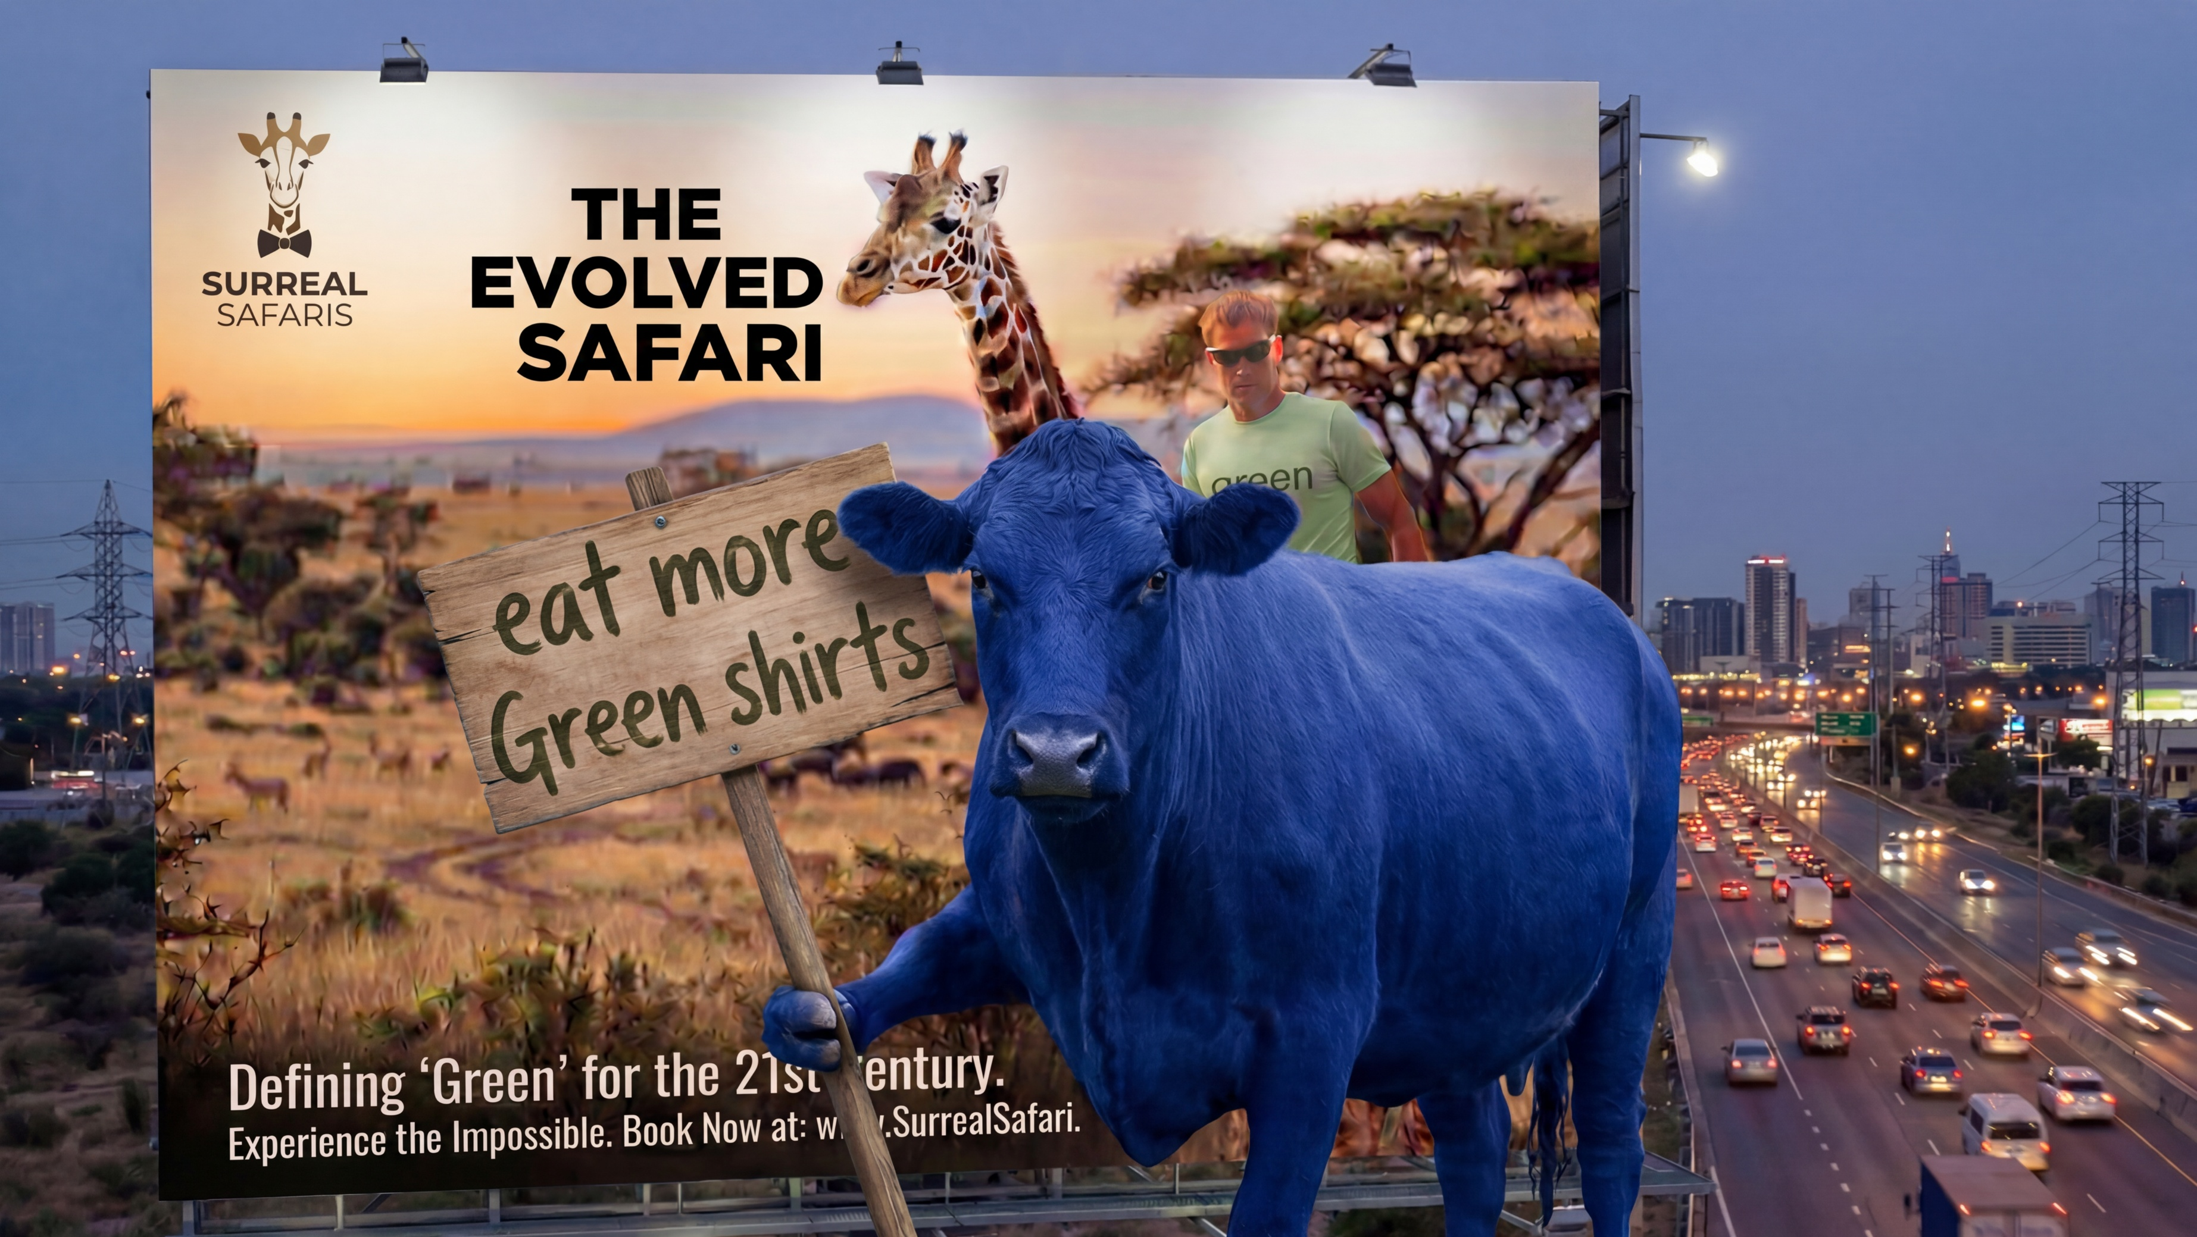

Slide 11


Slide 12
A Word out of Context
Love

Slide 13
The Word in the Context of the Verse
For God so loved the world, that he gave his only begotten Son, that whosoever believeth in him should not perish, but have everlasting life (John 3:16).

Slide 14
The Verse in the Context of the Passage
Nicodemus, a religious leader in Israel, acknowledges that Jesus is from God and has questions for him. Jesus responds by telling him about how to enter the kingdom of Heaven. He further explains that the Son of God came not to condemn, but to save the world

Slide 15
The Passage in the Context of the Book
And many other signs truly did Jesus in the presence of his disciples, which are not written in this book: But these are written, that ye might believe that Jesus is the Christ, the Son of God; and that believing ye might have life through his name (John 20:30–31).

Slide 16
The Book in the Context of the New Testament
John, like the other three gospels, portray the life of Jesus and how God made a new covenant with the world through Jesus’ sacrifice. It is this reality that the New Testament church was founded on.

Slide 17
The New Testament in the Context of the Bible
Humanity’s sin separated them from God and condemned them to the same fate as the rebellious Satan (Hell). God created a covenant/testament with Abraham’s family who would serve as his representatives on how to live lives that are pleasing to God. Unfortunately, like the rest of humanity, they proved unable to keep the covenant because of their sin, causing God to announce that He had planned to make a new covenant. This new covenant/testament was not dependent on sinful humanity rescuing themselves, but on God’s own Son, Jesus, rescuing them by His sacrificial death, allowing humanity the opportunity to come back to God.

Slide 18

Pay Attention to the Semantic Field

Slide 19
Semantic Field
The semantic field is the list of words that a person can choose from as they essentially mean the same thing.
So, the question becomes, why did an author choose to use that specific term rather than one of the other options.

Slide 20
Example Using the Word Love
Fondness, intimacy, liking, taste, partiality, devotion, worship, etc.

Slide 21
Example in John
Σημεῖον (Semeion): sign, miracle (John = 17)
Δύναμις (Dunamis): power, strength, miracle (John = 0)

Slide 22
Example of Love
So when they had dined, Jesus saith to Simon Peter, Simon, son of Jonas, lovest [ἀγαπᾷς] thou me more than these? He saith unto him, Yea, Lord; thou knowest that I love [φιλῶ] thee… He saith to him again the second time, Simon, son of Jonas, lovest [ἀγαπᾷς] thou me? He saith unto him, Yea, Lord; thou knowest that I love [φιλῶ] thee… He saith unto him the third time, Simon, son of Jonas, lovest [φιλεῖς] thou me? Peter was grieved because he said unto him the third time, Lovest [φιλῶ] thou me? And he said unto him, Lord, thou knowest all things; thou knowest that I love thee (John 21:15a, 16a, 17).

Slide 23

Semantic Range

Slide 24
Semantic Range
The semantic range (or range of meaning) is the variety of ways that a term can be used.
So, the question becomes, which meaning does the author intend in this context.

Slide 25
Liberal as an Example
Political affiliation: They identify as a liberal rather than a conservative
Excess: they applied the glue liberally rather than conservatively
Mindset: they have a liberal way of thinking

Slide 26
Example of Adam and Eve
And Adam knew [יָדַ֖ע = yada] Eve his wife; and she conceived, and bare Cain… (Gen 4:1 KJV).
יָדַ֖ע = yada: understanding, learning, care for, copulate
Now the man [אָדָ֔ם = Adam] had relations [יָדַ֖ע = yada] with his wife Eve, and she conceived and gave birth to Cain (Gen 4:1 NASB).

Slide 27
Conclusion
Every Christian can study God’s Word more effectively
By paying attention to these three concepts in word studies

Slide 28
Rationale
Pay Attention to the Context
Pay Attention to the Semantic Field
Pay Attention to the Semantic Range

