Slide 1
God invites us to partner with Him in His plans and purposes!
We’ve spent some time discussing how to better “Recognize” God’s “Invitations”
so that we might better “Respond” to Him.

Slide 2
Why should we bother?
What’s our “motivation” for adjusting our plans and priorities so that we can “partner” with God’s?

Slide 3
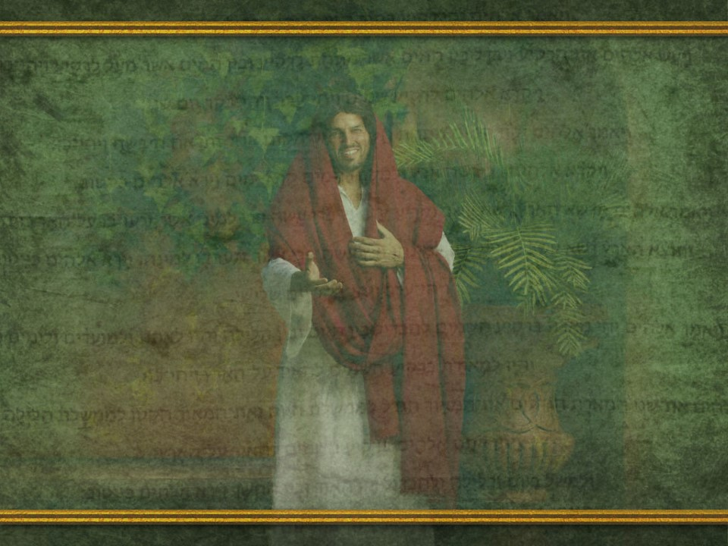
What’s the “risk”
if we refuse?
What’s the “Reward”
if we agree?

Slide 4
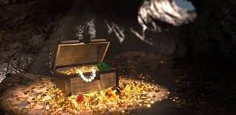
The hope of “Treasure” has motivated many men to face incredible challenges to obtain their “reward”.

Slide 5
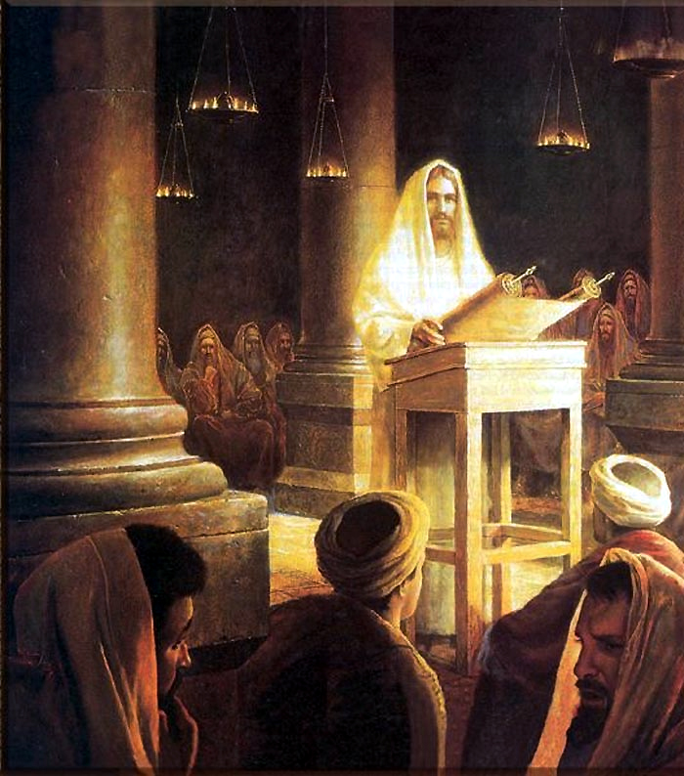
After refusing Satan’s offer of “all the kingdoms of the world”
Jesus first message was:
“Repent:
for the kingdom of heaven is at hand.”
Matthew 4:8-10,17
met-an-o-eh'-o:
to think differently
Meta: after noeō: exercise the mind.

Slide 6
1 Cor. 3:9 reminds us that “we are laborers together with God.”
The following verses remind us that we have a choice and are in fact free to choose whether or not we’ll “cooperate” with Him.
We can take His gifts and grace and “build” our lives around our own priorities and purposes.
(Most people do!)

Slide 7
“We are laborers together with God”
Vs 15 reminds us that those believers who fail to grasp the significance of God’s plan and choose rather to make the choices to build their lives around their own temporary purposes and priorities
“shall suffer loss:
But he himself shall be saved;
yet so as by fire.”

Slide 8
1 Cor. 3:9 reminds us that “we are laborers together with God.”
Vs 14 reminds us that to the degree that we do partner with God, We:
“shall receive a reward.”
What does this mean?

Slide 9
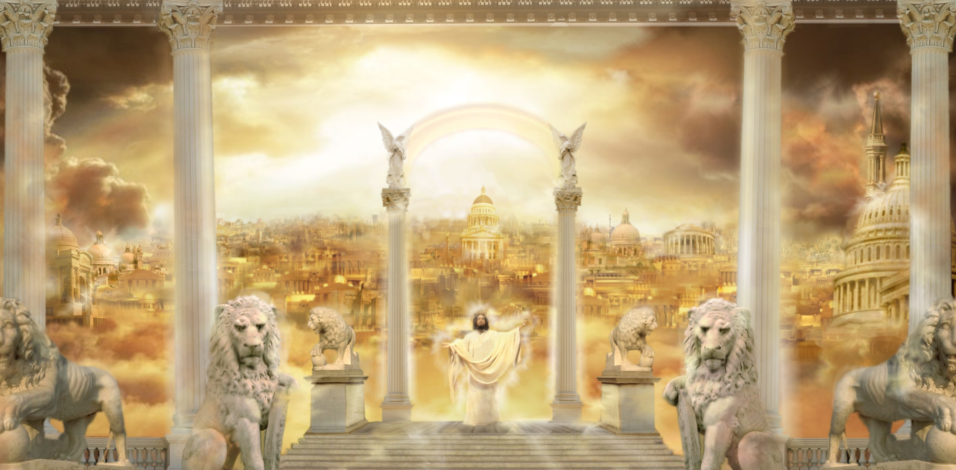
“Reward” is found 178 times in scripture.
I studied each reference and discovered that God uses 15 different words in both the OT (Hebrew) and NT (Greek) to describe our Rewards for serving Him.

Slide 10
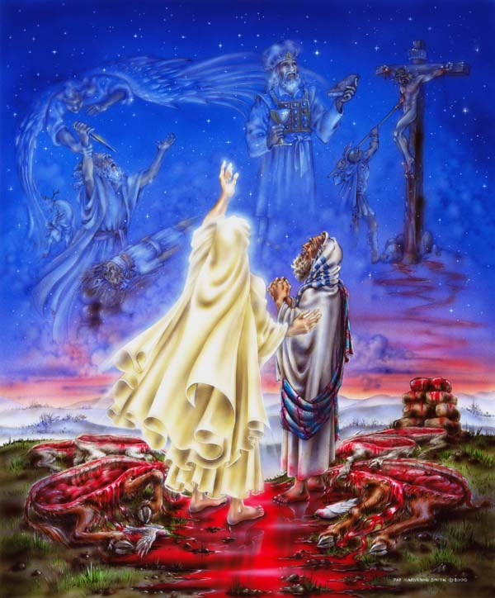
1) The first mention is found in Gen. 15:1
“Fear not, Abram: I am thy shield,
and thy exceeding great reward.”
Exceeding: meʾōd (to magnify greatly)
Great: rābâ’: to increase, heap up, multiply
Reward: Śākār’:
Payment of a contract,
salary, compensation!
Translated: hire 9, reward 9, wages 6, price 2, fare 1, worth 1

Slide 11
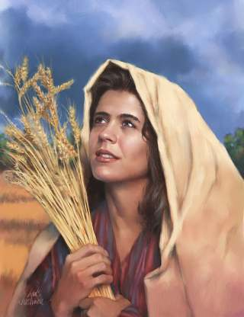
2) Ruth 2:12 “The LORD recompense thy
work, and a full reward be given thee
of the LORD God of Israel,
under whose wings thou art come to trust.”
Maśkōr’et: from Sakar:
wages.
Translated wages 3, reward 1

Slide 12
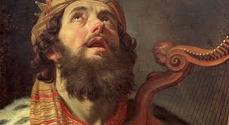
3) David in 2 Samuel 22:21
“The LORD rewarded me according to my righteousness: according to the cleanness of my hands hath he recompensed me.”
Gāmal’: To requite, recompense, benefit
Translated: reward 8x,
dealt bountifully 4x,
do 4x, bestowed 2x,
recompense 2x,
requite 1x

Slide 13
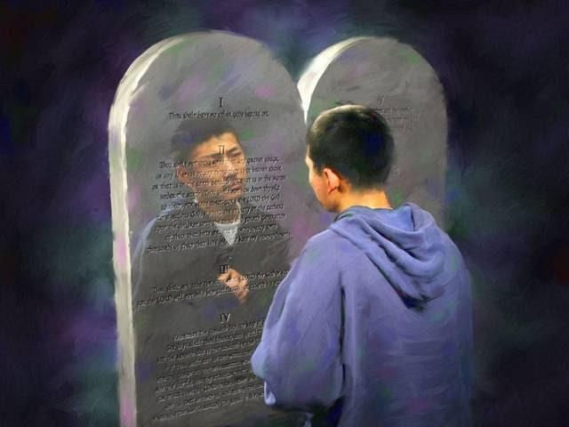
4) David. Ps. 19:10,11
“the Law of the Lord is perfect…
More to be desired are they than gold… sweeter also than honey and the honeycomb.
Moreover by them is thy servant warned:
and in keeping of them there is great reward.“
a'-keb: eternal compensation.
Translated: reward 3x, end 1x

Slide 14
5) Psalm 58:10-11 “The righteous shall
rejoice when he seeth the vengeance…
So that a man shall say,
Verily there is a reward for the righteous:
verily he is a God that judgeth in the earth.”
Perî’: fruit, reward
Translated “fruit(ful)” 118 times, reward 1x
“I have chosen you, and ordained you, that ye should go and bring forth fruit, and that your fruit should remain” John 15:16

Slide 15
6) Pro 11:18 “to him that soweth righteousness
shall be a sure reward.”
seh'-ker: (from Sakar) wages
7) Pro 13:13 “Whoso despiseth the word shall
be destroyed: but he that feareth the
commandment shall be rewarded.”
shaw-lam' to be paid, completed, to reciprocate.
Translated: pay 19, peace 11, recompense 11,
reward 10, render 9, restore 8, repay 7

Slide 16
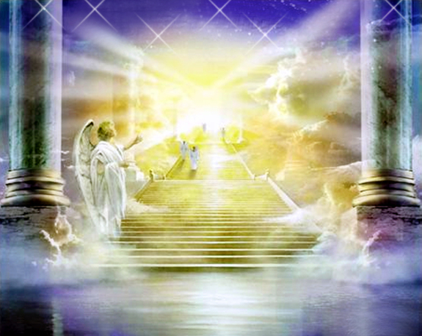
8) Pro 24:14 “So shall the knowledge of
wisdom be unto thy soul: when thou hast
found it, then there shall be a reward,
and thy expectation shall not be cut off. “
akh-ar-eeth': Future posterity.
Translated: end 31x, latter 12x , last 7x,
posterity 3x, reward 2x
expectation: tik-vaw‘ (hope,
the thing that I long for!)

Slide 17
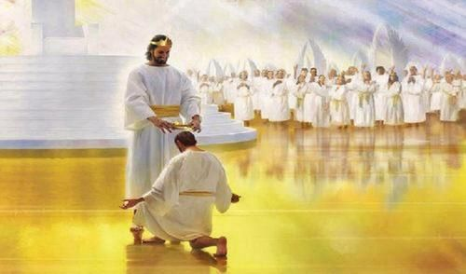
expectation: tik-vaw‘ (hope, thing that I long for)
What do you really “long for”?
“Well done, good and faithful servant:
thou hast been faithful over a few things,
I will make thee ruler over many things:
enter thou into the joy of thy lord.”
Matthew 25:23

Slide 18
New Testament “Rewards” mentioned 38 times using 8 different words.
Mt 5:11-12 “Blessed are ye, when men shall
revile you, and persecute you, and shall say
all manner of evil against you… for my sake.
Rejoice, and be exceeding glad:
for great is your reward in heaven.”
mis-thos': pay for service.
Translated reward 24x, hire 3x, wages 2x

Slide 19
2) Mt 16:26-27 “what is a man profited,
if he shall gain the whole world,
and lose his own soul? or what shall a man
give in exchange for his soul?
For the Son of man shall come in the glory of his Father with his angels;
and then he shall reward every man
according to his works.”
ap-od-eed'-o-mee: to deliver, repay, recompense.
Translated: pay 9x, give 9x, render 9x, reward 7x

Slide 20
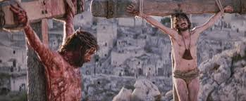
3) Luke 23:40,41 “dost thou not fear God seeing thou
art in the same condemnation?
For we indeed justly; for
we receive the due reward of our deeds:
but this man hath done nothing amiss.”
ax'-ee-os: deserving, suitable.
Translated worthy 35x, meet 4x, due reward 1x

Slide 21
4) Col 3:23-24 “whatsoever ye do, do it
heartily, as to the Lord, and not unto men;
Knowing that of the Lord
ye shall receive the reward of the inheritance:
for ye serve the Lord Christ.”
an-tap-od'-os-is: requital, repayment
“who hath first given to him,
and it shall be recompensed unto him again?
For of him, and through him, and to him, are all things:
to whom be glory for ever.”
Ro 11:35-36

Slide 22
5) Hebrews 11:6
“without faith it is impossible to please him:
for he that cometh to God must believe that he is,
and that he is a rewarder of them
that diligently seek him.”
mis-thap-od-ot'-ace: remunerate, reward

Slide 23
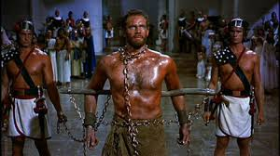
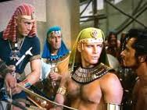
6) Heb 11:25,26 “by faith Moses refused …choosing
rather to suffer affliction with the people of God
than to enjoy the pleasures of sin for a season.
Esteeming the reproach of Christ greater riches than the treasures in Egypt:
for he had respect unto the
recompence of the reward.”
mis-thap-od-os-ee'-ah:
recompense 3x

Slide 24
7) “Lay up for yourselves
treasures in heaven”
“For where your treasure is,
there shall your heart be also.”
Mt. 6:20,21
thay-sow-ros':
deposits, wealth

Slide 25
Conclusion:
Virtually every one of the 15 different words God uses to describe eternal rewards have the idea of “repayment” or “reimbursement” (with INTEREST)
for some service or investment!
Śākār’: salary
Maśkōret: from Sakar: wages
Gāmal’: To requite, recompense
ay'-keb: eternal compensation
Perî’: fruit, reward
seh'-ker: wages
shaw-lam‘: to reciprocate.
akh-ar-eeth': Future posterity
mis-thos': pay for service
ap-od-eed'-o-mee: to repay,
ax'-ee-os: deserving, suitable
an-tap-od'-os-is: requital
misthapodosee'ah: recompense
mis-thap-od-ot'-ace: remunerate
thay-sow-ros': make deposits

Slide 26
Application:
Too many believers have an “eternal entitlement mentality”.
They assume God will just “hand out rewards” for showing up!
While few even bother to “show up” for church!
What we truly believe will determine where we will spend eternity!
How we “behave” (what we do) will determine our Rewards!

Slide 27
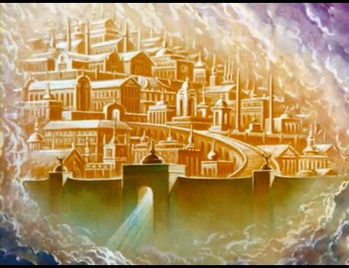
“He is no fool who gives up what he cannot keep,
Jim Elliot
In order to gain what he cannot lose!”

Slide 28
But Jesus said that “He is a fool who sacrifices what he cannot lose;
In order to gain (cling to) what he cannot Keep!”
LK 12:20-21 “But God said unto him, Thou fool, this night thy soul shall be required of thee:
then whose shall those things be,
which thou hast provided?
So is he that layeth up treasure for himself,
and is not rich toward God.”

Slide 29
“behold, I come quickly; and my reward is with me,
to give every man as his work shall be.”
Revelation 22:12
mis-thos': pay for service!
Are you “earning” your pay? (Eph. 4:1)

Slide 30
Are you Investing in Eternity? Mt. 6:20

