Slide 1
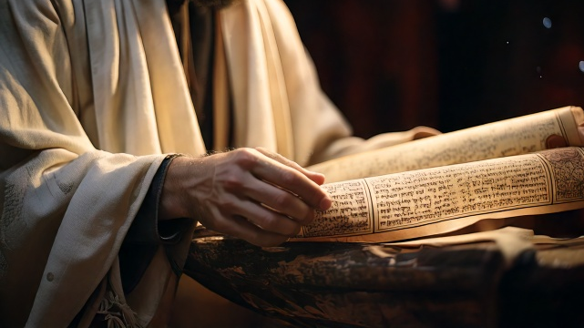
Rejections Because of Misconceptions
By Joseph Peters

Slide 2

Goal
Every Christian should be careful not to miss God’s Opportunities
For these three reasons

Slide 3
Reasons
Nazareth Had an Opportunity to Follow Jesus
Nazareth Rejected this Opportunity
Nazareth’s Rejection Amazed Jesus

Slide 4
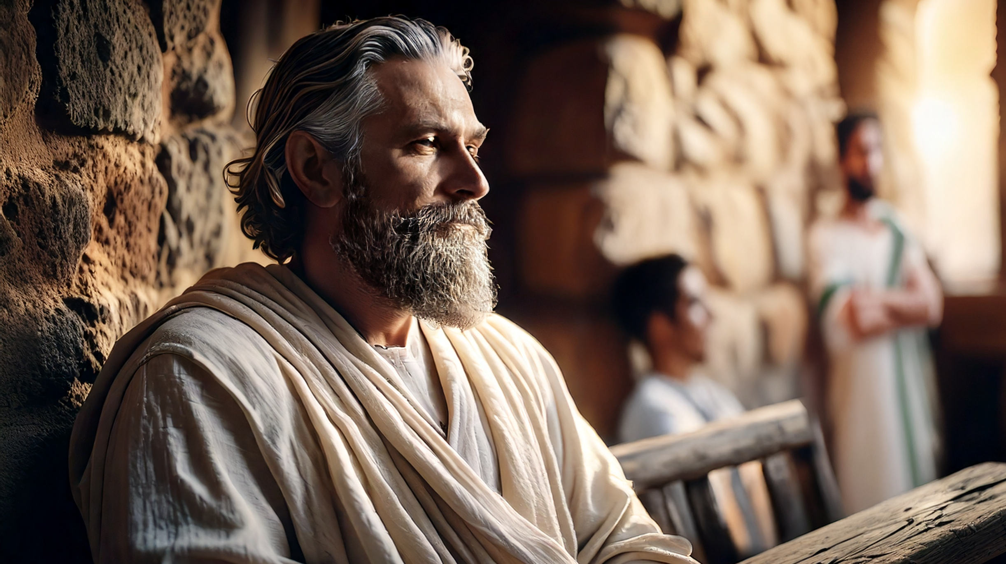
Nazareth Had an Opportunity to Follow Jesus

Slide 5
Mark’s Account
And he went out from thence, and came into his own country; and his disciples follow him. And when the sabbath day was come, he began to teach in the synagogue: and many hearing him were astonished, saying, From whence hath this man these things? and what wisdom is this which is given unto him, that even such mighty works are wrought by his hands (Mark 6:1–2)?

Slide 6
Luke’s Account P1
And Jesus returned in the power of the Spirit into Galilee: and there went out a fame of him through all the region round about. And he taught in their synagogues, being glorified of all. And he came to Nazareth, where he had been brought up: and, as his custom was, he went into the synagogue on the sabbath day, and stood up for to read (Luke 4:14–16).

Slide 7
Luke’s Account P2
And there was delivered unto him the book of the prophet Esaias. And when he had opened the book, he found the place where it was written, The Spirit of the Lord is upon me, because he hath anointed me to preach the gospel to the poor; he hath sent me to heal the brokenhearted, to preach deliverance to the captives, and recovering of sight to the blind, to set at liberty them that are bruised, To preach the acceptable year of the Lord (Luke 4:17–21).

Slide 8
Luke’s Account P3
And he closed the book, and he gave it again to the minister, and sat down. And the eyes of all them that were in the synagogue were fastened on him. And he began to say unto them, This day is this scripture fulfilled in your ears. And all bare him witness, and wondered at the gracious words which proceeded out of his mouth. And they said, Is not this Joseph’s son (Luke 4:20–22)?

Slide 9
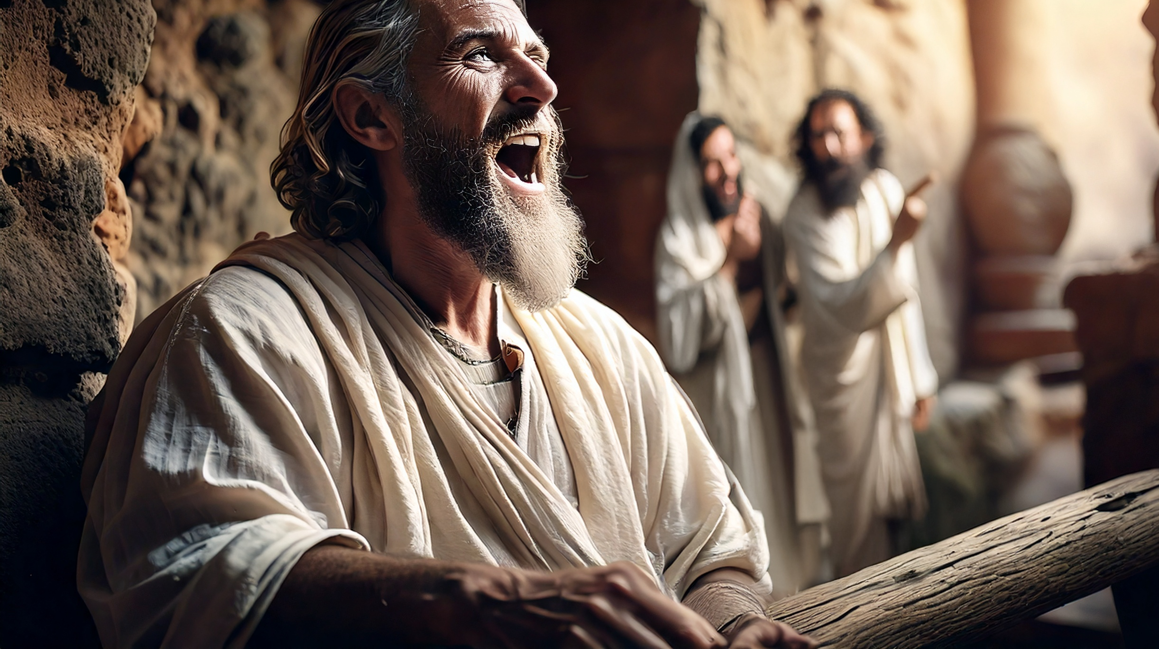
Nazareth Rejected this Opportunity

Slide 10
Jesus’ Response
And he said unto them, Ye will surely say unto me this proverb, Physician, heal thyself: whatsoever we have heard done in Capernaum, do also here in thy country. And he said, Verily I say unto you, No prophet is accepted in his own country. But I tell you of a truth, many widows were in Israel in the days of Elias, when the heaven was shut up three years and six months, when great famine was throughout all the land; But unto none of them was Elias sent, save unto Sarepta, a city of Sidon, unto a woman that was a widow. And many lepers were in Israel in the time of Eliseus the prophet; and none of them was cleansed, saving Naaman the Syrian (Luke 4:23–27).

Slide 11
Their Misperceptions and Rejections
And all they in the synagogue, when they heard these things, were filled with wrath, And rose up, and thrust him out of the city, and led him unto the brow of the hill whereon their city was built, that they might cast him down headlong. But he passing through the midst of them went his way (Luke 4:28–30).

Slide 12
Their Misperceptions and Rejections In Mark
Is not this the carpenter, the son of Mary, the brother of James, and Joses, and of Juda, and Simon? and are not his sisters here with us? And they were offended at him (Mark 6:3).
Philip findeth Nathanael, and saith unto him, We have found him, of whom Moses in the law, and the prophets, did write, Jesus of Nazareth, the son of Joseph. And Nathanael said unto him, Can there any good thing come out of Nazareth? Philip saith unto him, Come and see (John 1:45–46).

Slide 13
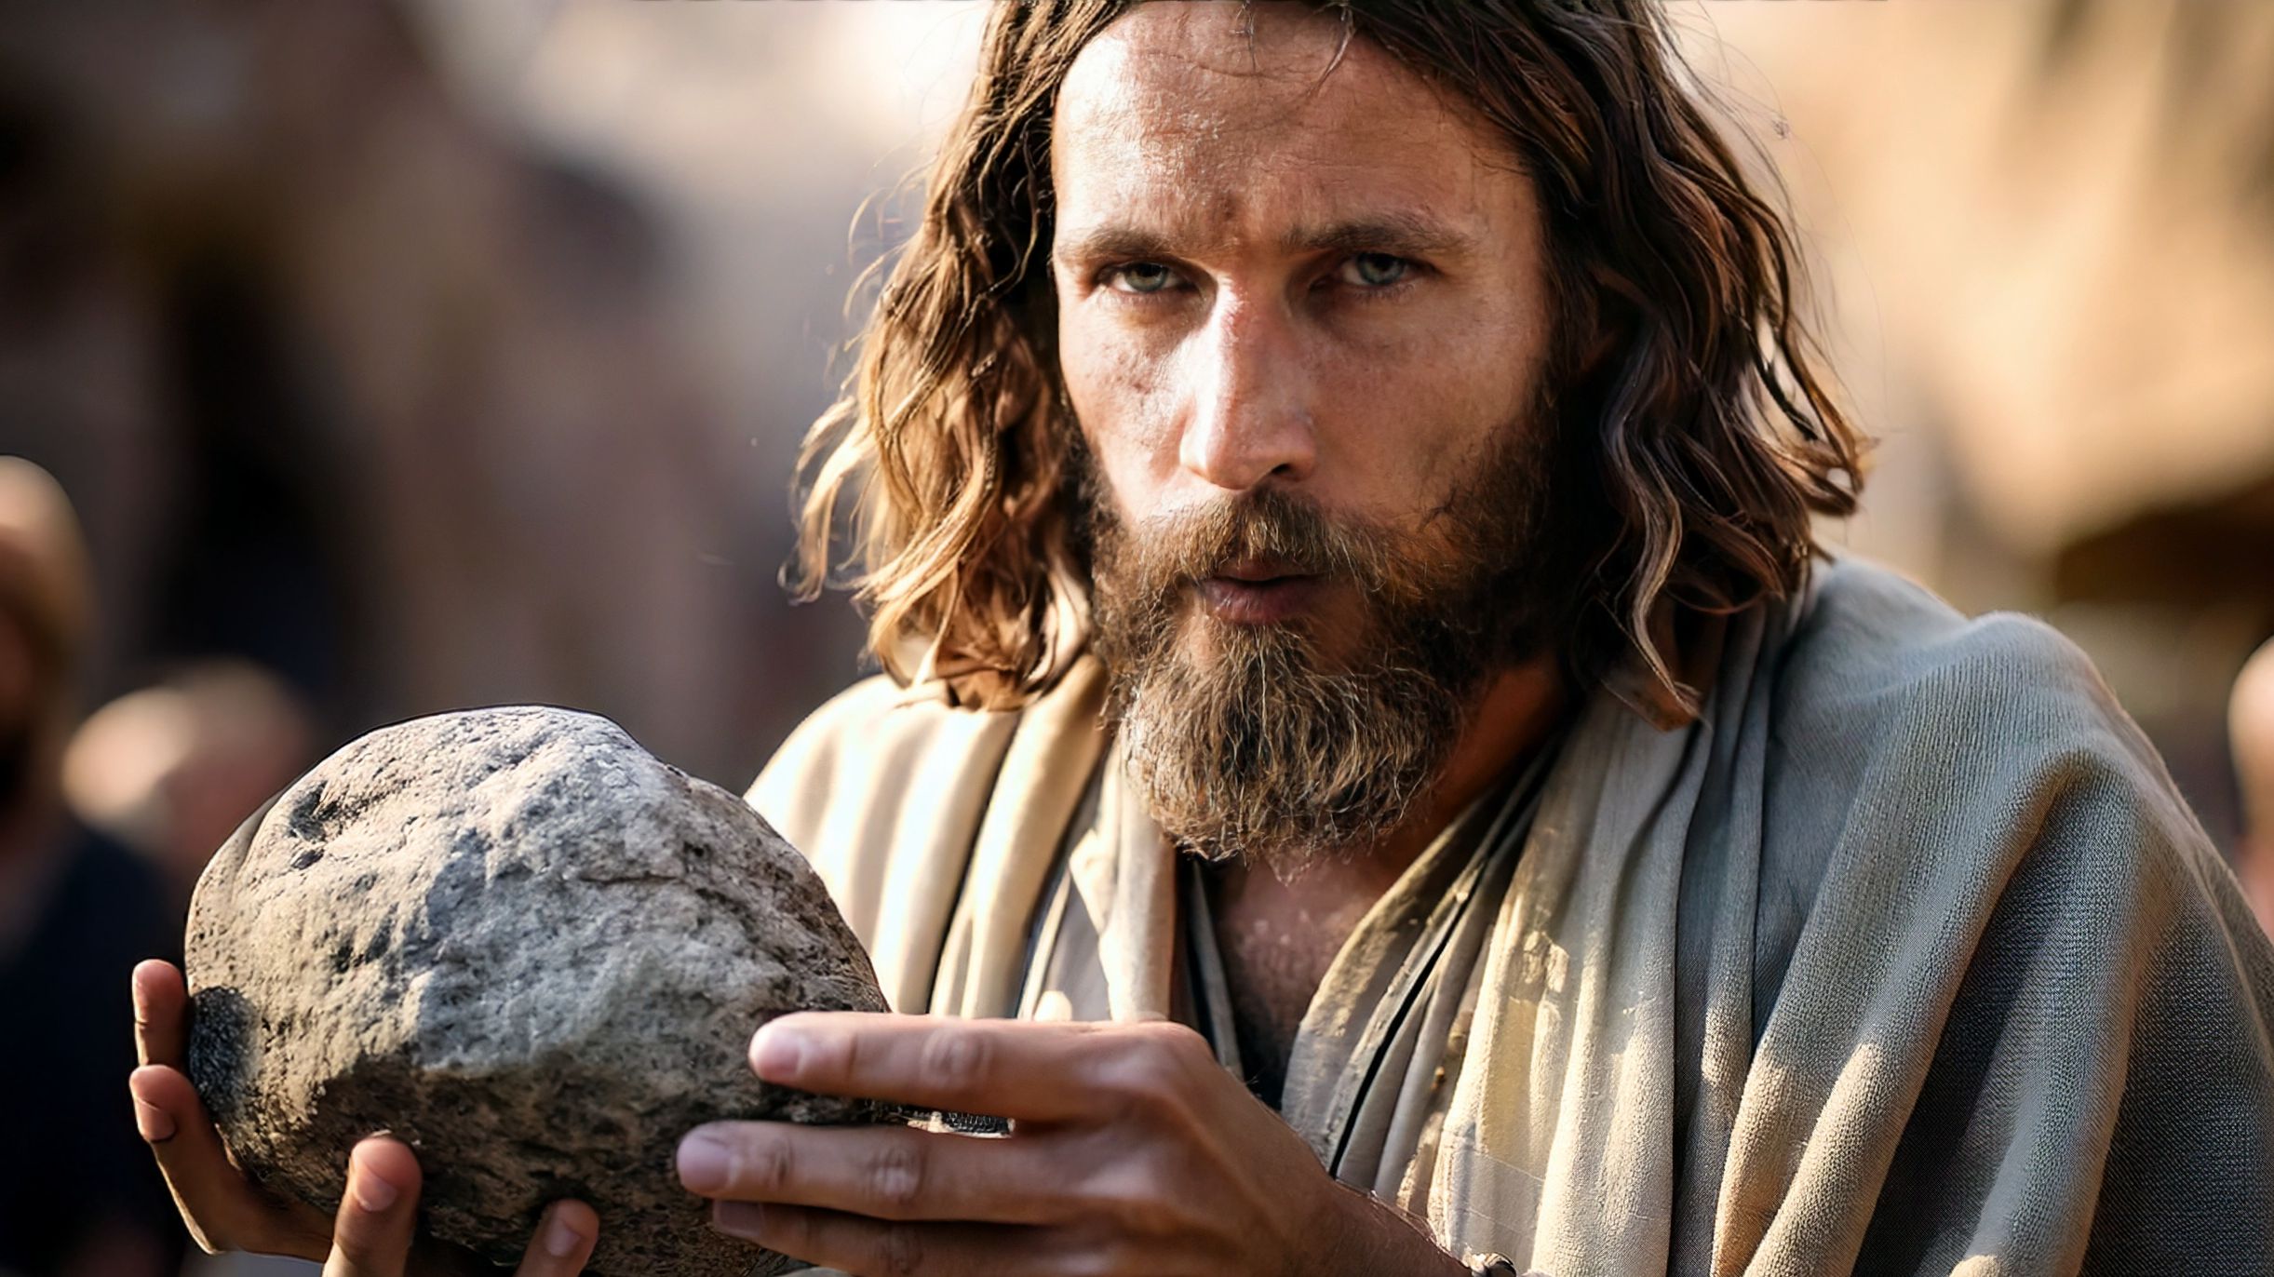
Nazareth’s Rejection Amazed Jesus

Slide 14
Their Lack of Faith
But Jesus said unto them, A prophet is not without honour, but in his own country, and among his own kin, and in his own house. And he could there do no mighty work, save that he laid his hands upon a few sick folk, and healed them. And he marvelled because of their unbelief. And he went round about the villages, teaching (Mark 6:4–6).

Slide 15
Goal
Every Christian should be careful not to miss God’s Opportunities
For these three reasons

Slide 16
Reasons
Nazareth Had an Opportunity to Follow Jesus
Nazareth Rejected this Opportunity
Nazareth’s Rejection Amazed Jesus

