Slide 1
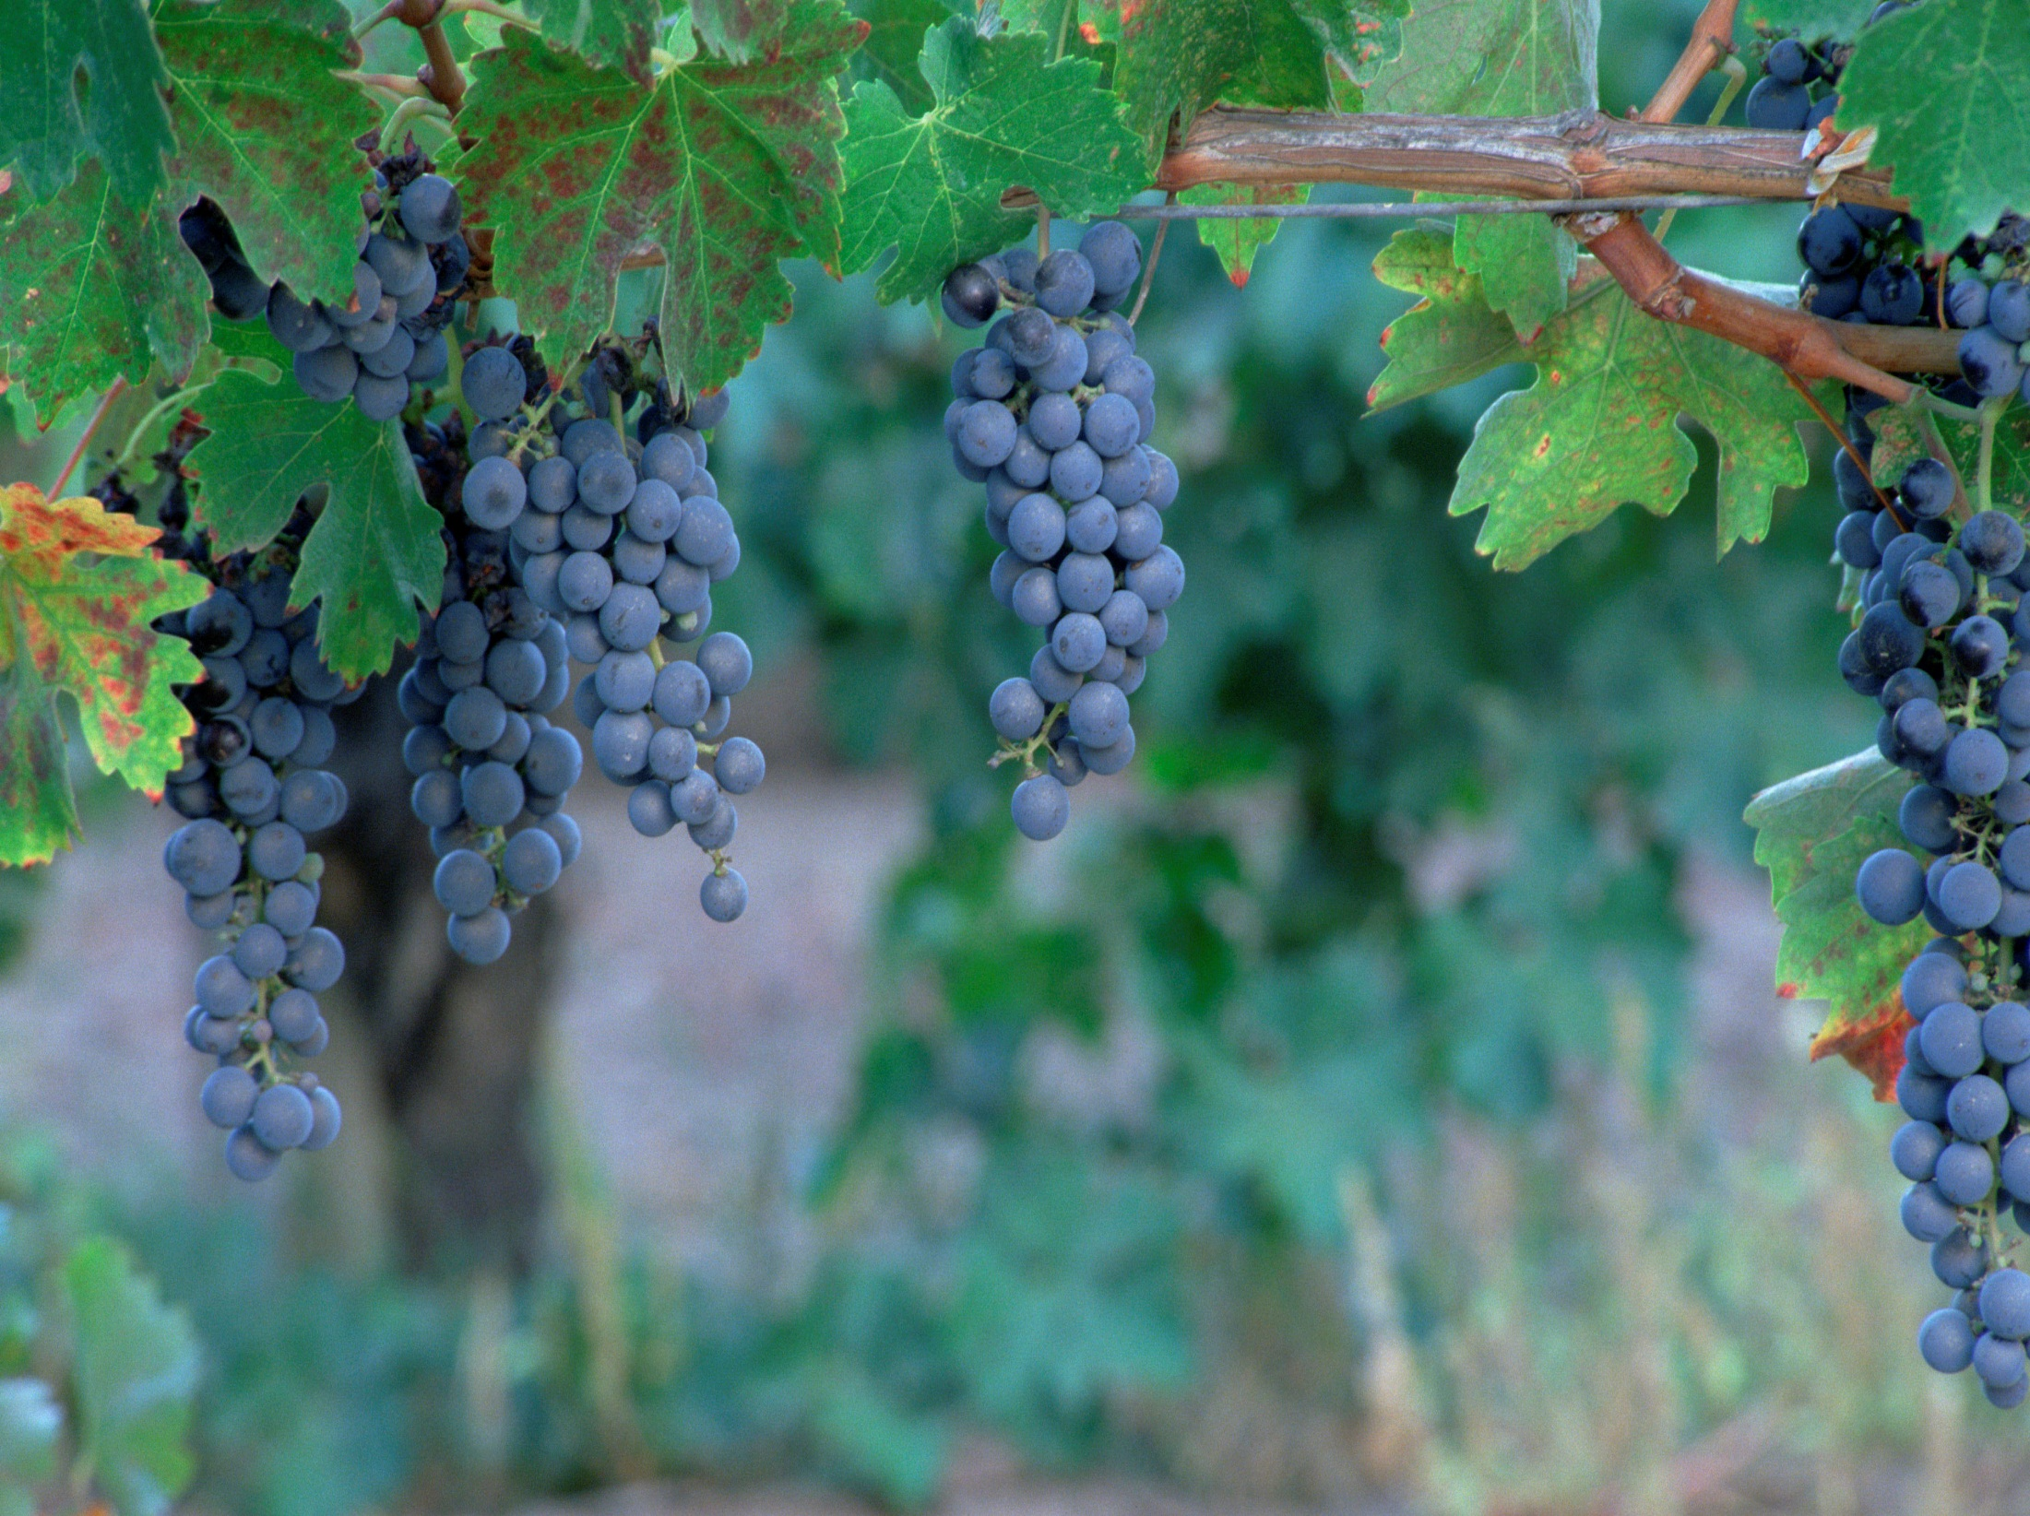
Pruning for a Productive Life.
Lessons in the Vineyard
John 15
The Picture: Vs 1,5
“I am the true vine,
my father is the Husbandman…
ye are the branches.”

Slide 2
Pruning for a Productive Life.
Lessons in the Vineyard
The Purpose: Jn 15:16
“I have chosen you and ordained you (tith’ēmi: appointed, placed)
… To bring forth fruit”

Slide 3
Pruning for a Productive Life.
Lessons in the Vineyard
The Process: vs 2-10
“every branch that beareth fruit,
he purgeth it,
that it may bring forth more fruit.”

Slide 4
1. The Point Of Pruning/Purging. Vs 2,3
Kathai’ro, actually has a double meaning:
A. To Cleanse: vs 3, 1 Jn 1:5-10
It comes from the root word “katharos’” meaning to make clean, clear, and pure.
B. To Cut: kathairō also means to prune/cut 1) To remove infected branches. (Sin)
2) To redirect unproductive branches. (Self)

Slide 5
2. The Purpose of Pruning/Purging. 2,3
A. Not Just To “Remove”
Ro. 12:2 “transformed by the renewing of your mind...”
B. Not to Hurt / Harm us,
2 Cor 4:17 "our light affliction, … worketh for us…”
C. Not to Terrorize,
Jms 1:2-3 “Count it all joy when ye tall into diverse temptations, Knowing that the trial
of your faith worketh patience.”
But To “Renovate”
But To Help Us Grow.
but to Test (Prove) us.

Slide 6
3. The Patience of Pruning
A. There is a “summer season” between the pruning and the “production” of fruit. Heb. 10:36
"For ye have need of patience, that,
after ye have done the will of God,
ye might receive the promise."
Jms 1:4 “But let patience have her perfect work,
(teleios: complete, from telos: to reach the goal)
that ye may be perfect and entire,
(holok’lēros: from holos {whole}
and Kleros {inheritance}!
lacking nothing.”

Slide 7
4. The Pattern of Pruning
A. Pruning involves a “trust test”.
1) They ultimately involve the “trial of our faith.”
(James 1:3; 1 Peter 1:7)
“the trial of your faith, being much more precious than of gold that perisheth,
though it be tried with fire,
might be found unto praise and honour and glory at the appearing of Jesus Christ:”

Slide 8
4. The Pattern of Pruning
A. Pruning usually involves a “trust test”.
2) God asks us to yield something of value to Him,
even when we feel we have a legitimate right to
retain control.
Mt 16:24-27 “If any man will come after me,
let him deny himself, take up his cross, and follow me.
For whosoever will save his life shall lose it:
and whosoever will lose his life for my sake shall find it.
(Ro. 12:1,2 “Reasonable service“)

Slide 9
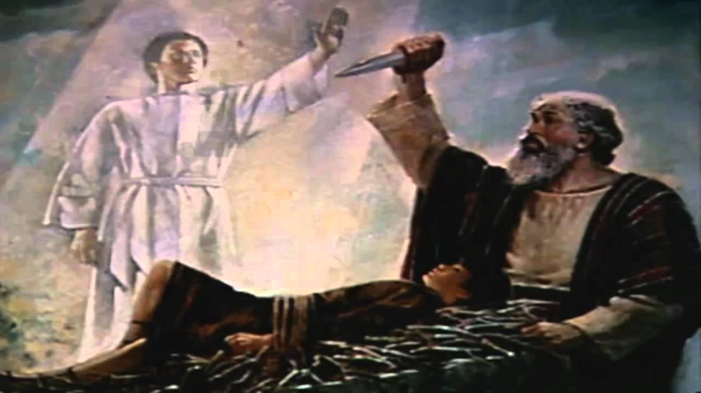
4. The Pattern of Pruning
A. Pruning usually involves a “trust test”.
2) God asks us to yield something of value to Him,
even when we feel we have a legitimate right to
retain control. (Ro. 12:1,2)
a) Abraham. Genesis 22
“Take now thy son Isaac…
and offer him
as a burnt offering…”

Slide 10
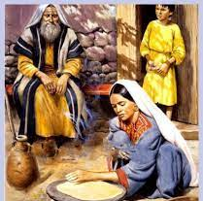
2) God asks us to yield something of value to Him,
even when we feel we have a legitimate right to
retain control. (Ro. 12:1,2)
b) Widow of Zarephath.
(1 Kings 17)
⁹ Arise, get thee to Zarephath,
…behold, I have commanded a widow woman there to sustain thee.”

Slide 11
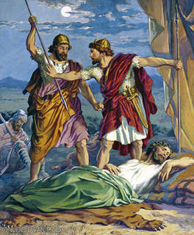
2) God asks us to yield something of value to Him,
even when we feel we have a legitimate right to
retain control. (Ro. 12:1,2)
c) David and King Saul:
(1 Sam. 24:10; 26:23)
“some bade me kill thee:
but mine eye spared thee;
and I said, I will not put forth mine hand against my lord;
for he is the LORD'S anointed.”
Repeated in 1 Sam. 26:23)

Slide 12
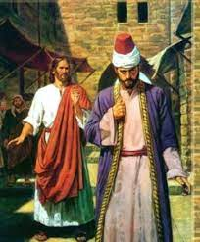
d) The Rich young ruler. (Mark 10:17-23)
21 “Jesus beholding him loved him,
and said, One thing thou lackest:
Go thy way, sell whatsoever thou hast,
and give to the poor,
& thou shalt have treasure in heaven:
and take up the cross, and follow me.
22 And he was sad at that saying,
and went away grieved:
for he had great possessions. ”

Slide 13
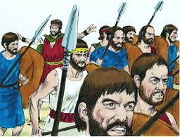
B. God Knows Just Where To Probe And Prune.
Jer 17:10 "I the LORD search the heart,
I try (Bāḥan’: to test, investigate, examine, prove)
the reins, (kilyâ’: innermost being)
Example: David in 1 Sam. 25
even to give every man
according to his ways,
and according to the fruit of his doings."

Slide 14
Example: David 1 Sam. 25
1) David had been anointed to be King, and yet spent
years as an outlaw, running from Saul’s jealousy.
2) He had protected Naboth’s property, (7,16)
yet received a cruel rejection. “Who is David” Vs 10-12
3) In his anger, he was about to destroy Naboth
(21-22) when Abigail appealed to him to look
beyond the pain of his present circumstances,
and “pass the trust test.” (vs 29-31)
God dealt with Naboth! Vs 37,38 (See Ro. 12:19)

Slide 15
C. God Normally “Prunes” In One Of Four Areas.
1) People (Our Relationships). Mat 10:37
"He that loveth father or mother more than me is
not worthy of me: and he that loveth son or daughter more than me is not worthy of me."
2) Perspective (Our Reasoning:) (Genesis 22)
3) Possessions (Our Rewards/security) (2 Cor. 8,9)
4) Pride: (Our Reputation) (Daniel 4; Phil. 3)

Slide 16
CONCLUSION:
(Paul in Philippians 3:7-15)
1) Paul realized that God had a purpose for his life,
and this purpose involved a process of pruning.
vs 7 “But what things were gain to me,
those I counted loss for Christ.”
2) He wasn’t a passive bystander, but a participant,
who had to make many choices along the way.
(Notice the 13 “I’s” in this passage.)

Slide 17
CONCLUSION: (Paul in Philippians 3:7-15)
3) Each choice he made opened up new paths
and new choices.
4) Each choice involved a “trust test”,
which brought him into closer harmony and
fellowship with Christ. Vs. 10
“That I may know him, and the power of his resurrection, and the fellowship of his sufferings,
being made conformable unto his death;”

Slide 18
APPLICATION:
In what area do you sense God might be
“pruning” (testing) you?
Relationships Reasoning
Rewards Reputation
What will your response be?
1) Obey and Trust?
2) Object and Resist?
(Produces Grace & Growth
James 4:6-10)
(Produces Grumbling & Grief
Mark 10:22; Phil. 2:13-15)

