Slide 1
Pictures of the People of God
Seeing ourselves through God’s Eyes.

Slide 2
Pictures of God’s People
“I will build my church;
and the gates of hell shall not prevail against it.”
Mt 16:7

Slide 4
Ekklesia: a called out assembly
belonging to the Lord. Mt 16:18

Slide 5
We’ve been discussing some of the ways God “pictures” or describes His people.
Precious pictures
(Treasure/Pearl)
Progressive Pictures
(Sheep, Vessels, Masterpieces)
Personal Pictures
(Family, Bride)

Slide 6
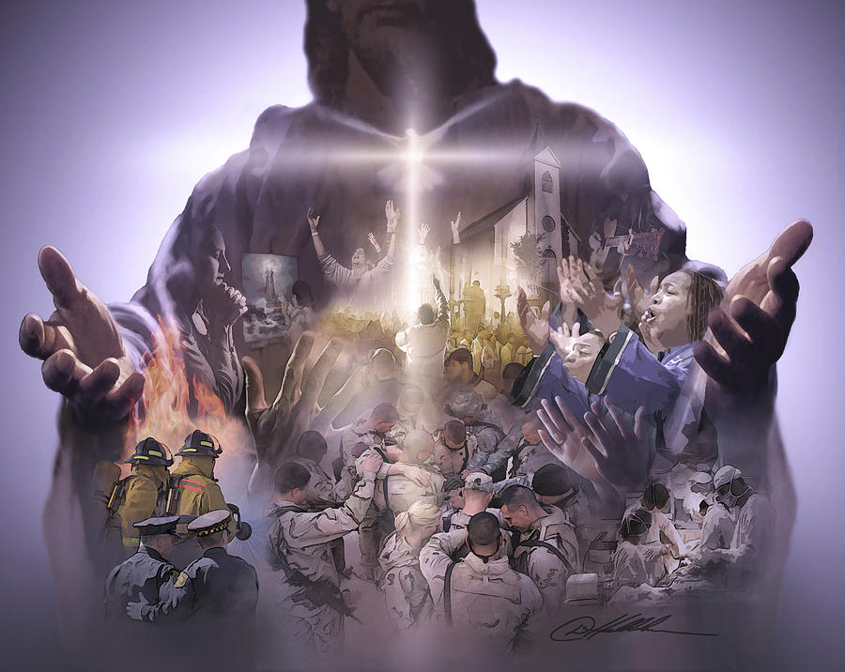
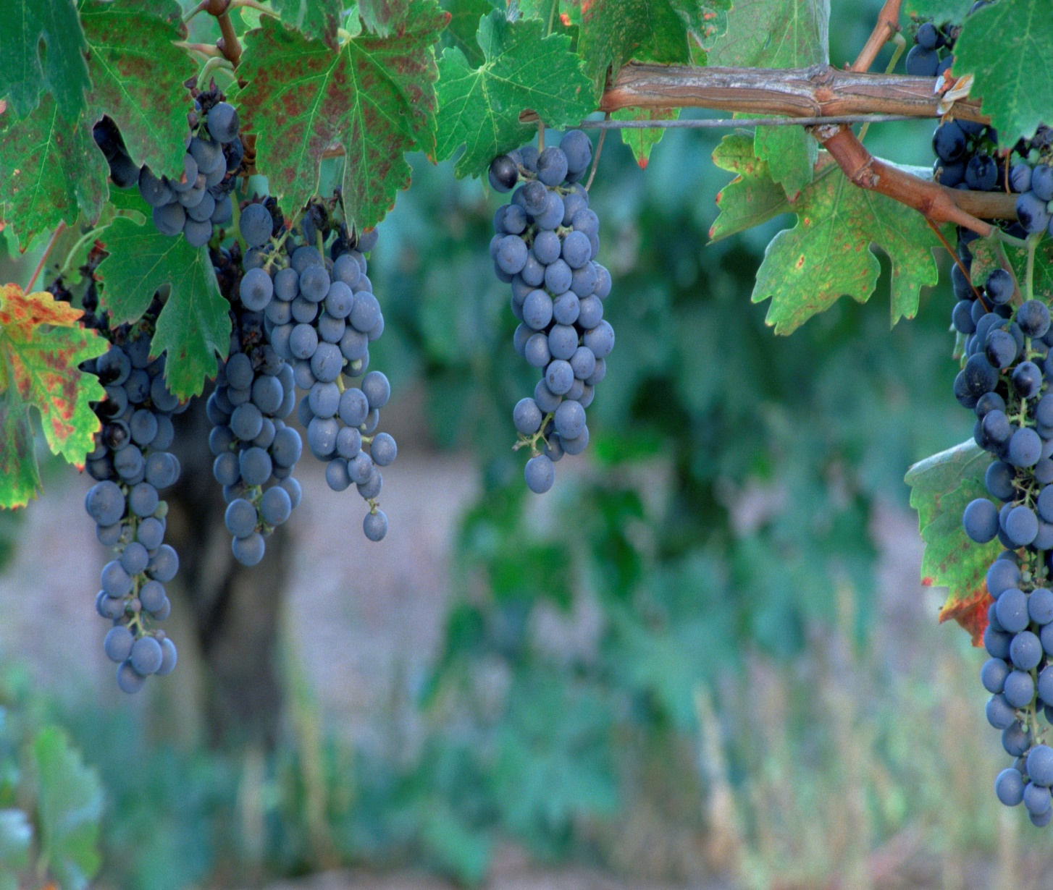
Some Practical Pictures:
“Ye are God’s Husbandry” 1 Cor 3:9
“Ye are the body of Christ…” 1Cor 12:27; Eph. 4

Slide 7
Productive farms/ lives require:
Proactive Planning. Pr. 29:18
Practical Preparation. Hosea 10:12
Purposeful Planting. Gal. 6:7,8
Persistent Protecting. Job 1:10
Painful Pruning. John 15

Slide 8
Pruning for a Productive Life.
Lessons in the Vineyard
John 15
The Picture: Vs 1,5
“I am the true vine,
my father is the Husbandman…
ye are the branches.”

Slide 9
Pruning for a Productive Life.
Lessons in the Vineyard
The Purpose: Jn 15:16
“I have chosen you and ordained you (tith’ēmi: appointed, placed)
… To bring forth fruit”

Slide 10
Pruning for a Productive Life.
Lessons in the Vineyard
The Process: vs 2-10
“every branch that beareth fruit,
he purgeth it,
that it may bring forth more fruit.”

Slide 11
“every branch that beareth fruit he purgeth,
that it may bring forth more fruit”
The Dimensions Of Purging. Vs 2,3
Kathai’ro, actually has a double meaning:
To Cleanse: vs 3, 1 Jn 1:5-10
It comes from the root word “katharos’” meaning to make clean, clear, and pure.
Jn 15:3 “Ye are clean through the word …”

Slide 12
The Dimensions Of Purging. Vs 2,3
B. To Cut: kathairō also means to prune/cut 1) “Cutting” is required to:
a) To cut away dead or dying (infected) growth.
b) Allow Sunlight to reach the other branches.
c) Increase the size and quality of the fruit.
d) Encourage new Growth (or growth in a new
direction) and fruit to develop.
Heb. 4:12 “The Word of God is quick and powerful
and sharper than any two edged sword”

Slide 13
2. The Motivations for Purging
A. TO DISCIPLINE (Hebrews 12:5-13)
Discipline deals with Sin in our lives.
1) It’s Part of being a child of God. Vs 7,8
2) It’s Painful. Heb. 12:11
3) It’s Purposeful. Heb. 12:10,11
4) It’s Progressive. Heb 12:5-6
The length and breadth of God’s Discipline
depends on our response to Him. (Heb 12:11)

Slide 14
2. Motivations for Purging
A. To Discipline: Deals with the sin in our lives.
B. To Direct: This Deals with “self” in our lives.
Jn 15:2 “every branch that beareth fruit, he purgeth it”
1) Pruning is necessary to deal with (direct)
the “wild nature” of the vine.
(a) We want to “direct our own paths.” (Pr 3:5-6)
Left alone, Grape branches tend to grow “wild”
(Is 5:2), working their way down into the dirt
or getting tangling between themselves.

Slide 15
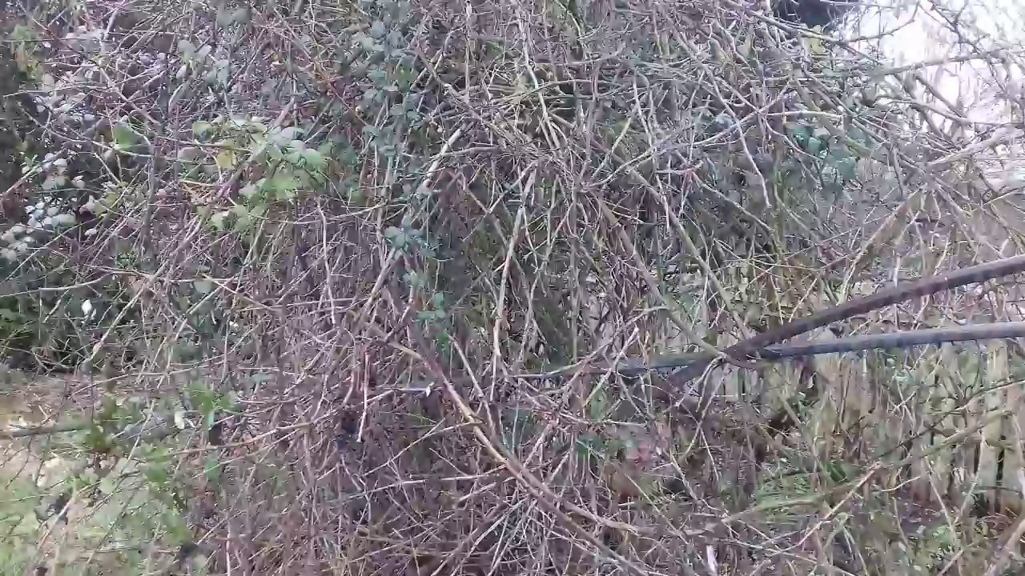
This blocks the leaves exposure to the sun,
starving the branch of the nutrients necessary to develop healthy fruit.
Pruning is the only solution!

Slide 16
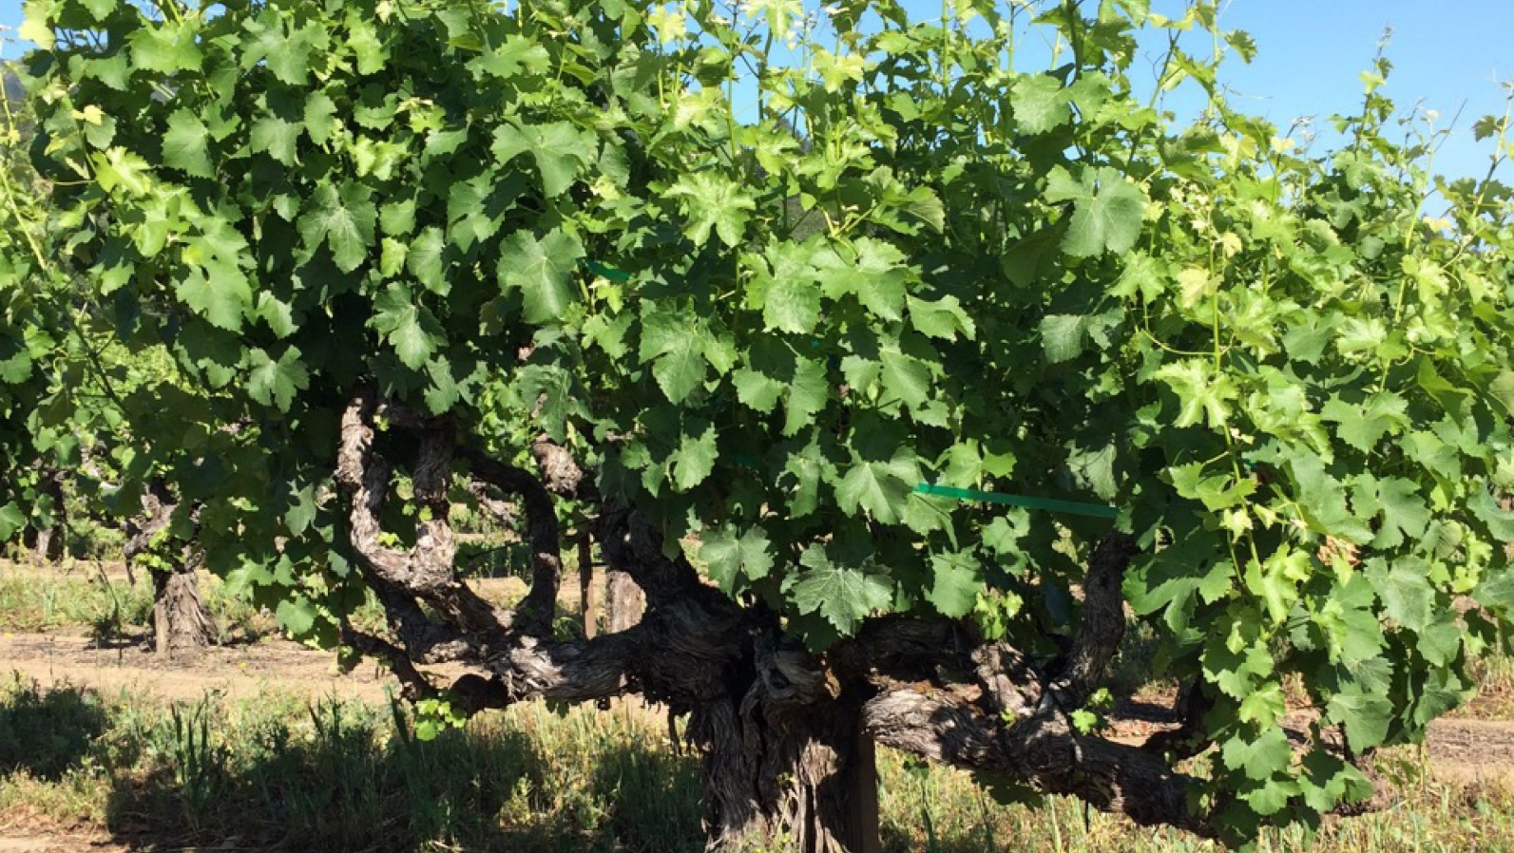
b) We’re too often content with leaves. (looks)
“When there’s not enough fruit to store the carbohydrates,
A grapevine will over-compensate with increased foliage.” (leaves)
(Ohio State Horticulture and Crop Science fact sheet)
Remember the “cursed” fig tree of Mt 21:19!
God’s looking for
Lasting Fruit!
(Jn 15:16)

Slide 17
Conclusion: Jn 15:2
“Every branch that beareth fruit he purgeth,
that it may bring forth more fruit”
The “Pruning” of otherwise healthy branches is called “The trial of your faith”
in other passages such as James 1:3
and 1 Peter 1:7.

Slide 18
God does this, not to:
Simply “remove”
Ro. 12:2 “transformed by the renewing of your mind...”
Anakai’nōsis: to renovate, or make new.
He’s trying to make room for healthier growth!
2 Cor 10:8 “our authority, which the Lord hath given us for edification,
and not for your destruction”
but to Renovate!
(Oikodomē’ comes from doma: to build)

Slide 19
God does this, Not to:
2) Terrorize,
Promotions are often preceded
Examinations allow us (and others) to recognize
Tests aren’t really “tests” unless…
they push you past your last test.
If you pull back,
but to test. Jms 1:3-5
by examinations.
areas of strength and weakness.
you won’t learn more or grow.

Slide 20
God does this, Not to:
3) Hurt
2 Cor 4:17 "our light affliction, which is but for a moment,
worketh for us (See Ro. 8:28)
a far more exceeding and eternal weight of glory;“
Is 48:10-11 “I have refined thee…; (ṣārap’: purged)
I have chosen thee in the furnace of affliction.
For mine own sake, will I do it: for how should my name
be polluted?
but to Help us grow!
and I will not give my glory unto another.”

Slide 21
God wouldn’t allow us to be hurt,
if any other method would be effective.
Not every “pain” is a result of pruning,
but every “pain” is an opportunity for growth. (Ro. 8:28
a) Your rebellious child is not God’s pruning,
but it can produce growth in you. (Ps 76:10)
b) God doesn’t bring pain just to see how we’ll respond,
but can use the pain of sinful actions to bring
great good to us, and glory to himself,
if we’ll yield to Him. (Ro. 8:28)

Slide 22
Ps. 66:10-12 "For thou, O God, hast proved us: thou hast tried us, as silver is tried. Thou broughtest us into the net; thou laidst affliction upon our loins.
Thou hast caused men to ride over our heads;
we went through fire and through water:
but thou broughtest us out into a wealthy place.“
from rāwâ’: to satisfy (slake our thirst)
Ps 17:15 “I will behold thy face in righteousness:
I shall be satisfied, when I awake,
with thy likeness.”

Slide 23
Application: Many confuse the pain of “discipline” and that of “direction.”
Heb. 12:1,2 “let us lay aside every weight and the sin which so easily besets us and run with patience the race set before us.”
Although they have some similar characteristics, it is important to rightly discern what God is trying to accomplish so that we can respond correctly.
How can we determine if the pain in our lives is due to discipline or direction?

Slide 24
Questions | Discipline | Direction
What’s happening? | Pain | Pain
Why’s it happening? | You’re Sinning | You’re doing right.
What’s your level of Fruit? | Little or None. | Some fruit
What’s God looking for? | Spiritual Fruit | More fruit
What needs to go? | Sin in my life. | Self rule in my life.
How should you feel? | Guilty, sad | Relief, trust
What should you do? | Repent / Confess. | Release /Cooperate.
When does the pain stop? | When I stop sinning. | When God’s finished. Ro. 8:28,29

Slide 25
John 15:5
“I am the vine,
ye are the branches:
He that abideth in me,
and I in him,
the same bringeth forth much fruit:
for without me ye can do nothing.”

Slide 26
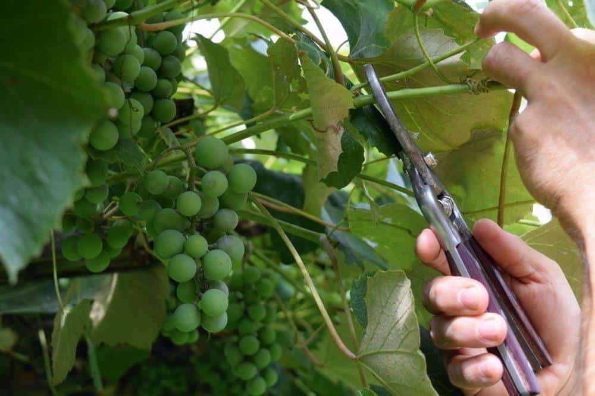
What’s the Husbandman trying to accomplish in & through your life?
Are you in a season of
Production or Pruning?
Of cleansing or cutting?
Of Correction or Direction?
How will
you respond?
Pr 3:5,6

