Slide 2
1 Cor 13 closes with:
12 “For now we see through a glass darkly…
(ai’nigma: obscured, unclear!)
{where the English “enig​ma” comes from.}
…now I know (ginōskō: understand) in part…”
How can we “trust” in the face of such obscurity and uncertainty?
“Now abideth faith, hope, charity” vs 13

Slide 3
“Now abideth faith, hope, charity”
Faith, (pistis: persuasion, conviction)
Hope, (elpis: anticipation, confidence)
Charity! (agape: expression of God’s love).
Faith becomes the basis of our hope,
enabling us to love!
Such Faith is more than a mental persuasion
It’s a Moral Conviction!

Slide 4
This kind of faith is:
“the substance of things hoped for,
the evidence of things not seen….
Without (such) Faith it is impossible to Please God” Hebrews 11:1,6
How does God move our faith from persuasion to “Conviction”?

Slide 5
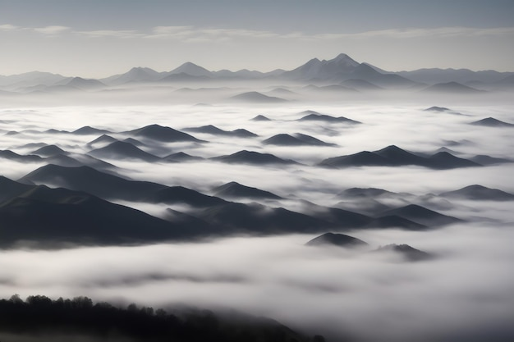
Faith must be tested to be Trusted!
We can’t reach the mountain tops
2 Cor 5:7
without walking through some valleys!

Slide 6
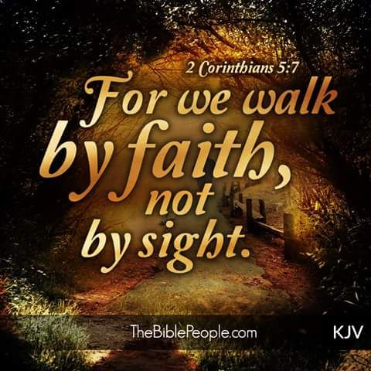
Faith must be tested to be Trusted!
Sometimes we must walk through the dark to teach us to Trust! (Job 23:10)
2 Cor 5:7

Slide 7
Jesus modeled this truth!
“I gave my back to the smiters, and my cheeks to them that plucked off the hair:
I hid not my face from shame and spitting.
For the Lord GOD will help me; therefore shall I not be confounded: therefore have I set my face like a flint, and I know that I shall not be ashamed.
He is near that justifieth me; … let us stand together:
Behold, the Lord GOD will help me…“
Isaiah 50:6-9

Slide 8
¹⁰ ”Who is among you that feareth the LORD,
that obeyeth the voice of his servant,
that walketh in darkness, and hath no light?
let him trust in the name of the LORD,
and stay (shāan’: lean) upon his God.
Behold, all ye that kindle a fire, that compass yourselves about with sparks: walk in the light of your fire,
and in the sparks that ye have kindled.
This shall ye have of mine hand;
ye shall lie down in sorrow.”

Slide 9
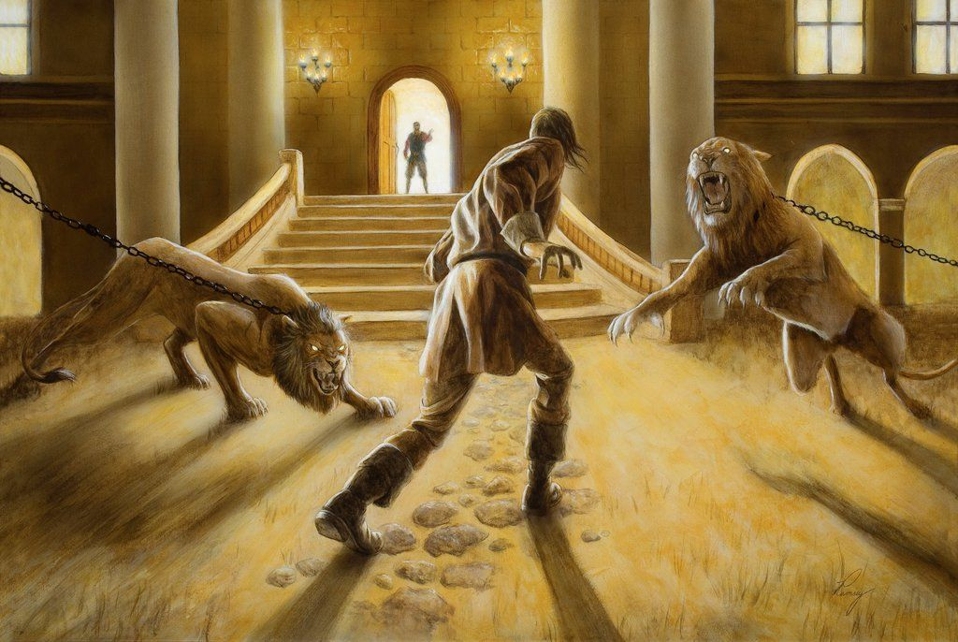
John Bunyan Illustrated this!
The Porter at the lodge, (Watchful) perceiving that Christian made a halt, as if he would go back, cried unto him, saying,
“Is thy strength (faith) so small? (Mark 4:40)
Fear not the lions, for they are chained, and are placed there
for trial of faith where it is,
and for discovery of those that have none:
keep in the midst of the path, and no hurt shall come unto thee. “
The Pilgrim's Progress 1679

Slide 10
Can There be “false” faith?
Faith (persuasion) must be tested
in order to be trusted! (conviction)
Is 48:10-12 “Behold, I have refined thee…;
(ṣārap’: purged, fused. {joined})
I have chosen thee in the furnace of affliction.
For mine own sake will I do it…,
For how shall my name be polluted.”

Slide 11
Faith untested is untrusted.
Is 48:10-12 “Behold, I have refined thee…;
(ṣārap’: purged, fused. {joined})
Notice How Jesus sought to “Fuse the Faith”
of His disciples.

Slide 12
“Faith under Fire!”
Mk 11: 9-10 “Hosanna; Blessed is he that cometh in the name of the Lord:
Blessed be the kingdom of our father David, that cometh in the name of the Lord:
Hosanna in the highest.”
Hosanna: from Yasha: save us
and na: now!

Slide 13
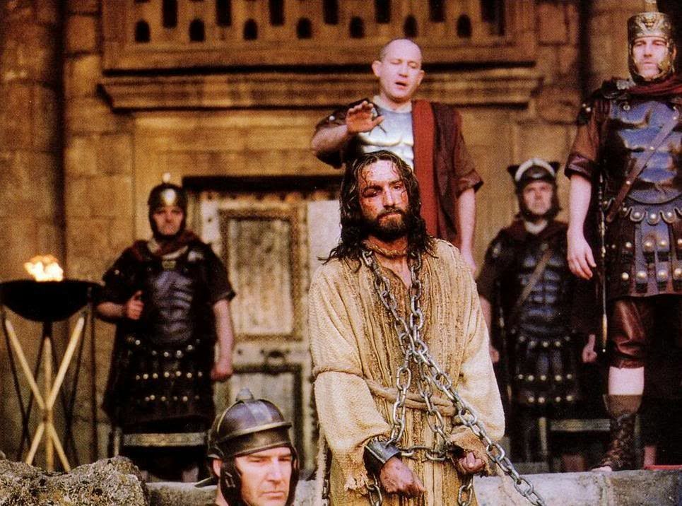
Mk 15:12-13 ”What will ye then that I shall do unto him whom ye call the King of the Jews?
they cried out Crucify him!”
What changed their cheers to jeers?

Slide 14
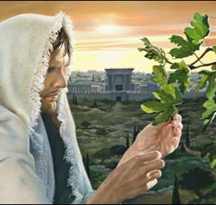
Let’s follow Jesus steps
Monday Mark 11:12-19
A. He Cursed the fruitless fig tree. V 13
“He found nothing but leaves”

Slide 15
Monday Mark 11:12-19
A. He Cursed the fruitless fig tree.
1) The Fig tree is a picture of Israel! Hos. 9:10
“I found Israel like grapes in the wilderness; I saw your fathers as the first ripe fig tree”
Is. 5:7 “the vineyard of the Lord
is the house of Israel”

Slide 16
A. He Cursed the fruitless fig tree. 12-14
2) Israel was “fruitless” in spite of God’s care.
Luke 13:6-9 “A certain man had a fig tree
planted in his vineyard; and he came and
sought fruit thereon, and found none.
Then said he unto the dresser of his vineyard, Behold, these three years I come seeking fruit on this fig tree, and find none: cut it down;
why cumbereth it the ground?”

Slide 17
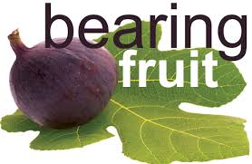
Monday Mark 11:12-19
A. He Cursed the fruitless fig tree.
2) Does He expect “fruit” from us? Jn. 15:8,16
“Herein is my Father glorified,
that ye bear much fruit;
so shall ye be
my disciples.”

Slide 18
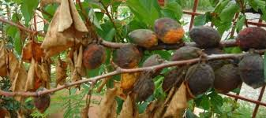
3) What happens if we’re “Fruitless?”
“If a man abide not in me,
he is cast forth as a branch,
and is withered…” John 15:2,6
“As the body without the spirit is dead,
so faith without works (fruit) is dead also!”
James 2:26

Slide 19
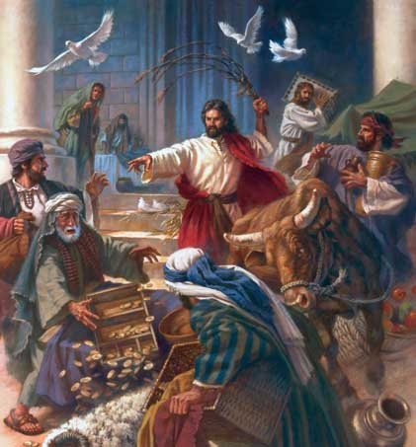
Monday Mark 11:12-19
B. He Cleansed the Temple. Vs 15-18
1) They used the court of the Gentiles for business.
“My house shall be called of all nations the house of prayer.
But ye have made it a den of thieves!”

Slide 20
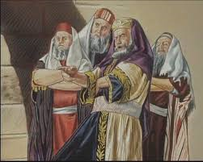
Monday Mark 11:12-19
B. He Cleansed the Temple.
2) They resented Jesus’ meddling.
“the chief priests heard it
and sought how they might
destroy him” vs 18
Are we instruments of outreach,
Or obstacles to people coming to God?

Slide 21
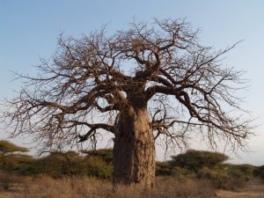
2. Tuesday Mark 11:20-13:37
Figs, faith, and forgiveness. 11:20-26
“And in the morning, as they passed by,
they saw the fig tree
dried up from
the roots.”

Slide 22
2. Tuesday Mark 11:20-13:37
Figs, faith, and forgiveness. 11:20-26
1) Jesus related this event to Faith!
“have faith in God”. (22)
a) Faith involves recognizing God’s will
and responding to it! (Heb. 11)

Slide 23
Faith, Figs, and Forgiveness. 11:20-26
Vs 25 “when ye stand praying, forgive…
that your Father also which is in heaven
may forgive you your trespasses.”
2) What does Faith have to do with Forgiveness?
a) Faith is the instrument through which God
demonstrates His power and purposes!
b) Bitterness poisons that process!
(Heb. 12:15)

Slide 24
2. Tuesday Mark 11:20-13:37
B. The priests Challenge His authority. V 27-33
28 “By what authority doest thou these things? …
29 Jesus answered and said unto them, I will also ask of you one question,
answer me, and I will tell you by what authority I do these things.
30 The baptism of John, was it from heaven, or of men? answer me.”

Slide 25
B. The priests Challenge His authority. V 27-33
1) Why did Jesus bring up John the Baptist?
a) Since they had rejected the truth (light) of John’s message, (Jn 1:7,8)
they would receive no more light!
(Lk 16:29-31) 30 “Nay, father Abraham: but if one went unto them from the dead, they will repent.
If they hear not Moses and the prophets,
neither will they be persuaded (peitho: trust)
though one rose from the dead”

Slide 26
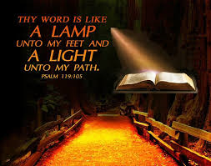
What are you doing with the “Light” God’s already given you?
1 John 1:7

Slide 27
2. Tuesday Mark 11:20-13:37
C. Parables of the wicked stewards. 12:1-11
12 “they sought to lay hold on him, for they knew that he had spoken the parable against them”
1) We’re all “Stewards” of God!
“Moreover it is required in stewards, that a man be found faithful.” (pistos: trustworthy)
1 Cor. 4:2 (also Mt. 25:14-30)
Can God really trust us?

Slide 28
2. Tuesday Mark 11:20-13:37
D. Tests and Traps. 12:13-34
“they sent certain Pharisees and Herodians to catch him in his words” Vs 13
1) Tribute (taxes) to Caesar. 13-17
2) Sadducee Snare. 18-27
“Ye do err not knowing the scriptures,
nor the power of God” Vs 24

Slide 29
D. Tests and Traps. 12:13-34
3) The Scribe’s Set up. Mark 12:28-34
“Which is the first commandment?
Thou shalt love the Lord thy God with all thy heart, with all thy soul, and with all thy mind,
and will all thy strength.
This is the first and great Commandment.
The second is like, namely this,
Thou shalt Love thy neighbor as thyself”

Slide 30
F. Contrast of the scribes 12:32-34; 38-40
1) A Sincerely “seeking” scribe. 12:32-34
“master, thou hast said the truth” vs 32
a) Notice Jesus’ response. Vs 34
“Thou are not far from the kingdom of God”
1) He had recognized the truth, (vs 32)
but hadn’t yet responded to it! (Jn 14:6)
2) Too many stop short of the strait gate!
Luke 13:24; Mt 23:13

Slide 31
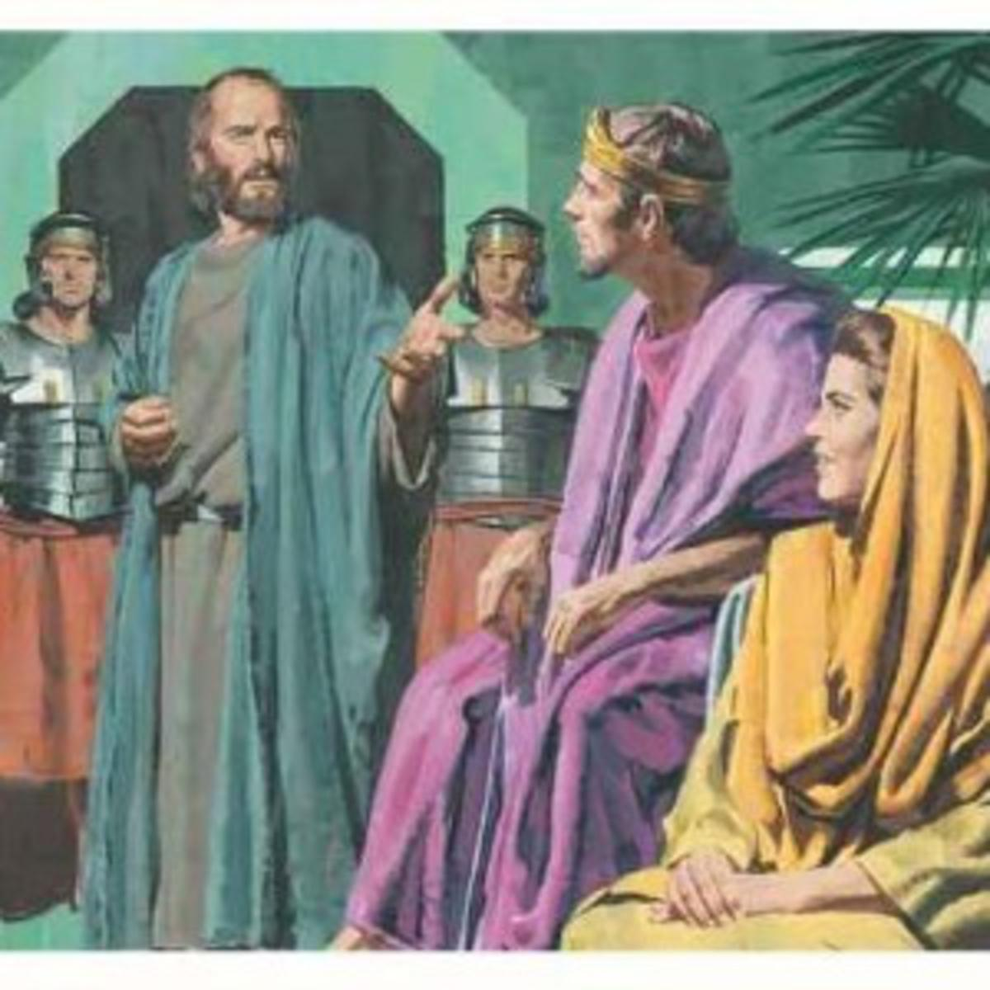
b) Faith is a journey some never complete.
Acts 26:27-28 “King Agrippa, believest thou the prophets? I know that thou believest.
Then Agrippa said unto Paul,
Almost thou
persuadest me
to be a Christian”

Slide 32
F. Contrast of the scribes 12:32-34; 38-40
2) The insincere “showman” scribe. 38-40
“Beware of the scribes…who love salutations, great
seats…these shall receive greater damnation.”
a) More about show than substance! Mt 6:2
“Therefore when thou doest thine alms, do not sound a trumpet before thee, as the hypocrites do in the synagogues and in the streets,
that they may have glory of men.
Verily I say unto you, They have their reward.”

Slide 33
12:41 “Jesus sat over against the treasury, and beheld:
G. The Widow’s mite. 12:41-44
1) Why did Jesus take the time to watch
“how people cast money into the treasury”?
2) What did the wealthy have that the widow lacked?
3) What did the widow have that the others lacked?
Which was more “valuable”?

Slide 34
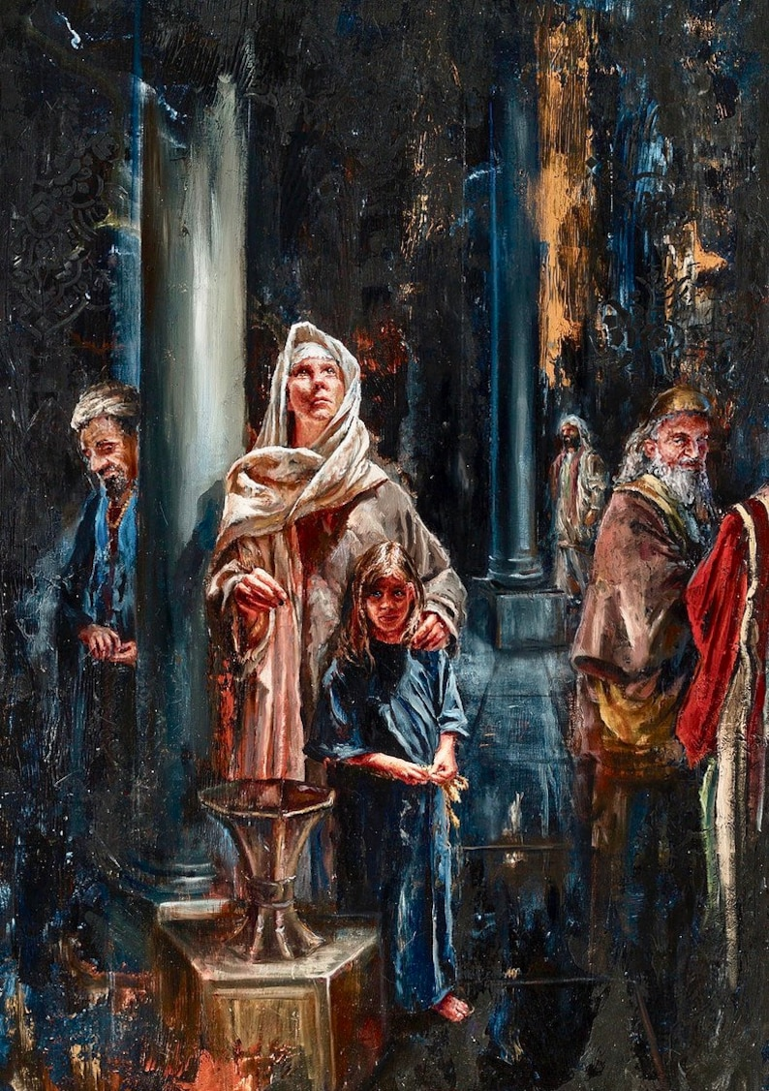
Which was more “valuable”?
43 “this poor widow hath cast
more in, than all…:
44 For they did cast in of their abundance;
but she of her want did cast in all that she had,
even all her living.”

Slide 35
H. Mt Olivet discourse. Mark 13
After teaching about signs of his return:
34 “For the Son of man is as a man taking a far journey, who left his house, and gave authority to his servants, and to every man his work,
and commanded the porter to watch.
35 Watch ye therefore: for ye know not when the master of the house cometh,
36 Lest coming suddenly he find you sleeping.”

Slide 36
Why did the cheers turn to jeers?
It’s really about “Faith”!
“Have Faith in God!” Mk 11:22
When Jesus didn’t restore “the kingdom of our father David.” Mark 11:10
They Turned on Him!
Are we so different today?

Slide 37
“Have Faith in God!” Mk 11:22
Pistis: persuasion that becomes conviction.
How does “mental persuasion”
become “Moral conviction”?
What happens to our faith in times of disappointment and darkness?

Slide 38
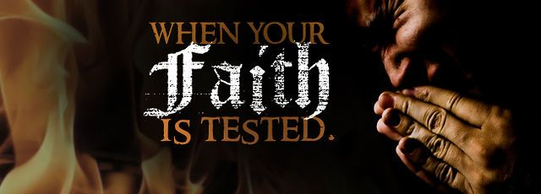
In the Fires of disappointment!
1 Peter 1:6 “ye greatly rejoice, though now for a season, if need be, ye are in heaviness
through manifold temptations:

Slide 39
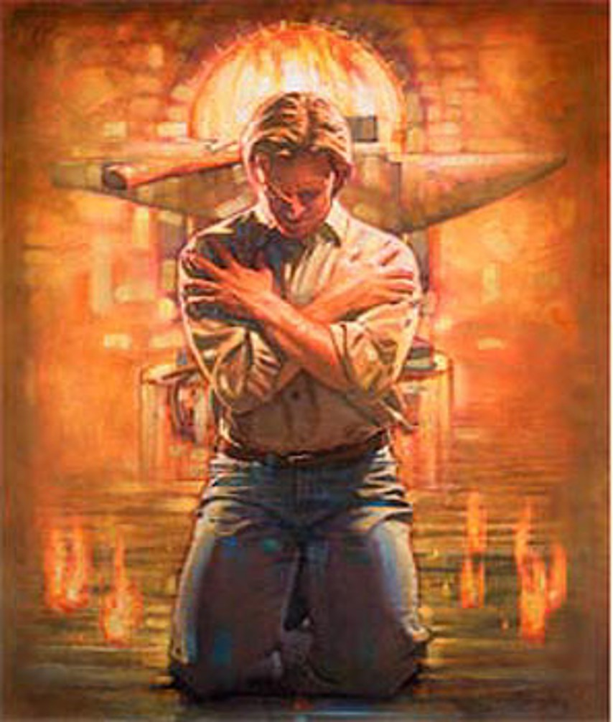
In the Fires of disappointment!
1 Pt 1:7 “That the trial of your faith, being much more precious than of gold that perisheth,
though it be tried with fire,
might be found unto praise and honor and glory
at the appearing of Jesus Christ:”

Slide 40
Trust must be tested!
In 1956 CS Lewis married American Poet Joy Davidson to keep her from being deported.
Later that year she discovered she had cancer at 41.
Over the next few difficult years,
their friendship blossomed into genuine love,
only to end in her death in 1960.
This produced a crisis of personal faith for Lewis.
He described his life during this time as
“the shadowlands.”

Slide 41
Trust must be tested!
After Joy’s death he wrote “A Grief Observed” (under a false name) chronicling his struggle for faith in the face of his deep disappointment.
His struggle became the inspiration for the 1995 movie “Shadowlands”.

Slide 42
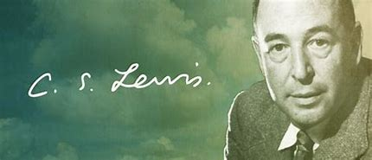
Intimacy is impossible without vulnerability!
CS Lewis wrote of this time:
“I pray because I can't help myself.
I pray because I'm helpless.
I pray because the need flows out of me…
It doesn't change God,
it changes me.”

Slide 43
Faith that doesn’t challenge us
Can’t “change” us!
If it can’t handle “Testing”
How can it “Transform” us?
“if any man be in Christ,
he is a new creature”
2 Corinthians 5:17

Slide 44
Developing such faith involves a “Journey”.
Jn 10:27 “My sheep hear
my voice and I know them
And they follow me!”
“for we walk by faith” 2 Cor 5:7

