Slide 1
Navigating the New Year
Recognizing God’s Directions During Difficult Times.

Slide 2
“The Just shall live by his faith.” (Hab. 2:4)
“We Walk by faith, not by sight.” (2 Cor 5:7)
What does it mean to “walk” or “live” by faith?
How is that contrasted to walking by sight?
Living (walking) by sight ➔ I live Reactively,
using Human Reasoning as my guide. (god)
Living (walking) by faith→ I live Proactively,
using Divine Revelation is my Guide.
What do we do when faced with Revelation
(directions from God’s Word)
that seems to contradict Reason?

Slide 3
Pr. 3:5,6 “Trust in the Lord with all thine heart
and lean not unto thine own understanding.
In all thy ways acknowledge (yada: know) Him,
and He shall direct thy paths.”
(yāshar’: make straight, prosper)
Ancient Israel is an example (both negative and positive) of this.
1 Cor 10:11-12 “these things happened unto them for ensamples:
and they are written for our admonition…
Wherefore let him that thinks he stands
take heed lest he fall!”

Slide 4
12 “and they are written for our admonition…
1 Cor 10:13 There hath no temptation (peirasmos: test)
taken you but such as is common to man:
but God is faithful,
(pistos’: trustworthy)
who will not suffer you to be tempted above that ye are able; but will with the temptation also make a way to escape,
that ye may be able to bear it.”

Slide 5
From the beginning of the “Exodus”, God seemed to direct His people contrary to human reason,
at one point even leading them into a “trap”.
Ex 14:1-3 “the LORD spake unto Moses, saying, Speak unto the children of Israel, that they turn and encamp before Pihahiroth, between Migdol and the sea, over against Baalzephon: before it shall ye encamp by the sea.
For Pharaoh will say of the children of Israel, They are entangled in the land, the wilderness hath shut them in.”

Slide 6
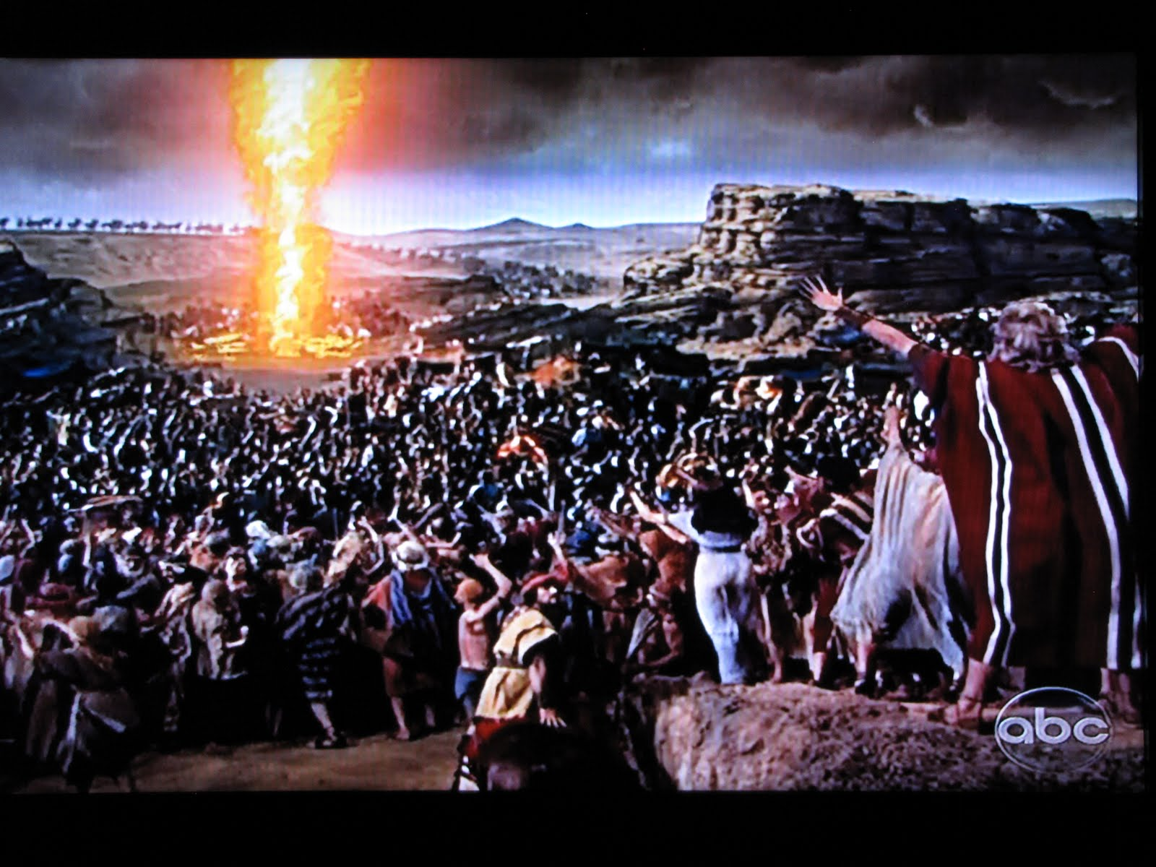
God’s Directions for Difficult times.
What does God expect of us when He leads us
“between the Devil and the Deep blue Sea?”

Slide 7
Remember Who Brought You Here.
1. When We Follow God Into Dead Ends,
He Will Always Make A Way. 1 Cor. 10:13
“who will not suffer you to be tempted above that ye are able;
but will with the temptation also make a way to escape…”
A. THIS IS THE EXPERIENCE OF ALL OF GOD’S SAINTS.
1) Job 23:10-14 “He knoweth the way that I take…
For he performeth the thing that is appointed for me"

Slide 8
Remember Who Brought You Here.
A. THIS IS THE EXPERIENCE OF ALL OF GOD’S SAINTS.
1) JOB
2) JOSEPH: (Gen 50:20) "ye thought evil against me;
but God meant it unto good.“
3) DANIEL: (Dan. 1:8; 9:23 and 10:11,19)
4) DAVID: (Anointed King, fleeing for years from Saul)
5) HEZEKIAH: (Revival, Sickness, Assyrian Army, deliverance.)
6) APOSTLES: Finding a storm en route to the Lord’s
commands. (Mt 8,14)
7) Paul: Saved, Preaching, Persecuted. (2 Cor 12)

Slide 9
Remember Who Brought You Here.
2. God’s Spirit Will Not Lead You Where
His Grace Cannot Sustain You.
A. Examples:
1) Paul. 2 Cor. 12:7-9 "there was given to me a thorn in the flesh, the messenger of Satan to buffet me….
For this thing I besought the Lord thrice, that it might depart from me. And he said unto me,
My grace is sufficient for thee:
for my strength is made perfect in weakness”

Slide 10
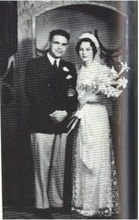
2) Missionaries Robert and Darlene Deibler

Slide 11
They were captured by the Japanese,
Who killed Robert.
Darlene endured years of suffering and was finally sent to a death camp where she was locked away beneath a sign: “This person must die!”
Gripped with fear and horror, she prayed and God reminded her of a childhood song that brought her hope and courage.

Slide 12
Fear not, precious flock, He goeth ahead,
Your Shepherd selects the path you must tread; The waters of Mara He'll sweeten for thee,
He drank all the bitter in Gethsemane.
Fear not little flock, whatever your lot;
He enters all rooms, the doors being shut.
He never forsakes, He never is gone;
So count on His presence, In darkness and dawn.
Only believe, only believe;
All things are possible, only believe; Only believe, only believe;
All things are possible, only believe. (Paul Rader)
She survived and returned to health and ministry.

Slide 13
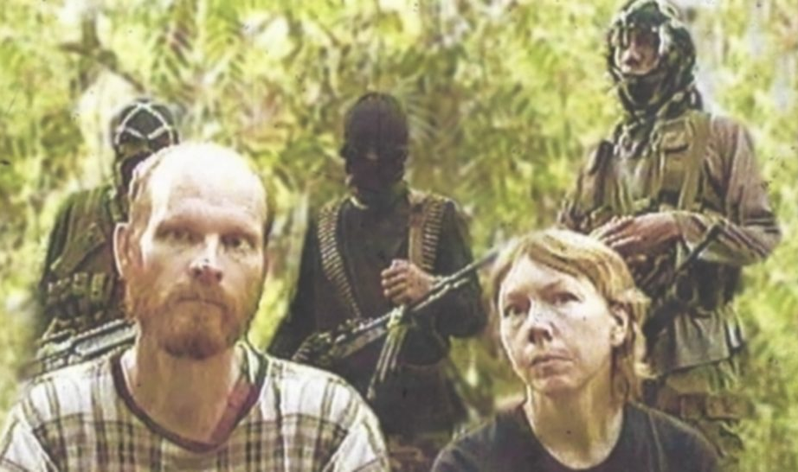
3) Remember Martin and Gracia Burnham?

Slide 14
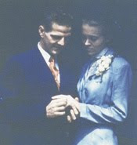
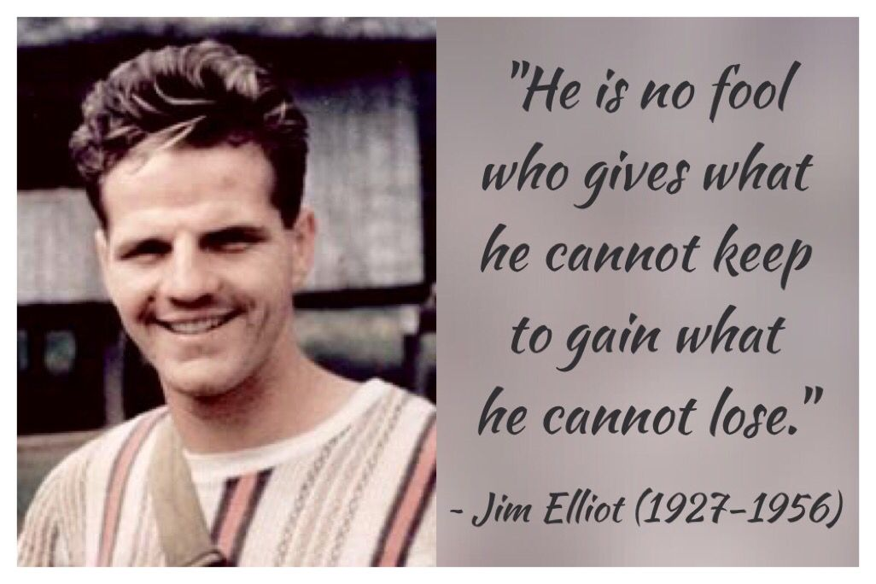
4) Jim and Elizabeth Elliot who surrendered to serve as Missionaries?

Slide 15
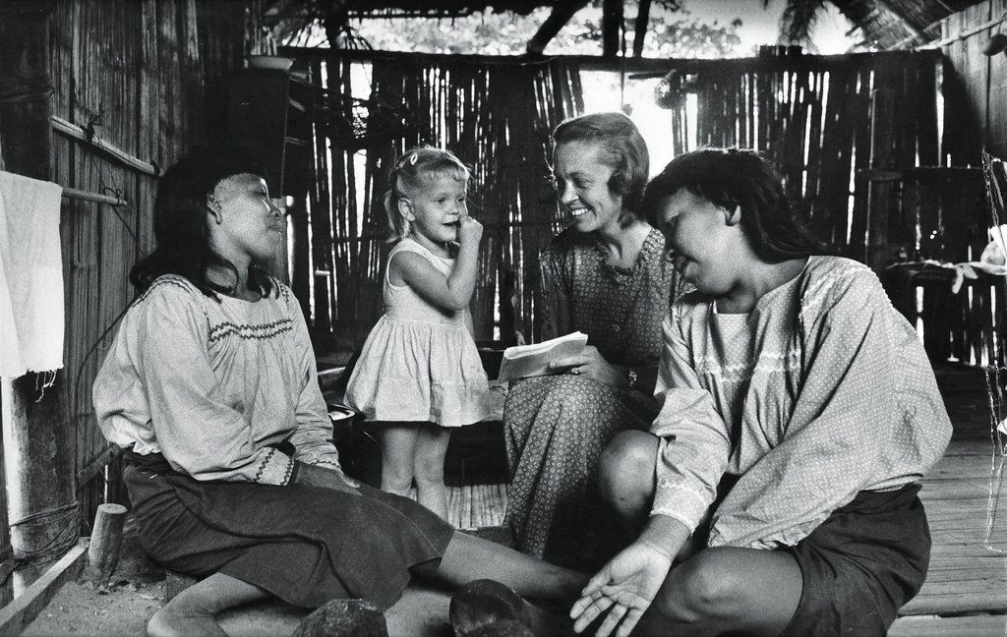
After the murder of her husband, Elizabeth returned (with her baby) to the people who killed him to bring them the gospel.

Slide 17
Remember Who Brought You Here.
1. When We Follow God Into Dead Ends, He’ll make a way.
2. God Won’t Lead You Where His Grace Can’t Sustain You.
3. God Has Purposes We Don’t Readily Recognize.
A. Beware of the “PROSPERITY GOSPEL.”
(1 Pet 4:12,13) "Beloved, think it not strange concerning the fiery trial which is to try you, as though some strange thing happened unto you: But rejoice,
inasmuch as ye are partakers of Christ's sufferings;
that, when his glory shall be revealed,
ye may be glad also with exceeding joy.”

Slide 18
3. God Has Purposes We Don’t Readily Recognize.
B. God uses the fire of Trials to purify us.
Job. 23:10 “I shall come forth as gold…”
Isa 48:10,11 "Behold, I have refined thee…;
I have chosen thee in the furnace of affliction.
For mine own sake, even for mine own sake, will I do it:
for how should my name be polluted?”
1 Pt 1:7 “the trial of your faith, being much more precious than of gold that perisheth, though it be tried with fire, might be found unto praise and honor and glory at the appearing of Jesus Christ”

Slide 19
1) How The old Hymns reflected this truth.
“Am I a soldier of the Cross— A follower of the Lamb?
And shall I fear to own His cause, Or blush to speak His name?
In the name, the precious name, Of Him who died for me,
Through grace I’ll win the promised crown, Whate’er my cross may be.
Must I be carried to the skies On flowery beds of ease,
While others fought to win the prize And sailed through bloody seas?
Are there no foes for me to face? Must I not stem the flood?
Is this vile world a friend to grace, To help me on to God?
Since I must fight if I would reign, Increase my courage, Lord!
I’ll bear the toil, endure the pain, Supported by Thy Word.”
Isaac Watts 1709

Slide 20
“Fear not, I am with thee, O be not dismayed,
For I am thy God, and will still give thee aid;
I’ll strengthen thee, help thee, and cause thee to stand,
Upheld by My righteous, omnipotent hand.”
When through the deep waters I call thee to go,
The rivers of sorrow shall not overflow;
For I will be with thee, thy troubles to bless,
And sanctify to thee thy deepest distress.”
When through fiery trials thy pathway shall lie,
my grace all sufficient shall be thy supply.
The flame shall not harm thee, I only design;
thy dross to consume and thy gold to refine.”
(How firm a Foundation) 1787 John Rippon

Slide 21
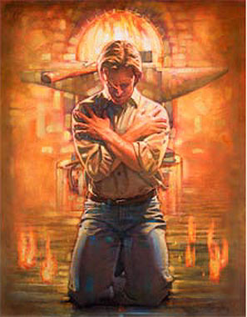
2) When God directs His children into the fiery furnace,
He keeps his eye on His children
and His hand on the thermostat!
Isaiah 43:1-7

Slide 22
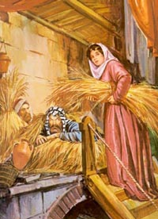
3. God Has Purposes We Don’t Readily Recognize.
C. God has bigger purposes at stake than our comfort.
41 years later Rahab (in Jericho) revealed in Josh. 2:9,10:
“I know that the LORD hath given you the land, and that your terror is fallen upon us, and that all the inhabitants of the land faint because of you.
For we have heard how the LORD dried up the water of the Red sea for you…”
Rahab became the mother of Boaz,
and the Great, Great Grandmother
of King David!.

Slide 23
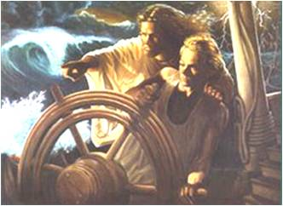
Conclusion: Principles of Painful Times.
1. When We Follow God Into Dead Ends, He’ll make a way.
2. God Won’t Lead You Where His Grace Can’t Sustain You.
3. God Has Purposes We Don’t Readily Recognize.
Psa 37:23-24 "The steps of a good man are ordered by the LORD: and he delighteth in his way.
Though he fall, he shall not be utterly cast down:
for the LORD upholdeth him with his hand.“

Slide 24
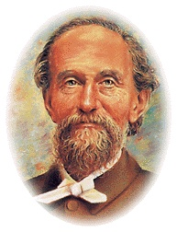
Example: South African Pastor Andrew Murray was a prolific author who wrote many books on prayer, faith, and surrender.
At one point he faced a terrible crisis that took his health and threatened his faith.
This crisis caused him and others to doubt God’s purposes and plan.
In response to the questions of his church
he prayerfully wrote the following :

Slide 25
First, God brought me here, it is by His will that I am in this strait place; In that I can rest.
Next, He will keep me here in his love and give me the grace to behave as His child.
Then, He’ll make this trial a blessing, teaching me the lessons He intends me to learn and working in me the grace He means to bestow.
Finally, in His time He can bring me out-
How and when He knows.

Slide 26
So then I am here:
1) By God’s appointment
2) In His keeping
3) Under His Training
4) For His Time.

Slide 27
What if we led ourselves into the Mess?
(The Sowing and Reaping of Gal. 6:6,7)
Confess the sin and attitude that created the
problem. (1 Jn 1:9; Pr. 28:13)
2) Learn from the lesson. (Heb. 12:1-15)
(Don’t repeat or prolong it by further rebellion)
3) Allow God to use it to purify you. (Job 23:10-16
Purpose to follow God’s directions in the
Future. (Ps. 119:71; Pr. 3:5,6; Isaiah 61:1-7)

