Slide 1
יְהוָ֔ה עַבְדּ֞
By Joseph Peters

Slide 2
Objective
Every Christian can understand what the right heart for missions is
By understanding these two stories.

Slide 3
Rationale
Jonah, the Prophet
William Carey

Slide 4
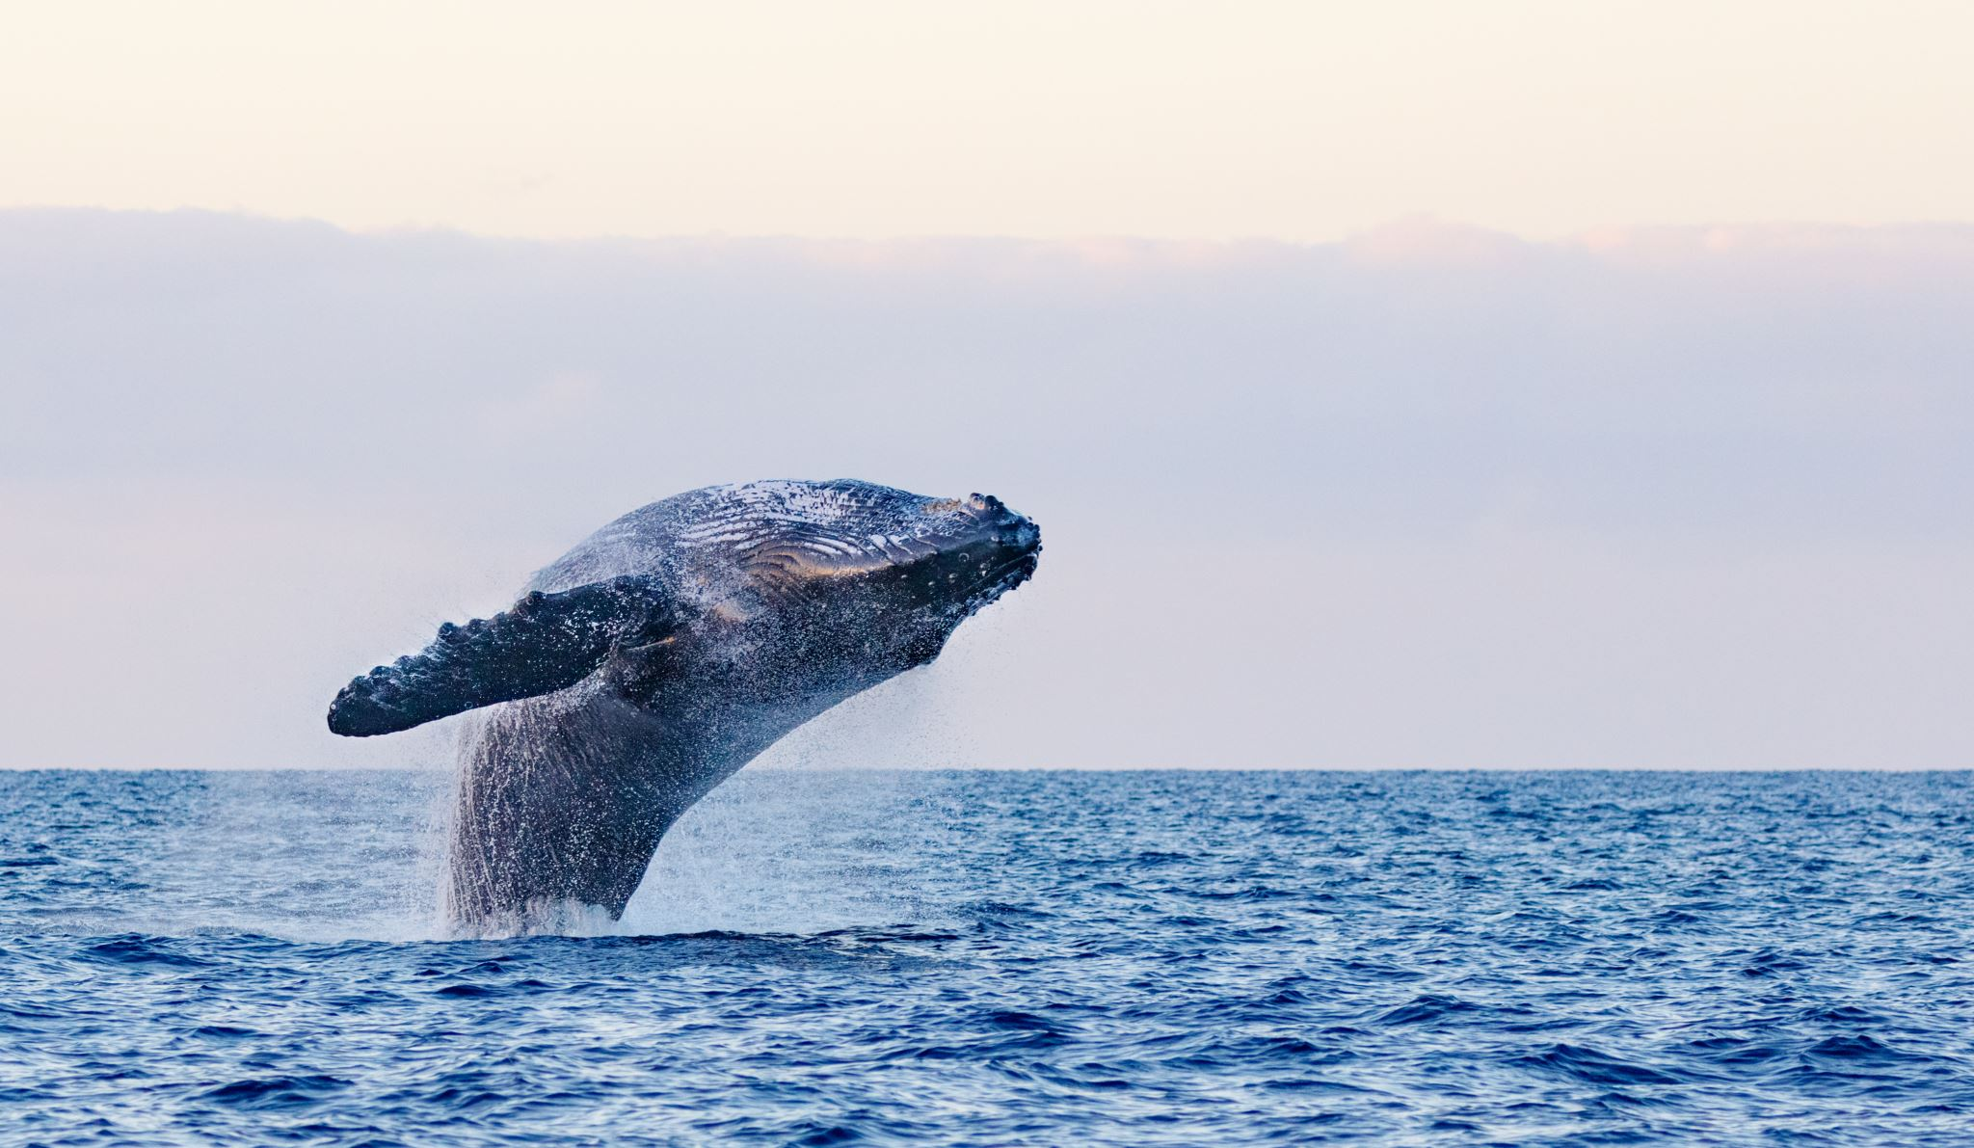
The Story of Jonah

Slide 5
Who was Jonah?
2 Kings 14:25 ESV
25 He restored the border of Israel from Lebo-hamath as far as the Sea of the Arabah, according to the word of the LORD, the God of Israel, which he spoke by his servant Jonah the son of Amittai, the prophet, who was from Gath-hepher
Jonah 1:1-2 ESV
Now the word of the LORD came to Jonah the son of Amittai, saying, Arise, go to Nineveh, that great city, and cry against it; for their wickedness is come up before me

Slide 6
Jonah’s Response
Jonah 1:3
But Jonah rose up to flee unto Tarshish from the presence of the LORD, and went down to Joppa; and he found a ship going to Tarshish: so he paid the fare thereof, and went down into it, to go with them unto Tarshish from the presence of the LORD.

Slide 7
Sailors Response
Jonah 1:11
Then said they unto him, What shall we do unto thee, that the sea may be calm unto us? for the sea wrought, and was tempestuous.

Slide 8
Jonah’s Solution
Jonah 1:12
And he said unto them, Take me up, and cast me forth into the sea; so shall the sea be calm unto you: for I know that for my sake this great tempest is upon you

Slide 9
God’s Provision
Jonah 1:17
Now the LORD had prepared a great fish to swallow up Jonah. And Jonah was in the belly of the fish three days and three nights.

Slide 10
Jonah’s Psalm of Thanksgiving
Jonah 2:6
I went down to the bottoms of the mountains; The earth with her bars was about me for ever: Yet hast thou brought up my life from corruption, O LORD my God

Slide 11
God’s Re-Commission
Jonah 1:17
And the word of the LORD came unto Jonah the second time, saying, 2 Arise, go unto Nineveh, that great city, and preach unto it the preaching that I bid thee.

Slide 12
Jonah’s Response
Jonah 3:3-4
3 So Jonah arose, and went unto Nineveh, according to the word of the LORD. Now Nineveh was an exceeding great city of three days’ journey. 4 And Jonah began to enter into the city a day’s journey, and he cried, and said, Yet forty days, and Nineveh shall be overthrown.

Slide 13
Nineveh’s Response
Jonah 3:7-9
And he caused it to be proclaimed and published through Nineveh by the decree of the king and his nobles, saying, Let neither man nor beast, herd nor flock, taste any thing: let them not feed, nor drink water: 8 But let man and beast be covered with sackcloth, and cry mightily unto God: yea, let them turn every one from his evil way, and from the violence that is in their hands. 9 Who can tell if God will turn and repent, and turn away from his fierce anger, that we perish not?

Slide 14
God’s Response
Jonah 3:10
And God saw their works, that they turned from their evil way; and God repented of the evil, that he had said that he would do unto them; and he did it not.

Slide 15
Jonah’s Response
Jonah 4:1-3
But it displeased Jonah exceedingly, and he was very angry. 2 And he prayed unto the LORD, and said, I pray thee, O LORD, was not this my saying, when I was yet in my country? Therefore I fled before unto Tarshish: for I knew that thou art a gracious God, and merciful, slow to anger, and of great kindness, and repentest thee of the evil. 3 Therefore now, O LORD, take, I beseech thee, my life from me; for it is better for me to die than to live.

Slide 16
Jonah as a Missionary
Personally called to bring God’s message to Nineveh
Refused and sought to flee a great distance
Paid a lot for transportation to flee
Preferred death over proclaiming God’s message to the heathens
Was shown an extraordinary amount of grace and mercy
Was angry that God showed mercy to the heathens

Slide 17
William Carey

Slide 18
Who was William Carey
William Carey lived in England in the late 18th century.
He had three jobs: Baptist Pastor, Teacher, shoe salesman.
He became a missionary to India
He is often recognized as the father of protestant missions
He wrote an 87 page article titled “Enquiry”, which speaks of his heart for missions

Slide 19
God’s Commission
“Our Lord Jesus Christ, a little before His departure, commissioned his apostles to Go and teach all nations”…
“I shall enquire whether the commission given by our Lord to his discipled be not still binding on us..”
William Carey, “An Enquiry Into the Obligations of Christians to Use Means for the Conversion of the Heathens” Perspectives on the World Christian Movement. Edited by Ralph Winter and Steven Hawthorne. (Pasadena: William Carey Library, 1981). 312-318

Slide 20
Societies Response P1
“Some think little about it, others are unacquainted with the state of the world, and others love their wealth better than the souls of their fellow creatures.”
“It seems as if many thought the commission was sufficiently put into execution by what the apostles and others have done; and that, if God intends the salvation of the heathen, he will some way or other bring them to the Gospel, or the gospel to them”

Slide 21
Societies Response P2
“It has been objected that there are multitudes in our own nation, and within our immediate spheres of action, who are as ignorant as the South-Sea savages, and that therefore we have enough work at home, without going into other countries”

Slide 22
Carey’s Response P1
“That there are thousands in our own land as far from God as possible, I readily grant, and that this ought to excite us to ten-fold diligence to our work, and in attempts to spread divine knowledge amongst them is a certain fact; but that it ought to supersede all attempts to spread the gospel in foreign parts seems to want proof…”

Slide 23
Carey’s Response P2
“Our own countrymen have the means of grace, and may attend on the word preached if they choose it. They have the means of knowing the truth and faithful ministers are placed in almost every part of the land, whose spheres of action might be much extended if their congregations were but more hearty and active in the cause; but with them the case is widely different, who have no Bible, no written language… no ministers…

Slide 24
Objection 1
“FIRST, As for their distance from us, whatever objections might have been made on that account before the invention of the mariner’s compass, nothing can be alleged for it, with any color of plausibility in the present age”

Slide 25
Objection 2
“SECONDLY, As to their uncivilized and barbarous way of living, this can be no objection to any, except those whose love of ease renders them unwilling to expose themselves to inconveniences for the good of others.
It was no objection to the apostles, who went among the barbarous Germans and Gaul's, and still mor barbarous Britons!”

Slide 26
Objection 3
“THIRDLY, in respect to the danger of being killed by them, it is true that whoever does go must put his life in his hand, and not consult with the flesh and blood; but do not the goodness of the cause, the duties incumbent on us as the creatures of God, and Christians, and the perishing state of out fellow men, loudly call upon us to venture all… Paul and Barnabas, who hazarded their lives for the name of our Lord Jesus Christ, were not blamed as rash, but commended for doing so.

Slide 27
Concerning Giving p1
“In respect to contributions for defraying the expenses, money will doubtless be wanting… if congregagations were to open subscriptions of one penny, or more per week, according to their circumstances, and deposit it as a fund for the propagation of the Gospel, much might be raised in this way…”

Slide 28
Concerning Giving p1
“We are exhorted to lay up treasures in heaven… it is also declared that whatsoever a man soweth, that shall he also reap. These Scriptures teach us that the enjoyments of the life to come bear a near relation to that which now is a relation similar to that of the harvest and the seed.”

Slide 29
Jonah Carey
Personally called to bring God’s message to Nineveh
Refused and sought to flee a great distance
Paid a lot for transportation to flee
Preferred death over proclaiming God’s message to the heathens
Was shown an extraordinary amount of grace and mercy
Was angry that God showed mercy to the heathens
Not personally called, but took the Great Commission as enough
Accepted, regardless of the criticism that he received from society
Paid a great price to follow
Would rather die following the Commission than live
Was inspired by the mercy shown to him and his country
Was angry that others were not also helping the heathens.

