Slide 1
Making a difference in a Difficult World
“who knoweth whether thou art come to the kingdom
for such a time as this?”
Esther 4:14

Slide 2
The Bible teaches us that this world is not a playground for God’s people,
but a battleground! (2 Tim. 2:3,4)
Satan, as “the god of this world” (2 Cor 4:4) uses the “things of this world”
to distract, deceive, and destroy our commitment to God.
1 Jn 2:15,16

Slide 3
The Bible is clear that this world will become increasingly hostile to God, His purposes and His People.
1 Tim. 4; 2 Tim 3;4; Luke 17:26-30
“as it was in the days of Noah…Lot…
Even thus shall it be in the day when the Son of man is revealed!”.

Slide 4
Walking with (abiding in) Christ is no guarantee of an easy ride!
Jn 15:19 “If ye were of the world,
the world would love his own:
but because ye are not of the world,
but I have chosen you out of the world,
therefore the world hateth you.”

Slide 5
In Jn 16 Jesus continues to warn of the reality of spiritual warfare concluding with: vs 33 “These things I have spoken unto you, that in me ye might have peace.
In the world ye shall have tribulation:
but be of good cheer; (tharseo: courage)
I have overcome the world.”
1 Jn 4;4; 5:4

Slide 6
In John 17 Jesus is praying for us:
14 “I have given them thy word; and the world hath hated them, because they are not of the world, even as I am not of the world.
15 I pray not that thou shouldest take them out of the world,
but that thou shouldest keep them from the evil.”
(Poneros 1 Jn 5:19)

Slide 7
Our natural tendency is to
“go along to get along.”
But what if the world is “going” in the wrong direction?
Many try to remain obscure and unobtrusive hoping to avoid conflict.

Slide 8
While many have been shipwrecked by listening to the “Siren Song” of the world,
Others have chosen to walk with God,
Making a difference in a Difficult World.

Slide 9
Both Nehemiah and Esther were captives in Persia who found themselves in positions of security and influence.
They led safe and secure lives and could have avoided many of the difficulties that affected others.

Slide 10
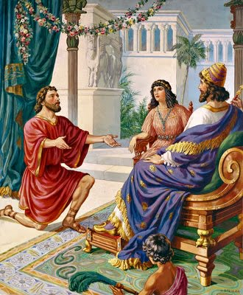
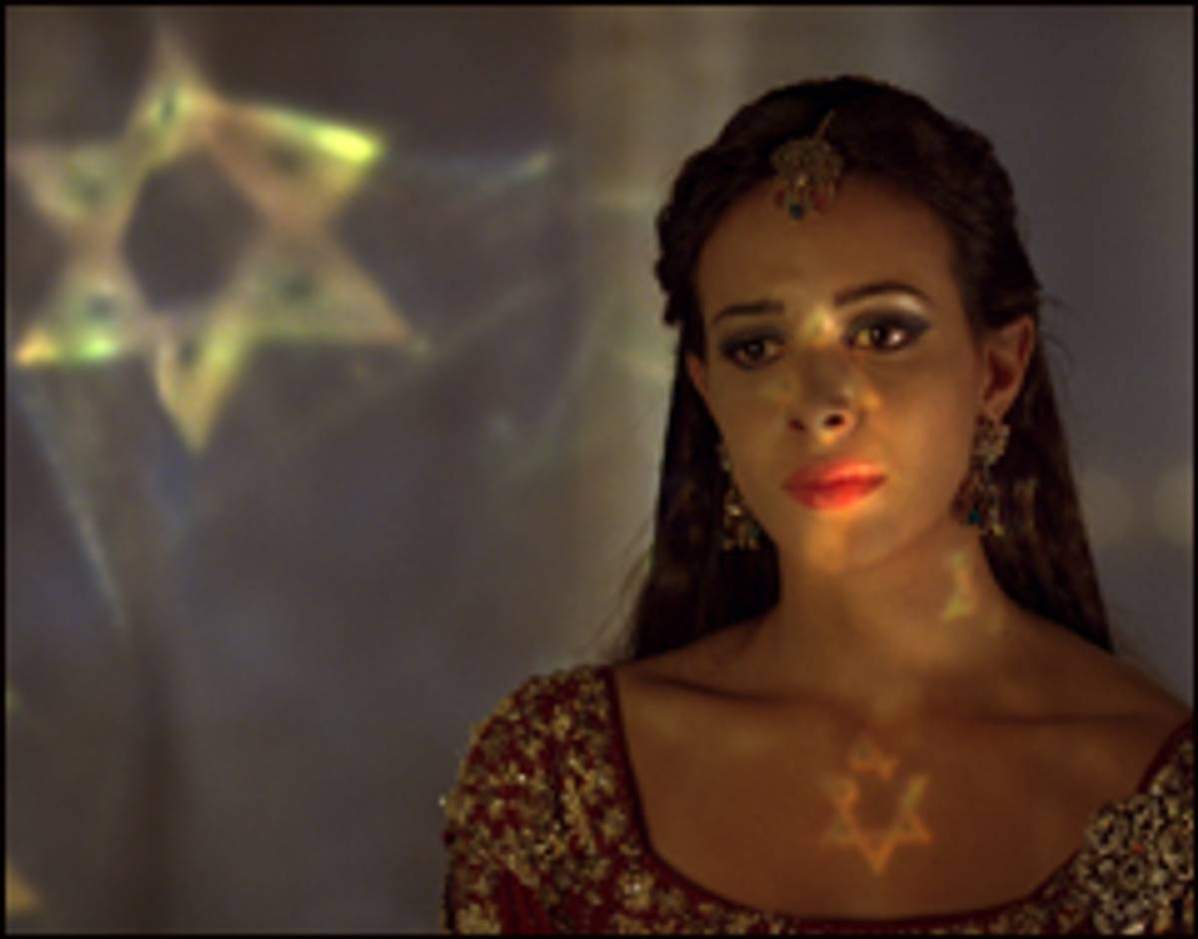
Difficulties often prompt decisions.
Both Decided that, instead of remaining silent and protecting their positions,
they would stand up and use their influence to
make a difference.

Slide 11
1. Their Difficulties.
A. ESTHER: (Between Ezra 6 and 7)
1) Ahasuerus (Xerxes) was the son of
Darius and ruled from 485 to 465.
2) Queen (Vashti) had been banished
for disrespecting his wishes. (1:12)
3) Esther was chosen to replace Vashti
in 479 BC (Esther 2)

Slide 12
1. Their Difficulties.
A. ESTHER: (Between Ezra 6 and 7)
4) Satan was at work (through Haman)
seeking to destroy Israel. (Ch. 3)
Haman was a descendent of the
Amalekite King Agag Killed by Saul in
1 Sam. 15!

Slide 13
1. Their Difficulties.
A. ESTHER: (Between Ezra 6 and 7)
5) There were some 15 million Jews in his
Kingdom, most of whom were spiritually
indifferent.
These all had a “death sentence” from Haman and the King.
(ignored Cyrus’ decree)

Slide 14
1. Their Difficulties.
B. Nehemiah: 50 years after Esther.
1) Zerubbabel led some 43,000 Jews home
in 537 BC to rebuild the Temple.
2) Ezra led a second group back in 458 BC
to Purify the Temple and worship of God.

Slide 15
1. Their Difficulties.
B. Nehemiah: 50 years after Esther.
3) Nehemiah was the King’s cup bearer.
In 445 BC he learned that Jerusalem was still in ruin and without walls for defense,
leaving the people discouraged, vulnerable and surrounded by hostile enemies.

Slide 16
2. Their Decisions.
A. Esther: She would get involved:
1) Her Risk: She risked everything. “If I perish, I perish” (Esther 4:16)
2) Her Reasoning: God may have put
her in this position “for such a time as
this!” (4:14)

Slide 17
2. Their Decisions.
A. Esther: She would get involved:
3) Her resolve: Since the stakes were
so high, she would use all of her
Influence and intelligence to try to
make a difference by:

Slide 18
3) Her resolve:
a) Prayer support from her friends and
the other Jews. (Esther 4:16)
b) Planning: Planned and prepared two
banquets. (Esther 5,7)
c) Petitioning the King.
(Without an invitation! Esther 7)

Slide 19
4:16 “Go, gather all the Jews that are in Shushan, and fast ye for me, and neither eat nor drink three days, night or day:
I also and my maidens will fast likewise; so will I go in unto the king,
which is not according to the law:
and if I perish, I perish.”

Slide 20
2. Their Decisions.
B. Nehemiah: Nehemiah 1,2
1) The Risk: No one was allowed to be
sad or upset in the King’s presence.
(As the Cup Bearer,
he was the most watched.)

Slide 21
The Reasoning: How can he enjoy life
when his people were in such trouble.
Neh 2:3 “And said unto the king…why should not my countenance be sad, when the city, the place of my fathers' sepulchres, lieth waste, and the gates thereof are consumed with fire?”

Slide 22
B. Nehemiah:
3) His Resolve:
a) Praying (Nehemiah 1)
b) Planning (Neh 2) 4 months elapsed
between chapters 1 and 2.
c) Petitioning the King. (Neh. 2)

Slide 23
3. The Difference their decisions made:
A. Esther:
1) Haman (and his sons) were executed.
(7:9,10; 10:10)
2) Jews were able to defend themselves
and spoil those that attacked them.
3) Mordecai became the Prime Minister.
(8:1,2)

Slide 24
3. The Difference their decisions made:
A. ESTHER:
4) Less than 10 years later Ezra is
granted permission to lead a second
group back to Israel,
which led to a great national revival.
(See Neh. 8)

Slide 25
3. The Difference their decisions made:
B. NEHEMIAH:
1) He brings a clear purpose to God’s
People that unifies them.
2) He establishes a system of defense
for the people and rebuilds the walls.

Slide 26
3. The Difference their decisions made:
B. NEHEMIAH:
3) He becomes the Governor and:
a) Confronts the corruption in the leaders.
b) Works with Ezra to re-establish
God’s laws.

Slide 27
Conclusion
1. Difficulties are inevitable.
➔ Many are a biproduct of corruption and sin. Pr 14:34
➔ These difficulties affected the good
as well as the bad or indifferent.
Pr. 29:2

Slide 28
2. Difficulties are Motivating!
They produce Opportunities
for us to make wise Decisions.
➔ Men, like streams, tend to naturally seek the path of least resistance.”
➔ It’s often the difficulties that
prompt / produce the decisions.

Slide 29
2. Difficulties are Motivating!
“Adversity is the diamond dust heaven polishes its jewels with.“ Robert Leighton (1611-1684)
Mal. 3:17 “they shall be mine, saith the LORD of hosts, in that day
when I make up my jewels; …

Slide 30
3) Difficulties are Revealing! Mal 3:18
“Then shall ye …discern between the
righteous and the wicked, between him that
serveth God
1 Cor 11:18,19 “there must also be heresies
that they which are approved (dokimos)
may be made manifest among you.”
and him that serveth him not.”

Slide 31
Difficulties are Determining:
Our Decisions will determine the Difference our lives will make.
"So teach us to number our days, that we may apply our hearts unto wisdom." (Psa 90:12)

Slide 32
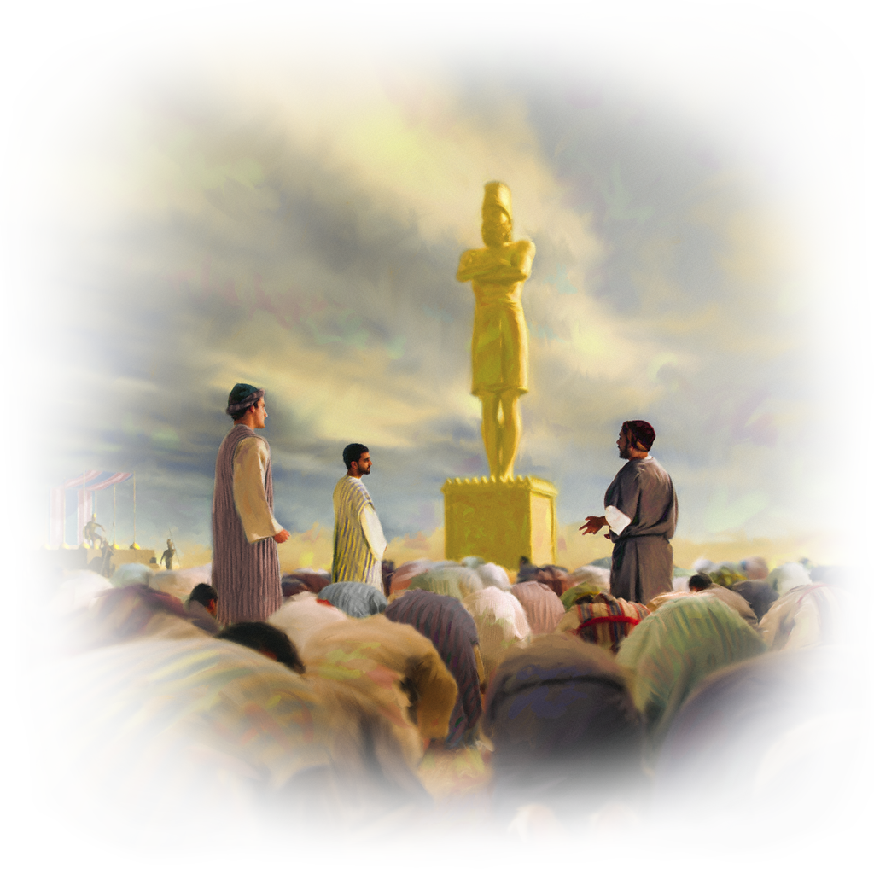
Application
The Bible is filled with examples of those who decided to
stand on principle
in the face of persecution.
Will you?

Slide 33
Application
Hebrews 11:24-25 “By faith Moses, when he was come to years, refused to be called the son of Pharaoh's daughter;
Choosing rather to suffer affliction with the people of God, than to enjoy the pleasures of sin for a season;

Slide 34
Application
Hebrews 11:26 “Esteeming the reproach of Christ greater riches
than the treasures in Egypt:
for he had respect unto the recompence of the reward. “
Do You?

