Slide 1
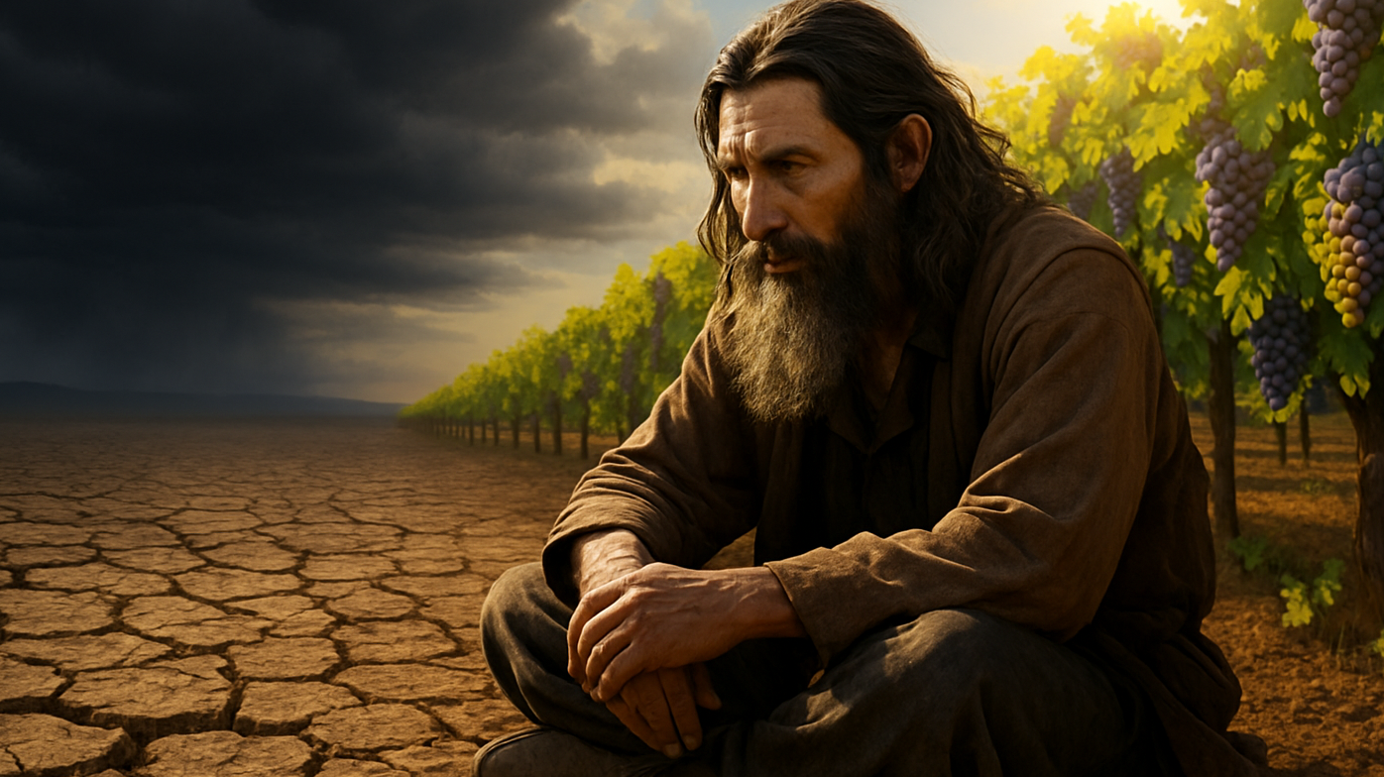
Living a Life Worthy of Blessing
Joseph D. Peters

Slide 2

Goal
Every Christian can live a life that God can bless
By following these three steps

Slide 3
The Three Steps
Demonstrate Obedience to God
Demonstrate Genuine Repentance to God
Demonstrate Care for God

Slide 4
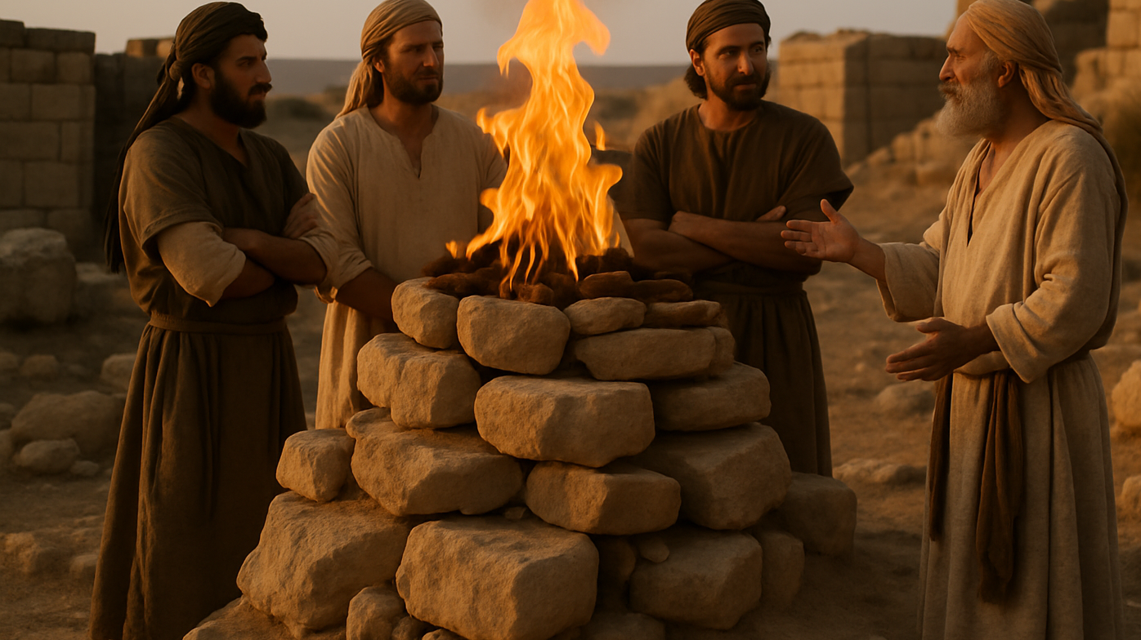
Demonstrate Obedience to God

Slide 5
A Blessing Removed Because of Wickedness
Therefore also will I make thee sick in smiting thee, In making thee desolate because of thy sins. Thou shalt eat, but not be satisfied; And thy casting down shall be in the midst of thee; And thou shalt take hold, but shalt not deliver; And that which thou deliverest will I give up to the sword. Thou shalt sow, but thou shalt not reap; Thou shalt tread the olives, but thou shalt not anoint thee with oil; And sweet wine, but shalt not drink wine (Mic 6:13–15).

Slide 6
Israel’s Proposed Solution
Wherewith shall I come before the LORD, And bow myself before the high God? Shall I come before him with burnt offerings, With calves of a year old? Will the LORD be pleased with thousands of rams, Or with ten thousands of rivers of oil? Shall I give my firstborn for my transgression, The fruit of my body for the sin of my soul (Mic 6:6–7)

Slide 7
God’s Remedy
He hath shewed thee, O man, what is good; And what doth the LORD require of thee, But to do justly, and to love mercy, And to walk humbly with thy God (Mic 6:8)?
And Samuel said, Hath the LORD as great delight in burnt offerings and sacrifices, As in obeying the voice of the LORD? Behold, to obey is better than sacrifice, And to hearken than the fat of rams. For rebellion is as the sin of witchcraft, And stubbornness is as iniquity and idolatry. Because thou hast rejected the word of the LORD, He hath also rejected thee from being king (1 Sam 15:22–23).

Slide 8
God’s Remedy P2
…because they have not hearkened unto my words, nor to my law, but rejected it. To what purpose cometh there to me incense from Sheba, and the sweet cane from a far country? your burnt offerings are not acceptable, nor your sacrifices sweet unto me (Jer 6:19b–20).
But this thing commanded I them, saying, Obey my voice, and I will be your God, and ye shall be my people: and walk ye in all the ways that I have commanded you, that it may be well unto you (Jer 7:22–23).

Slide 9
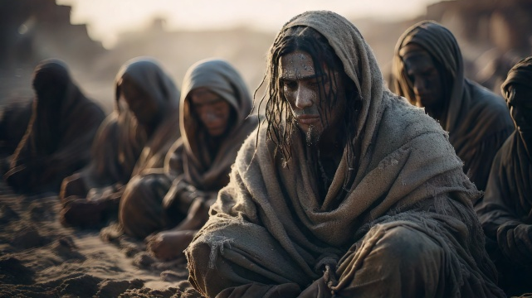
Demonstrate Genuine Repentance to God

Slide 10
Judgment Averted
And God saw their works, that they turned from their evil way; and God repented of the evil, that he had said that he would do unto them; and he did it not (Jonah 3:10).

Slide 11
God’s Declaration
If I shut up heaven that there be no rain, or if I command the locusts to devour the land, or if I send pestilence among my people; If my people, which are called by my name, shall humble themselves, and pray, and seek my face, and turn from their wicked ways; then will I hear from heaven, and will forgive their sin, and will heal their land (2 Chron 7:13–14).

Slide 12
The Lord Disciplines Out of Love
My son, despise not thou the chastening of the Lord, nor faint when thou art rebuked of him: For whom the Lord loveth he chasteneth, and scourgeth every son whom he receiveth. If ye endure chastening, God dealeth with you as with sons; for what son is he whom the father chasteneth not? But if ye be without chastisement, whereof all are partakers, then are ye bastards, and not sons (Heb 12:5–8).

Slide 13
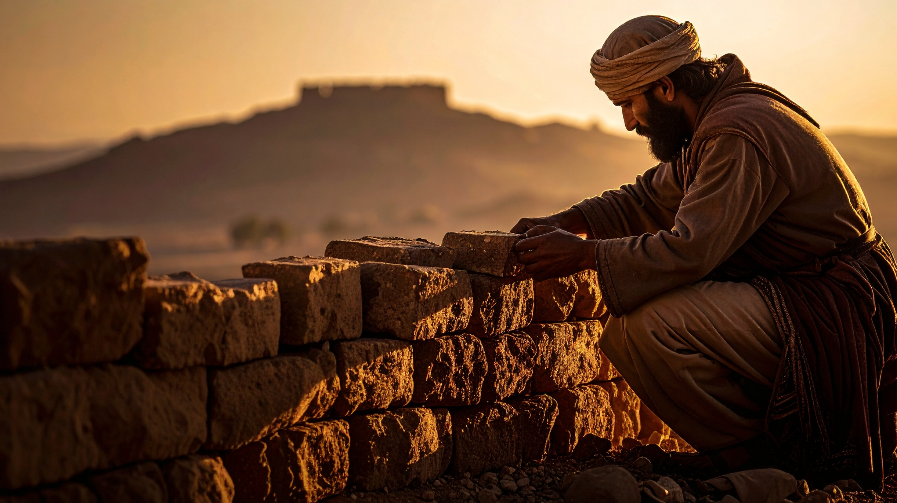
Demonstrate Care for God

Slide 14
Israel Neglects caring for God
Thus speaketh the LORD of hosts, saying, This people say, The time is not come, the time that the LORD’s house should be built. Then came the word of the LORD by Haggai the prophet, saying, Is it time for you, O ye, to dwell in your cieled houses, And this house lie waste (Haggai 1:2-4)

Slide 15
They Have Not Prospered
Now therefore thus saith the LORD of hosts; Consider your ways. Ye have sown much, and bring in little; Ye eat, but ye have not enough; Ye drink, but ye are not filled with drink; Ye clothe you, but there is none warm; And he that earneth wages earneth wages to put it into a bag with holes. Thus saith the LORD of hosts; Consider your ways. Go up to the mountain, and bring wood, and build the house; And I will take pleasure in it, and I will be glorified, saith the LORD (Haggai 1:5–8)

Slide 16
God is the One Preventing Their Prosper
Ye looked for much, and, lo, it came to little; And when ye brought it home, I did blow upon it. Why? saith the LORD of hosts. Because of mine house that is waste, And ye run every man unto his own house. Therefore the heaven over you is stayed from dew, And the earth is stayed from her fruit. And I called for a drought upon the land, and upon the mountains, And upon the corn, and upon the new wine, and upon the oil, And upon that which the ground bringeth forth, And upon men, and upon cattle, and upon all the labour of the hands (Haggai 1:9–11).

Slide 17
God’s Blessing Returns
Then Zerubbabel the son of Shealtiel, and Joshua the son of Josedech, the high priest, with all the remnant of the people, obeyed the voice of the LORD their God, and the words of Haggai the prophet, as the LORD their God had sent him, and the people did fear before the LORD. Then spake Haggai the LORD’s messenger in the LORD’s message unto the people, saying, I am with you, saith the LORD (Haggai 1:12–14).

Slide 18
Conclusion
Every Christian can live a life that God can bless
By following these three steps

Slide 19
The Three Steps
Demonstrate Obedience to God
Demonstrate Genuine Repentance to God
Demonstrate Care for God

