Slide 1
Review: The Laws of the Harvest:
Preparation: We must make room for
what’s truly important.
Planting: “We reap what we sow.”
Patience: “We reap after we sow.”
Proportion: “We reap more than we sow.”
“shall receive an hundred fold” Mt. 19:29
These principles are universal and apply to both time and eternity!

Slide 2
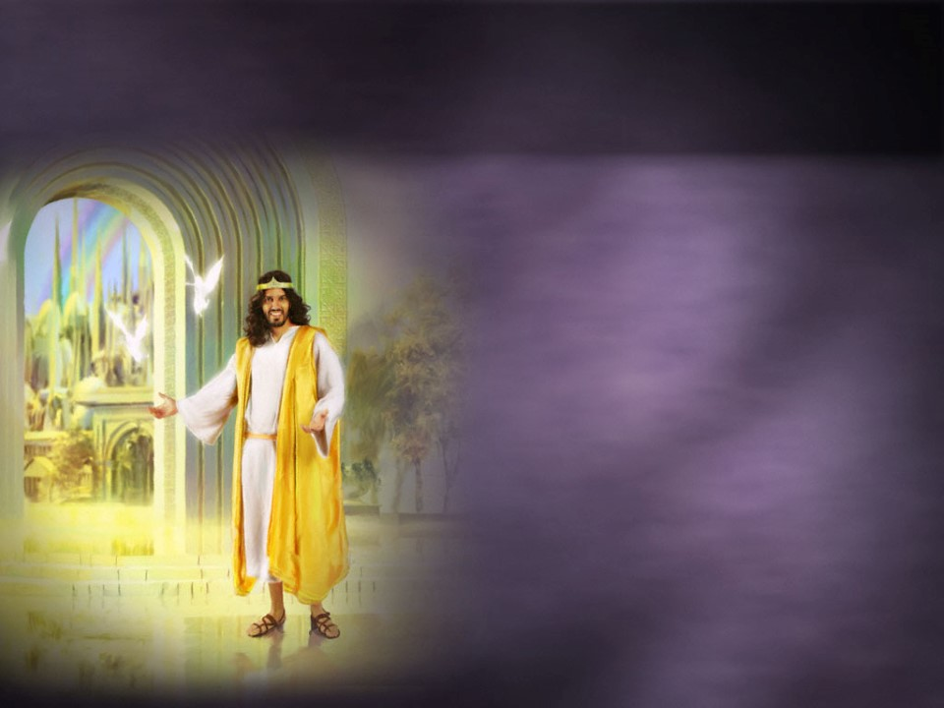
“Behold I come quickly and my reward is with me
μισθός (misthos)
Pay for Service, wages
to give every man
according as his work shall be.”
Rev. 22:12

Slide 3
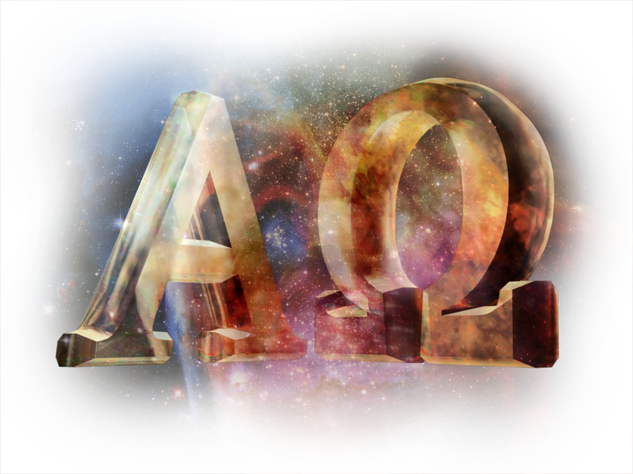
“I am Alpha and Omega,
the beginning and the end,
the first and
the last.”
Rev. 22:13
But WE want to be FIRST!
Col 1:17-18 “he is before all things, and by him all things consist….that in all things he might have the preeminence.

Slide 4
The Tug between what we want and what God wants pulls on each of us.
Gal 5:16-17 “Walk in the Spirit,
and ye shall not fulfil the lust of the flesh.
For the flesh lusteth against the Spirit,
and the Spirit against the flesh:
these are contrary the one to the other:
so that ye can’t do the things that ye would.”
This “Tug” leaves us “Torn” between time and Eternity.
How do we deal with this “Tension”?

Slide 5
Lessons from Laodicea Revelation 3:14-22

Slide 6
The Laodicean believers chose the “safe” middle ground.
“I know thy works,
that thou art neither cold nor hot:
I would thou wert cold or hot.”
Rev. 3:15

Slide 7
God revealed the effects of their choice.
“So then because thou art lukewarm,
and neither cold nor hot,
I will spue thee
(eme’ō: vomit)
out of my mouth.”
Rev. 3:16
This attitude “nauseates” God!

Slide 8
What’s God’s Problem with living “Lukewarm”?
It’s a “Comfortable” Condition.
A. Here we’re “self sufficient”. Rev 3:17
“thou sayest, I am rich, and increased with goods and have need of nothing;”
Ph. 3:19 “Who mind (focus on) earthly things.”
Mt. 6:19,20 “lay not up for yourselves
treasures on earth…for
where your treasure is, your heart shall be.”

Slide 9
Living “Lukewarm”
Is a “Comfortable” Condition.
B. Why would God say he’d rather we
be “cold or hot” than lukewarm?
1) The “Cold” Christian knows his condition.
They can recognize God’s conviction and if
they respond, are cleansed. (1 Jn. 1:9)
2) The “Lukewarm” Christians deceives
themselves through rationalizations….
that “blinds” them to their true condition.
(2 Cor. 4:4; 2 Peter 1:9; 1 Jn 1:6)

Slide 10
Living “Lukewarm”…
2. Is a “Confused” Condition.
A. Here we confuse the “wood, hay, stubble”
for “gold, silver, precious things.” (1 Cor. 3:12-15)
Rev 3:17 “Because thou sayest, I am rich, …, and have need of nothing;
and knowest not that thou art wretched, and miserable, and poor, and blind, and naked:

Slide 11
Living “Lukewarm”…
2. Is a “Confused” Condition.
B. The human heart is easily “confused” by
self- interests. Jer. 17:9,10
“The heart is deceitful above all things, and desperately wicked: who can know it?
I the LORD search the heart, I try the reins, even to give every man according to his ways,
and according to the fruit of his doings.”

Slide 12
Living “Lukewarm”…
3. Is a “Compromising” Condition.
Lukewarm is synonymous with compromise.
A. It’s a transitory condition between
hot and cold!
1) It’s Entropy at work (Or play!)
Entropy explains the natural effect the “environment” has on everything in it!
The “current” of the culture is always away from God!

Slide 13
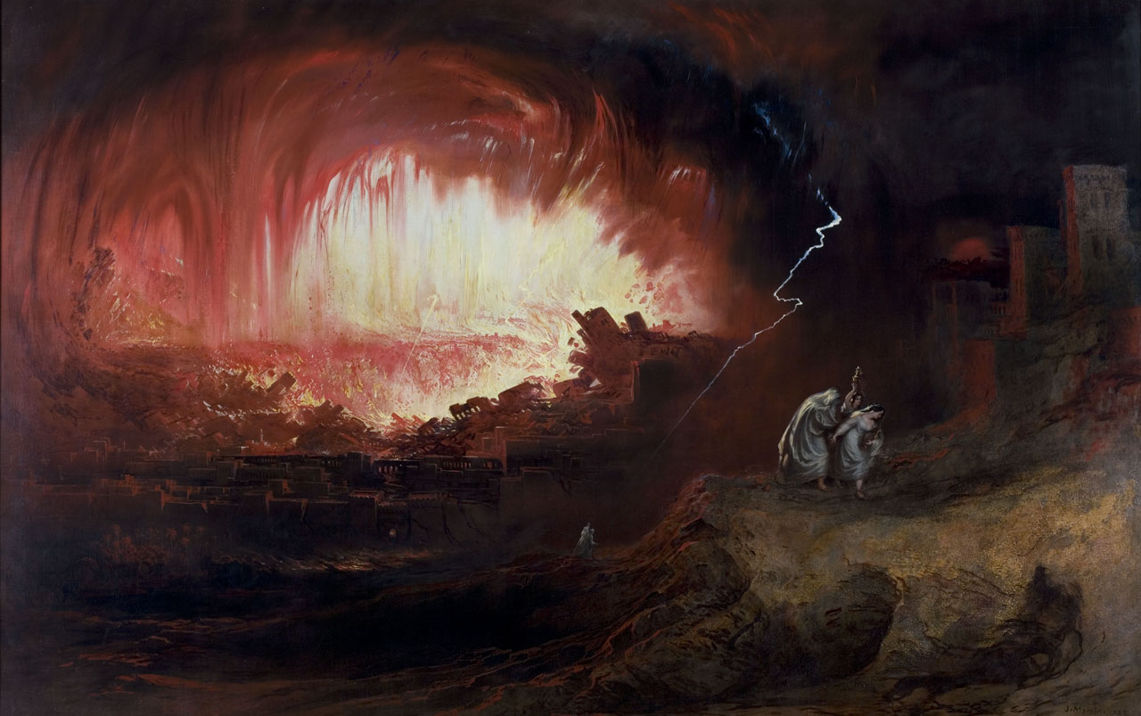
Living “Lukewarm”…
3. Is a “Compromising” Condition.
Remember Lot progressively moved closer to Sodom, until he was contaminated by it. (Gen. 19)
2 Peter 2:8 “vexed (tortured) his righteous soul from day to day”
“Remember Lot’s wife!” Luke 17:31

Slide 14
3. It’s a “Compromising” Condition.
2 Cor 6:14-16“what fellowship hath righteousness with unrighteousness?
what communion hath light with darkness?
what concord (harmony) hath Christ with Belial?
or what part hath he that believeth with an infidel?
what agreement hath the temple of God with idols?
for ye are the temple of the living God;
as God hath said, I will dwell in them and walk in them and be their God and they shall be my people”

Slide 15
Living “Lukewarm”?
4. Is a “Contaminated” Condition.
A. The pull of the world, flesh, and
Devil not only tugs on our hearts,
it seeks to “trap and trash” it. Ro. 12:1,2
“be not conformed to this world, but be ye transformed by the renewal of your mind.”
Col 2:8 “Beware lest any man spoil you
through philosophy and vain deceit…
after the rudiments of the world…”

Slide 16
Living “Lukewarm”?
4. Is a “Contaminated” Condition.
2 Cor 6:17 “Wherefore come out from among them,
and be ye separate, saith the Lord, and touch not
the unclean thing; and I will receive you,
1 Cor 15:33 “Be not deceived: evil
communications (Companionship)
corrupt good manners.” (useful habits)
Micah 2:10 “Arise ye, and depart; for this is
not your rest: because it is polluted, it shall
destroy you, even with a sore destruction.”

Slide 17
God’s Solution Rev. 3:18-22
1. Refocus on Eternity!
“I counsel thee to buy of me gold tried in the fire,
(purged of wood, hay stubble)
that thou mayest be rich;
They thought they were already rich!
(So did the Sodomites!)
Rev. 3:18

Slide 18
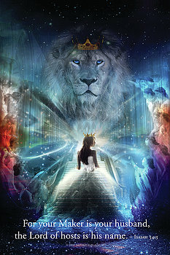
God’s Solution Rev. 3:18-22 “and white raiment, that thou mayest be clothed…
There’s a correlation between our “works” and our eternal “wardrobe!”
“rejoice …for the marriage of the Lamb is come
and his wife hath
made herself ready.”
Rev 19:7,8

Slide 19
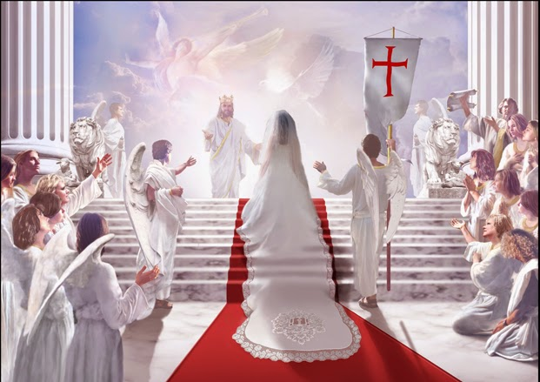
“to her was granted that she should be arrayed in fine linen, clean and white:”
for the fine linen is the righteousness of saints.”
Rev 19:7,8
Dikai’ōma: Equitable Deeds, decisions

Slide 20
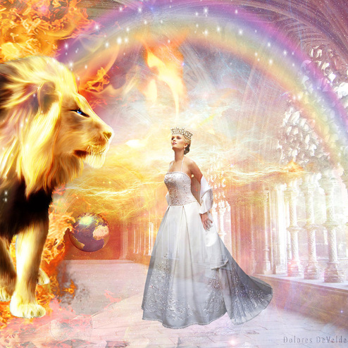
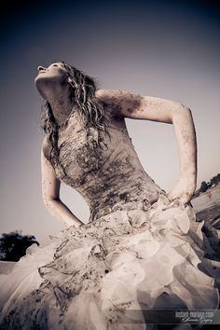
What will your “wedding dress” look like?

Slide 21
God’s Solution Rev. 3:18-22 “and anoint thine eyes…, that thou mayest see.”
Their compromises kept them from seeing clearly!
2 Pt 1:9 “But he that lacketh these things
(Faith, virtue, knowledge, temperance, patience, godliness, kindness, charity)
is blind, and cannot see afar off…”
Rev. 3:18

Slide 22
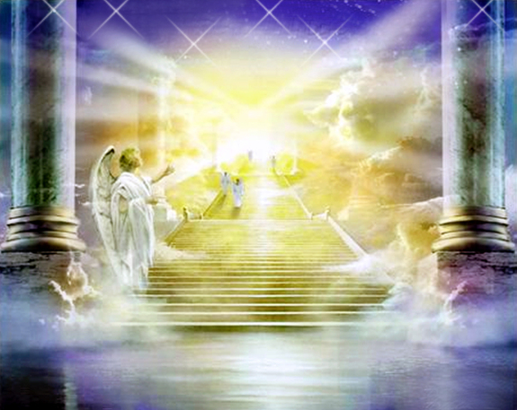
2 Pt 1:10,11
“Wherefore, brethren, give diligence to make your calling and election sure:
for if ye do these things, ye shall never fall:
“For so an entrance shall be ministered unto you abundantly into the everlasting kingdom of our Lord and Savior Jesus Christ.”

Slide 23
God’s Solution Rev. 3:18-22
2) Rethink our values
and priorities!
“As many as I love,
I rebuke and chasten:
be zealous therefore,
and repent.”
Metanoe’ō: reconsider.
Rev. 3:19

Slide 24
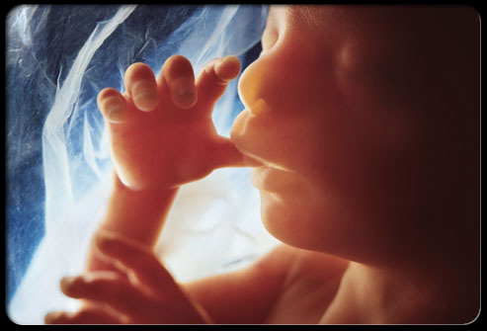
The decision to “abort” a Baby is a tragic, but accurate picture of the folly of short sightedness.
It sacrifices something with eternal significance (a life)
In order to protect or preserve (?) something Temporary!
(job, relationship, reputation, etc)
Ps. 139

Slide 25
God’s Solution Rev. 3:18-22
3) “Rekindle” our relationship with Him.
“I stand at the door and knock.
If any hear my voice
and open the door,
I will come in to him,
and will sup with him, and he with me.”
Rev. 3:20

Slide 26
So we can be fit to “reign” with Him!
“To him that overcometh will I grant to sit with me
in my throne,
even as I also overcame, and am set down with my Father
in his throne.”
Rev. 3:21

Slide 27
Revelation 3:22
“He that hath an ear, let him hear what the Spirit saith unto the churches.”

Slide 28
What’s His Spirit saying to You?
How will you respond?

