Slide 1
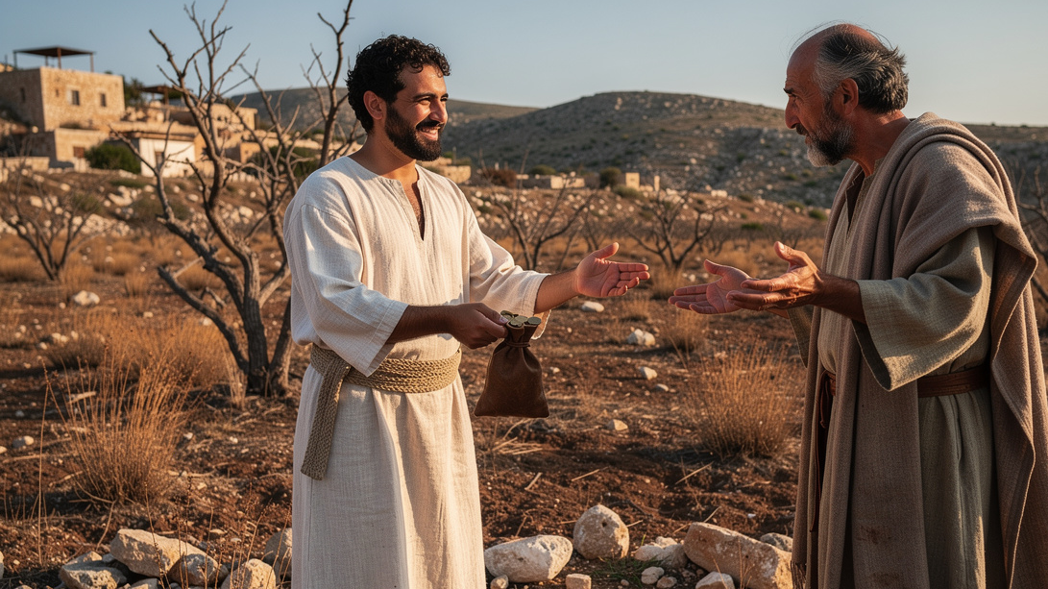
Knowledge that Leads to Action
By Joseph Peters

Slide 2

Goal
Everyone should see the truths of Scripture through the actions of God’s people
For these three reasons

Slide 3
Reasons
The men invested in what they knew were greater treasures
The only investments that will last are heavenly investments
The heavenly investments will be much greater than what is sacrificed on earth

Slide 4
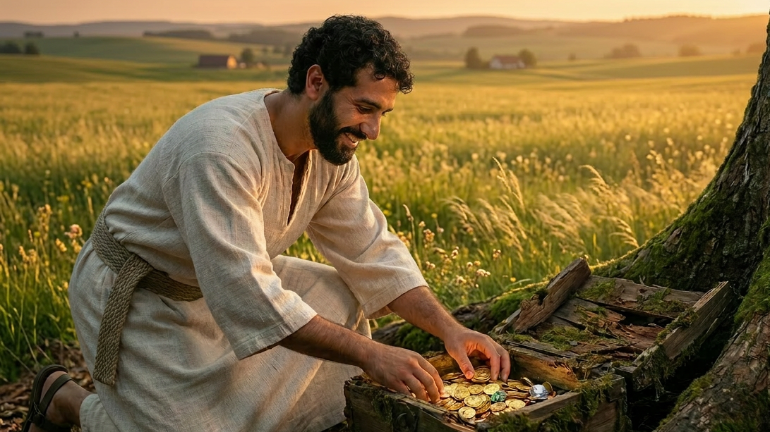
The Men Invested in What They Knew Were Greater Treasures

Slide 5
One Discovered, One Searched, Both Valued
Again, the kingdom of heaven is like unto treasure hid in a field; the which when a man hath found, he hideth, and for joy thereof goeth and selleth all that he hath, and buyeth that field (Matt 13:44).
Again, the kingdom of heaven is like unto a merchant man, seeking goodly pearls: Who, when he had found one pearl of great price, went and sold all that he had, and bought it (Matt 13:45–46).

Slide 6
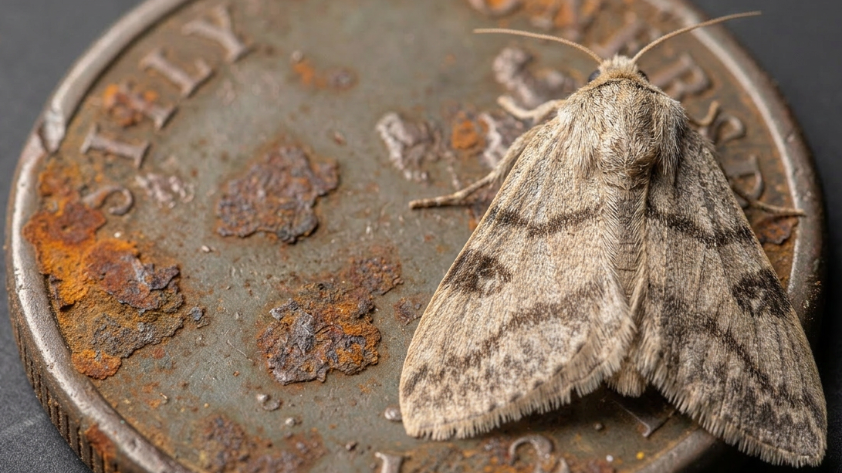
The Only Investments that Will Last are Heavenly Investments

Slide 7
The Temporary VS the Permanent
Lay not up for yourselves treasures upon earth, where moth and rust doth corrupt, and where thieves break through and steal: But lay up for yourselves treasures in heaven, where neither moth nor rust doth corrupt, and where thieves do not break through nor steal: For where your treasure is, there will your heart be also (Matt 6:19–21).

Slide 8
Know them by their Fruit
Beware of false prophets, which come to you in sheep’s clothing, but inwardly they are ravening wolves. Ye shall know them by their fruits. Do men gather grapes of thorns, or figs of thistles? Even so every good tree bringeth forth good fruit; but a corrupt tree bringeth forth evil fruit. A good tree cannot bring forth evil fruit, neither can a corrupt tree bring forth good fruit. Every tree that bringeth not forth good fruit is hewn down, and cast into the fire. Wherefore by their fruits ye shall know them (Matt 7:15–20).

Slide 9
Doing the Will of the Father
Not every one that saith unto me, Lord, Lord, shall enter into the kingdom of heaven; but he that doeth the will of my Father which is in heaven. Many will say to me in that day, Lord, Lord, have we not prophesied in thy name? and in thy name have cast out devils? and in thy name done many wonderful works? And then will I profess unto them, I never knew you: depart from me, ye that work iniquity (Matt 7:21–23).

Slide 10
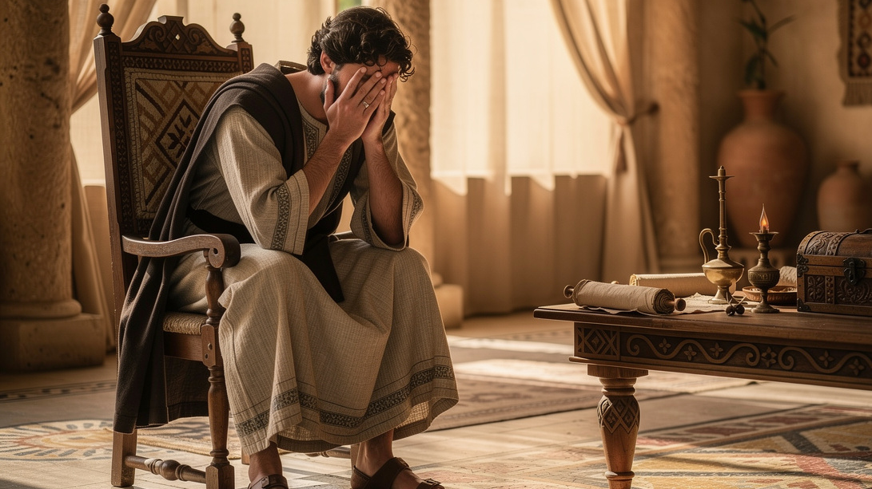
The Heavenly Investments Will be Much Greater Than What is Sacrificed on Earth

Slide 11
Sacrifices that Lead to Rewards
Then answered Peter and said unto him, Behold, we have forsaken all, and followed thee; what shall we have therefore? And Jesus said unto them, Verily I say unto you, That ye which have followed me, in the regeneration when the Son of man shall sit in the throne of his glory, ye also shall sit upon twelve thrones, judging the twelve tribes of Israel. And every one that hath forsaken houses, or brethren, or sisters, or father, or mother, or wife, or children, or lands, for my name’s sake, shall receive an hundredfold, and shall inherit everlasting life. But many that are first shall be last; and the last shall be first (Matt 19:27–30).

Slide 12
Conclusion
Everyone should see the truths of Scripture through the actions of God’s people
For these three reasons

Slide 13
Reasons
The men invested in what they knew were greater treasures
The only investments that will last are heavenly investments
The heavenly investments will be much greater than what is sacrificed on earth

