Slide 1
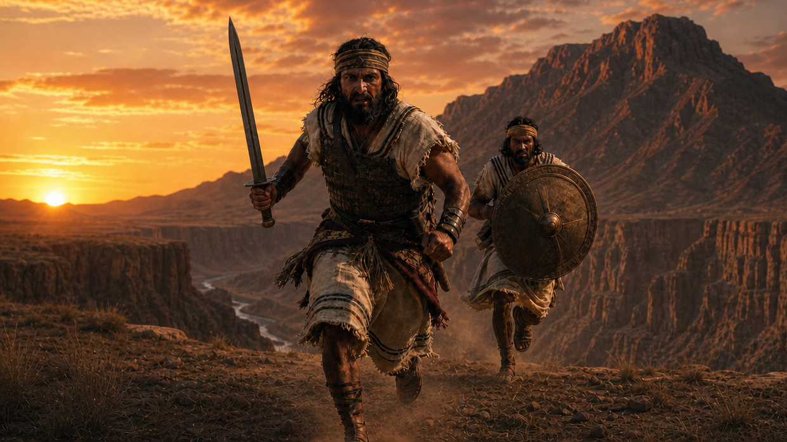
Jonathan: Started a Battle Cry
By Joseph Peters

Slide 2

Goal
Every Christian should have a trust in God like Jonathan did
For these three reasons

Slide 3
Reasons
Jonathan served a fearful army
Jonathan trusted God, regardless of God’s decision
Jonathan inspired a rally cry throughout fearful Israel

Slide 4
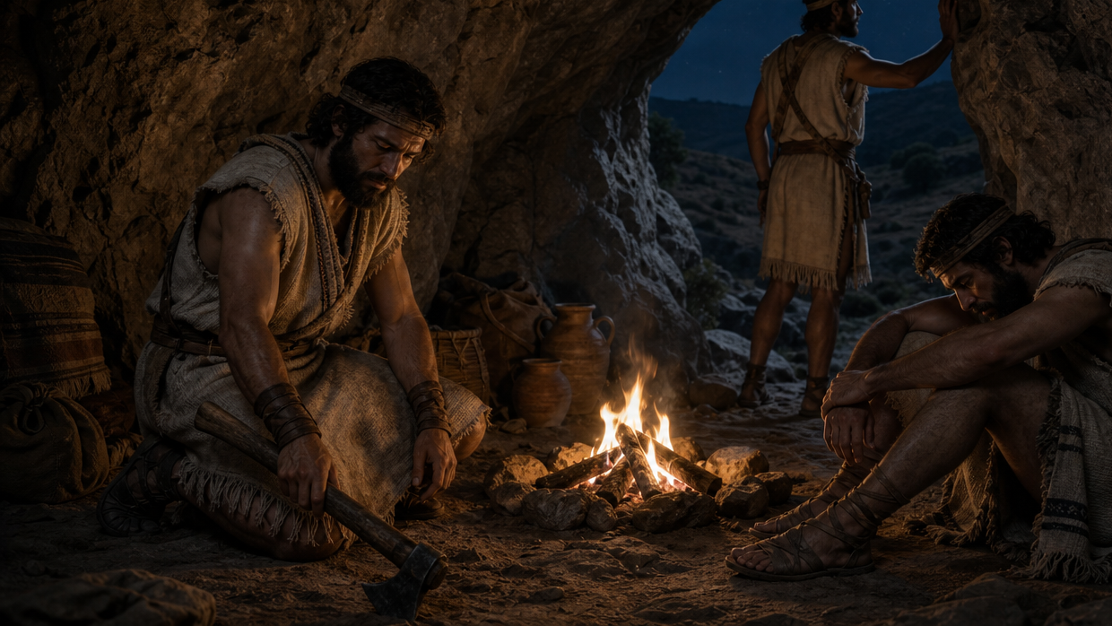
Jonathan Served a Fearful Army

Slide 5
Beginning with a Large Army
Saul chose him three thousand men of Israel; whereof two thousand were with Saul in Michmash and in mount Beth-el, and a thousand were with Jonathan in Gibeah of Benjamin: and the rest of the people he sent every man to his tent. And Jonathan smote the garrison of the Philistines that was in Geba, and the Philistines heard of it. And Saul blew the trumpet throughout all the land, saying, Let the Hebrews hear (1 Sam 13:2-3).

Slide 6
The Enemy Gathers a Huge Army
And the Philistines gathered themselves together to fight with Israel, thirty thousand chariots, and six thousand horsemen, and people as the sand which is on the sea shore in multitude: and they came up, and pitched in Michmash, eastward from Beth-aven (1 Sam 13:5).

Slide 7
The Israelites Start Scattering
When the men of Israel saw that they were in a strait, (for the people were distressed,) then the people did hide themselves in caves, and in thickets, and in rocks, and in high places, and in pits. And some of the Hebrews went over Jordan to the land of Gad and Gilead. As for Saul, he was yet in Gilgal, and all the people followed him trembling (1 Sam 13:6–7).

Slide 8
A Small Army
And Saul numbered the people that were present with him, about six hundred men. And Saul, and Jonathan his son, and the people that were present with them, abode in Gibeah of Benjamin: but the Philistines encamped in Michmash (1 Sam 13:15–16).

Slide 9
Inferior Armory
Now there was no smith found throughout all the land of Israel: for the Philistines said, Lest the Hebrews make them swords or spears: But all the Israelites went down to the Philistines, to sharpen every man his share, and his coulter, and his axe, and his mattock. Yet they had a file [2/3 of a shekel] for the mattocks, and for the coulters, and for the forks, and for the axes, and to sharpen the goads. So it came to pass in the day of battle, that there was neither sword nor spear found in the hand of any of the people that were with Saul and Jonathan: but with Saul and with Jonathan his son was there found (1 Sam 13:19–22).

Slide 10
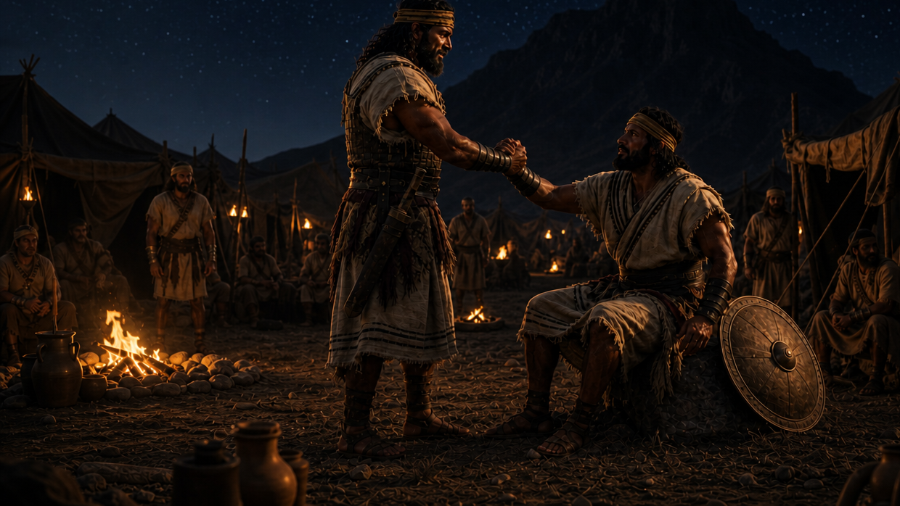
Jonathan Trusted God, Regardless of God’s Decision

Slide 11
Jonathan’s Bold Action
Now it came to pass upon a day, that Jonathan the son of Saul said unto the young man that bare his armour, Come, and let us go over to the Philistines’ garrison, that is on the other side. But he told not his father (1 Sam 14:1).

Slide 12
Jonathan’s Trust in the Lord Inspired One Man
And Jonathan said to the young man that bare his armour, Come, and let us go over unto the garrison of these uncircumcised: it may be that the LORD will work for us: for there is no restraint to the LORD to save by many or by few. And his armourbearer said unto him, Do all that is in thine heart: turn thee; behold, I am with thee according to thy heart (1 Sam 14:6–7).

Slide 13
Jonathan’s Sign from the Lord
Then said Jonathan, Behold, we will pass over unto these men, and we will discover ourselves unto them. If they say thus unto us, Tarry until we come to you; then we will stand still in our place, and will not go up unto them. But if they say thus, Come up unto us; then we will go up: for the LORD hath delivered them into our hand: and this shall be a sign unto us (1 Sam 14:8–10).

Slide 14
The Sign Confirmed
And both of them discovered themselves unto the garrison of the Philistines: and the Philistines said, Behold, the Hebrews come forth out of the holes where they had hid themselves. And the men of the garrison answered Jonathan and his armourbearer, and said, Come up to us, and we will shew you a thing. And Jonathan said unto his armourbearer, Come up after me: for the LORD hath delivered them into the hand of Israel (1 Sam 14:11–12).

Slide 15
Jonathan’s Boldness Caused Confusion and Fear
And Jonathan climbed up upon his hands and upon his feet, and his armourbearer after him: and they fell before Jonathan; and his armourbearer slew after him. And that first slaughter, which Jonathan and his armourbearer made, was about twenty men, within as it were an half acre of land, which a yoke of oxen might plow. And there was trembling in the host, in the field, and among all the people: the garrison, and the spoilers, they also trembled, and the earth quaked: so it was a very great trembling (1 Sam 14:13–15).

Slide 16
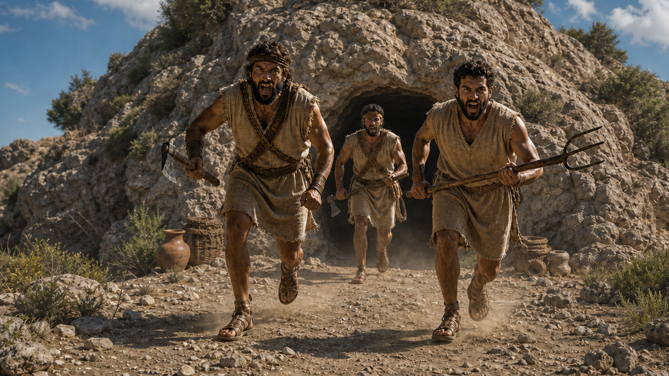
Jonathan Inspired a Rally Cry Throughout Fearful Israel

Slide 17
Israel Discovers that Jonathan is Responsible
And the watchmen of Saul in Gibeah of Benjamin looked; and, behold, the multitude melted away, and they went on beating down one another. Then said Saul unto the people that were with him, Number now, and see who is gone from us. And when they had numbered, behold, Jonathan and his armourbearer were not there (1 Sam 14:16–17).

Slide 18
Jonathan’s Faith Started a Battle Cry
And Saul and all the people that were with him assembled themselves, and they came to the battle: and, behold, every man’s sword was against his fellow, and there was a very great discomfiture. Moreover the Hebrews that were with the Philistines before that time, which went up with them into the camp from the country round about, even they also turned to be with the Israelites that were with Saul and Jonathan (1 Sam 14:20–21).

Slide 19
Those Hiding Were Inspired to Join the Fight
Likewise all the men of Israel which had hid themselves in mount Ephraim, when they heard that the Philistines fled, even they also followed hard after them in the battle. So the LORD saved Israel that day: and the battle passed over unto Beth-aven (1 Sam 14:22–23).

Slide 20
Conclusion
Every Christian should have a trust in God like Jonathan did
For these three reasons

Slide 21
Reasons
Jonathan served a fearful army
Jonathan trusted God, regardless of God’s decision
Jonathan inspired a rally cry throughout fearful Israel

