Slide 1
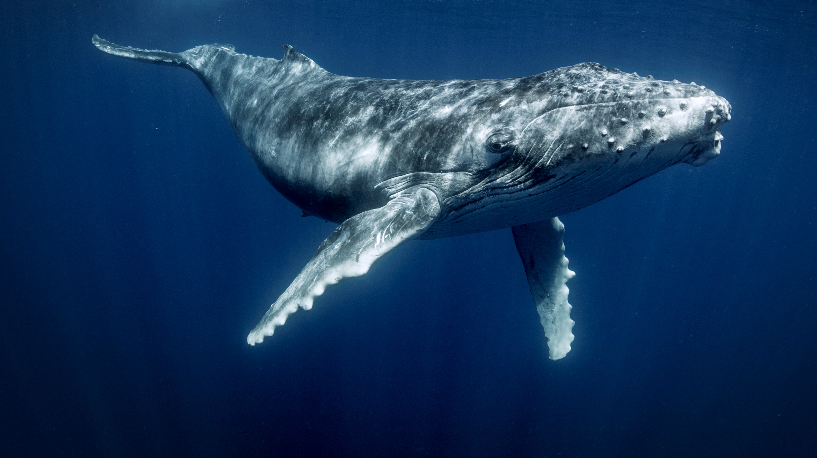
יְשׁוּעָ֖תָה לַיהוָֽה
By Joseph D. Peters

Slide 2
Objective
Anyone can trust that God is a merciful God
By noticing these three aspects of Jonah 1 and 2

Slide 3
Rationale
God showed mercy to Israel
God showed mercy to the Pagans
God showed mercy to Jonah

Slide 4
God Showed Mercy To Israel

Slide 5
Wicked Israel
2 Kings 14:23-24
23 In the fifteenth year of Amaziah the son of Joash king of Judah Jeroboam the son of Joash king of Israel began to reign in Samaria, and reigned forty and one years.
24 And he did that which was evil in the sight of the Lord: he departed not from all the sins of Jeroboam the son of Nebat, who made Israel to sin.

Slide 6
Was Allowed to Prosper
2 Kings 14:25
25 He restored the coast of Israel from the entering of Hamath unto the sea of the plain, according to the word of the Lord God of Israel, which he spake by the hand of his servant Jonah, the son of Amittai, the prophet, which was of Gathhepher.

Slide 7
God Was Merciful
2 Kings 14:26-27
26 For the Lord saw the affliction of Israel, that it was very bitter: for there was not any shut up, nor any left, nor any helper for Israel.
27 And the Lord said not that he would blot out the name of Israel from under heaven: but he saved them by the hand of Jeroboam the son of Joash.

Slide 8
God Showed Mercy To the Pagans

Slide 9
God’s Commission to Jonah
Jonah 1:1-2
1 Now the word of the Lord came unto Jonah the son of Amittai, saying,
2 Arise, go to Nineveh, that great city, and cry against it; for their wickedness is come up before me.

Slide 10
Jonah’s Response
Jonah 1:3
3 But Jonah rose up to flee unto Tarshish from the presence of the Lord, and went down to Joppa; and he found a ship going to Tarshish: so he paid the fare thereof, and went down into it, to go with them unto Tarshish from the presence of the Lord.

Slide 11
God’s Response
Jonah 1:4
4 But the Lord sent out a great wind into the sea, and there was a mighty tempest in the sea, so that the ship was like to be broken.

Slide 12
The Sailors Response
Jonah 1:5-6
5 Then the mariners were afraid, and cried every man unto his god, and cast forth the wares that were in the ship into the sea, to lighten it of them. But Jonah was gone down into the sides of the ship; and he lay, and was fast asleep.
6 So the shipmaster came to him, and said unto him, What meanest thou, O sleeper? arise, call upon thy God, if so be that God will think upon us, that we perish not.

Slide 13
Jonah is Discovered
Jonah 1:7-8
7 And they said every one to his fellow, Come, and let us cast lots, that we may know for whose cause this evil is upon us. So they cast lots, and the lot fell upon Jonah.
8 Then said they unto him, Tell us, we pray thee, for whose cause this evil is upon us; What is thine occupation? and whence comest thou? what is thy country? and of what people art thou?

Slide 14
Jonah’s Confession
Jonah 1:9-10
9 And he said unto them, I am an Hebrew; and I fear the Lord, the God of heaven, which hath made the sea and the dry land.
10 Then were the men exceedingly afraid, and said unto him. Why hast thou done this? For the men knew that he fled from the presence of the Lord, because he had told them.

Slide 15
Jonah’s Answer
Jonah 1:9-10
11 Then said they unto him, What shall we do unto thee, that the sea may be calm unto us? for the sea wrought, and was tempestuous.
12 And he said unto them, Take me up, and cast me forth into the sea; so shall the sea be calm unto you: for I know that for my sake this great tempest is upon you.

Slide 16
Lose – Lose - Lose
Jonah 1:13-14
13 Nevertheless the men rowed hard to bring it to the land; but they could not: for the sea wrought, and was tempestuous against them.
14 Wherefore they cried unto the Lord, and said, We beseech thee, O Lord, we beseech thee, let us not perish for this man's life, and lay not upon us innocent blood: for thou, O Lord, hast done as it pleased thee.

Slide 17
God’s Mercy to the Sailors
Jonah 1:15-16
15 So they took up Jonah, and cast him forth into the sea: and the sea ceased from her raging.
16 Then the men feared the Lord exceedingly, and offered a sacrifice unto the Lord, and made vows.

Slide 18
God Showed Mercy To Jonah

Slide 19
What is my gender?

Slide 20
From Judgement to Mercy
Jonah 1:17, 2:1
17 Now the Lord had prepared a great fish to swallow up Jonah. And Jonah was in the belly of the fish three days and three nights.
2:1 Then Jonah prayed unto the Lord his God out of the fish's belly,

Slide 21
Recognizing the LORD
Jonah 2:2-4
2 And said, I cried by reason of mine affliction unto the Lord, and he heard me; out of the belly of hell cried I, and thou heardest my voice.
3 For thou hadst cast me into the deep, in the midst of the seas; and the floods compassed me about: all thy billows and thy waves passed over me.
4 Then I said, I am cast out of thy sight; yet I will look again toward thy holy temple.

Slide 22
Beyond Redemption
Jonah 2:5-7
5 The waters compassed me about, even to the soul: the depth closed me round about, the weeds were wrapped about my head.
6 I went down to the bottoms of the mountains; the earth with her bars was about me for ever: yet hast thou brought up my life from corruption, O Lord my God.
7 When my soul fainted within me I remembered the Lord: and my prayer came in unto thee, into thine holy temple.

Slide 23
A Quote from Psalms
Psalms 31:6 ESV
I hate those who pay regard to worthless idols, but I trust in the LORD.
Jonah 2:8 ESV
Those who pay regard to vain idols forsake their hope of steadfast love.

Slide 24
Jonah’s Pride
Jonah 2:8-9
8 They that observe lying vanities forsake their own mercy.
9 But I will sacrifice unto thee with the voice of thanksgiving; I will pay that that I have vowed. Salvation is of the Lord

Slide 25
The LORD’s Mercy
Jonah 2:10
10 And the Lord spake unto the fish, and it vomited out Jonah upon the dry land.

Slide 26
Conclusion
Anyone can trust that God is a merciful God
By noticing these three aspects of Jonah 1 and 2

Slide 27
Rationale
God showed mercy to Israel
God showed mercy to the Pagans
God showed mercy to Jonah

