Slide 1
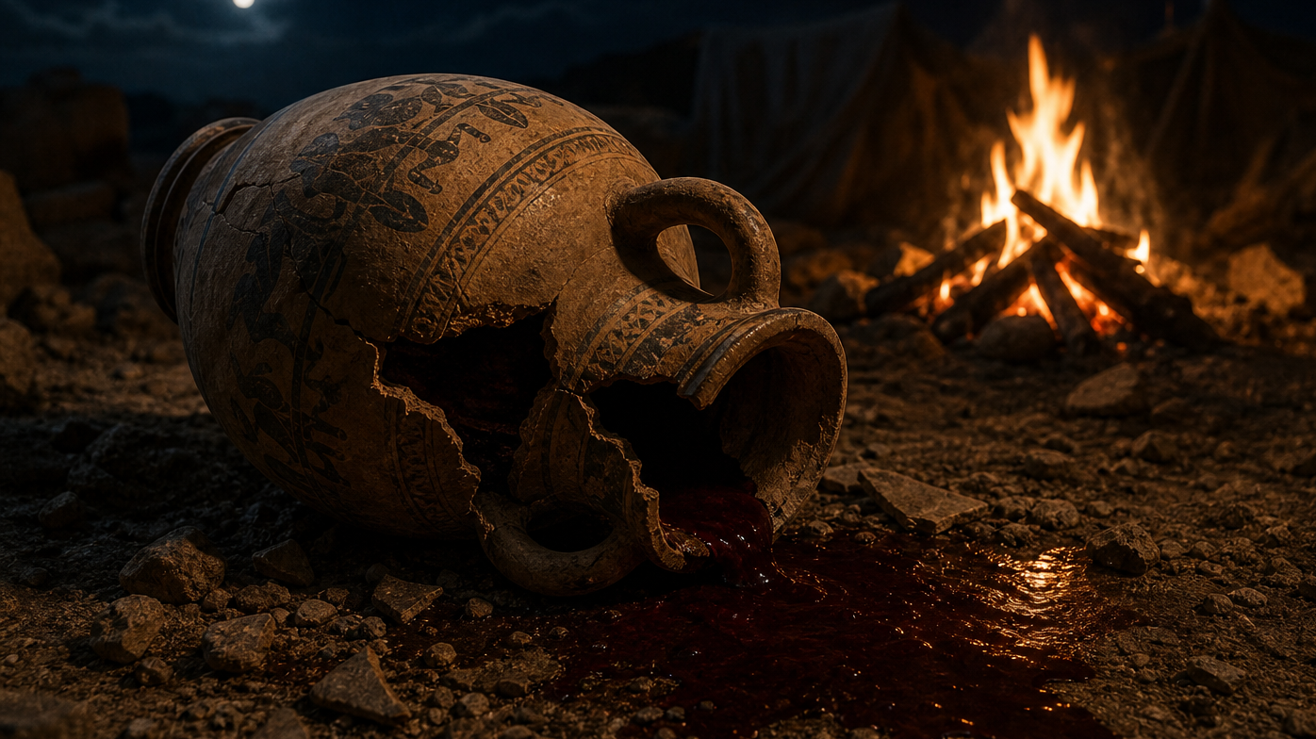
Jonadab’s Sons: Obeying the Confusing
By Joseph Peters

Slide 2

Goal
Everyone should obey God, even if you do not understand or agree with His commands.
For these three reasons

Slide 3
Reasons
God Tested the Faithfulness of Jonadab’s Family
God Commends Them For Their Faithfulness
God Compares Their Faithfulness to Israel’s Unfaithfulness

Slide 4
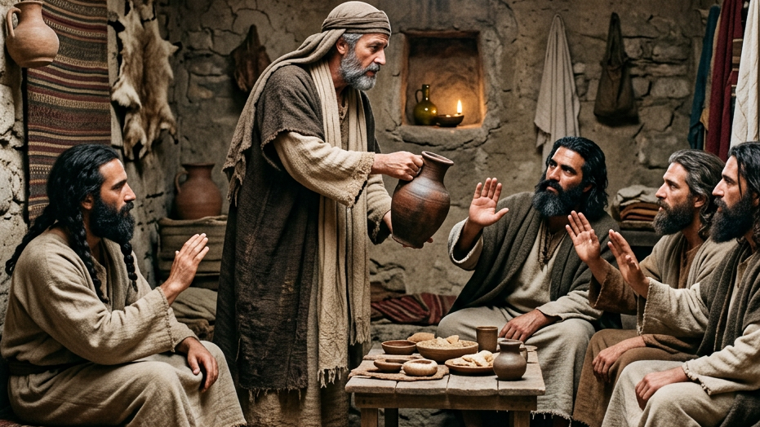
God Tested the Faithfulness of Jonadab’s Family

Slide 5
God’s Instructions to Jeremiah
The word which came unto Jeremiah from the LORD in the days of Jehoiakim the son of Josiah king of Judah, saying, Go unto the house of the Rechabites, and speak unto them, and bring them into the house of the LORD, into one of the chambers, and give them wine to drink. Then I took Jaazaniah the son of Jeremiah, the son of Habaziniah, and his brethren, and all his sons, and the whole house of the Rechabites (Jer 35:1–3).

Slide 6
Jeremiah’s Instructions to Jonadab’s Sons
And I brought them into the house of the LORD… And I set before the sons of the house of the Rechabites pots full of wine, and cups, and I said unto them, Drink ye wine (Jer 35:4a, 5).

Slide 7
Their Forefather’s Request
But they said, We will drink no wine: for Jonadab the son of Rechab our father commanded us, saying, Ye shall drink no wine, neither ye, nor your sons for ever: Neither shall ye build house, nor sow seed, nor plant vineyard, nor have any: but all your days ye shall dwell in tents; that ye may live many days in the land where ye be strangers (Jer 35:6–7).

Slide 8
Following Confusing Commands
And the king said unto the man of God, Come home with me, and refresh thyself, and I will give thee a reward. And the man of God said unto the king, If thou wilt give me half thine house, I will not go in with thee, neither will I eat bread nor drink water in this place: For so was it charged me by the word of the LORD, saying, Eat no bread, nor drink water, nor turn again by the same way that thou camest. So he went another way, and returned not by the way that he came to Beth-el (1 Kings 13:7–10).

Slide 9
The Old Prophets Request
Now there dwelt an old prophet in Beth-el; and his sons came and told him all the works that the man of God had done that day in Beth-el… And went after the man of God, and found him sitting under an oak: and he said unto him, Art thou the man of God that camest from Judah? And he said, I am. Then he said unto him, Come home with me, and eat bread. And he said, I may not return with thee, nor go in with thee: neither will I eat bread nor drink water with thee in this place: For it was said to me by the word of the LORD, Thou shalt eat no bread nor drink water there, nor turn again to go by the way that thou camest (1 Kings 13:11a, 14–17).

Slide 10
The Man of God Was Tricked
He said unto him, I am a prophet also as thou art; and an angel spake unto me by the word of the LORD, saying, Bring him back with thee into thine house, that he may eat bread and drink water. But he lied unto him. So he went back with him, and did eat bread in his house, and drank water (1 Kings 13:18–19).

Slide 11
The Man of God is Cursed
And it came to pass, as they sat at the table, that the word of the LORD came unto the prophet that brought him back: And he cried unto the man of God that came from Judah, saying, Thus saith the LORD, Forasmuch as thou hast disobeyed the mouth of the LORD, and hast not kept the commandment which the LORD thy God commanded thee, But camest back, and hast eaten bread and drunk water in the place, of the which the LORD did say to thee, Eat no bread, and drink no water; thy carcase shall not come unto the sepulchre of thy fathers (1 Kings 13:20–22).

Slide 12
The Man of God is Killed
And when he was gone, a lion met him by the way, and slew him: and his carcase was cast in the way, and the ass stood by it, the lion also stood by the carcase (1 Kings 13:24).

Slide 13
Their Faithful Obedience
Thus have we obeyed the voice of Jonadab the son of Rechab our father in all that he hath charged us, to drink no wine all our days, we, our wives, our sons, nor our daughters; Nor to build houses for us to dwell in: neither have we vineyard, nor field, nor seed: But we have dwelt in tents, and have obeyed, and done according to all that Jonadab our father commanded us (Jer 35:8–10).

Slide 14
Why They Were in Jerusalem
But it came to pass, when Nebuchadrezzar king of Babylon came up into the land, that we said, Come, and let us go to Jerusalem for fear of the army of the Chaldeans, and for fear of the army of the Syrians: so we dwell at Jerusalem (Jer 35:11).

Slide 15
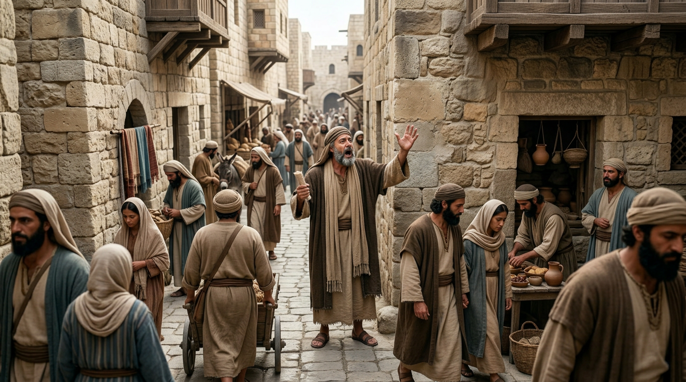
God Compares Their Faithfulness to Israel’s Unfaithfulness

Slide 16
God’s Message to Judah
Then came the word of the LORD unto Jeremiah, saying, Thus saith the LORD of hosts, the God of Israel; Go and tell the men of Judah and the inhabitants of Jerusalem, Will ye not receive instruction to hearken to my words? saith the LORD (Jer 35:12–13).

Slide 17
A Comparison
The words of Jonadab the son of Rechab, that he commanded his sons not to drink wine, are performed; for unto this day they drink none, but obey their father’s commandment: notwithstanding I have spoken unto you, rising early and speaking; but ye hearkened not unto me (Jer 35:14).

Slide 18
God’s Attempts to Reach His People
I have sent also unto you all my servants the prophets, rising up early and sending them, saying, Return ye now every man from his evil way, and amend your doings, and go not after other gods to serve them, and ye shall dwell in the land which I have given to you and to your fathers: but ye have not inclined your ear, nor hearkened unto me (Jer 35:15).

Slide 19
Now it is Too Late
Because the sons of Jonadab the son of Rechab have performed the commandment of their father, which he commanded them; but this people hath not hearkened unto me: Therefore thus saith the LORD God of hosts, the God of Israel; Behold, I will bring upon Judah and upon all the inhabitants of Jerusalem all the evil that I have pronounced against them: because I have spoken unto them, but they have not heard; and I have called unto them, but they have not answered (Jer 35:16–17).

Slide 20
God’s Promise to Exile
The LORD shall bring thee, and thy king which thou shalt set over thee, unto a nation which neither thou nor thy fathers have known; and there shalt thou serve other gods, wood and stone. And thou shalt become an astonishment, a proverb, and a byword, among all nations whither the LORD shall lead thee (Deut 28:36–37).

Slide 21
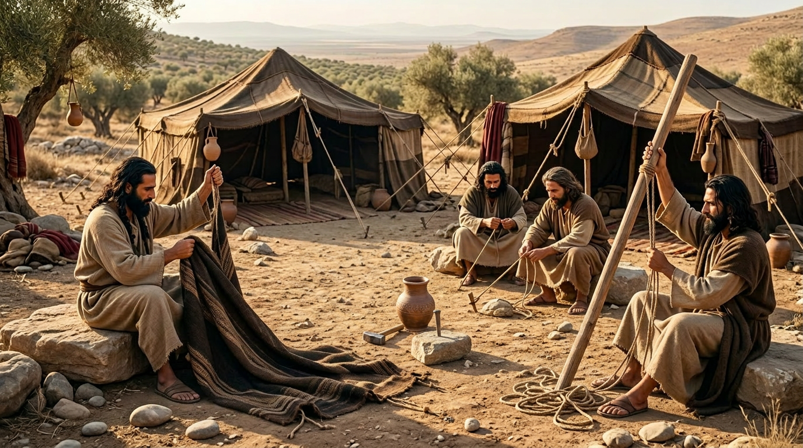
God Commends Them For Their Faithfulness

Slide 22
A Blessing for Jonadab’s Family
And Jeremiah said unto the house of the Rechabites, Thus saith the LORD of hosts, the God of Israel; Because ye have obeyed the commandment of Jonadab your father, and kept all his precepts, and done according unto all that he hath commanded you: Therefore thus saith the LORD of hosts, the God of Israel; Jonadab the son of Rechab shall not want a man to stand before me for ever (Jer 35:18–19).

Slide 23
Conclusion
Everyone should obey God, even if you do not understand or agree with His commands.
For these three reasons

Slide 24
Reasons
God Tested the Faithfulness of Jonadab’s Family
God Commends Them For Their Faithfulness
God Compares Their Faithfulness to Israel’s Unfaithfulness

