Slide 1
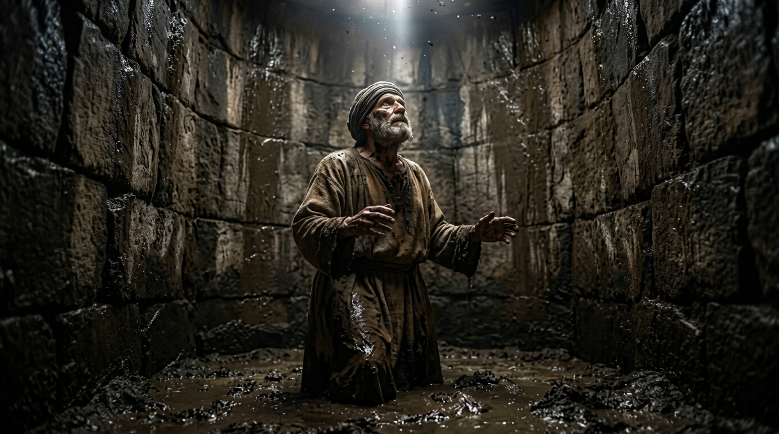
Jeremiah: A Heart and Soul in Conflict
By Joseph Peters

Slide 2

Goal
Everyone of God’s people should be terrified and emboldened
For these three reasons

Slide 3
Reasons
Jeremiah was reluctant to answer God’s call
Jeremiah suffered for obeying God
Jeremiah was a failure by the world’s standards

Slide 4
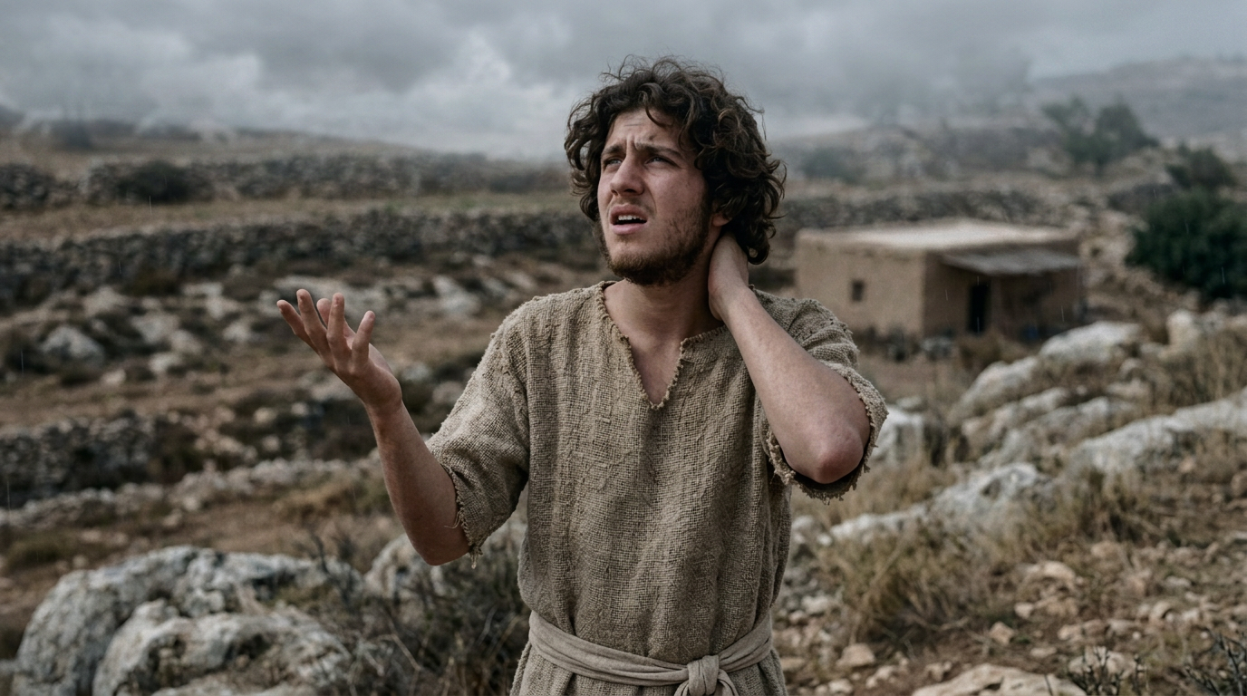
Jeremiah was reluctant to answer God’s call

Slide 5
From a Righteous Time to the Time of Judgment
The words of Jeremiah the son of Hilkiah, of the priests that were in Anathoth in the land of Benjamin: To whom the word of the LORD came in the days of Josiah the son of Amon king of Judah, in the thirteenth year of his reign… unto the carrying away of Jerusalem captive in the fifth month (Jer 1:1–2, 3b).

Slide 6
Chosen, Not Requested
Then the word of the LORD came unto me, saying, Before I formed thee in the belly I knew thee; and before thou camest forth out of the womb I sanctified thee, and I ordained thee a prophet unto the nations (Jer 1:4–5).

Slide 7
Excuses Denied
Then said I, Ah, Lord GOD! behold, I cannot speak: for I am a child. But the LORD said unto me, Say not, I am a child: for thou shalt go to all that I shall send thee, and whatsoever I command thee thou shalt speak. Be not afraid of their faces: for I am with thee to deliver thee, saith the LORD (Jer 1:6–8).

Slide 8
I Am With You
And Jesus came and spake unto them, saying, All power is given unto me in heaven and in earth. Go ye therefore, and teach all nations, baptizing them in the name of the Father, and of the Son, and of the Holy Ghost: Teaching them to observe all things whatsoever I have commanded you: and, lo, I am with you alway, even unto the end of the world. Amen (Matt 28:18–20).

Slide 9
Equipping Jeremiah
Then the LORD put forth his hand, and touched my mouth. And the LORD said unto me, Behold, I have put my words in thy mouth. See, I have this day set thee over the nations and over the kingdoms, to root out, and to pull down, and to destroy, and to throw down, to build, and to plant (Jer 1:9–10).

Slide 10
Parallels With Moses
And Moses said unto the LORD, O my Lord, I am not eloquent, neither heretofore, nor since thou hast spoken unto thy servant: but I am slow of speech, and of a slow tongue. And the LORD said unto him, Who hath made man’s mouth? or who maketh the dumb, or deaf, or the seeing, or the blind? have not I the LORD? Now therefore go, and I will be with thy mouth, and teach thee what thou shalt say (Exod 4:10–12).

Slide 11
God and Jeremiah Against Judah
Thou therefore gird up thy loins, and arise, and speak unto them all that I command thee: be not dismayed at their faces, lest I confound thee before them. For, behold, I have made thee this day a defenced city, and an iron pillar, and brasen walls against the whole land, against the kings of Judah, against the princes thereof, against the priests thereof, and against the people of the land. And they shall fight against thee; but they shall not prevail against thee; for I am with thee, saith the LORD, to deliver thee (Jer 1:17–19).

Slide 12
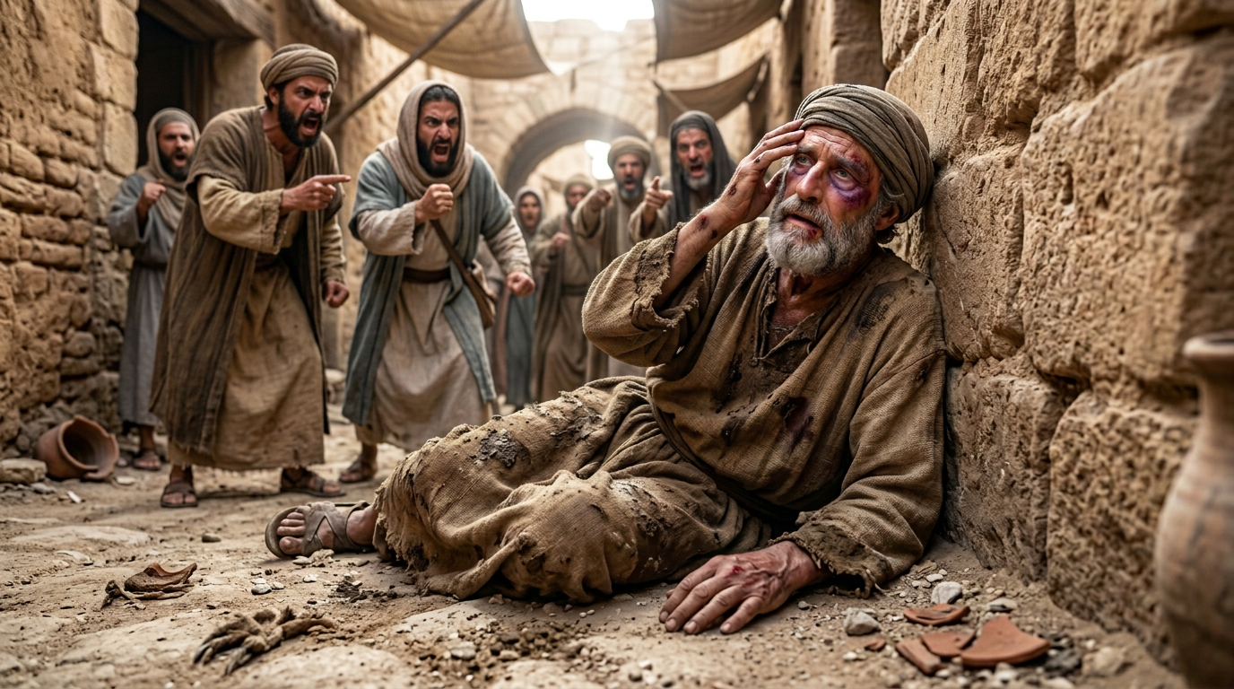
Jeremiah Suffered for Obeying God

Slide 13
Jeremiah is Persecuted by Other Priests
Now Pashur the son of Immer the priest, who was also chief governor in the house of the LORD, heard that Jeremiah prophesied these things. Then Pashur smote Jeremiah the prophet, and put him in the stocks that were in the high gate of Benjamin, which was by the house of the LORD. And it came to pass on the morrow, that Pashur brought forth Jeremiah out of the stocks. (Jer 20:1–3a).

Slide 14
Jeremiah Desire VS Conviction
O LORD, thou hast deceived me, and I was deceived: Thou art stronger than I, and hast prevailed: I am in derision daily, Every one mocketh me. For since I spake, I cried out, I cried violence and spoil; Because the word of the LORD was made a reproach unto me, And a derision, daily. Then I said, I will not make mention of him, Nor speak any more in his name. But his word was in mine heart as a burning fire shut up in my bones, And I was weary with forbearing, and I could not stay (Jer 20:7–9).

Slide 15
His Persecutors will Stumble
For I heard the defaming of many, fear on every side. Report, say they, and we will report it. All my familiars watched for my halting, saying, Peradventure he will be enticed, and we shall prevail against him, And we shall take our revenge on him. But the LORD is with me as a mighty terrible one: Therefore my persecutors shall stumble, and they shall not prevail: They shall be greatly ashamed; for they shall not prosper: Their everlasting confusion shall never be forgotten (Jer 20:10–11).

Slide 16
His Persecutors will Stumble
Cursed be the day wherein I was born: Let not the day wherein my mother bare me be blessed. Cursed be the man who brought tidings to my father, saying, A man child is born unto thee; Making him very glad… Because he slew me not from the womb; Or that my mother might have been my grave, And her womb to be always great with me. Wherefore came I forth out of the womb To see labour and sorrow, That my days should be consumed with shame (Jer 20:14-15, 17-18)?

Slide 17
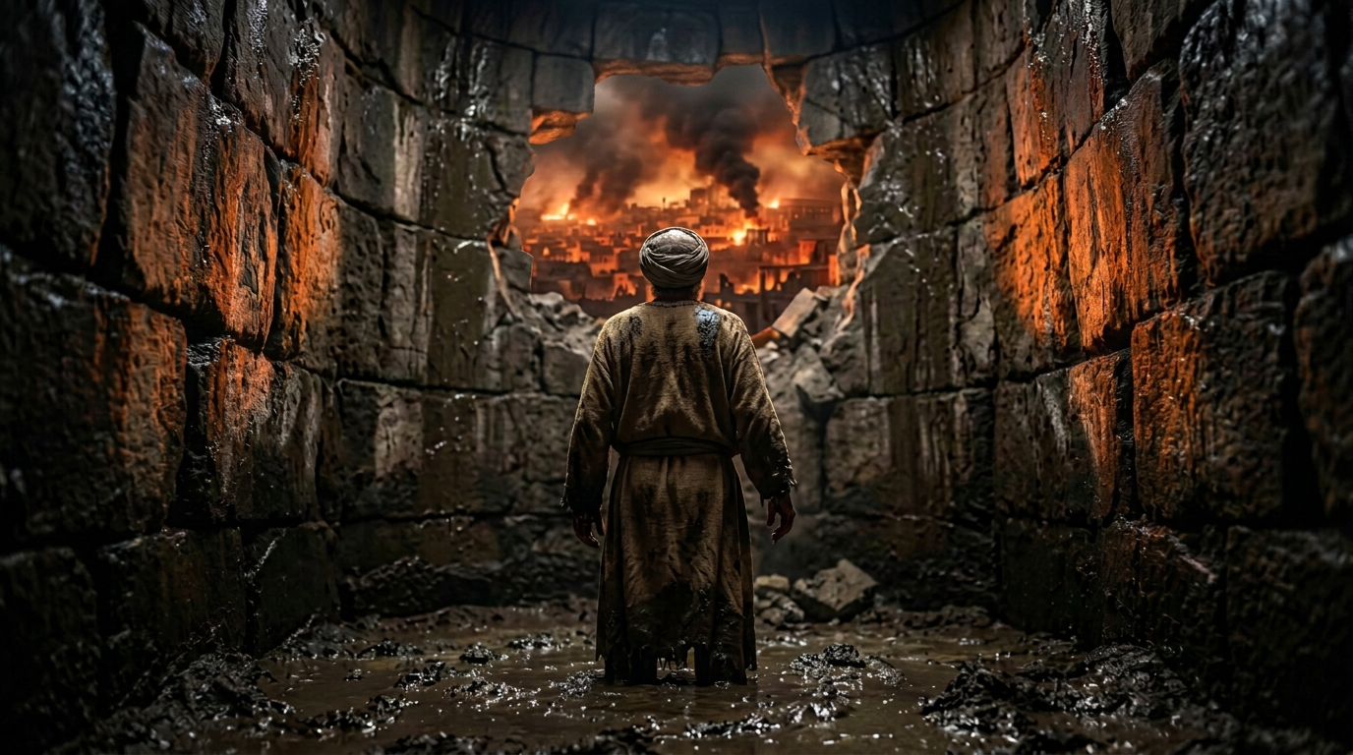
Jeremiah Was a Failure by the World’s Standards

Slide 18
If the People Listened
Turn, O backsliding children, saith the LORD; for I am married unto you: and I will take you one of a city, and two of a family, and I will bring you to Zion: And I will give you pastors according to mine heart, which shall feed you with knowledge and understanding… At that time they shall call Jerusalem the throne of the LORD; and all the nations shall be gathered unto it, to the name of the LORD, to Jerusalem: neither shall they walk any more after the imagination of their evil heart. In those days the house of Judah shall walk with the house of Israel, and they shall come together out of the land of the north to the land that I have given for an inheritance unto your fathers (Jer 3:14–15, 17-18).

Slide 19
It Was Too Late
Therefore pray not thou for this people, neither lift up cry nor prayer for them, neither make intercession to me: for I will not hear thee. Seest thou not what they do in the cities of Judah and in the streets of Jerusalem? The children gather wood, and the fathers kindle the fire, and the women knead their dough, to make cakes to the queen of heaven, and to pour out drink offerings unto other gods, that they may provoke me to anger (Jer 7:16–18).

Slide 20
Jerusalem Falls While Jeremiah is Saved
And the Chaldeans burned the king’s house, and the houses of the people, with fire, and brake down the walls of Jerusalem. Then Nebuzar-adan the captain of the guard carried away captive into Babylon the remnant of the people that remained in the city, and those that fell away, that fell to him, with the rest of the people that remained…
Now Nebuchadrezzar king of Babylon gave charge concerning Jeremiah to Nebuzar-adan the captain of the guard, saying, Take him, and look well to him, and do him no harm; but do unto him even as he shall say unto thee (Jer 39:8–9, 11-12).

Slide 21
Goal
Everyone of God’s people should be terrified and emboldened
For these Three Reasons

Slide 22
Reasons
Jeremiah was reluctant to answer God’s call
Jeremiah suffered for obeying God
Jeremiah was a failure by the world’s standards

