Slide 1
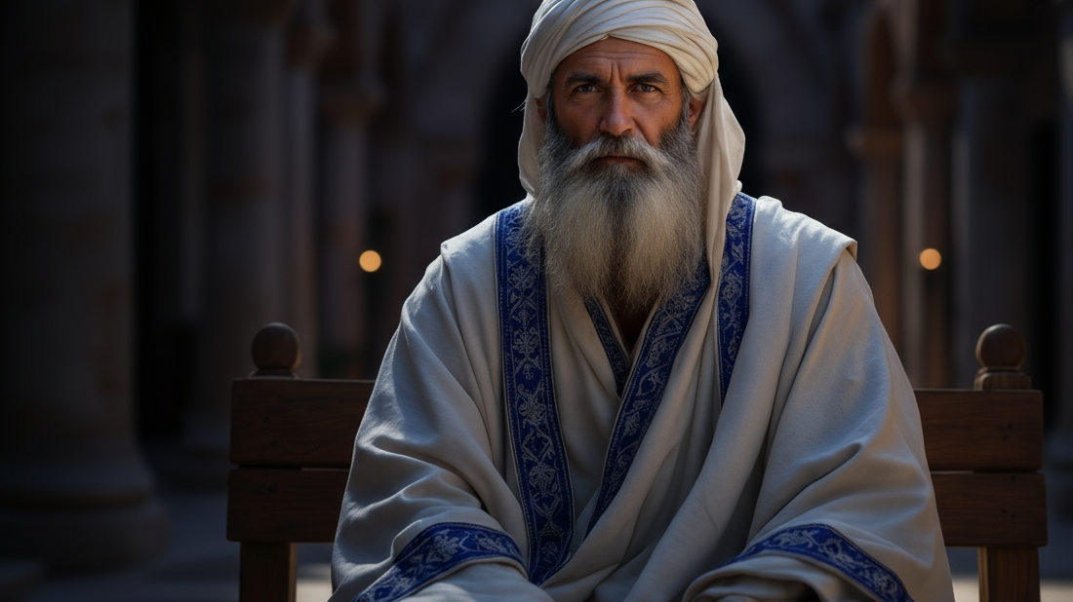
Intentions that Led to Murder
By Joseph Peters

Slide 2

Goal
Every Christian should be careful not to justify wickedness with good intentions
For these three reasons

Slide 3
Reasons
The Religious Leaders Thought They Had Good Reasons
The Religious Leaders Wanted to Kill Jesus (and Lazurus)
The Religious Leaders Broke the Rules

Slide 4
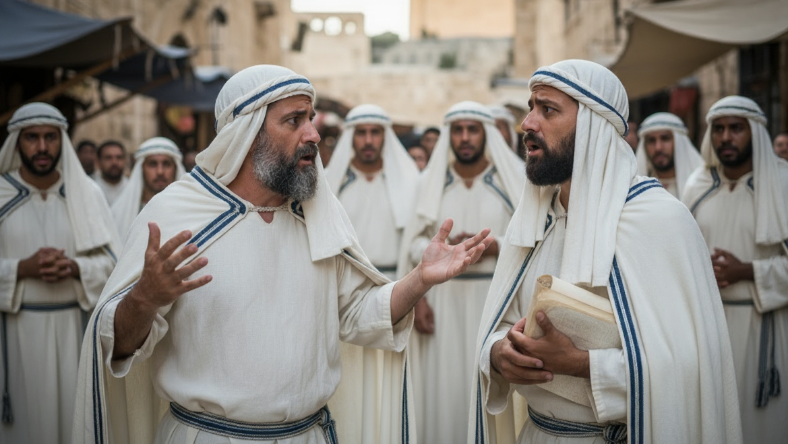
The Religious Leaders Thought They Had Good Reasons

Slide 5
Their Roles Were In Jeopardy
Then many of the Jews which came to Mary, and had seen the things which Jesus did, believed on him. But some of them went their ways to the Pharisees, and told them what things Jesus had done. Then gathered the chief priests and the Pharisees a council, and said, What do we? for this man doeth many miracles. If we let him thus alone, all men will believe on him: and the Romans shall come and take away both our place and nation (John 11:45–48).

Slide 6
The Utilitarian Conviction
And one of them, named Caiaphas, being the high priest that same year, said unto them, Ye know nothing at all, Nor consider that it is expedient for us, that one man should die for the people, and that the whole nation perish not. And this spake he not of himself: but being high priest that year, he prophesied that Jesus should die for that nation; And not for that nation only, but that also he should gather together in one the children of God that were scattered abroad (John 11:49–52).

Slide 7
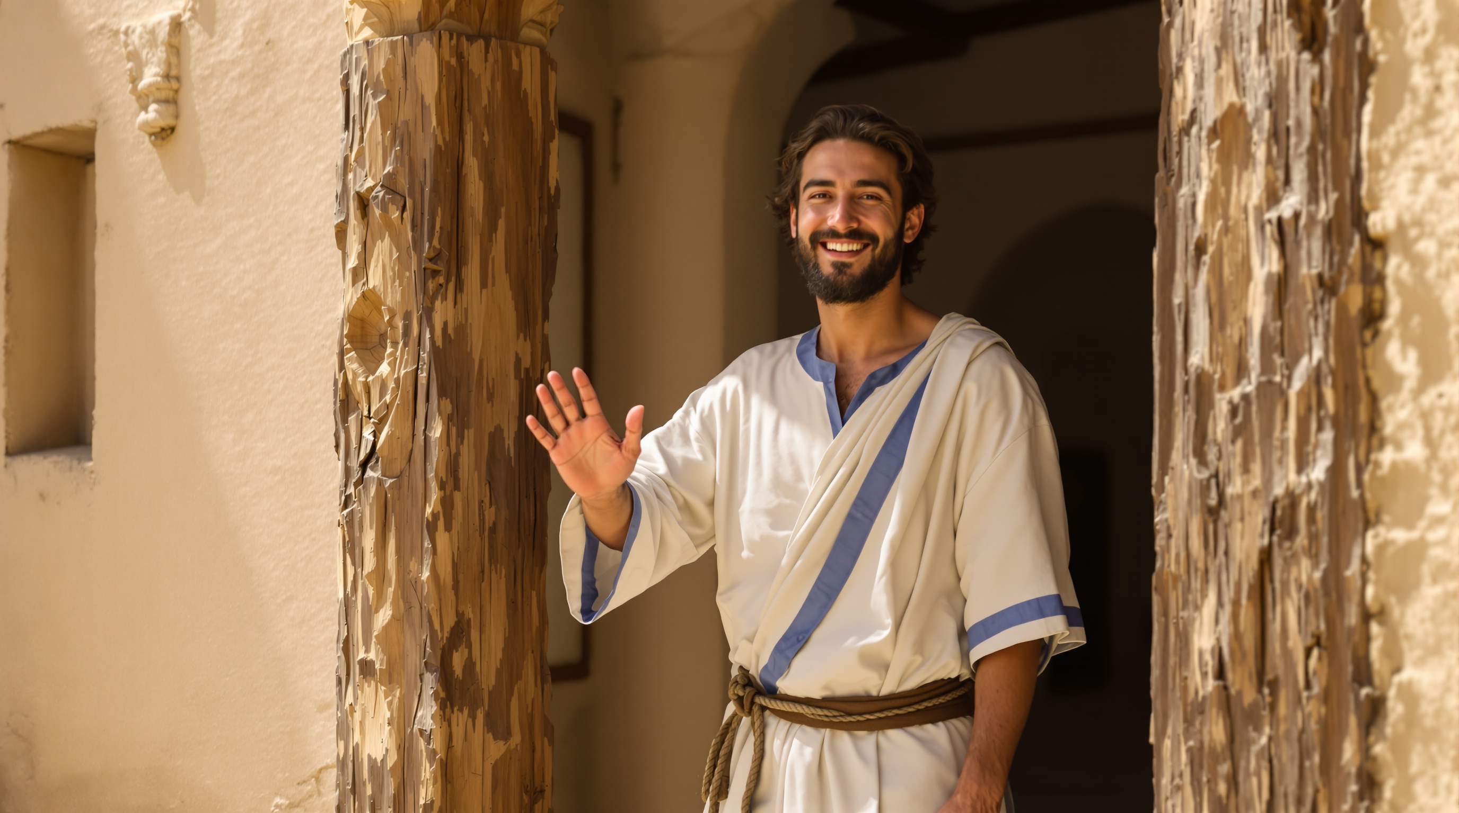
The Religious Leaders Wanted to Kill Jesus (and Lazurus)

Slide 8
Jesus Knew What Was Coming
And it came to pass, when Jesus had finished all these sayings, he said unto his disciples, Ye know that after two days is the feast of the passover, and the Son of man is betrayed to be crucified. Then assembled together the chief priests, and the scribes, and the elders of the people, unto the palace of the high priest, who was called Caiaphas, And consulted that they might take Jesus by subtilty, and kill him. But they said, Not on the feast day, lest there be an uproar among the people (Matt 26:1–5).
Then from that day forth they took counsel together for to put him to death (John 11:53)…

Slide 9
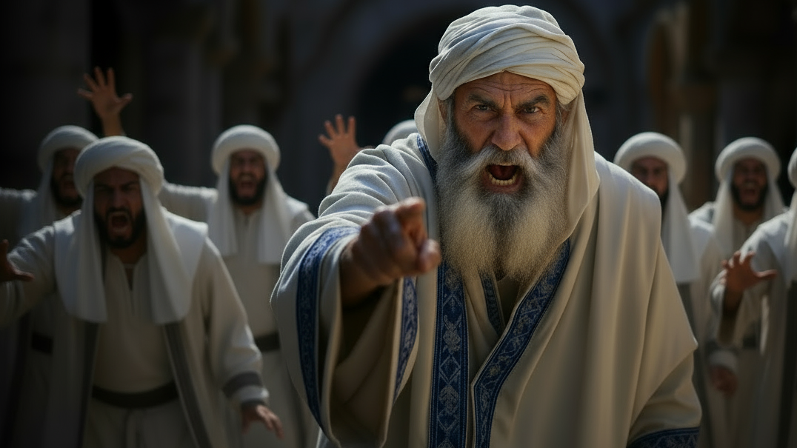
The Religious Leaders Broke the Rules

Slide 10
Led Him To Annas’ House
…Then Simon Peter having a sword drew it, and smote the high priest’s servant, and cut off his right ear. The servant’s name was Malchus. Then said Jesus unto Peter, Put up thy sword into the sheath: the cup which my Father hath given me, shall I not drink it?
Then the band and the captain and officers of the Jews took Jesus, and bound him, And led him away to Annas first; for he was father in law to Caiaphas, which was the high priest that same year. Now Caiaphas was he, which gave counsel to the Jews, that it was expedient that one man should die for the people (John 18:10–14)

Slide 11
Punishment Before Judgment
And when he had thus spoken, one of the officers which stood by struck Jesus with the palm of his hand, saying, Answerest thou the high priest so? Jesus answered him, If I have spoken evil, bear witness of the evil: but if well, why smitest thou me? Now Annas had sent him bound unto Caiaphas the high priest (John 18:22–24,)

Slide 12
More Punishment Before Judgment
And the men that held Jesus mocked him, and smote him. And when they had blindfolded him, they struck him on the face, and asked him, saying, Prophesy, who is it that smote thee? And many other things blasphemously spake they against him. And as soon as it was day, the elders of the people and the chief priests and the scribes came together, and led him into their council, saying… (Luke 22:63–67).

Slide 13
No Evidence Was Found
And the chief priests and all the council sought for witness against Jesus to put him to death; and found none. For many bare false witness against him, but their witness agreed not together. And there arose certain, and bare false witness against him, saying, We heard him say, I will destroy this temple that is made with hands, and within three days I will build another made without hands. But neither so did their witness agree together (Mark 14:55–59).

Slide 14
They Justified Their Judgment
But he held his peace, and answered nothing. Again the high priest asked him, and said unto him, Art thou the Christ, the Son of the Blessed? And Jesus said, I am: and ye shall see the Son of man sitting on the right hand of power, and coming in the clouds of heaven. Then the high priest rent his clothes, and saith, What need we any further witnesses? Ye have heard the blasphemy: what think ye? And they all condemned him to be guilty of death. And some began to spit on him, and to cover his face, and to buffet him, and to say unto him, Prophesy: and the servants did strike him with the palms of their hands (Mark 14:61–65).

Slide 15
They Were Hypocrites.
Then led they Jesus from Caiaphas unto the hall of judgment: and it was early; and they themselves went not into the judgment hall, lest they should be defiled; but that they might eat the Passover (John 18:28)

Slide 16
Conclusion
Every Christian should be careful not to justify wickedness with good intentions
For these three reasons

Slide 17
Reasons
The Religious Leaders Thought They Had Good Reasons
The Religious Leaders Wanted to Kill Jesus (and Lazurus)
The Religious Leaders Broke the Rules

