Slide 1
Dt. 8:2 “Thou shalt remember all the way which the LORD thy God led thee.”
Reflection and Direction

Slide 2
We closed 2023 by reflecting on Deut. 6 and remembering:
1) That we should “keep” God’s Commandments.
Deut. 6:1-2 “these are the commandments…which the LORD your God commanded to teach you,
that ye might do them …
That thou mightest fear the LORD thy God,
to keep all his commandments, …all the days of thy life;
“Keep”: shamar: guard, have charge of,
Treasure!

Slide 3
2) Why we should keep God’s commands
Deut. 6 “Keeping” God’s Laws Produces:
A Full life 6:2 “that thy days may be prolonged”
A Fulfilling life v 3 “that it may be well with thee”
A Fruitful life v 3“that ye may increase mightily”
Dt 10:13 “… keep the commandments of the LORD,
…for thy good!”
See Psalm 1
(ṭôḇ: prosperity)

Slide 4
3) How we should keep God’s commands. With:
Fear (Dread/reverence) This Guards us! Dt 6:2
Pr 9:13 “The fear of the LORD is to hate evil: pride, and arrogancy, the evil way, and the froward mouth, do I hate.”
Faithfulness (Dedication) This Guides us! Dt 6:2-9
Vs 8 “bind them for a sign upon thine hand,
And they shall be as frontlets between thine eyes”
Fidelity (Devotion) This Grows us! Dt 6:4,5
“Love the LORD thy God with all….”

Slide 5
Last week we learned that Failure to “keep” them, (ignorantly/indifferently) results in us being incomplete, ill equipped, and ineffective!
2 Tim. 3:16,17 “All scripture is given by inspiration of God and is profitable for doctrine, reproof, correction, instruction in righteousness
That the man of God may be perfect, (complete)
thoroughly furnished (equipped)
unto all good (useful/beneficial) works.”

Slide 6
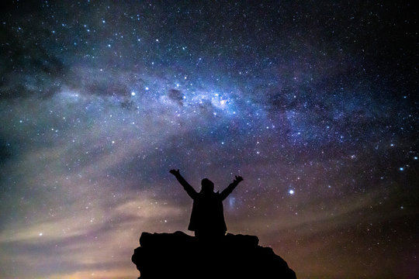
1 “The heavens declare the glory of God;
and the firmament sheweth his handywork.
2 Day unto day uttereth speech,
and night unto night sheweth knowledge.
3 There is no speech nor language,
where their voice is not heard.”
That means no one is totally ignorant!
Romans 1:18-20
Ps 19 records of how God has revealed himself: Through His Creation vs 1-6

Slide 7
God reveals himself Through His Word. Vs 7-11
7 “The law of the LORD is perfect, (tāmîm: complete)
converting (šûḇ: restoring) the soul:
the testimony (ēḏûṯ: witness) of the LORD is sure,
('āman’: faithful) making wise the simple.
8 The statutes of the LORD are right, (yāšār: straight)
rejoicing the heart:
the commandment of the LORD is pure, (bar: clear)
enlightening the eyes.

Slide 8
God reveals himself Through His Word. Vs 9-11
9 “The fear of the LORD is clean, (ṭâôr: untainted) enduring for ever:
the judgments of the LORD are true
and righteous altogether.
10 More to be desired are they than gold…:
sweeter also than honey and the honeycomb.
11 …by them is thy servant warned: (zāhar’: admonished)
and in keeping of them there is great reward”
(rab: multitudes) (ʿēqeḇ: compensation)

Slide 9
Since keeping God’s word results in such “Great Rewards” (2 Pt 1:4)…
What keeps us from
“Keeping” God’s Word?
shamar: to guard, have charge of,
To value, Treasure!

Slide 10
1. Ignorance: We don’t know! {Understand}
This leaves us vulnerable:
A. To Deception 2 Cor 4:3,4 “if our gospel be hid,
it is hid to them that are lost: (apollymi: destroyed)
In whom the god of this world hath blinded (typhloo: to obscure, blunt) the minds (noema: perception, purpose)
of them which believe not, (apistos: faithless {Jn 3:18})
lest the light of the glorious gospel of Christ,
who is the image of God, should shine unto them.”

Slide 11
Ignorance leaves us vulnerable:
A. To Deception
1) Deception is related to Drifting. Mt 22:29
“Ye do err, (planaō: to drift, deceive)
not knowing the scriptures”
The “god of this world”, (2 Cor 4:4) uses the current (and cares) of this world to pull us from God!
(Mk 4:19; Mt 13:22; 2 Tim. 4:10; 1 Jn 2:15,16)
“Slow drift” (compromise) is most effective!

Slide 12
1. Ignorance: Leaves us vulnerable:
A. To Deception/Drifting.
Where is this current going to take you?
B. To Destruction. Pr 14:12; 16:25; Mt 7:13
“Enter ye in at the strait gate: for wide is the gate,
and broad is the way,
(apō’leia: perdition 8x, destruction 5x, Waste! 2x)
and many there be which go in thereat:”
that leadeth to destruction,

Slide 13
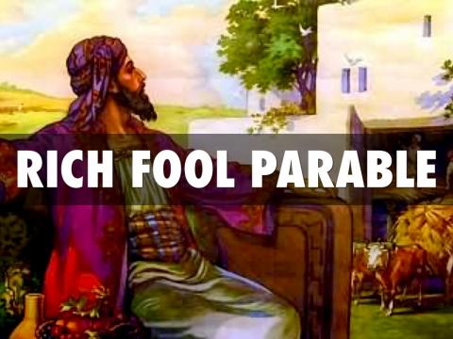
B. Drifting usually leads to Destruction.
1) Of our eternal soul! Lk 12:16-21
19 “I will say to my soul…take thine ease…
20 but God said unto him thou fool!
This night shall thy soul be required of thee…
21 So is he that layeth up treasure for himself
And is not rich toward God!”

Slide 14
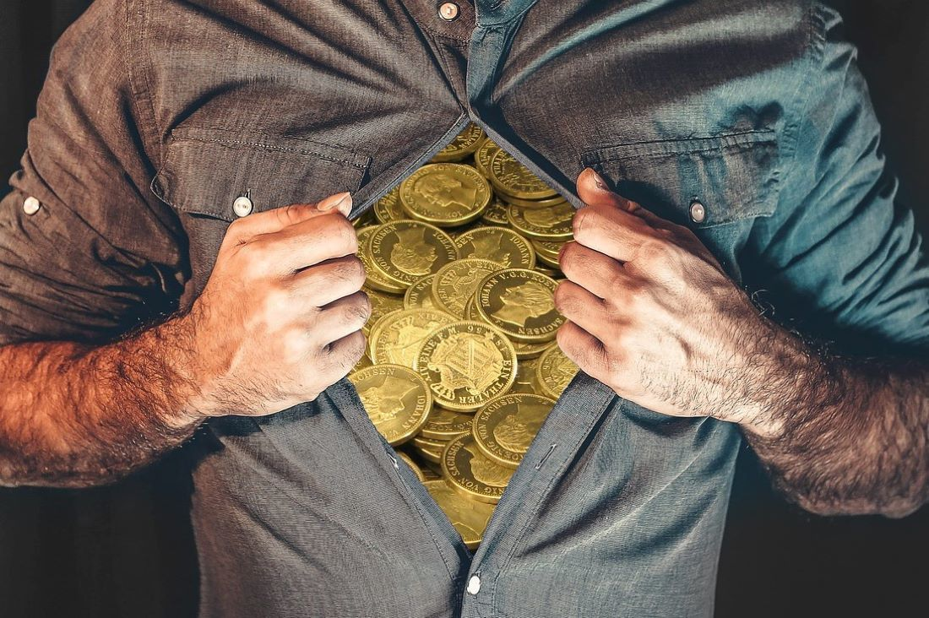
1) Destruction of our eternal soul. Mark 8:36
“For what shall it profit a man,
if he shall gain the whole world,
and lose his own soul?
37 Or what shall
a man give
in exchange
for his soul?”

Slide 15
B. Deception leads to destruction!
2 Thes. 1:7-9 “when the Lord Jesus shall be revealed from heaven with his mighty angels,
In flaming fire taking vengeance on them
that know (eido: perceive, pay attention) not God,
that obey not the gospel of our Lord Jesus Christ:
Who shall be punished with everlasting destruction from the presence of the Lord, (Mt 7:33)
and from the glory of his power;” (Rev 20:15)

Slide 16
B. Deception leads to destruction!
2) Of our Eternal Rewards. Eph. 4:17,18
“This I say therefore, and testify in the Lord,
that ye henceforth walk not as other Gentiles walk, in the vanity of their mind,
Having the understanding darkened,
being alienated from the life of God
through the ignorance that is in them,
because of the blindness of their heart:

Slide 17
B. Deception leads to destruction!
2) Of our eternal Rewards. Eph. 4:20-24
“But ye have not so learned (manthano: understood) Christ; If so be that ye have heard (akouo: considered) him, and have been taught by him, as the truth is in Jesus:
That ye put off concerning the former conversation …, which is corrupt according to the deceitful lusts;
And be renewed in the spirit of your mind; (Ro. 12:2)
And that ye put on the new man, which after God
is created in righteousness and true holiness.”

Slide 18
B. Deception leads to destruction!
2) Of our eternal Rewards. Phil. 3:18,19
“For many walk, of whom I have told you often,
and now tell you even weeping,
that they are the enemies of the cross of Christ:
Whose end is destruction, (apōleia: waste) whose God is their belly, and whose glory is in their shame,
who mind (phroneo: focus, regard) earthly things.”
a) Satanic deception and self preservation tend to shift our priorities (focus) from Heaven to Earth.

Slide 19
As darkness is dissolved by light,
Ignorance is dissolved by God’s Truth!
While Satan “blinds the minds” (2 Cor 4:4)
6 “God, who commanded the light to shine out of darkness, hath shined in our hearts,
to give the light of the knowledge
of the glory of God in the face of Jesus Christ.
7 but we have this treasure in earthen vessels that the excellency of the power may be of God”

Slide 20
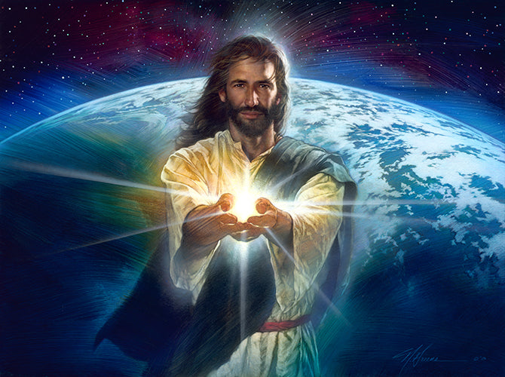
Light (truth) received brings more light!
John 8:12 “I am the light of the world:
he that followeth me shall not walk in darkness, (scotia: obscurity,
ignorance, shadow)
but shall have
the light of life.”

Slide 21
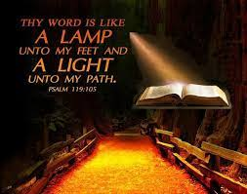
Light received brings more light. Ps 119:130
“The entrance of thy words giveth light;
it gives understanding (bîn: discernment) unto the simple.”
(‘ôr: clarity)

Slide 22
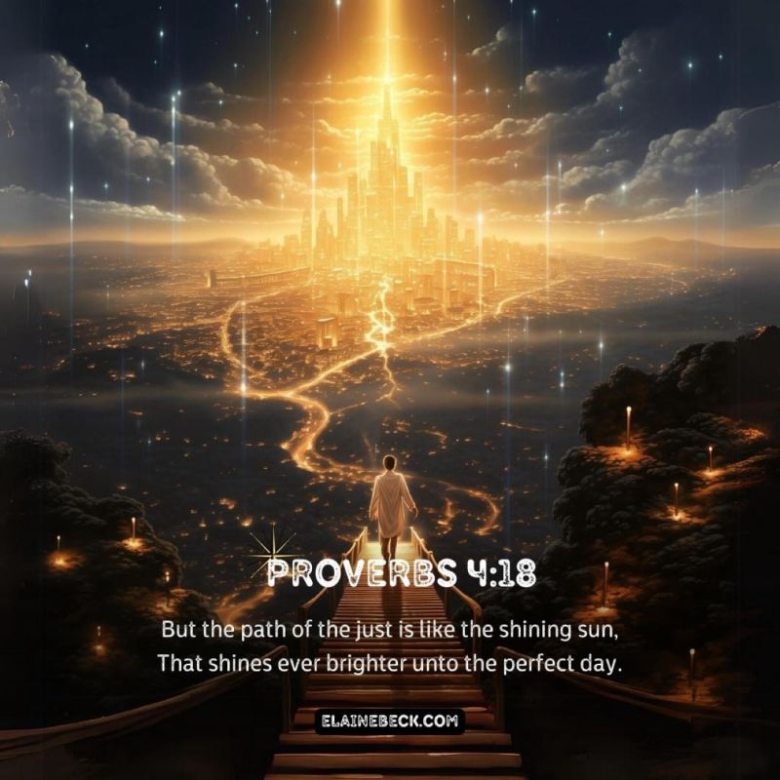
Light received brings more light.

Slide 23
Light Received brings more light.
Jms 1:18-20 18 “Do not err, (drift, be deceived)
my beloved brethren.
19 Every good gift and every perfect gift is from above, and cometh down
from the Father of lights…,
20 Of his own will begat he us with
the word of truth,
that we should be ...firstfruits of his creatures.

Slide 24
We must make room for God’s Truths!
Jms 1:21 “Wherefore lay apart all filthiness
and superfluity of naughtiness,
and receive with meekness the engrafted word,
(Em’phytos: implanted)
which is able to save your souls.”
What are you doing to make room to “receive” (engraft) God’s Truth
into your heart and life?

Slide 25
Information without application produces self Deception!
James 1:22 “But be ye doers of the word,
and not hearers only,
deceiving your own selves.”
What are you doing with the truths of God’s word? Ps. 119:9-11

Slide 26
James 1:25 “But whoso looketh into the perfect law of liberty, and continueth therein, (parameno: abides Jn 15)
he being not a forgetful hearer,
but a doer of the work,
this man shall be blessed in his deed.”
Markarios: supremely fortunate
(See Psalm 1)

Slide 27
Do you want to prosper in 2024
Make much of God’s Word,
And it (He) will make much of you!
“More to be desired are they than gold…: sweeter also than honey and the honeycomb.
Moreover by them is thy servant warned:
and in keeping of them there is great reward.”
Psalm 19:10,11

Slide 28
Ps 19:1-6 “The heavens declare the glory of God;
and the firmament sheweth his handywork.
2 Day unto day uttereth speech,
and night unto night sheweth knowledge.
3 There is no speech nor language,
where their voice is not heard.”
Responding to what God has revealed,
Brings more revelation. Vs 7-11
Light received brings more light!

Slide 29
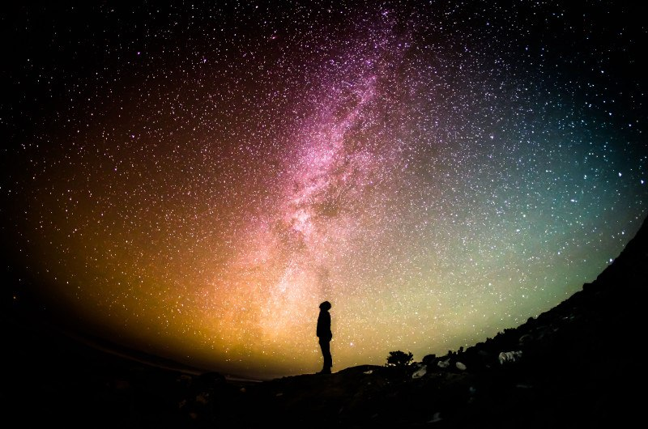
Light rejected (neglected) brings Darkness!
Ro 1:18-19 “For the wrath of God is revealed from heaven against all ungodliness and unrighteousness of men, who hold the truth in unrighteousness;
For the invisible things of him from the creation of the world are clearly seen, being understood by the things that are made, even his eternal power and Godhead;
so that they are without excuse:

Slide 30
²¹ Because when they knew God, they glorified him not as God, …but became vain in their imaginations,
and their foolish heart was darkened. (2 Cor 4:4)
²² Professing themselves to be wise, they became fools,
²⁵ Who changed the truth of God into a lie, & worshipped and served the creature more than the Creator,”
What are you doing with what God has revealed?
Who are you really worshipping and serving?

