Slide 1
Eph 6:10-18; 2 Cor 10:3-5; 2 Cor 2:11
“Lest Satan should get an advantage of us: for we are not ignorant of his devices.”

Slide 2
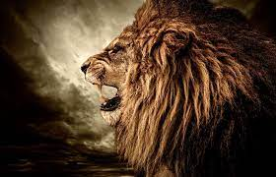
There’s invisible war being waged for the hearts and souls of humanity.
The Bible repeatedly warns us about the nature of this conflict,
as well as the Powers and personalities
behind this struggle.
1 Pt 5:8,9

Slide 4
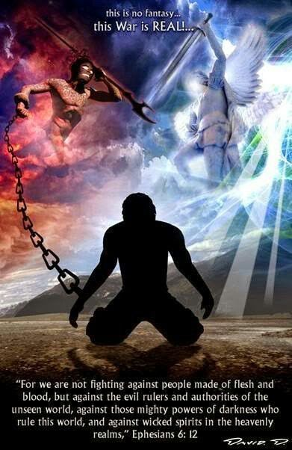
How to avoid becoming a casualty of spiritual warfare
1 Tim. 1:18
“This Charge Commit I unto thee…
That thou mayest war
a good warfare.”

Slide 5
Please Consider:
god’s commandment. 1 Tim 1:5
“the end (telos: goal) of the commandment (entole: authoritative prescription) is:
A. Charity (agape: loving benevolence)
1) This is a byproduct of our relationship with God.
Gal. 5:22 “The Fruit of the Spirit is love…”
Eph. 5:1,2 “Be ye therefore followers of God
as dear children,
and walk in love as Christ hath loved us..”

Slide 6
“the end (telos: goal) of the commandment is:
A. Charity (agape: loving benevolence)
2) This is an evidence of our relationship with God.
1 Jn 4:7-8 “Beloved, let us love one another: for love is of God; and every one that loveth is born of God, and knoweth God. 8 He that loveth not knoweth not God; for God is love.”
13 Hereby know we that we dwell in him, and he in us, because he hath given us of his Spirit.”
Jn 13:35 “By this shall all men know that ye are my
disciples,
if ye have love one to another.”

Slide 7
“The End of the commandment is Charity
3) “out of a pure (katharos: clean, purged)
heart, (kardia: mind, feelings)
1 Jn 4:16-17 “we have known and believed the love that God hath to us. God is love; and he that dwelleth in love dwelleth in God, and God in him.
Herein is our love made perfect, that we may have boldness in the day of judgment:
because as he is, so are we in this world.”
(See also 1 Jn 2:28-3:3)

Slide 8
1 Tim 1:5 “the end of the commandment is:
A. Charity out of a pure heart,
B. and of a good (agathos: effective, beneficial)
conscience, (synei’dēsis: co-perception)
1) What makes a conscience “good” (useful?)
a) How does a conscience become bad/useless?
1 Tim 4:2 “Speaking lies in hypocrisy;
having their conscience seared with a hot iron;”
b) What’s the effect of a “bad” (ineffective) conscience?
Ro 1:28 “as they did not like to retain God in their knowledge, God gave them over to a reprobate (adokimos) mind,”

Slide 9
2 Pt 3:5 “For this they willingly are ignorant of”
Evolutionist George Wald (a Harvard University biochemist and Nobel Laureate), wrote,
"When it comes to the Origin of Life there are only two possibilities:
creation or spontaneous generation.
There is no third way.
Spontaneous generation (Big Bang)
was disproved one hundred years ago!”

Slide 10
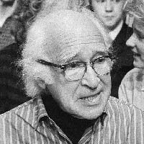
“that leads us to only one other conclusion,
that of supernatural creation.
We cannot accept that on philosophical grounds;
therefore, we choose to believe the impossible:
that life arose spontaneously by chance!"
("The Origin of Life," Scientific American, 191:48, May 1954).

Slide 11
“I don’t want to believe in God!
Therefore I choose to believe in that which I know is scientifically impossible,
Spontaneous generation
leading to evolution.”
“Frontiers of Modern Biology to Theories of Origin of Life” (Ney York: Houghton Mifflin, 1972 P. 187)

Slide 12
B. and of a good (agathos: effective, beneficial)
conscience, (synei’dēsis: co-perception)
2) What does God mean by “co-perception”?
a) Someone/thing will influence our perception!
Pr 20:27 “The spirit of man is the candle of the LORD,
searching all the inward parts …”
Ps 36:9 “For with thee is the fountain of life:
in thy light shall we see light.”
Ps 119:105 “Thy word is a lamp unto my feet,
and a light unto my path.”

Slide 13
1 Tim 1:5 …and of a good conscience,
2) What does God mean by “co-perception”?
a) Someone/thing will influence our perception!
b) Satan seeks to obscure our perception!
2 Cor 4:4 “the god of this world blindeth
(typhlo’ō: obscures/dims)
the minds…” (noema: perception, purpose)
Consider what Jesus said about Satan
and those he influences!

Slide 14
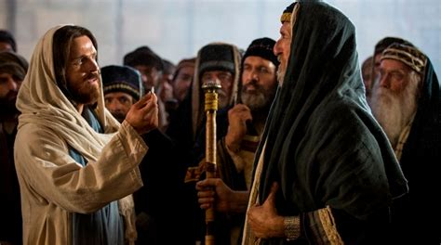
Jn 8:44 “Ye are of your father the Devil, and the lusts of your Father ye will do. He was a murderer from the beginning, and abode not in the truth, because there is no truth in him. When he speaketh a lie,
he speaketh of his own: for he is a liar,
and the father of it.
45 And because I tell you the truth,
ye believe me not.”

Slide 15
god’s commandment. 1 Tim 1:5
“the end of the commandment is:
A. Charity out of a pure heart,
B. and of a good conscience, (beneficial co-perception)
C. and of faith (pistis: persuasion, conviction, trust)
(from peitho: to assent, agree, and commit to)
unfeigned:” (anypok’ritos: sincere, genuine)

Slide 16
“The end of the commandment is…Faith unfeigned”
1) Unfeigned (sincere) Faith involves a conviction:
a) That something/someone is true (Jn 14:6; Ps 119:160)
b) And an agreement/commitment to cooperate
(partner) with it/Him!
Heb 11:6 “without faith it is impossible to please him: for he that cometh to God must believe that he is,
and that he is a rewarder of them
that diligently seek him.”

Slide 17
God’s Commandment 1 Tim 1:5
2. god’s charge. 1 Tim 1:18
What? “This charge I commit”
1) “Charge” (parangeli’a: to transmit orders
{from a superior officer})
from para (near)
and angelo (angel, messenger)

Slide 18
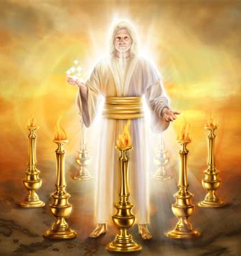
Rev 2:1,2 “Unto the angel of the church of Ephesus write;
These things saith he that holdeth the seven stars in his right hand,
who walketh in the midst of the seven golden candlesticks;
I know thy works…”
Rev 1:20
Notes:
Rev 1:202:1,2

Slide 19
What? “This charge I commit”
1) “Charge” (parangeli’a: to transmit orders)
a) Who were these orders ultimately from?
General Jesus!
1 Cor 11:23 “for I have received of the Lord
that which I also delivered unto you.”
Mt 11:18-20 “All power is given unto me in heaven and earth
…Go ye therefore and teach…baptize, disciple”
2) “I commit” (paratith’ēmi: to deposit beside/near)
as a sacred trust!

Slide 20
2. god’s charge. 1 Tim 1:18
What? “This charge I commit”
B. Who? “unto thee, …”
1) Paul was the original messenger,
Timothy was the original recipient;
but We are the ultimate recipient! (2 Tim. 3:16,17)
2) Once delivered, who was/is responsible for it?
3) This is the consistent pattern of scripture!
(See Heb. 13:17)

Slide 21
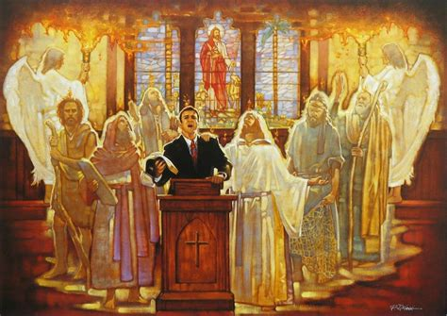
1 Tim 1:18 “This charge I commit I commit unto thee”
Who’s God’s messenger this morning?
Who’s responsible for receiving and responding to
(acting on)
the message?

Slide 22
2. god’s charge. 1 Tim 1:18
What? “This charge I commit”
B. Who? “I commit unto thee, …”
C. Why? “that thou by them mightest war
a good (kalos: virtuous, valuable, worthy) Warfare” (stratei’a: to contend {in military service})
Jude 3 “it was needful to write…and exhort you that ye should earnestly contend for the faith…”
Epagōniz’omai: fight for, struggle

Slide 23
1 Tim 1:18 “This charge I commit unto thee,
that thou …mightest war a good Warfare”
D. How? 1 Timothy 1:19-20
1) “Holding faith, (conviction of God’s truth)
2) and a good conscience; (clear co-perception)
which some having put away concerning faith
Of whom is Hymenaeus and Alexander;
whom I have delivered unto Satan,
that they may learn not to blaspheme.”
have made shipwreck: (nauageō: Stranded)

Slide 24
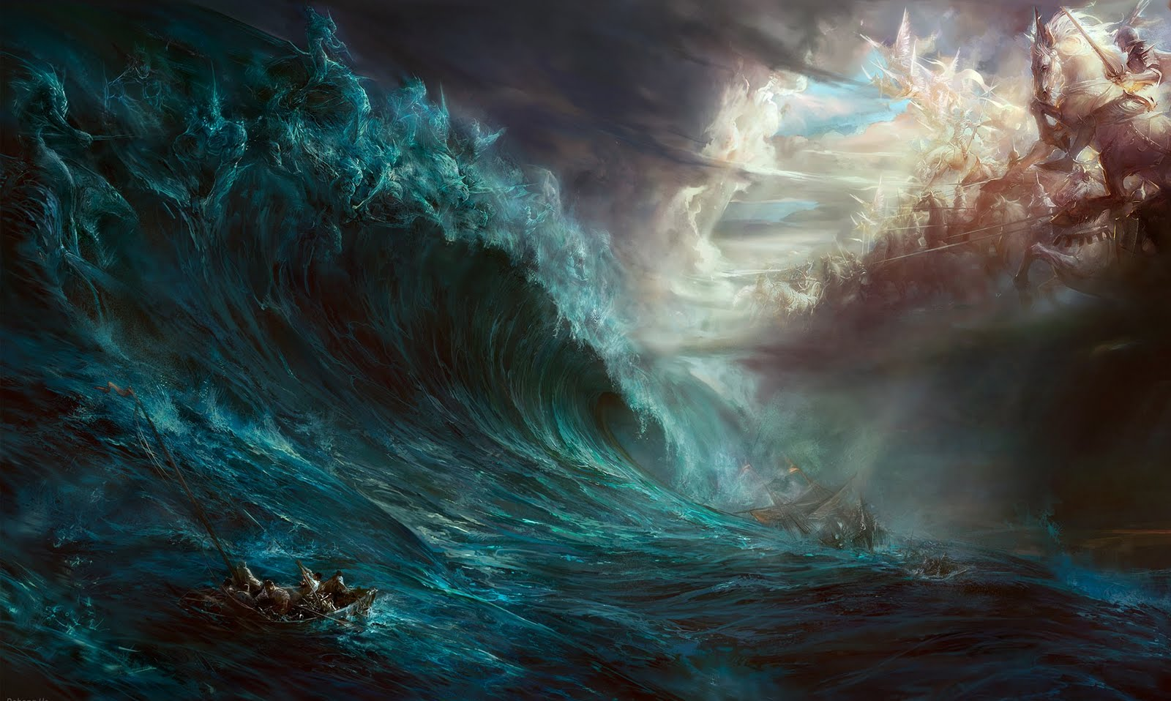
In this age-old conflict,
there’s no neutral ground!
Mt 12:30 “He that is not with me
is against me!”

Slide 25
Both “sides” (Jesus and Satan) are
at work in the midst of the storms of life.
If we’re not firmly anchored to Christ:
“Holding faith” (Heb. 8:17-19)

Slide 26
We can end up ”shipwrecked!”
1Tim. 1:18-20 “This charge I commit unto thee…
that thou mayest war a good warfare,
Holding faith and a good conscience.
Which some having put away concerning faith,
have made shipwreck:
of whom are Hymenaeus and Alexander;

Slide 27
20 “whom I have delivered unto Satan,
that they may learn
not to blaspheme.”

Slide 28
“some…have made shipwreck”
Or Worse!
Notice which side they’re rowing toward!

Slide 29
The Poison of Partnering with Satan!!
2 Tim 2:17 “And their word will eat as doth a canker: (gangrene)
of whom is Hymen’aeus…;
18 Who concerning the truth have erred, …
and overthrow the faith of some.”

Slide 30
Jesus often spoke of this cosmic conflict and the choices before us, and warned:
“The thief cometh not but for to steal,
to kill, and to destroy:
I am come that they might have life,
and have it more abundantly.” Jn 10:10
Our choices place us in of Partnership with either this thief or the Shepherd.

Slide 32
Which side are you “pulling” for/toward?

