Slide 1
Do you ever wonder what makes stars “Twinkle”?
Hubble was launch in 1990 in order to get a clearer view of the universe without the interference of Earth’s “Atmosphere”

Slide 2
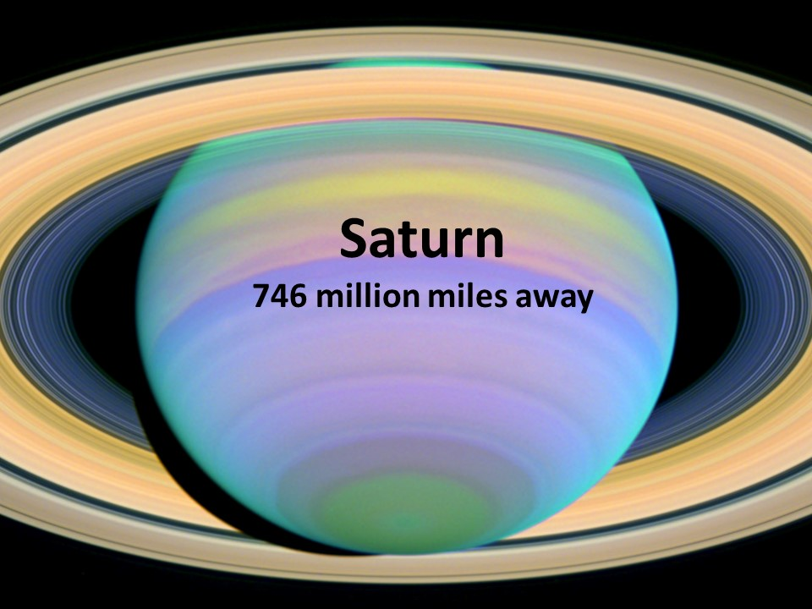
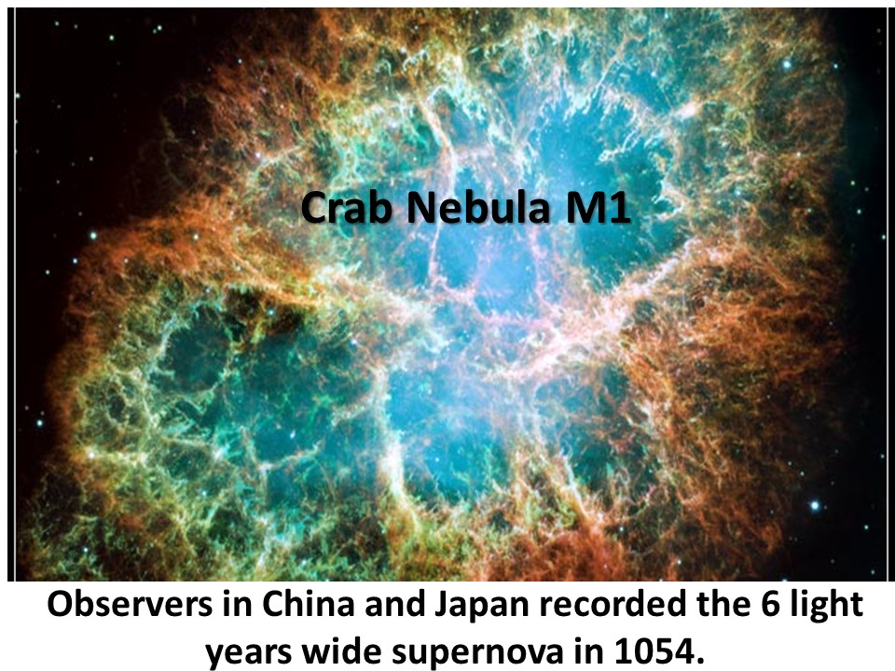
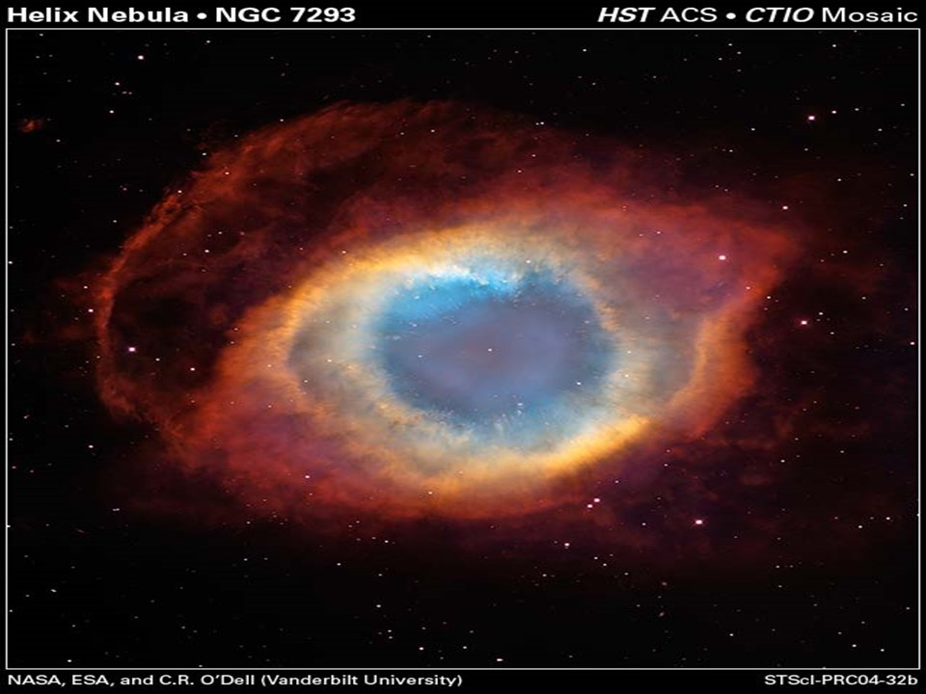

Slide 3
In order to clearly see the value of Investing in “The Kingdom of Heaven”
We also need to get above the “interference” of the Earth’s “atmosphere”.

Slide 4
After refusing Satan’s offer of “all the kingdoms of the world”
Jesus first message was:
“Repent:
for the kingdom of heaven is at hand.”
Matthew 4:8-10,17
met-an-o-eh'-o:
to think differently

Slide 5
“Repent for the Kingdom of Heaven is at hand.” Mt. 4:17
The People of Jesus’ day were so preoccupied with the “Kingdoms of this World” that they needed to “repent”
Before they could really “recognize”
the Kingdom of Heaven!
So do We!

Slide 6
“Keys” of the Kingdom of Heaven. Mt 16:19
What we believe (Faith) determines Where we’ll spend eternity.
(Our Destination!)
How we behave (Works) determines How we’ll spend eternity.
(Our Compensation)

Slide 7
These Keys in Ephesians 2:8-10
“By grace are ye saved through faith;
and that not of yourselves:
it is the gift of God:
Not of works, lest any man should boast.
For we are his workmanship, created in Christ Jesus unto good works,
which God hath before ordained
that we should walk in them.”

Slide 8
Contrast the Keys of Faith and Works
Category | Key of Belief (Faith) Eph.2:8,9 | Key of Behavior (Works) Eph. 2:10
What I do
What I received
Who does the Work
The Basis
The Result
I “believe” (trust) Christ
I Serve Christ
Forgiveness, Eternal Life
Blessings,
Eternal Rewards
Christ died
for me.
I live for Him
My Faith in Christ
My Works for Christ
Eternal Salvation
Eternal Compensation

Slide 9
Rewards In Heaven
Many think Heaven will be the same for every believer.
IT WILL NOT!

Slide 10
Principles of the Harvest.
“Be not deceived; God is not mocked:
for whatsoever a man soweth,
that shall he also reap.
For he that soweth to his flesh shall of the flesh reap corruption;
but he that soweth to the Spirit shall of the Spirit reap life everlasting.”
Galatians 6:7-8

Slide 11
Harvest Principles. Gal. 6:7,9
1. The Principle of Preparation.
A. You must prepare the soil.
Parable of the sower and seeds. Mt. 13:1-9
1) Unprepared soil hinders the plant.
2) Only “weeds” grow “naturally”.
3) The only difference between the types
of soil is the amount of preparation!
Nothing Ventured; Nothing __________!
Many expect to receive the “fruit” (Reward) without any real “effort”.

Slide 12
1 Cor 9:24-25 “Know ye not that they which run
in a race run all, but one receives the prize?
So run, that ye may obtain.
And every man that strives for the mastery is temperate (disciplined) in all things.
Now they do it to obtain a corruptible crown;
but we an incorruptible.” (Immortal)

Slide 13
2 Tim 2:3-6 “Thou therefore endure hardness,
as a good soldier of Jesus Christ.
⁴ No man that warreth entangleth himself with the affairs of this life; that he may please him who hath chosen him to be a soldier.
⁵ And if a man also strive for masteries, yet is he not crowned, except he strive lawfully.
The husbandman that laboreth must be first
partaker of the fruits.”
What “disciplines” are you developing to prepare for your race? (Heb. 12:1,2)

Slide 14
Harvest Principles. Gal. 6:7,9
2. The Principle of Planting
A. We’ll reap What we sow!
“For he that soweth to his flesh shall of the flesh reap corruption;
fthor-ah‘: decay, ruin
but he that soweth to the Spirit shall of the Spirit reap life everlasting.”
Galatians 6:7-8

Slide 15
Harvest Principles. Gal. 6:7,9
A. We’ll reap What we sow!
1) That’s why Paul warned Believers to build for eternity. 1 Cor 3:14-15
“If any man's work abide which he hath built thereupon, he shall receive a reward.
“If any man's work shall be burned,
he shall suffer loss…”

Slide 16
Harvest Principles. Gal. 6:7,9
B. You’ll reap What you sow!
Mt. 16:27 “the Son of man shall come in the
glory of his Father with his angels…
then he shall reward every man
according to his works.”
prax'-is: Practice
What “practices” are you planting?

Slide 17
3. The Principle of Patience.
A. You reap After you sow Gal 6:9
“let us not be weary in well doing:
for in due season we shall reap,
if we faint not.”
1) Too many “quit” during “dry” seasons.
(of Marriage and Ministry!)
“Preach the word; be instant in season,
out of season; reprove, rebuke, exhort
with all longsuffering and doctrine.”
2 Timothy 4:2

Slide 18
3. The Principle of Patience.
A. You reap After you sow Gal 6:9
2 John 1:8 “Look to yourselves, that we lose not those things which we have wrought,
but that we receive a full reward.”
Heb. 10:35-36 “Cast not away your confidence,
which hath great recompense of reward.
For ye have need of patience, that,
after ye have done the will of God,
ye might receive the promise.”

Slide 19
3. The Principle of Patience. Pr 24:10-12
“If thou faint in the day of adversity,
thy strength is small.
If thou forbear to deliver them that are drawn unto death, those that are ready to be slain;
If thou sayest, Behold, we knew it not; doth not he that pondereth the heart consider it?
he that keepeth thy soul, doth not he know it?
and shall not he render to every man
according to his works?”
Have you grown weary in well doing?

Slide 20
Wait: (kaw-vaw‘)
To bind together!

Slide 21
4. Principle of Proportion
“Give, and it shall be given unto you; good measure, pressed down, and shaken together...
For with the same measure that ye mete
withal it shall be measured to you again.” Luke 6:38

Slide 22
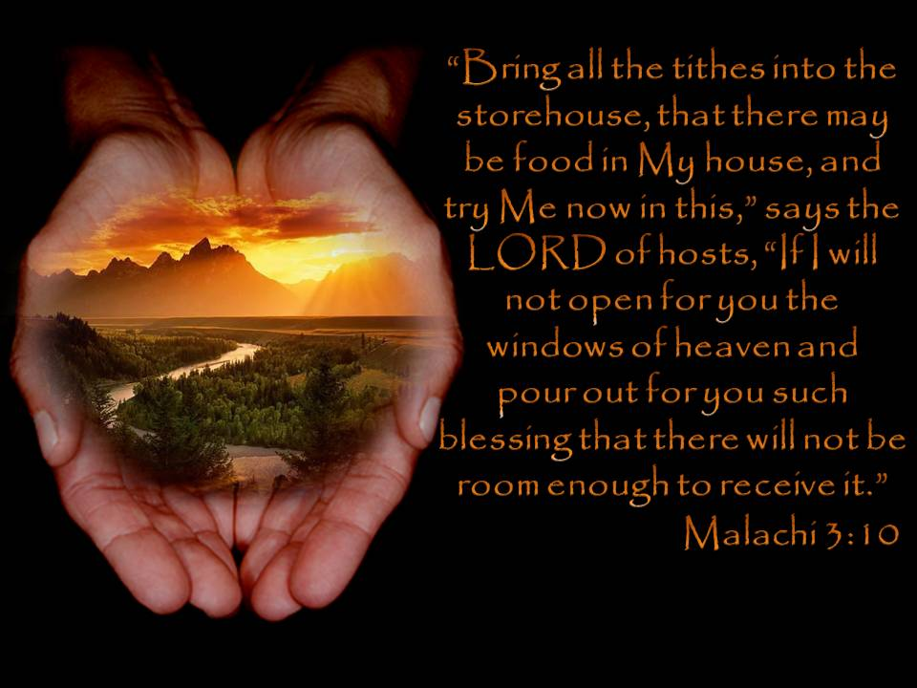
4. The Principle of Proportion.
A. We’ll reap More than we sow!
“Bring ye all the tithes into the storehouse, that there may be meat in mine house, and prove me now … saith the LORD of hosts,
if I will not open you the windows of heaven, and pour you out a blessing, that there shall not be room enough to receive it.”
Malachi 3:10
“Bring ye all the tithes into the storehouse…
and prove me now,
saith the LORD,
if I will not open you the windows of heaven, and pour you out a blessing,
that there shall not be room enough to receive it.”
Malachi 3:10

Slide 23
Mt 19:27-29
“we have forsaken all, and followed thee; what shall we have therefore?
And Jesus said unto them, Verily I say unto you, That ye which have followed me, in the regeneration when the Son of man shall sit in the throne of his glory, ye also shall sit upon twelve thrones, judging the twelve tribes of Israel.
And every one that hath forsaken houses, or brethren, or sisters, or father, or mother, or wife, or children, or lands, for my name's sake,
shall receive an hundredfold,
and shall inherit everlasting life.”

Slide 24
4. Principle of Proportion
B. Life is a “evaluation” for Eternity!
Luke 16:10-13 “He that is faithful in that which is least is faithful also in much:
and he that is unjust in the least
is unjust also in much.
If therefore ye have not been faithful in the unrighteous mammon,
who will commit to your trust the true riches?

Slide 25
Luke 16:12-13
“And if ye have not been faithful in that which is another man's, (or God’s)
who shall give you that which is your own?
No servant can serve two masters:
either he will hate one, and love the other;
or he will hold to one, and despise the other.
Ye cannot serve God and mammon.”
Which (who) are you actually serving?

Slide 26
The Laws of the Harvest are:
Universal: Apply to saved and lost.
Practical: Apply to every area.
(Relationships, Retirement, families, finances)
Irreversible: We Can’t go back and reclaim lost time and opportunities.
“The harvest is past, the summer is ended, and we are not saved.”
Jeremiah 8:20

Slide 27
While it’s true that you can’t go back and make a brand new start, my friend;
Anyone can start from now,
And make a brand new End!
What “End” do you want?

Slide 28
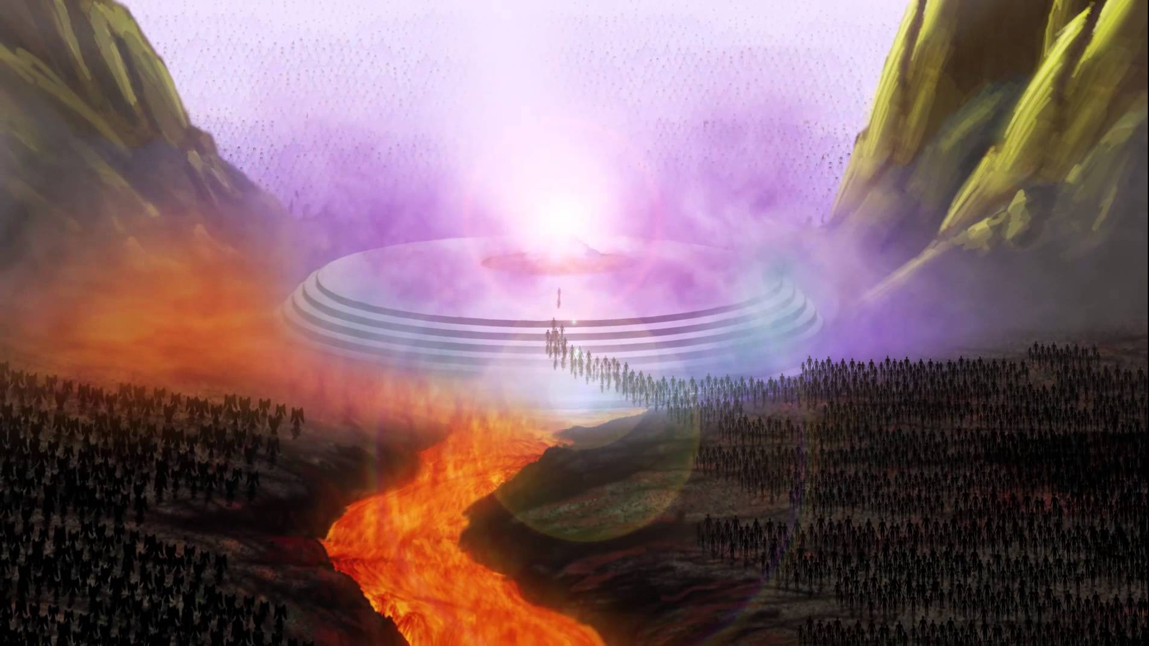
The Lost? “Depart from me, ye cursed,
into everlasting fire, prepared for the
devil and his angels:” Mat. 25:41
Revelation 20:11-15

Slide 29
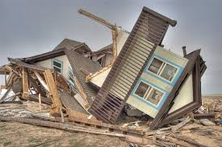
For the “worldly minded’: Phil 3:18-19
“For many walk, of whom I have told you often, and now tell you even weeping, that they are the enemies of the cross of Christ:
Whose end is destruction, (apōl’eia: loss)
whose God is their belly, whose glory is in their shame,
who mind
(fron-eh'-o: focus, regard)
earthly things.”
See also 1 Cor. 3:15; Rev. 3:14-22

Slide 30
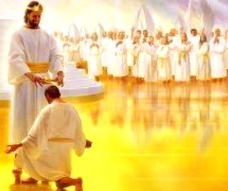
For the Faithful “Servant” Mt 25:23 Well done, good and faithful servant;
thou hast been faithful over a few things,
I will make thee ruler over many things:
enter thou into the joy of thy lord.
“for our conversation is in Heaven,
from whence also we look for our savior.”
Phil. 3:20

Slide 31
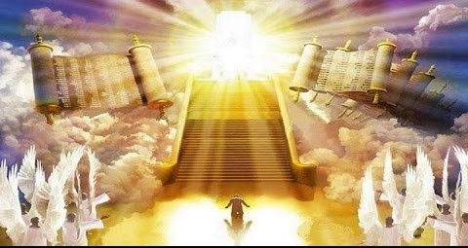
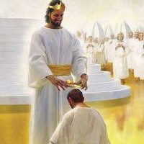
What are you doing to prepare for it?
1 John 2:28, 3:3
“And now, little children, abide in him; that, when he shall appear, we may have confidence, and not be ashamed before him at his coming.
And every man that hath this hope in him purifieth himself, even as he is pure.”
2 Tim 4:7,8

Slide 32
“Lay up for yourselves
treasures in heaven”
“For where your treasure is,
there shall your heart be also.”
Mt. 6:20,21

Slide 33
Are you Investing in Eternity? Mt. 6:20

