Slide 1
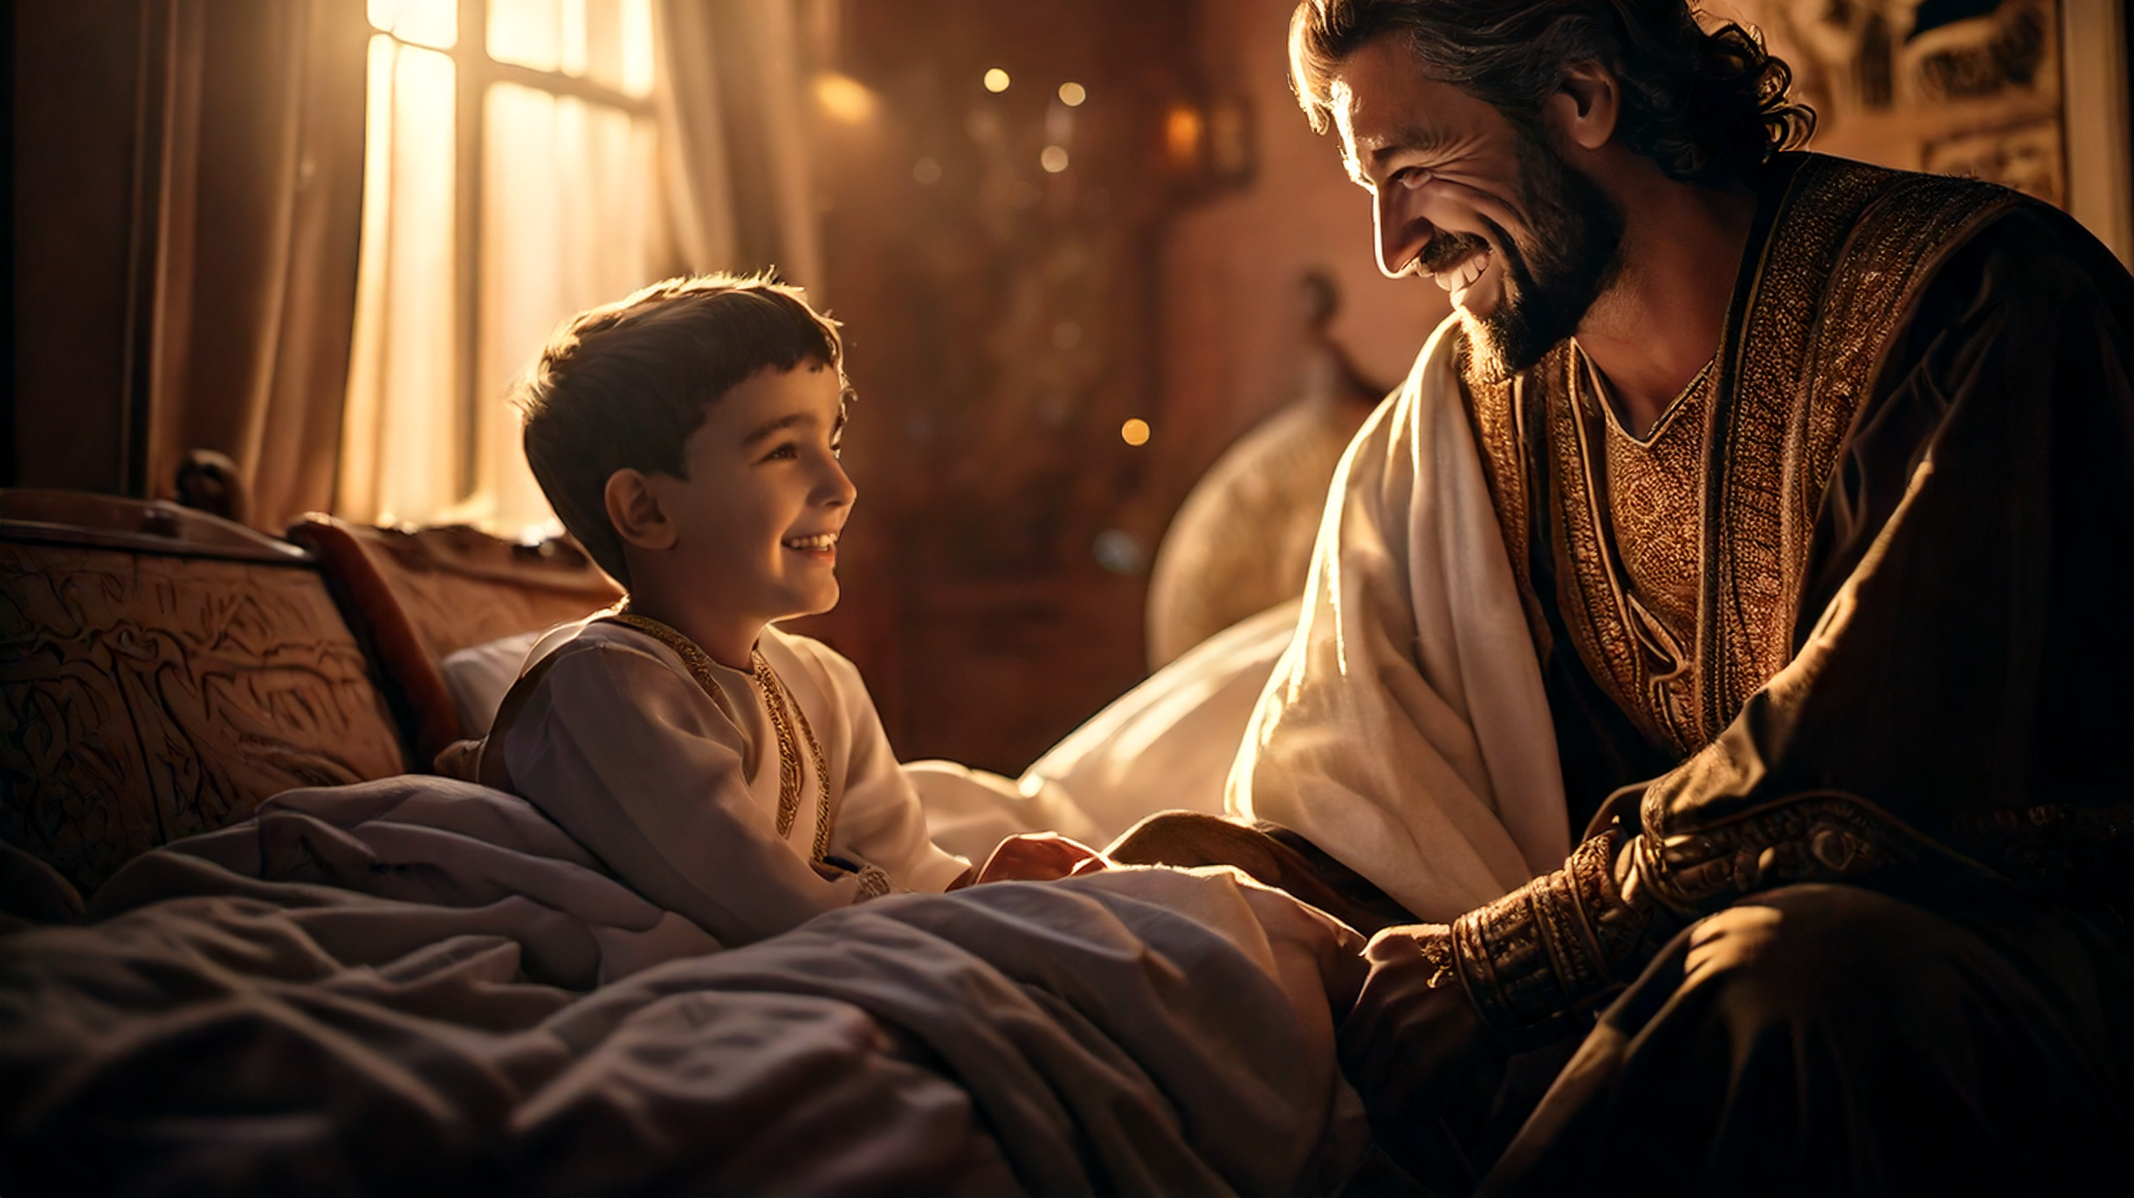
Growing a Hesitant Faith
By Joseph Peters

Slide 2

The Goal
Everyone should trust in Jesus, not in his abilities
For these three reasons

Slide 3
Reasons
The Official Believed Jesus Could Heal
The Official’s Faith was Incomplete
The Official’s Faith Grew

Slide 4
Samaria’s Acceptance
And many of the Samaritans of that city believed on him for the saying of the woman, which testified, He told me all that ever I did. So when the Samaritans were come unto him, they besought him that he would tarry with them: and he abode there two days. And many more believed because of his own word; And said unto the woman, Now we believe, not because of thy saying: for we have heard him ourselves, and know that this is indeed the Christ, the Saviour of the world (John 4:39–42).

Slide 5
Israel’s Superficial Acceptance
Now after two days he departed thence, and went into Galilee. For Jesus himself testified, that a prophet hath no honour in his own country. Then when he was come into Galilee, the Galilaeans received him, having seen all the things that he did at Jerusalem at the feast: for they also went unto the feast (John 4:43–45).

Slide 6
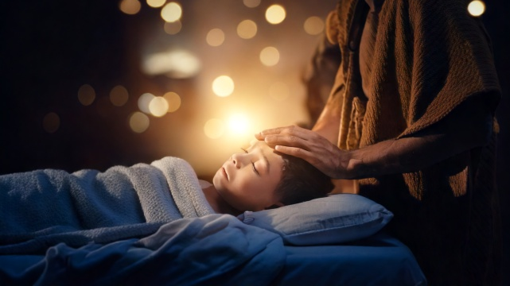
The Official Believed Jesus Could Heal

Slide 7
The Father’s Request
So Jesus came again into Cana of Galilee, where he made the water wine. And there was a certain nobleman, whose son was sick at Capernaum. When he heard that Jesus was come out of Judaea into Galilee, he went unto him, and besought him that he would come down, and heal his son: for he was at the point of death (John 4:46–47).

Slide 8
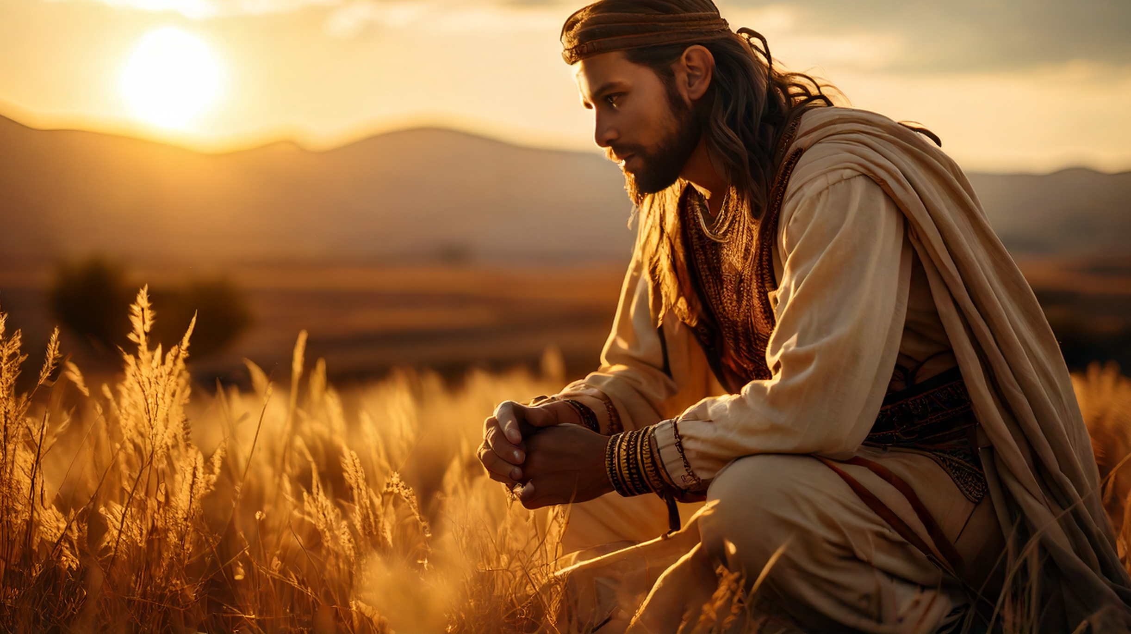
The Official’s Faith was Incomplete

Slide 9
Jesus’ Response
Then said Jesus unto him [singular], Except ye [plural] see signs and wonders, ye [plural] will not believe (John 4:48).
Then answered the Jews and said unto him, What sign shewest thou unto us, seeing that thou doest these things (John 2:18)?
And a great multitude followed him, because they saw his miracles which he did on them that were diseased (John 6:2).
For the Jews require a sign, and the Greeks seek after wisdom (1 Cor 1:22).

Slide 10
Incomplete Faith
Then when Mary was come where Jesus was, and saw him, she fell down at his feet, saying unto him, Lord, if thou hadst been here, my brother had not died. When Jesus therefore saw her weeping, and the Jews also weeping which came with her, he groaned in the spirit, and was troubled (John 11:32–33).
Then Jesus answered and said, O faithless and perverse generation, how long shall I be with you? how long shall I suffer you? bring him hither to me (Matt 17:17).

Slide 11
The Official’s Faith Grew

Slide 12
The Official Believes Jesus
The nobleman saith unto him, Sir, come down ere my child die. Jesus saith unto him, Go thy way; thy son liveth. And the man believed the word that Jesus had spoken unto him, and he went his way. And as he was now going down, his servants met him, and told him, saying, Thy son liveth. Then inquired he of them the hour when he began to amend. And they said unto him, Yesterday at the seventh hour the fever left him. So the father knew that it was at the same hour, in the which Jesus said unto him, Thy son liveth: and himself believed, and his whole house (John 4:49–53).

Slide 13
Conclusion
Everyone should trust in Jesus, not in his abilities
For these three reasons

Slide 14
Reasons
The Official Believed Jesus Could Heal
The Official’s Faith was Incomplete
The Official’s Faith Grew

