Slide 1
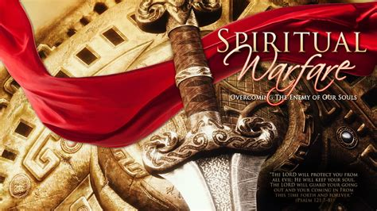
“Be Strong in the Lord, and in the power of His Might.” Eph 6:10

Slide 2
Deut 32:8 “When the most High divided to the nations their inheritance, when he separated the sons of Adam, he set the bounds of the people
according to the number of the children of Israel.”
This occurred at the tower of Babel. Gen. 11
Led by Nimrod (Rebel) and Semiramis who formed a demonic “trinity cult”.
Nimrod: “Sun God”
Semiramis: “Queen of Heaven”
Tammuz: (Tammuzi/Dumuzi) god of fertility

Slide 3
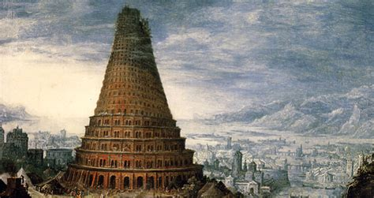
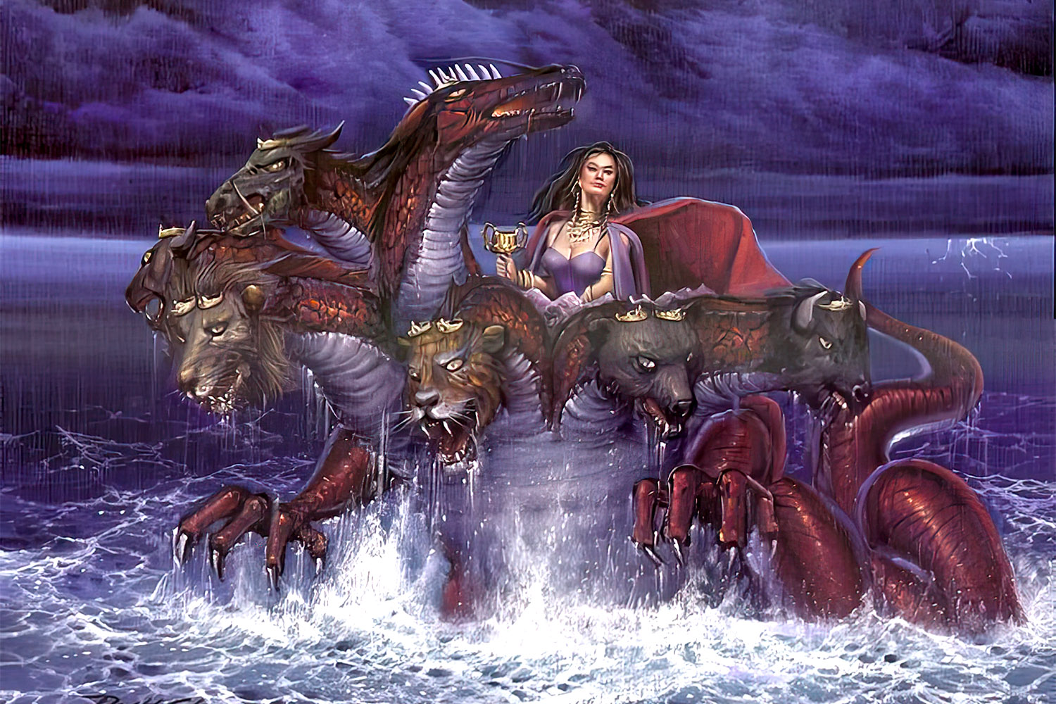
Babylon was the first (Gen. 10,11)
and will be the last example (Rev. 17, 18)
of a world empire in rebellion against God.
Rev 17:5 “Mystery, babylon the great,
the mother of harlots and abominations of the earth.”

Slide 4
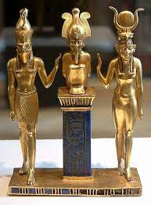
After the division of the Nations, the people branched out and worshipped different “gods”,
but usually kept some form of this “trinity” of gods.
While Egypt had almost 2000 different “gods”,
Their “Trinity” were known as Osiris, Isis, and Horus.
After Seth killed Orsiris,
Isis “put him back together”
Long enough to conceive “Horus”.
(Notice the sun disc?)

Slide 5
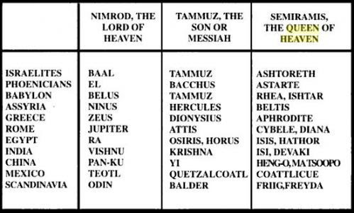
Unholy Trinities

Slide 6
Last week we learned from Deut 32:9 that
“When the most High divided to the nations their inheritance…, he set the bounds of the people according to the number of the children of Israel.
For the LORD'S portion is his people;
Jacob is the lot of his inheritance.”
While most people followed “strange gods”,
God had a plan to reach/redeem them.

Slide 7
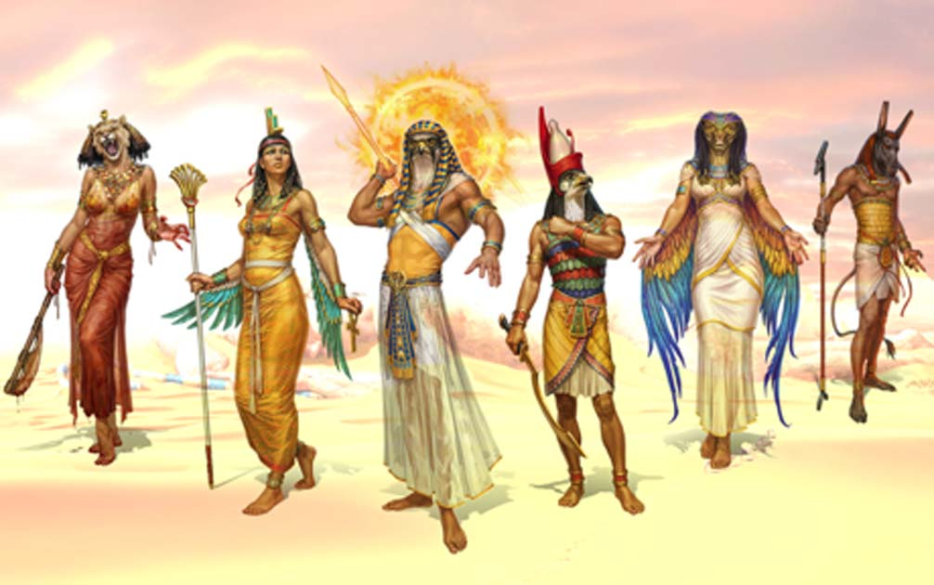
1. It began by exposing these false “gods”.
Ex 12:12
“Against all the gods of Egypt
(2000 of them)
I will execute Judgment:
I am the LORD!”
Ex 12:12
A. Each plague exposed their impotency.

Slide 8
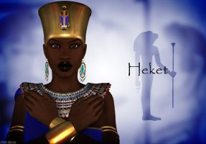
1) Water Turned to Blood
(Hapi: god of the Nile)
2) Frogs:
(Heket: fertility)

Slide 9
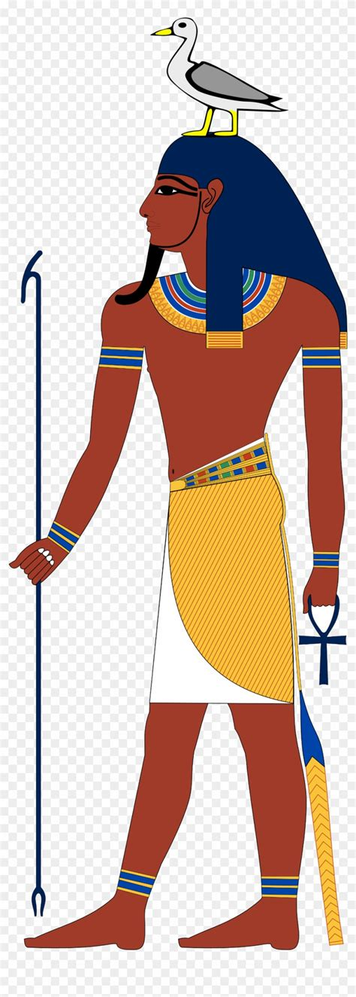
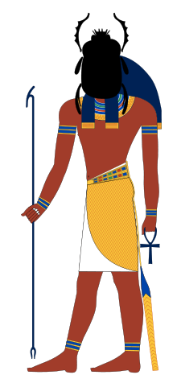
3) Lice From the Dust (Geb: god of earth/land)
4) Swarms of flies: Khepri
(god of resurrection)
Face of a scarob beatle
born of dung

Slide 10
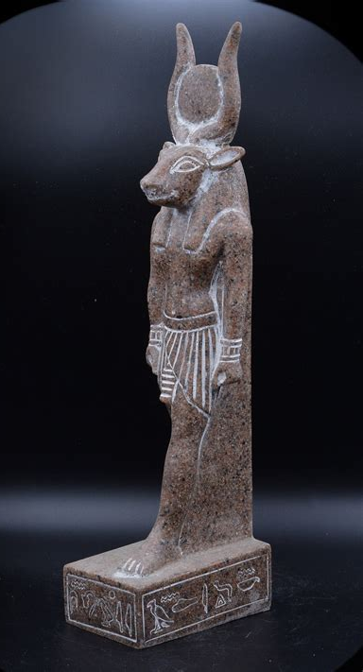
5) Death of Cattle
(Hathor: goddess
of fertility, livestock)
6) Ashes Turned to Boils
(Isis: goddess of healing)
(Both are related
to Semiramis;
and the golden calf
of Dt. 32)

Slide 11
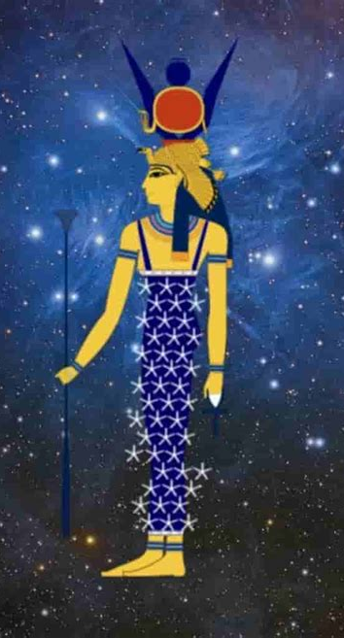
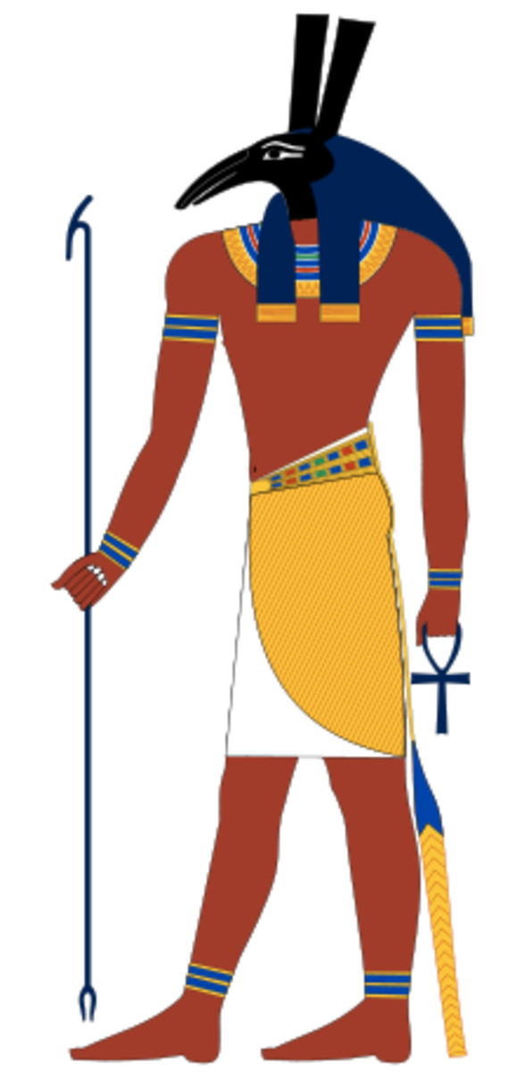
7) Fiery Hail
(Nut: sky goddess)
8) Locus
(Seth: god of desert
and storms)

Slide 12
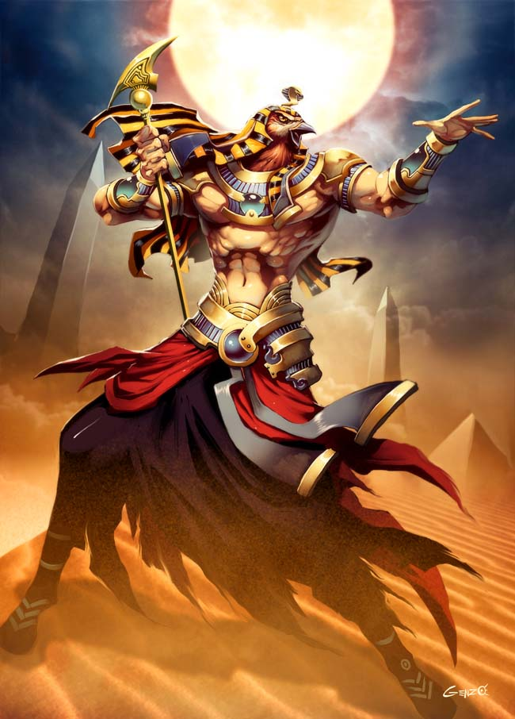
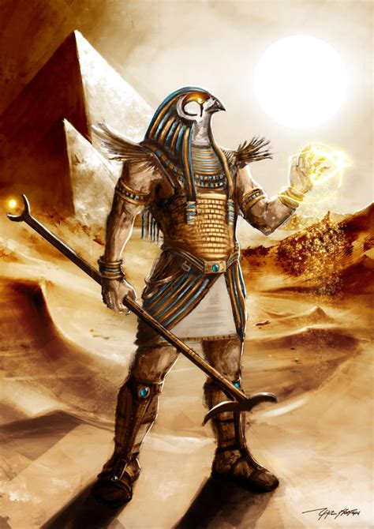
9) Darkness:
Ra god of the sun
10) Death of firstborn
Horus: god of kingship,
healing and protection
(Particularly of Pharoah)

Slide 13
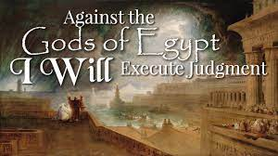
1. It began by exposing these false “gods”.
Ex 19:4
“Ye have seen what
I did unto the Egyptians,
and brought you unto myself.”
Ex 12:12
A. Each plague exposed their impotency.

Slide 14
2. God’s plan included a means of reaching
and redeeming those enslaved by them.
A. Many Egyptians joined the Exodus. Ex 7:5
“And the Egyptians shall know that I am the LORD.”
Ex 11:3 “the LORD gave the people favour in the sight of
the Egyptians. Moreover the man Moses was very
great in the land of Egypt…in the sight of the people”
Ex 12:37,38 “Israel journeyed from Rameses about six
hundred thousand on foot that were men…
And a mixed multitude went up also with them…”

Slide 15
2. And included a means of reaching and
redeeming those enslaved by them.
B. God invited Israel to partner with him. 19:5 “Now therefore, if ye will obey my voice indeed,
and keep my covenant,
then ye shall be a peculiar treasure unto me …:
for all the earth is mine:
And ye shall be unto me a kingdom of priests, and an holy nation.”

Slide 16
2. And included a means of reaching and
redeeming those enslaved by them.
B. God invited Israel to partner with him. 19:5 1) They initially responded to him. Vs 7,8
“Moses …laid before their faces all these words ...
And all the people answered together, and said,
All that the LORD hath spoken we will do.”
2) They failed to recognize how much influence the gods of Egypt still had on them.

Slide 17
C. In Dt. 32 Moses revealed the contrast between
1) God’s Character 3,4
vs 3-4 “He is the Rock, his work is perfect: for all his ways are judgment: a God of truth and without iniquity, just and right is He!”
2) And Israel’s Corruption vs 5
“They have Corrupted themselves, …
they’re a perverse and crooked generation.
16 They provoked him to jealousy with strange gods”

Slide 18
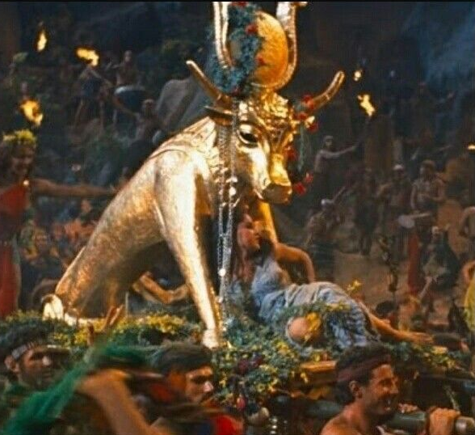
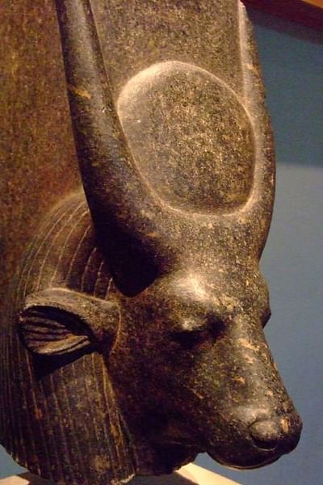
a) The first of the 10 commandments warn.
Ex 20:3 “Thou shalt have no other gods before me.”
(1) Soon they declared: “These (hep) be thy gods, which brought thee out of Egypt.” Ex. 32:4
a) Hep was the “god” of fertility from Memphis region
Associated with the goddess Hathor
(Isis) daughter of Ra and
Mother of Horus.
c) She was the sky goddess
of love, fertility, and sex
Hathor
(Isis)
hep/hapi
https://egyptianmuseum.org/deities-hathor

Slide 19
D. The corruptions of these strange gods would only grow in Canaan.
1) God’s commands would defend &protect them.
Ex 23:32-33 “Thou shalt make no covenant with them,
nor with their gods. They shall not dwell in thy land; lest they make thee sin against me:
for if thou serve (partner/cooperate with) their gods,
it will surely be a snare unto thee.”
(môqēsh’: a noose, hook or trap)

Slide 20
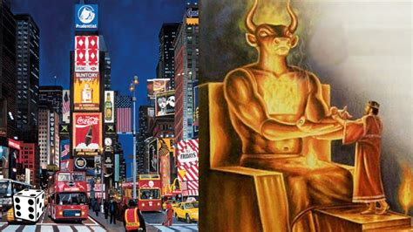
2) They failed (again) to obey God’s Laws.
Ps 106:35-37 ”they were mingled among the heathen,
and learned their works, and served their idols:
which were a snare
unto them.
³⁷ Yea, they sacrificed their sons and their daughters
unto devils!”

Slide 21
God offered Israel a Partnership with Him.
Ex 19:5 “Now therefore, if ye will obey my voice indeed, and keep my covenant,
then ye shall be a peculiar treasure unto me above
all people:
for all the earth is mine:
And ye shall be unto me a kingdom of priests.”
Vs 8 “All that the LORD hath spoken we will do!”
But they didn’t!

Slide 22
While most people still follow “strange gods”,
God still has a plan to reach/redeem them.
Mt 24:14 “this gospel of the kingdom shall be preached in all the world for a witness unto all nations;
and then shall the end come. “
Mk 16:15 “go into all the world and preach the gospel”
2 Pt 3:9 “The Lord is … not willing that any should perish, but that all should come to repentance.”
Dt 32:9 “For the LORD'S portion is his people”

Slide 23
He gives us the same promise and partnership (Challenge/Charge) he gave Israel:
1 Pt 2:9-11 “But ye are a chosen generation,
a royal priesthood, …, a peculiar people;
that ye should shew forth the praises of him
who hath called you out of darkness
into his marvellous light:
11 Dearly beloved, I beseech you as strangers and pilgrims, abstain from fleshly lusts,
which war against the soul!”
(Mark 4:19; 2 Tim. 2:3,4)

Slide 24
Will we heed the warning of 1 Cor 10:11-14; Or repeat their deception, distraction, and disobedience?
11 “Now all these things happened unto them for ensamples:
and they are written for our admonition,
upon whom the ends of the world are come.
12 Wherefore let him that thinketh he standeth take heed lest he fall...
14 Wherefore, my dearly beloved,
flee from idolatry.”

Slide 25
Over the next few weeks we’ll discuss:
Who were these “strange gods”?
Where did they come from?
What did (and do) they want?
Where are they now?
What can we do about them?

Slide 26
Eph 6:10-18; 2 Cor 10:3-5; 2 Cor 2:11
“Lest Satan should get an advantage of us: for we are not ignorant of his devices.”

