Slide 1
Begin with an end in view.
In 2 Tim. 4:1-8 Paul compares our lives to a race that will inevitably end at a specific “finish line.”
Jesus will review with us how we ran our race. Vs 1
He’ll reward those who ran it well. Vs 8
Some get discouraged or distracted. Vs. 10 (Demas)
Some actually try to trip us up. Vs. 14
“Alexander…did me much evil,
the Lord reward him according to his works”.

Slide 2
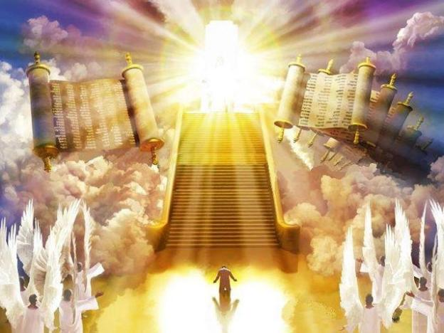
This “finish line” (judgment) is universal and inevitable.
“we must all appear before the judgment seat”
2 Cor. 5:10, Heb. 9:27

Slide 3
Rev 20:11 “I saw a great white throne…And I saw the dead, small and great, stand before God;
and the books were opened: …
and the dead were judged out of those things which were written in the books…”

Slide 4
We’ve been discussing these “books” that will be opened for our final judgment.
Some of the specific records that God reveals include:
Our Disappointments: Ps 56:8 “Thou tellest my
wanderings: …: are they not in thy book?”
Our Decisions: Mal. 3:16,17 “They that feared the Lord
spake often …and the Lord heart it …
and a book of remembrance was written …
for them that feared the LORD...”

Slide 5
Some of the specific records that God reveals include:
Our Disappointments: Ps 56:8; Our Decisions: Mal. 3:16,17
Our “Dreams” (Purposes or Value) Ps 139:16
“Thine eyes did see my substance, (ʿōṣem: Might) yet being unperfect; and in thy book all [my members] were written”
Our “Deeds” “According to their works” Rev. 20:12
God’s “Decrees” or standards. (His Law)
(Joshua 1:8; Eccl. 12:13,14)

Slide 6
These particular “books” will contain important and accurate records of our lives and be used to
determine the extent of our eternal “Compensation”!

Slide 7
There’s one other book repeatedly mentioned that will determine our eternal “Destination”. Rev. 20:12,15
“another book was opened which is the book of life….
And whosoever was not found written in the book of life was cast into the lake of fire.”

Slide 8
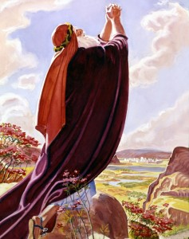
Since the content of this book is so critical,
let’s examine what God reveals about it.
1. Moses Wrote Of This Book Ex 32:31,32 (After the Golden Calf)
“Moses returned unto the LORD, and said, Oh, this people have sinned a great sin, and have made them gods of gold.
Yet now, if thou wilt forgive their sin--; and if not,
blot me, I pray thee, out of thy book which thou hast written.”

Slide 9
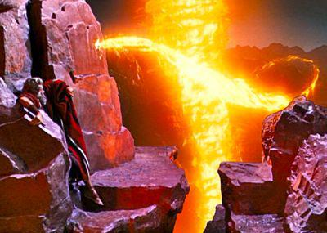
Notice God’s answer in Exodus 32:33:
“Whosoever hath sinned against me,
him will I blot out of my book.”

Slide 10
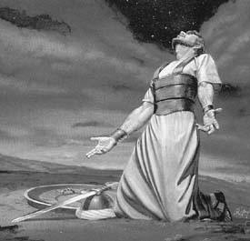
2. David Knew Of It. Ps 69:27,28
“let them not come into thy righteousness.
Let them be blotted out of the book of the living,
and not be written
with the righteous.”

Slide 11
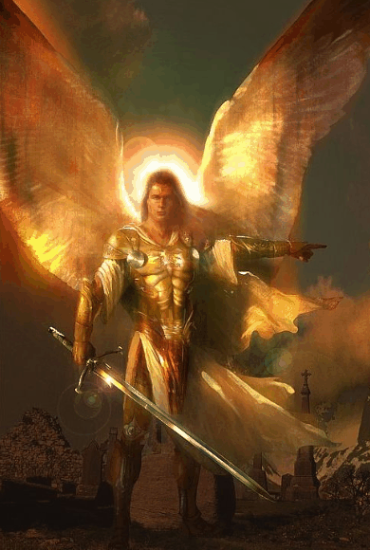
3. Daniel Wrote Of It! Daniel 12:1
“And at that time shall Michael stand up…: and there shall be a time of trouble, such as never
was since there was a nation …:
and at that time thy people shall be delivered,
every one that shall be found written in the book.”

Slide 12
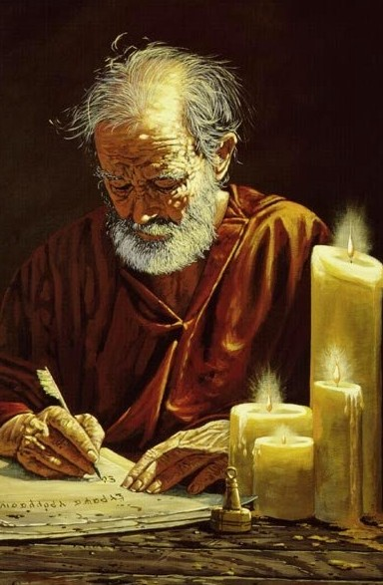
4. Paul wrote of it in Philippians 4:3
“I intreat thee, true yokefellow, help those women which labored with me in the gospel, with Clement and …my fellow laborers,
whose names are in the book of life.”

Slide 13
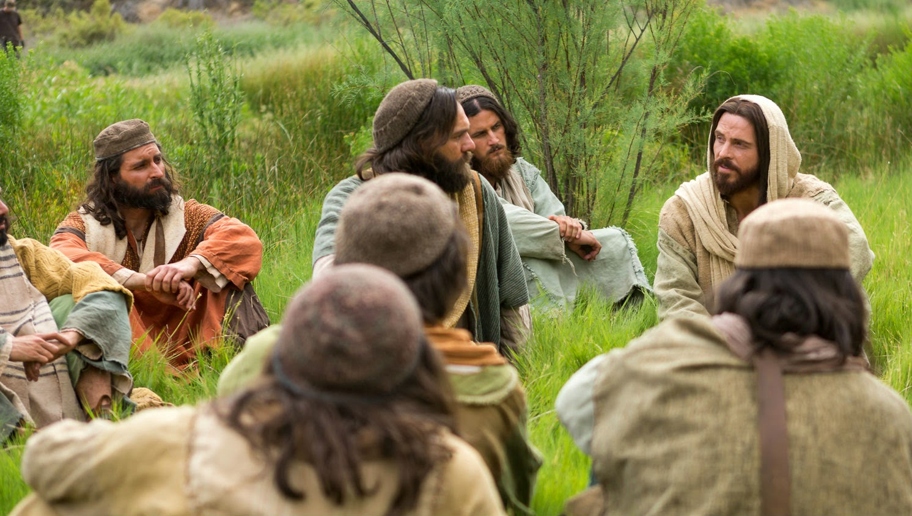
5. Jesus References It:
A. Luke 10:18-20 “Behold, I give unto you
power … over all the power of the enemy…
Notwithstanding in this rejoice not,
that the spirits are subject unto you;
but rather rejoice,
because your names are
written in heaven.”

Slide 14
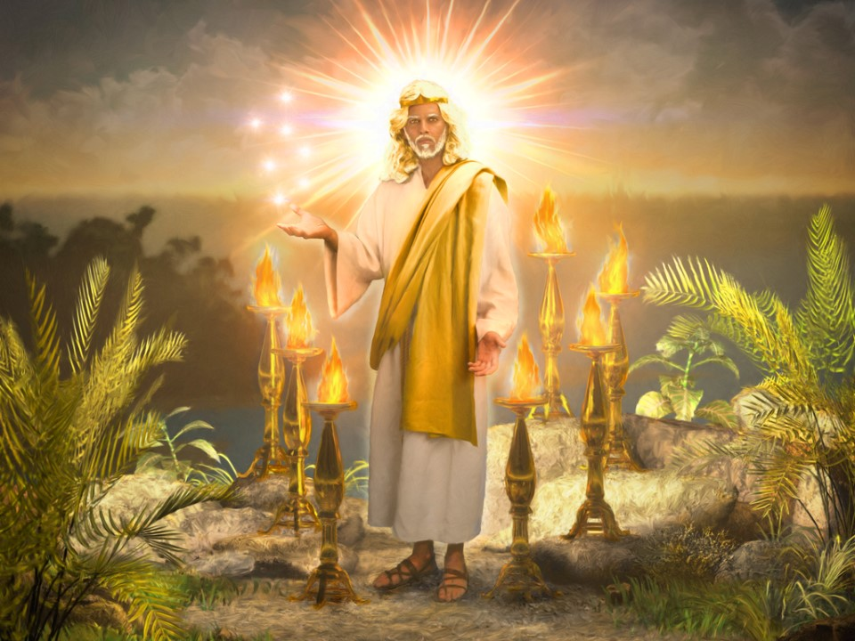
5. Jesus References It:
B. Rev 3:5 “He that overcometh, the same shall be clothed in white raiment; and I will not blot out his name out of the book of life,
but I will confess his name before my Father, and his angels.”

Slide 15
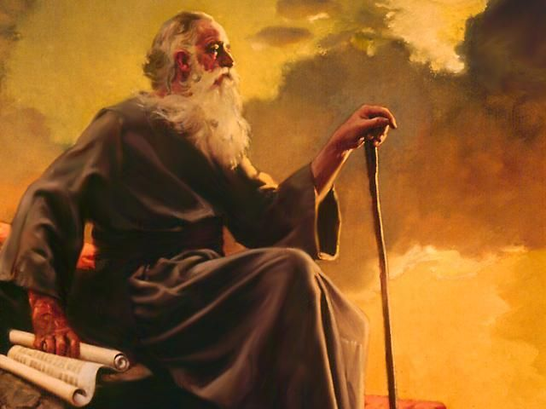
6. John References it in Revelation:
A. Those who follow the antichrist. Rev 13:8-9
“all that dwell upon the earth shall worship him,
whose names are not written in the book of life of the Lamb
slain from the foundation
of the world.“
(also Rev. 17:8,9)

Slide 16
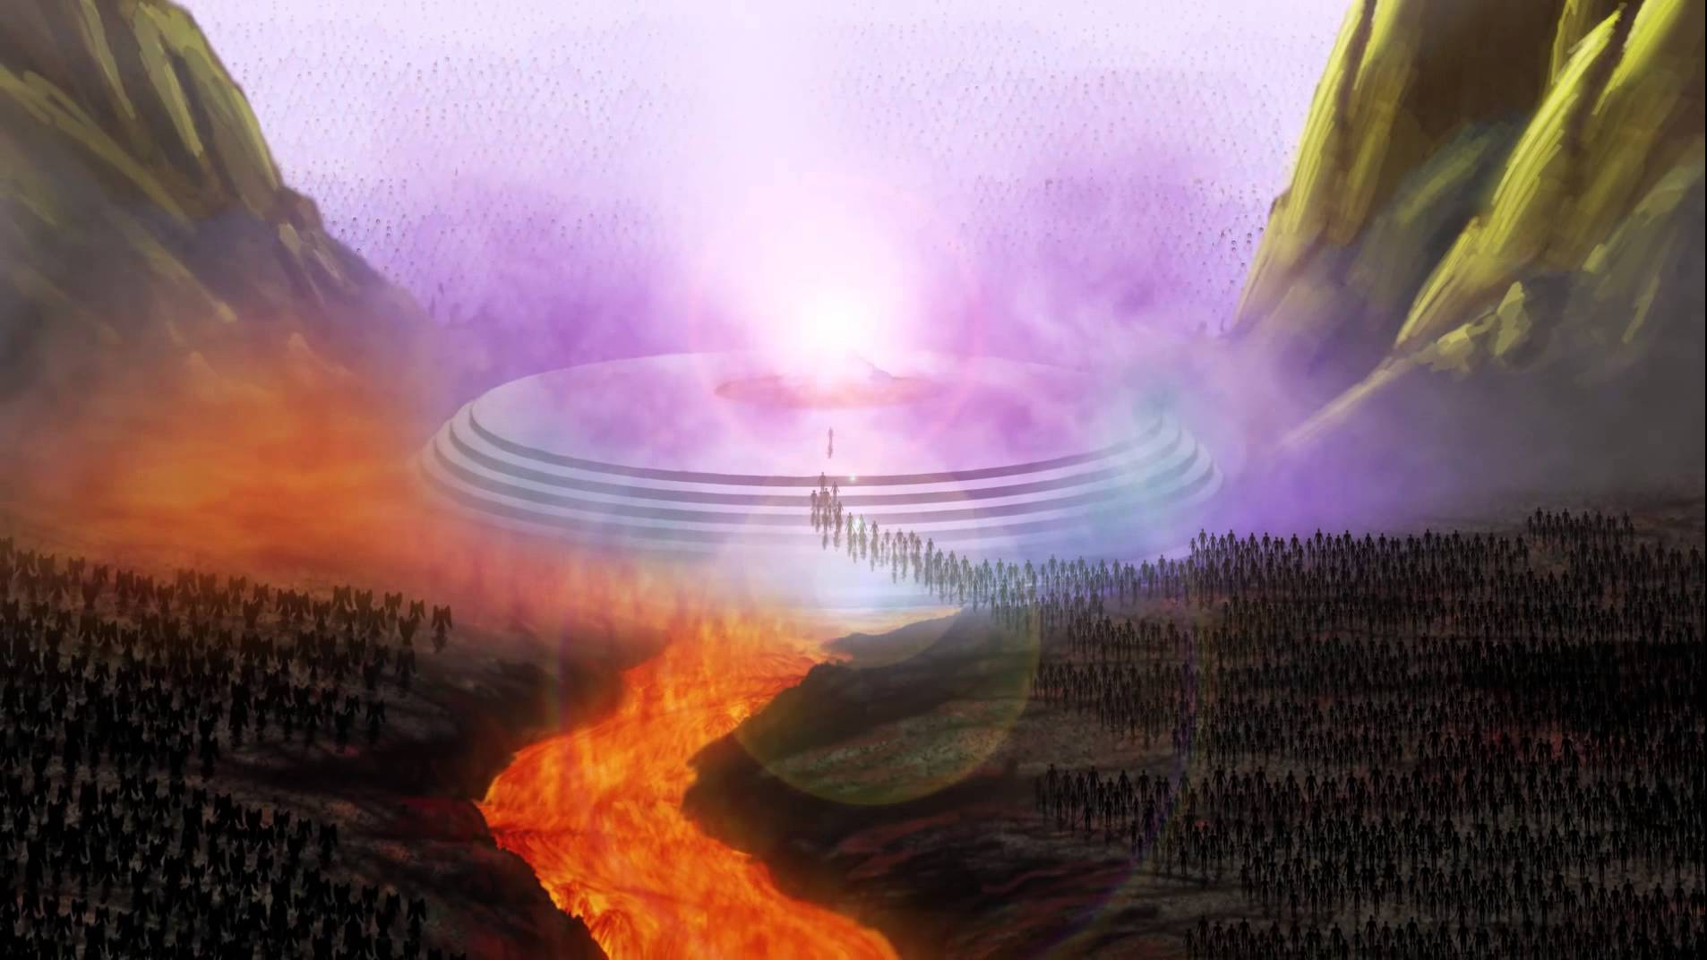
6. John References it in Revelation:
B. Identified in the White Throne Judgment.
Rev 20:15 “whosoever was not found written in the book of life was cast into the lake of fire.”

Slide 17
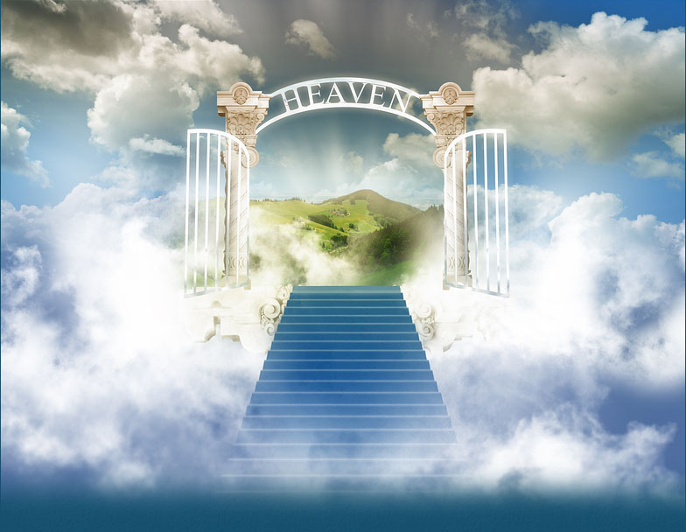
C. Prerequisite for access to Heaven. Rev 21:27
“there shall in no wise enter into it any thing that defiles,
but they which are written in the Lamb's book of life.”

Slide 18
D. Warns about tampering with God’s Word. Rev 22:19 “if any man shall take away from the words of the book of this prophecy, God shall take away his part out of the book of life, and out of the holy city, and from the things written in this book.“

Slide 19
Observations:
1) There are several references to God “blotting out” names.
Ex 32:33 “Whosoever hath sinned against me, him will I blot out of my book.”
Ps. 69:18 “Let them be blotted out of the book of the living,”
Rev 3:5 “He that overcomes, I will not blot out his name out of the book of life”
Rev 22:19 “if any shall take away from the words of the book of this prophecy,
God shall take away his part out of the book of life”
This is not a reference to “losing” your salvation, since God repeatedly reminds us that our salvation is eternal. Jn. 10:28
“I give unto them eternal life; and they shall never perish”
(also Jn 3:16; Heb. 13:5; 1 Jn. 5:11-13)

Slide 20
Observations: “Blotting out” names…
This is a probable reference to the fact that there was a place for everyone in God’s “book of life”.
It’s also called the “Lamb’s book of life” (Rev. 13:9; 21:27).
Those who die without transferring their trust (and thereby their sin) to God’s lamb (Jesus Christ) will perhaps have their name blotted out upon their death.

Slide 21
Observations: “Blotting out” names…
Since Jesus died for “the world” (Jn 3:16) and God is not willing that “any should perish” (2 Pt 3:9),
God may record their names in this book (at birth) to show them at the final judgment that there really was “room” for them. Jn. 8:24
“I said … unto you, that ye shall die in your sins:
for if ye believe not that I am he, (the lamb of God)
ye shall die in your sins.”

Slide 22
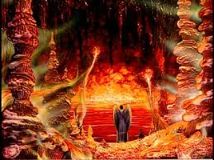
2) If we are not identified with the
“lambs book of life”, we’ll go to Hell!
“whosoever was not found written in the book of life
was cast into the lake of fire.”
Rev. 20:15

Slide 23
John 3:16-18 “God so loved the world, that he gave his only begotten Son, that whosoever believeth in him should not perish, but have everlasting life.
For God sent not his Son into the world to condemn the world; but that the world through him might be saved.
He that believeth on him is not condemned:
but he that believeth not is condemned already,
because he hath not believed in the name of the only begotten Son of God.”

Slide 24
John 3:36 ”He that believeth (pisteuō: to credit, trust) on the Son hath everlasting life:
and he that believeth not the Son
shall not see life;
but the wrath of God abideth on him.”
Orge’: indignation, violent punishment

Slide 25
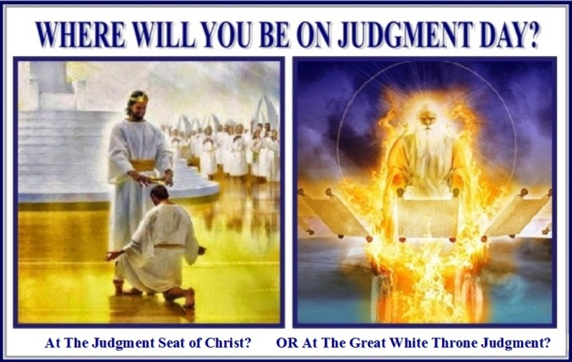
Which “end” do you want?

Slide 26
2 Timothy 4:7-8
“I have fought a good fight, I have finished my course, I have kept the faith:
Henceforth there is laid up for me a crown of righteousness, which the Lord, the righteous judge, shall give me at that day:
and not to me only, but unto all them also
that love his appearing.”

Slide 27
1 Jn 2:28 “And now, little children, abide in him;
that, when he shall appear,
(phanero’ō: to reveal, make manifest, render apparent)
we may have confidence,
and not be ashamed before him at his coming…
3:3 Everyone that hath this hope in him,
purifieth himself.”
Aren’t you glad for Mid-course corrections!

