Slide 1
When you buy something of value, you often get an owners manual from the manufacturer.
Most warn you that if you don’t follow the manual, and often some maintenance schedule,

Slide 2
you’ll void the warrantee!
It should come as no surprise that life, (and relationships) comes with a manual (instructions) from the manufacturer .

Slide 3
Relationships: Some Assembly Required!
Too often we ignore the instructions and “maintenance”, but then wonder why the “guarantee” is voided when it breaks.
The results of such negligence are tragic!
Pr. 14:12 “There is a way which seems
right unto a man,
but the end thereof
are the ways of death.”
maw'-veth: ruin, hell

Slide 4
Relationships:
Some Assembly Required.
Last week we discovered how Solomon learned this painful lesson too late!
Satan still seeks to seduce us to follow him rather than submit to God. (Jn. 10:10)
God warns us that failure to comply with His instructions will void the “home warrantee.”
Ps. 127:1 "Except the LORD build the house,
they labor in vain that build it: “
shawv: desolating; evil; uselessness

Slide 5
No where is this more evident than in Relationships.
Last week I used a tandem bike to illustrate our approach to relationships.
Some couples learn to work together for a relatively “smooth” ride.

Slide 6
Others have an “I’m just along for the ride” mentality,
expecting the other to do most of the work!

Slide 7
Still others just seem to work against each other!

Slide 8
God repeatedly asks us to trust Him so that He can guide us (Pr. 3:5,6; Ro. 12:1,2) and warns us of the dangers of becoming:
“conformed to this world…
“but be ye transformed: metamorfo'o
by the Renewing anakia’nosis (renovation)
Of your Mind: nooce (thoughts, feelings, will)
that ye may prove what is that good, and acceptable, and perfect, will of God.”
Romans 12:2

Slide 9
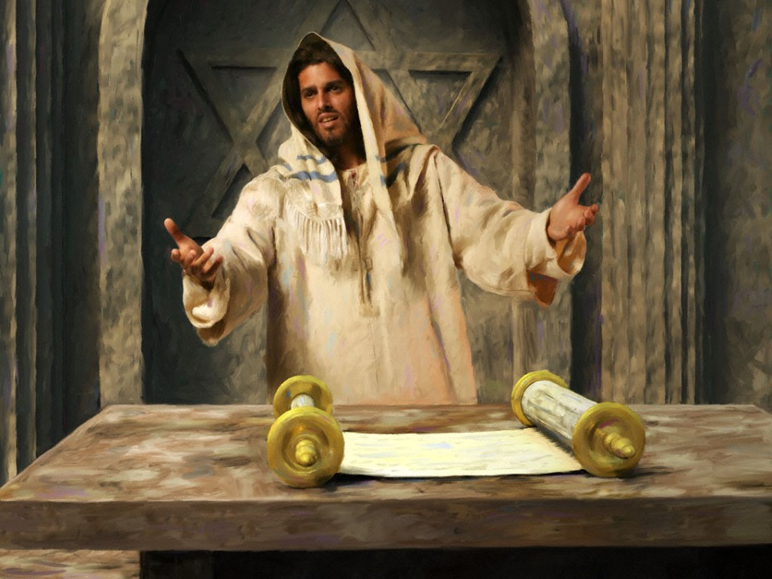
Jesus warned that the “thief” comes to
“kill, destroy, steal” (John 10:10)
Jesus comes to bring “beauty out of ashes; Joy out of mourning, praise out of heaviness”. Isaiah 61:1-3; Luke 4:18

Slide 10
How do we get from “ashes”
to “beauty”?
Mt. 18: Jesus Speaks of the power of forgiveness and the blindness of bitterness.
Holy Wedlock becomes Unholy Deadlock!
In Mt. 19: Confronted with the broken relationships of his day, Jesus reminds us of God’s design “from the beginning” (vs 4-8)
and revealed that the root cause of such conflict is hard hearts that always produce “ashes”. (vs 8)

Slide 11
God’s Design ➔ Our Delight. Ps. 37:3-5
Marriage: Some assembly required!

Slide 12
The Dilemma of Man.
A. God described Creation as “Good” 10 times!
Genesis 1:25 “…and God saw that it was good.”
Tobe: beautiful, pleasing, precious.
Eccl 3:11 “He hath made everything beautiful in his time”
1) Creation was Precious and brought Him
Pleasure!
2) This was why we were created! Rev. 4:11
3) This is why Satan hates us!

Slide 13
The Dilemma of Man.
B. God intentionally created Adam first. 1 Tim.2:13
“Adam was first formed, then Eve.”
1) Adam had perfect:
➔ Position: He was in charge of the world,
crowned with glory and honor. (Ps. 8:6)
➔Possessions: He had it all! (Gen. 1:26-29)
➔Prosperity: Perfect health and immortality.
And yet God still said in Gen. 2:18:
"It is not good that the man should be alone;

Slide 14
The Dilemma of Man.
B. God intentionally created Adam first. Gen. 2:18
"It is not good that the man should be alone;
2) God created Adam with needs:
➔ Physical needs: Food, Air, Water, Exercise
➔ Spiritual needs: Intimacy with God. (Ecc. 3:11)
➔ Soul (Emotional) needs: Intimacy with others.
C. The Dangers Of This Dilemma (Needs)
1) Self-Sufficiency: Deny my needs! (or meet my own)
2) Self-Centeredness: Deify My needs! ➔ Manipulation.
3) Self-Condemnation: Doubt my needs/value.

Slide 15
2. The Design of God Gen. 2:18
A. God Took The Initiative.
“I will make an help meet for him.”
1) Adam wasn’t qualified to design his own
“Help Meet”. (Are you?)
Imagine if Adam had designed Eve!
2) God Knew What Adam (we) Needed!
“Help meet” aw-zar'; to aid or help.
From ʿāzar: to surround, protect, aid!

Slide 16
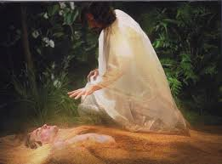
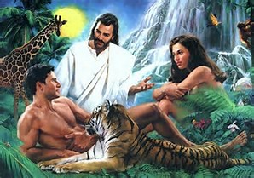
2) God knew what Adam needed.
God knows what (and who) you need also!
a) She was to be a completer, not a “competer.”
b) She was designed “different” from Adam.
c) Adam had to “Sleep” in order for God to
“operate”. (S. of Sol. 2:7, 3:5, 8:4)
We try to direct the “Great Physician” in this delicate surgery!

Slide 17
2. The Design of God
B. Being a “help meet” is a:
1) Mutual responsibility. 1 Cor 11:8-12
“the man is not of the woman; but the woman of the man. Neither was the man created for the woman; but the woman for the man…
Nevertheless neither is the man without the woman, neither the woman without the man, in the Lord.
For as the woman is of the man, even so is the man also by the woman; but all things of God.”
God designed us for mutual interdependence!
(on Him and each other!)

Slide 18
2. The Design of God
B. Being a “help meet” is a:
1) Mutual responsibility. 1 Cor 11:8-12
2) Primary responsibility.
1 Cor 7:33 “he that is married careth …
how he may please his wife.”
(also Eph. 5:25-33; 1 Peter 3:7)
1 Cor 7:34 “she that is married careth …
how she may please her husband.”
(also Eph. 5:22-24; 1 Peter 3:1-6)
Careth: Merimnaō: to take careful thought
Do you “take careful thought”
about pleasing your spouse?

Slide 19
2. The Design of God
B. Being a “help meet” is a:
3) Sacred responsibility. Eph. 5:22-33
a) Wives: v. 22 “submit yourselves unto your
own husband as unto the Lord…”
b) Husbands: v.24 “Husbands, love your wives,
even as Christ also loved the church,
and gave himself for it…”
“This is a great mystery: but I speak concerning Christ and the church.
Nevertheless let every one of you in particular so love his wife even as himself; and the wife see that she reverence her husband.” Eph. 5:32,33

Slide 20
2. The Design of God
C. This design elevated creation to “very good”.
Gen. 1:31 “God saw every thing that he had made,
and, behold, it was very good.” meʾōd tobe:
exceedingly beautiful, pleasing, precious.
1) God intends Marriage to be precious and
bring pleasure to us as well as Him!
Gen. 2:8 “The Lord God planted a garden …in Eden”
ʿêden: Pleasure 2x; Delights 1x; Delicate 1x
1st time “pleasure” is mentioned in the Bible is in the context of Marriage. Gen. 18:12

Slide 21
2. The Design of God:
D. God Established Relationships To Meet
Our Intimacy Needs. (Eccl 4:12)
“a threefold cord is not quickly broken."
1) Marriage: Gen 2:24 "joined unto his wife…”
2) Family: Ps. 68:6 "God setteth the solitary
in families: “
3) Church: Mt 16:18 "I will build my church…”
Eph. 2:19 “ye are no more strangers and foreigners, but fellow citizens…
and of the household of God.”

Slide 22
3. The Desire of the Devil. Jn. 10:10
“The thief cometh …to steal… kill…destroy:”
A. Satan Attacked The First Marriage (Ge. 3)
1) Division: Eve was alone before Satan. (Mt 12:25)
2) Deception: “Yea hath God said?” (Vs. 1-4)
3) Temptation: Vs. 5 “ye shall be as god’s
knowing (determining) good and evil”
4) Isolation: Running from God (Vs 6-7)
5) Rationalization:
Blaming each other.
(Vs 11-14)

Slide 23
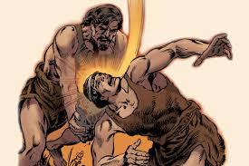
3. The Desire of the Devil. Jn. 10:10
“The thief cometh …to steal… kill…destroy:”
B. Satan Attacked The First Family. Gen. 4
1) Sin led to Sibling Rivalry ➔ Jealousy
Jealousy led to Tragedy.
2) The Pattern of the parents continued.
Division, Deception, Temptation, Isolation, Rationalization.
a) 2/3 US kids don’t have both parents home.
b) Dad spends <14 minutes each week with kids.
10 of those moments are spent in discipline.

Slide 24
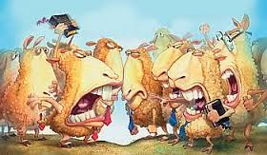
3. The Desire of the Devil. Jn. 10:10
“The thief cometh …to steal… kill…destroy:”
C. Satan Attacked The First Church Acts 4-6
1) External Sources: Persecution. (Acts 4,8)
2) Internal Sources:
a) Pride (Acts 5, 1 Cor. 4:6)
b) Prejudice (Acts 6, 1 Cor. 3)
c) Passion (1 Cor. 3,5,6)

Slide 25
Conclusion:
Mankind has a dilemma.
(We’re “needy”)
God has a design.
(Interdependency leading to Intimacy)
Satan has a Desire:
To destroy/corrupt God’s design through “independence” of God and others.

Slide 26
The path back to paradise was blocked because of Sin!
”Therefore the LORD God sent him forth from the garden of Eden…
So he drove out the man; and he placed at the east of the garden of Eden Cherubims, and a flaming sword.”
Gen 3:23-24

Slide 27
God no longer blocks the path to relational “Eden”…
“Thou wilt shew me the path of life:
in thy presence is fulness of joy;
at thy right hand there are pleasures for evermore.” Psalm 16:11
But it is “blocked” by Satan’s Deceptions
And our own Selfishness!

Slide 28
The path from “beauty to ashes”
(Is. 61:1-3) Requires:
Humility: 1 Pt 5:5-6 “God resisteth the
proud, and giveth grace to the humble.
Humble yourselves therefore under the
mighty hand of God, that he may exalt you”
Transparency: Pr 28:13 “He that covers his
sins shall not prosper: but whoso confesseth
and forsaketh them shall have mercy.”
Honesty: Eph. 4:15 “But speaking the truth in love, may grow up into him in all things”

Slide 29
The path from “beauty to ashes” Requires:
Charity: 1 Peter 4:8 “above all things have fervent charity among yourselves:
for charity shall cover the multitude of sins.”
1 Cor. 13:13 “Now abideth faith, hope, charity…
But the greatest of these is charity.”

Slide 30
Are you willing to pursue the path of life? Where are you “stuck”?
Sincere Humility?
Vulnerable Transparency?
Total Honesty?
Transforming Charity?
“The Thief comes to kill, destroy, steal…
I am come that they might have life,
and that more abundantly.” Jn 10:10

Slide 31
God’s Design: Our Delight
Psalm 37:3-5
Trust in the LORD, and do good; so shalt thou dwell in the land, and verily thou shalt be fed.
Delight thyself also in the LORD; and he shall give thee the desires of thine heart.
Commit thy way unto the LORD; trust also in him;
and he shall bring it to pass.

